Slide 1
Quark-Matter Cores in Massive NSs
Author: Annala E, Gorda T, et al. (2020)
Speaker: Boyuan Zhang (张博源)
Notes:
Hello, everyone. I’m 张博源，a first-year graduate student under the supervision of Prof. 白雪宁 and Prof. 肖志刚。Today I’ll introduce this paper, .

Slide 2
Take-home Message
$M_{NS}\sim M_{max}$: quark-matter core
$M_{NS}\sim {1.4M}_{⊙}$: pure hadronic matter
Should be considered as the standard scenario
Notes:
First of all, here’s the take-home message. For a neutron star with a maximum mass, it might have a quark-matter core;
This should be considered as the standard scenario for neutron stars.

Slide 3
Outline
Introduction
Mass & radius measurements
Evidence of quark-matter cores
Notes:
Introduce sth related to the content of this article
Brief thm
Details of the article

Slide 4
Introduction

Slide 5
Neurton stars
Supernova remnants ($M_{∗}=8−20 M_{⊙}$)
Mass:$\sim 1.4 M_{⊙}$ (Chandrasekhar limit)
Radius: $\sim 12 km$
Notes:
Let’s recall some knowledge for neutron stars.

Slide 6
Inner structure of NS
$$ρ_{0}=0.15 {fm}^{−3} (\sim 1.1×{10}^{14}{g·cm}^{−3})$$
$${10}^{19}$$
$${10}^{19}$$
Notes:
The typical density of a neutron star is ρ0，
If we compare this to a

Slide 7
Tolman–Oppenheimer–Volkoff Equation
Pressure should balance gravity:
$$\frac{dP}{dr} = −\frac{Gρ\left(r\right)M\left(r\right)}{r^{2}}\left[1+\frac{P\left(r\right)}{ρ\left(r\right)}\right]\left[1+\frac{4πr^{3}P\left(r\right)}{M\left(r\right)}\right]{\left[1−\frac{2GM\left(r\right)}{r}\right]}^{−1}$$
Mass conservation:
$$\frac{dM}{dr} = 4πr^{3}ρ\left(r\right)$$
EoS: 𝑃(𝜌)= ?
Notes:
The equation for the NS structure is known as the …
So, how many variables are there in the equations?
Here, It’s the equation of state, which is the dependence of P on ρ。The EoS describes the physical properties of nuclear matter, and we do not know it very well.

Slide 8
Mass-Radius Relation
$$P=ρ^{γ}$$
$$(γ\sim 2.5)$$
TOV
Notes:
The left figure shows some equation of states. There are many theoretical models, but most of them follow a straight line. The slope of it is about 2.5. If we substitute it into the TOV equations, we can solve for the Mass-Radius relationship of NSs.
On the other hand, we can measure the mass and radius from observations. If an EoS cannot give such mass and radius, it will be ruled out. For example, the models marked as grey lines are ruled out, because their maximum mass is less than 2 solar masses.

Slide 9
Mass & radius measurements

Slide 10
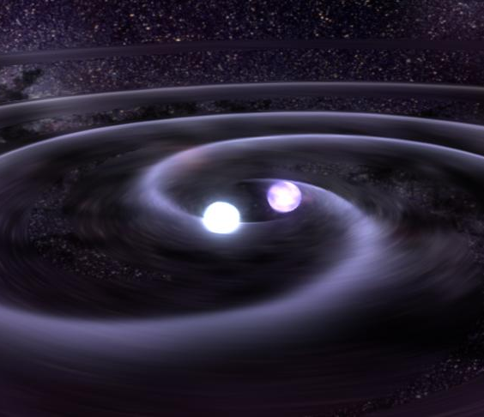
Neutron star observations
X-ray Binary
Pulsar
GW Event
Notes:
We know that there are mainly 3 kinds of observations for NSs.

Slide 11
Mass Measurements
Doppler effect:
$$f=\frac{{\left(M_{WD }sin i\right)}^{3}}{{\left(M_{NS }+M_{WD}\right)}^{2}}=\frac{v_{max}^{2}}{2πG}P_{orb}$$
Rømer delay → orbit shape
Shapiro delay (GR effect) → $M_{WD}$
PSR J0740+6620:
$$M=2.08±0.07 M_{⊙}$$

Slide 12
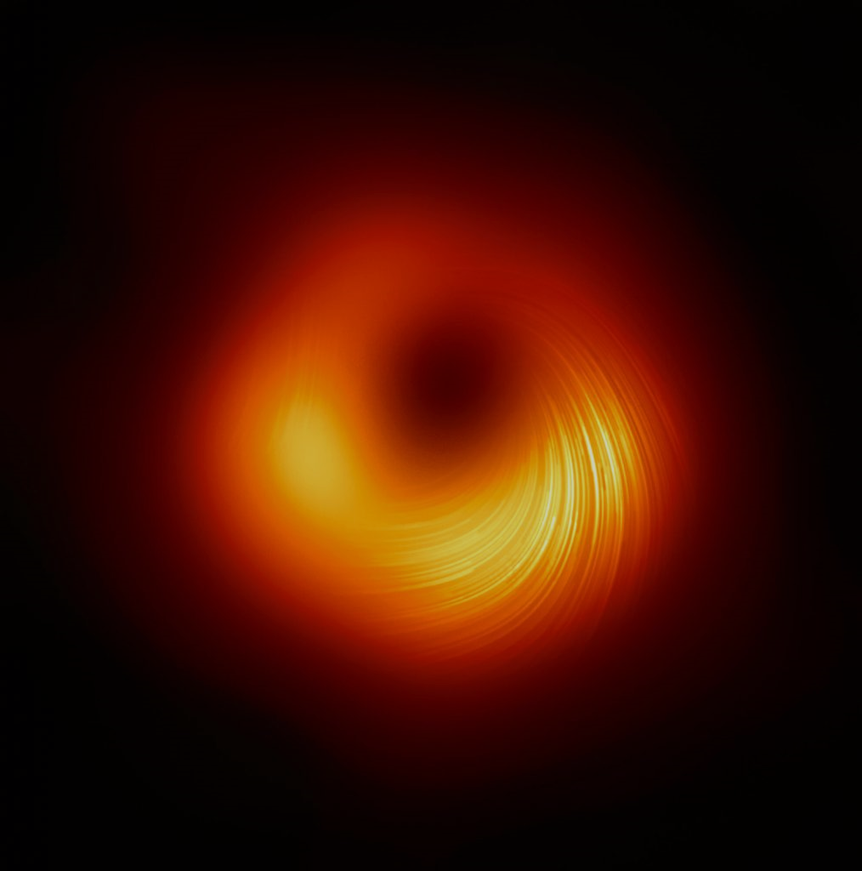
Radius Measurements: more difficult!
Direct measurements are impossible !

Slide 13
Radius Measurements
NS Accretes from its companion
Hot ionized matter moves along magnetic field lines
Falls onto magnetic poles → “hotspots”
Rotation → periodic light curve (soft X-ray, 0.1 keV)
Notes:
But we do find a method to measure its radius. For a NS in a binary system,
And if we consider its rotation, we can see a periodic light curve in soft X-ray band, which is similar to the radio pulses.

Slide 14
Radius Measurements
With GR
Without GR
PSR J0740+6620:
$$R={12.4}_{−1.0}^{+1.3} km$$

Slide 15
Evidence of quark-matter cores

Slide 16
Nuclear matter eos

Slide 17
Nucleon matter & quark matter
normal nuclear matter
quark-gluon plasma (QGP)
$ρ$↑

Slide 18
Nuclear-matter eos
Speed of sound $c_{s}:$
$ρ→∞: c_{s}^{2}→c^{2}/3$
$ρ>40ρ_{0}, c_{s}^{2}<c^{2}/3$ (pQCD)
$ρ \sim ρ_{0}: c_{s}^{2}≪c^{2}/3$ (Exp.)
NS observation:
NS with $M_{\max{ }}$($6−10ρ_{0}$)
$c_{s}^{2} \sim c^{2}$ !!

Slide 19
Quark-matter core
If we require $c_{s}^{2}≤c^{2}/3$ …
Phase transition at lower $ρ$
Massive NS has a quark core
NS with $M_{\max{ }}$:
$M_{core} \sim 0.7 M_{⊙}$
$R_{core} \sim 6.5 km$

