Slide 1
A snapshot of the oldest active galactic nuclei feedback phases
https://www.nature.com/articles/s41550-021-01491-0
Speaker: Naihui Chen 陈乃辉
2021.12.10
Notes:
a

Slide 2
Outline
Introduction
AGN in Nest200047
Summary
Notes:
Introduce sth related to the content of this article
Brief thm
Details of the article

Slide 3
Introduction

Slide 4
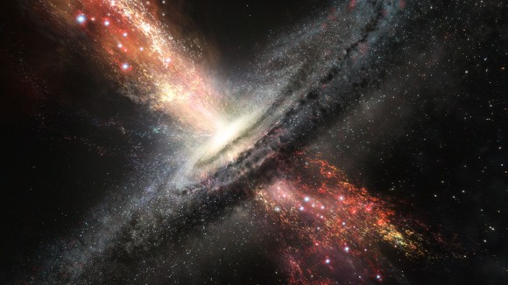
AGN and their impact to galaxies
Active galactic nuclei (AGN): a compact region at the center of a galaxy, resulted from the accretion by supermassive BH.
Inject large amounts of energy into their host galaxies, shaping their properties and evolution
May account for quenching of cooling flows, exponential decline in the numbers of bright galaxies.
Notes:
The small size of emission region and the large amount of energy output suggest the central engine maybe associated with smbh
As u can see in the img, there're well-collimated jets, large amount of materials and energy are threw into the gm, and they will shape … through radiative feedback and mechanical feedback
Some phenomena like Quenching of cooling flows, exponential decline in the numbers of bright galaxies are thought to be related with …
Faraday rotation. measurements and B deposited by radio galaxies and/or quasars
Mergers maybe triggers of AGN

Slide 5
AGN in Nest200047
Notes:
Here we comes to the details about this article

Slide 6
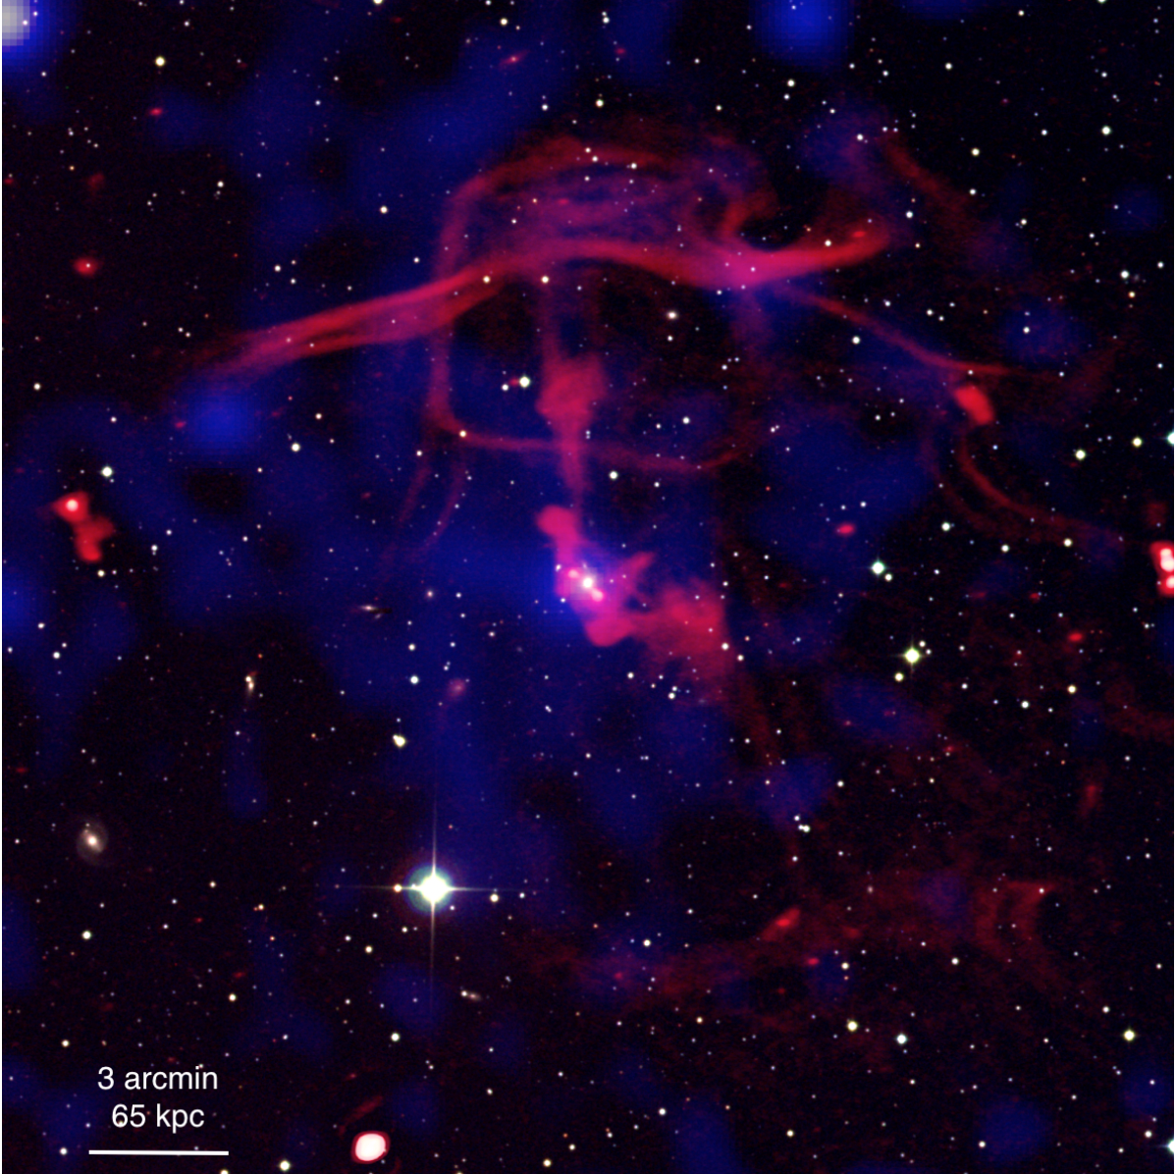
About the observation
Instruments: Low Frequency Array(LOFAR) Two-meter Sky Survey @53MHz & 144MHz; eROSITA in x-ray band
Nest200047: 17 galaxies in this group, no dedicated radio observations are available of other telescope.

Slide 7
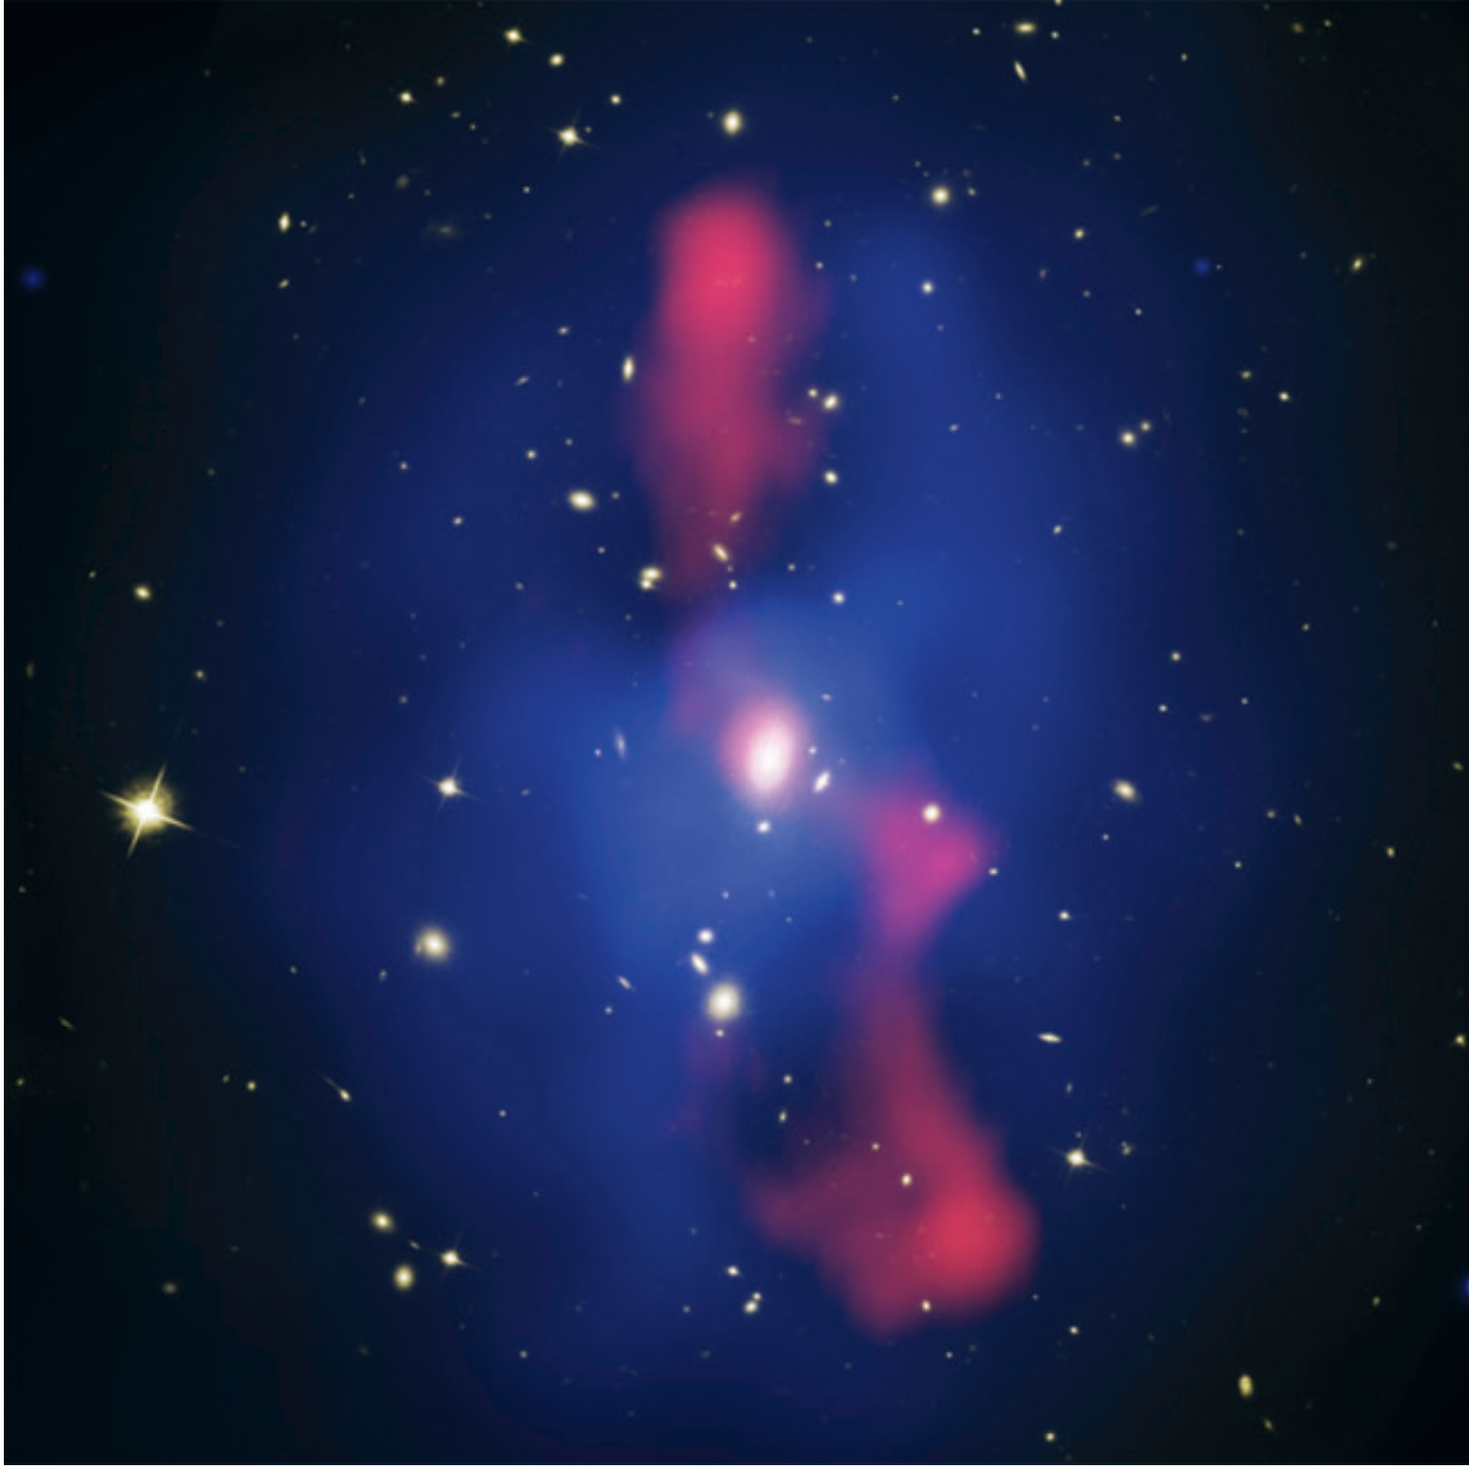
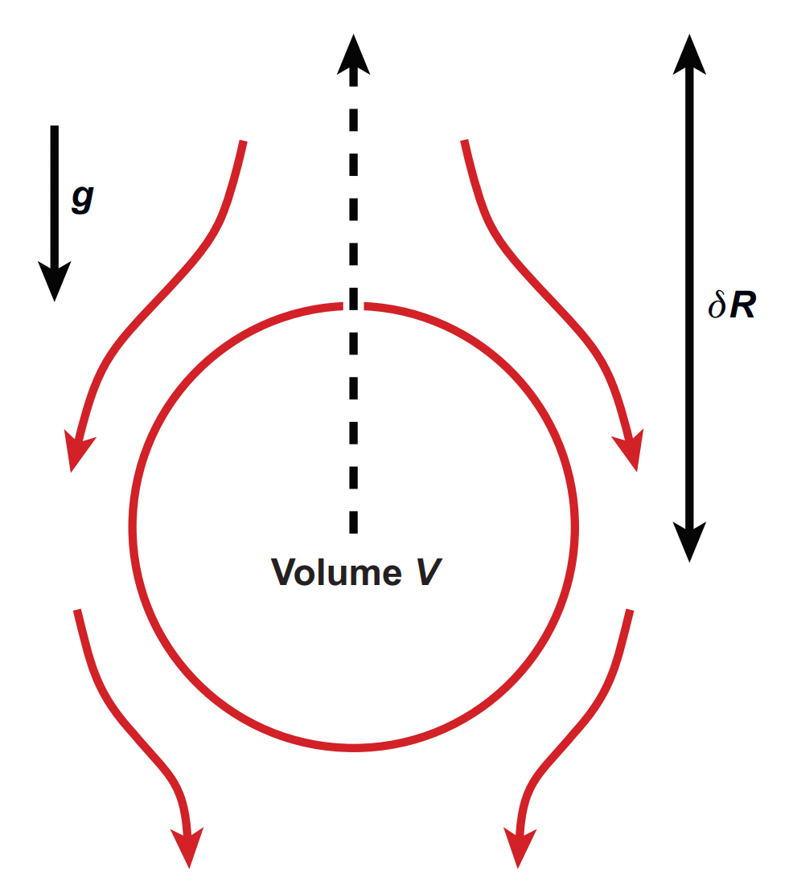
Typical AGN observation features
Radio jets: well-collimated outflows of material, high density and supersonic
Radio lobes: bloom from the jet terminals, subsonic, pressure is comparable to ambient ICM
X-ray cavities: filled with radio emission, inflated by jets, can rise as a bubble
HST image superposed with Chandra (blue) VLA (red)
of MS0735.6+7421
Buoyant cavity
Notes:
What can we see in AGN observation? In radio band we will see narrow radio jets, it's well-collimated due to its high density and speed and less influenced by the nearby medium. At the terminal of the radio jets, there're radio lobes, sometimes they can displace x-ray emitting gas, and there will be x-ray cavities. The x-ray cavities are believed to be inflated by jets from the central SMBH, and the related power can be substantial, more than enough to offset the radiative cooling of the intrastellar gas. The x-ray cavity can rise buoyantly as a bubble, during this process, some x-ray emitting gas will move inward to fill the cavity and their gravitational potential energy will convert to kinetic energy so they're heated

Slide 8
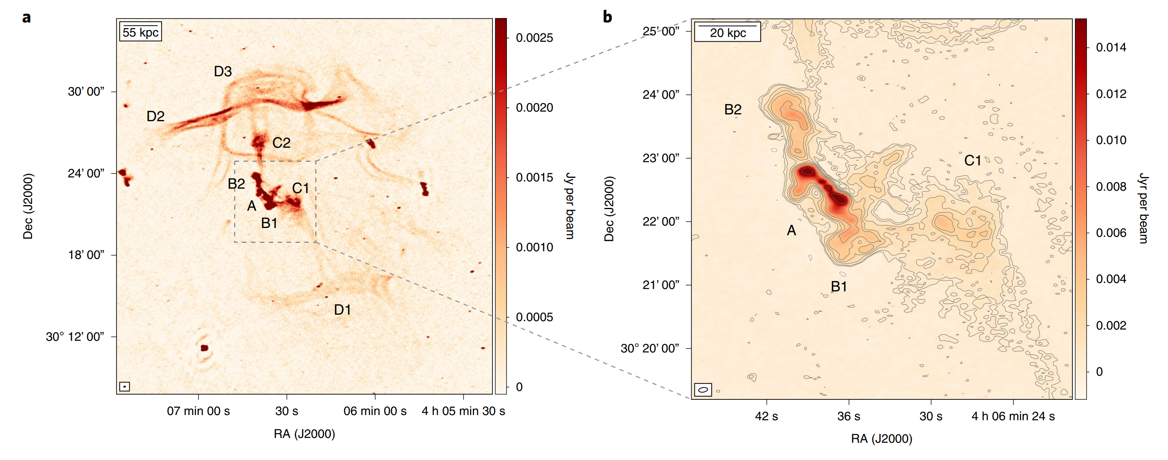
Radio lobes & filaments
A: radio jets, higher flux density, suggesting recurrent AGN event
B & C: AGN lobes, remnant lobes of past AGN event or plasma bubble detaching from a continuous operating jet
D: complex array of filamentary structures connected to lobes C1 and C2
Radio image from LOFAR at 144MHz
Multiple generations of AGN lobes and clear morphological connection with the filamentary structures!
Notes:
They first observed the system with the help of the low frequency array (LOFAR) two meter sky survey at 144 MHz, the image shows the nonthermal plasma distribution and the morphology is really bizarre ,and we can see there're many labeled regions. Region A shows two nearly symmetric radio jets about 25kpc long, higher flux density suggests there is a recurrent AGN event. Region B and C are radio lobes, their existence support that AGN is inflating new bubbles. At a distance of about 200kpc from the central of the group, there are filamentary structures labeled D connected with C, they can be interpreted as older emissi
BC remnant lobes of past AGN event or a series of plasma bubbles detaching from a continuous operating jet
Filaments 350kpc D1 sharp bend and double strands of very narrow emission
25 arcsec
D2D3 vortex ring M87
Alpha_D2=0.75 mild compression of plasma, as a result of weak shock launched by a subsequent outburst of the group dynamics increase the synchorotron break frequency by a factor of 2.5
Merger relics spectral index distribution differs from classical relics

Slide 9
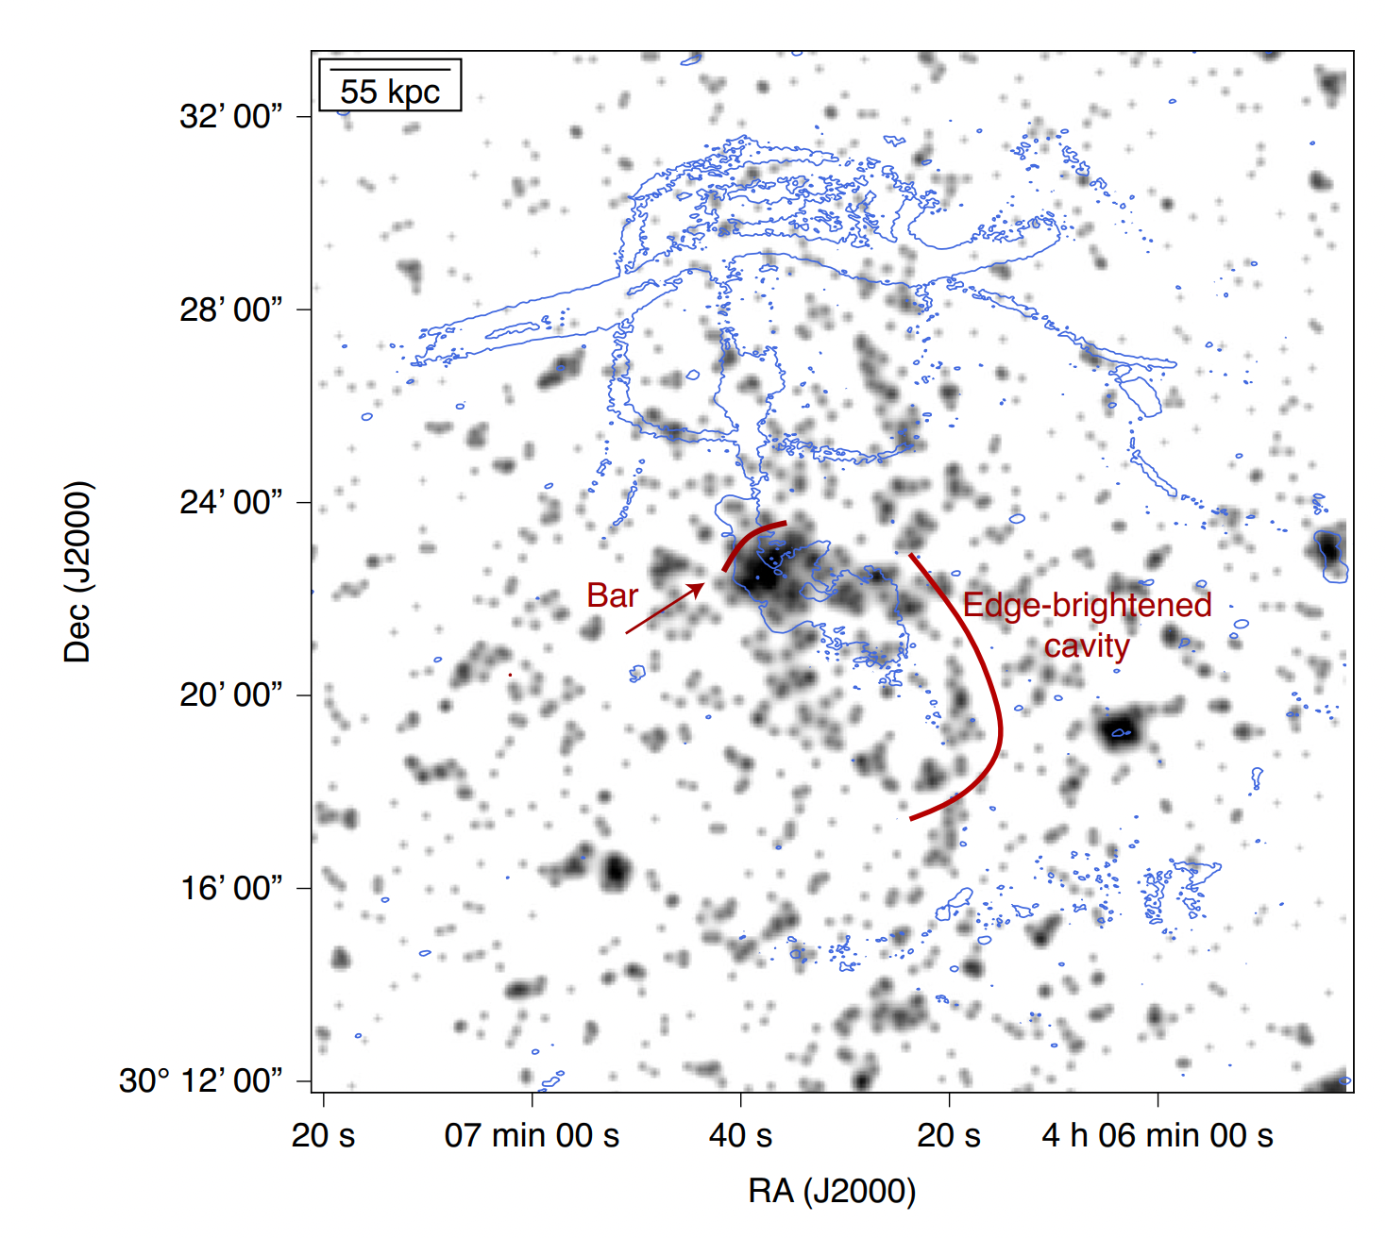
X-ray cavity
Cavity: partly filled with radio lobe C1, good anticorrelation with radio observation in ~100kpc
Qualitatively similar to other AGN feedback-driven objects
eROSITA X-ray image
Notes:
The observation in x-ray band also found there is a cavity and it was partly filled with radio lobe, which shows a good anticorrelation in the scale of about 100kpc It also strongly resembles with other AGN feedback driven objects.
Accretion disk's radiation?
Anticorrelation between radio and x-ray

Slide 10
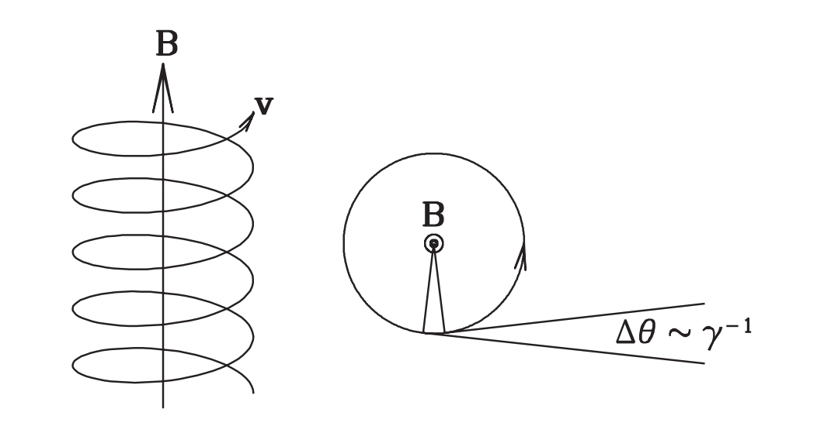
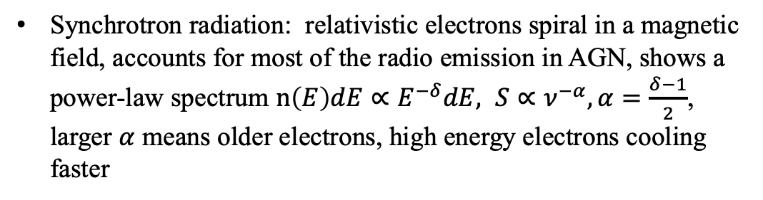
Relevant radiative process
Synchrotron radiation: relativistic electrons spiral in a magnetic field, accounts for most of the radio emission in AGN, shows a power-law spectrum $n\left(E\right)dE∝E^{−δ}dE, S∝ν^{−α}, α=\frac{δ−1}{2}$, larger $α$ means older electrons, high energy electrons cooling faster
Synchrotron radiation scheme
Notes:
Not made by electrons changing their orbits.
Here I will introduce the most important radiative process related to AGN feedback synchrotron radiation. As we all know, when charged particles are accelerated in electromagnetic field, there will be radiative emission. When relativistic electrons spiral in a magnetic field, there will be the so-called synchrotron radiation, as shown in the picture, the radiation is beamed in a forward cone with opening angle 1/gamma(lorentz factor) syn.. can account for most of the radio emission in AGN, and it will show a powerlaw distribution, so we can get such a relationship, S is flux density and niu is frequency.the spectral index alpha can tell us some useful information as shown later

Slide 11
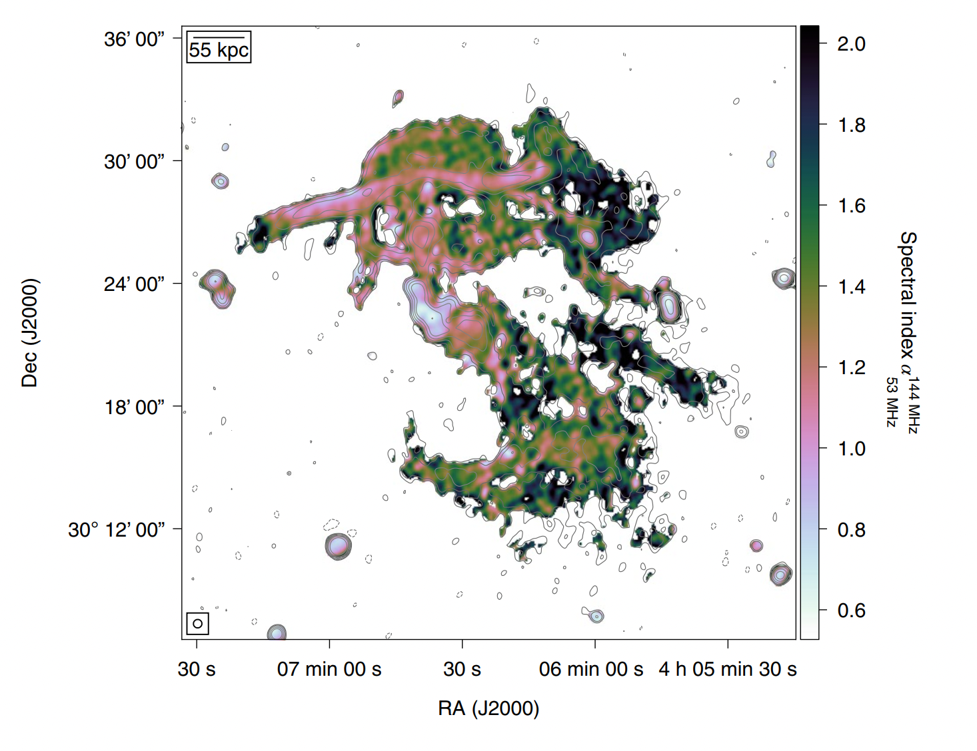
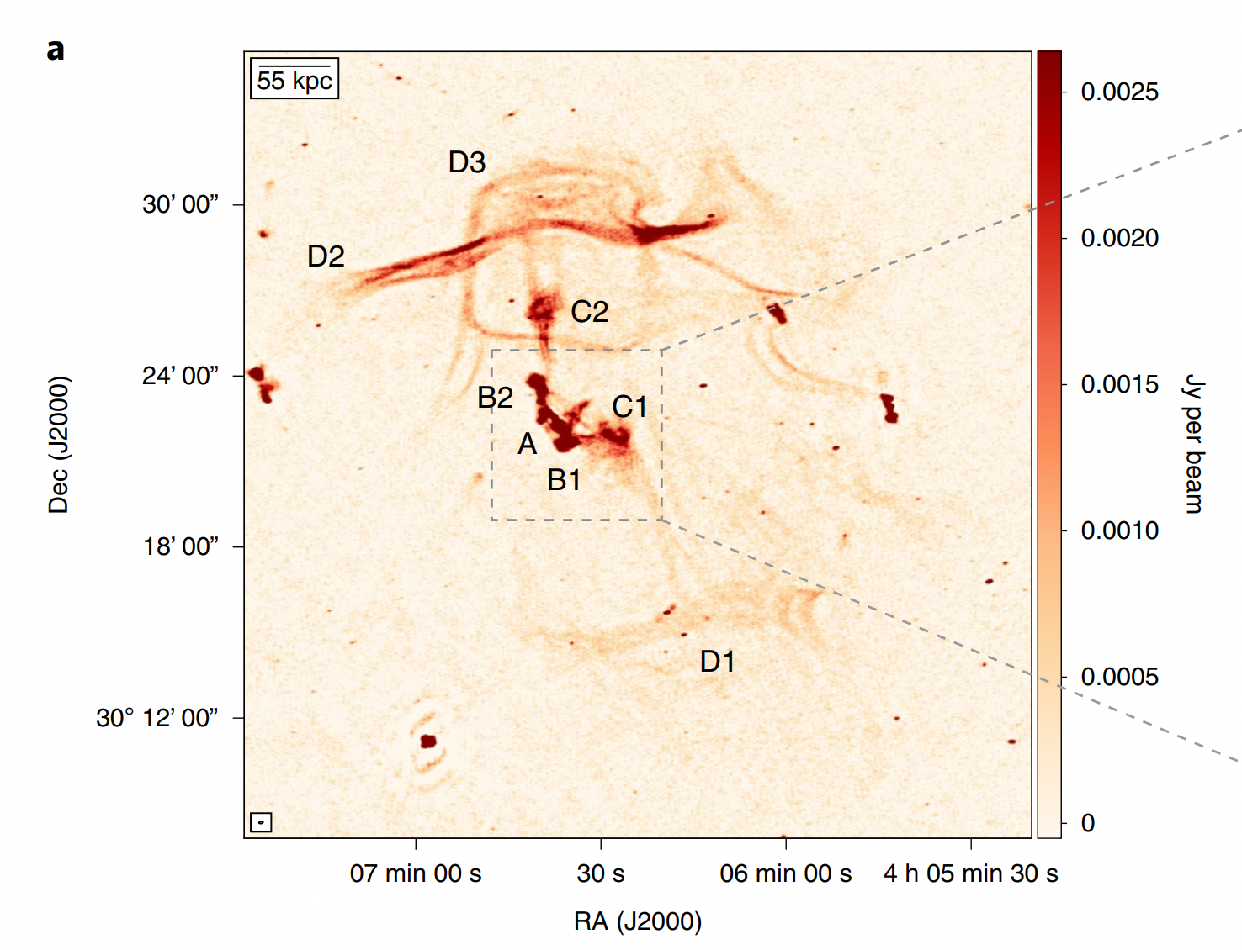
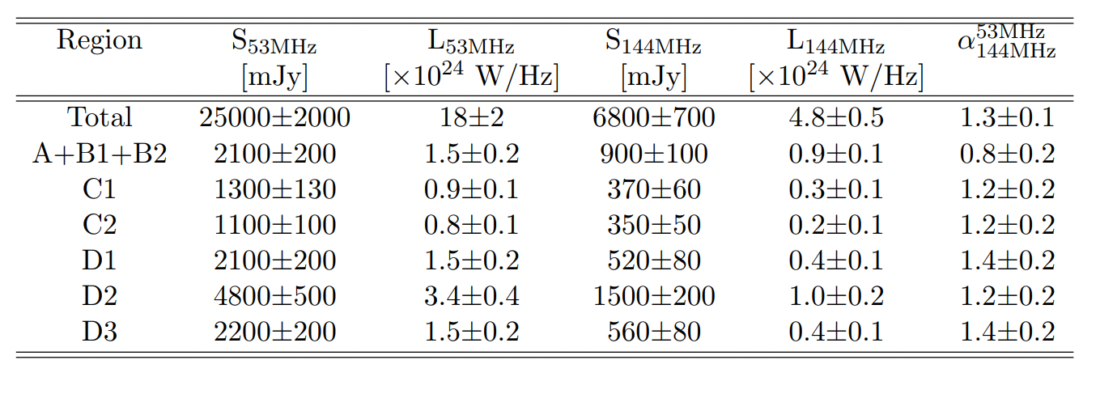
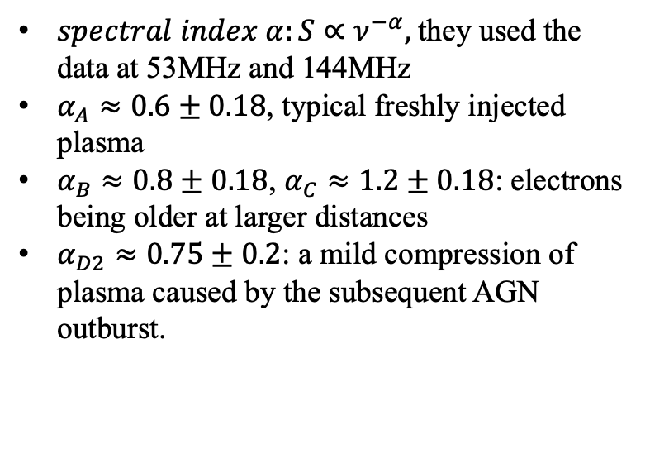
Spectral-index map
$spectral index α:S∝ν^{−α},$they used the data at 53MHz and 144MHz
$α_{A}≈0.6±0.18$, typical freshly injected plasma
$α_{B}≈0.8±0.18$, $α_{C}≈1.2±0.18$: electrons being older at larger distances
$α_{D2}≈0.75±0.2$: a mild compression of plasma caused by the subsequent AGN outburst.
Spectral-index map in the range 53 & 144MHz
LOFAR 144MHz radio image
Spectral density, flux density and spectral index
Notes:
What's more, they get the spectral-index map with data at 53MHz and 144MHz. We can see that the index of region A is about 0.6, which is a typical freshly injected plasma and index of region B and C suggests much older electrons, these realities further support the scenario that there is a recurrent AGN feedback. We also noticed that the index of D is about 0.75, they thought there is a mild compression of plasma caused by the weak shock of subsequent AGN outburst
South fialment?

Slide 12
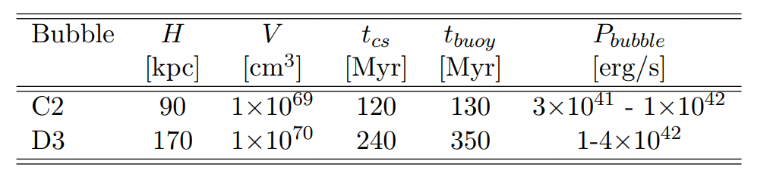
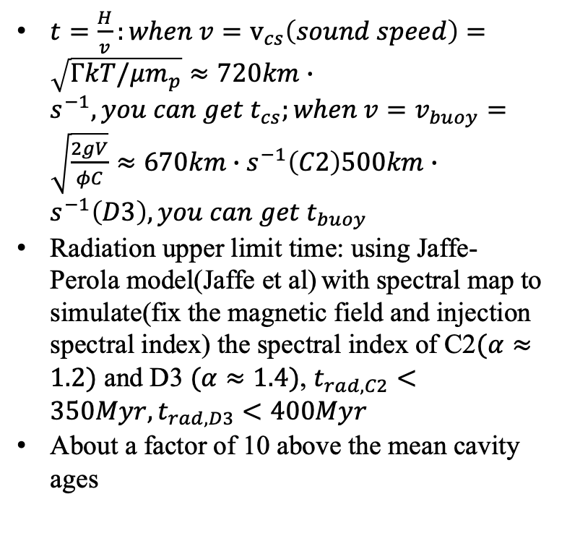
Timescale
$t=\frac{H}{v}:when v=v_{cs}\left(sound speed\right)=\sqrt{ΓkT/μm_{p}}≈720km∙s^{−1}, you can get t_{cs};when v=v_{buoy}=\sqrt{\frac{2gV}{φC}}≈670km∙s^{−1}\left(C2\right)500km∙s^{−1}\left(D3\right), you can get t_{buoy}$
Radiation upper limit time: using Jaffe-Perola model(Jaffe et al) with spectral map to simulate(fix the magnetic field and injection spectral index) the spectral index of C2$(α≈1.2)$ and D3 $(α≈1.4)$, $t_{rad,C2}<350Myr,t_{rad,D3}<400Myr$
About a factor of 10 above the mean cavity ages
Notes:
Then they estimated the time scale of different structures. The formula is easy, H is the projected height from the group center, v could be sound speed or buoyant speed, they assumed bubble C2 and D3 are formed near the center of AGN, so they can get the timescale of different regions. They also simulated the radiation upper limit time, they can be considered in good consistence. Such high ages are about a factor of 10 above the mean cavity ages found in galaxy clusters

Slide 13
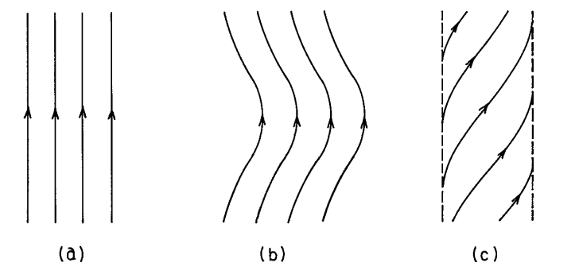
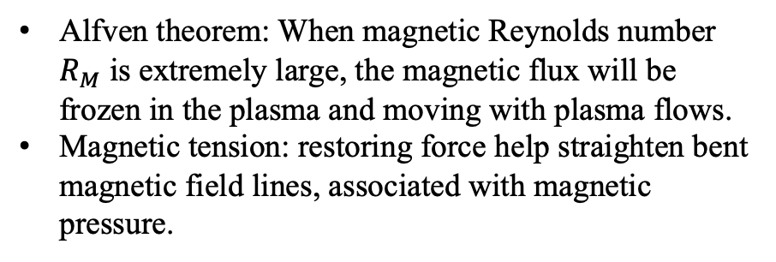
MHD explanation to the observed feature
How could bubbles travel such a long distance(~200kpc)?
Why could bubbles and filaments manage to maintain integrity over such a long timescale(~350Myr)?
Spherical bubbles transformed to torus structure due to the lack of surface tension(subsonic), such a structure can move longer(several times of their own diameters) than amorphous structures in MHD simulation.
Alfven scale is 1-5kpc consistent with the width of the filaments, magnetic fields move along with plasmas, and it may play a major role in the stability of the structure, the field tension suppress those instability processes, which proposed by MHD simulation.(De Young et al. Relic radio bubbles and cluster cooling flows)
Alfven theorem: When magnetic Reynolds number $R_{M}$ is extremely large, the magnetic flux will be frozen in the plasma and moving with plasma flows.
Magnetic tension: restoring force help straighten bent magnetic field lines, associated with magnetic pressure.
Notes:
Initially spherical bubble transformed into a torus due to lacking strong surface tension, and in magnetohydrodynamic(MHD) simulations perfect torus structure can move much larger distance(comparable with their size) than amorphous structures.
Calculate the Alfven scale, in this scale, magnetic tension will start playing a role in
The Alfven scale is 1-5kpc, consistent with the width of the filaments. In this scale, magnetic fields will play a major role in the stability of the structure, also proposed by simulations of magnetized vortex ring

Slide 14
Summary
Radio band image together with spectral-index map and x-ray cavity shows the morphology of multigeneration AGN bubbles and recurrent AGN feedback.
Those bubbles and filaments managed to maintain their structures in a time scale about hundreds of million years, about a factor of 10 longer than the mean cavity ages.
MHD simulations can explain some phenomena, the observation can also provide a empirical constrains on MHD simulation.

Slide 15
Comment and Questions
Comment:
Very interesting observation, and maybe they can do more simulation themselves to account for the formation of different structures in this system. I also hope to see more resembling system using telescopes with higher angular resolution and sensitivity.
Questions:
Why can they find such a special system but others can't?
How could the radio lobe form a filamentary structure?

