Slide 1
Introduction to the Bubbles in the Milky Way Halo
Huang Shuo
2021.11

Slide 2
Content
Ferimi bubble
eROSITA bubble
Possible link between two bubbles
Possible origins (Fermi)
Take home message
Q&A

Slide 3
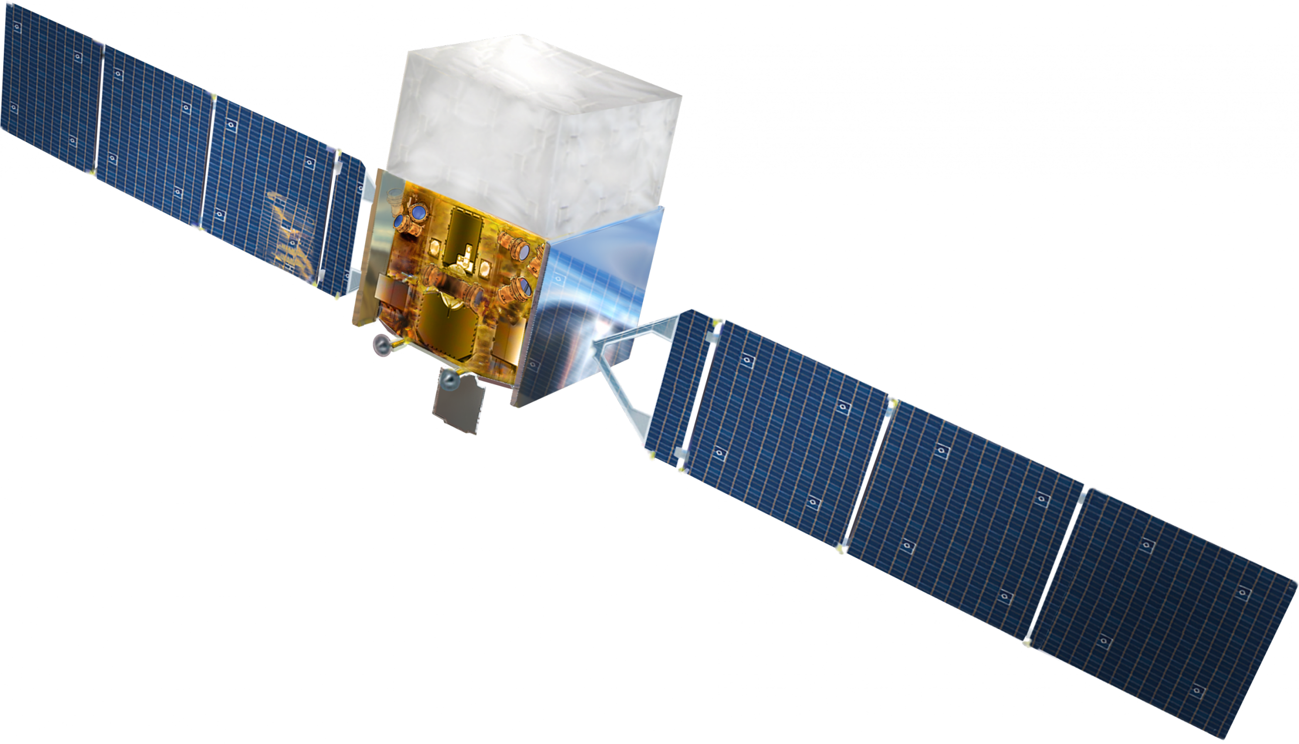
Fermi LAT
Launched: in 2008.
Band: 20 MeV to 300 GeV.
Science interests:
Active galaxies
Milky Way galaxy
Gamma-ray background radiation
Gamma-ray bursts
...
Source: https://en.jinzhao.wiki/wiki/Fermi_Gamma-ray_Space_Telescope

Slide 4
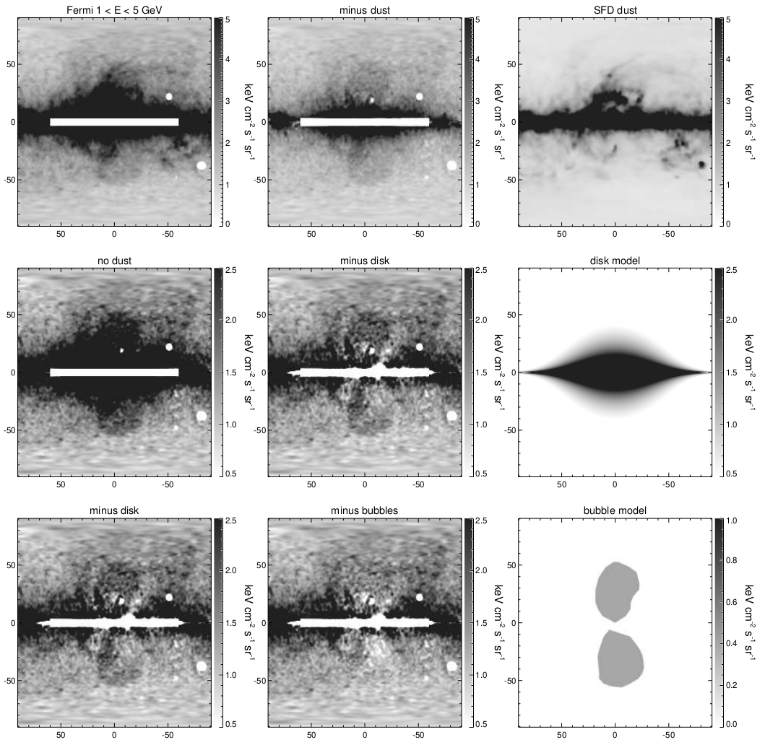
Fermi Bubbles
Band: 1-5 GeV. A pair of Fermi bubbles appears after the background substraction (dust, disk), Su et. al (2010). Total energy ~ 10^55 erg.
Notes:
Since the dominant foreground gamma-rays originate
from π 0 gammas produced by CR protons interact-
ing with the ISM, the resulting gamma-ray distribution
should be morphologically correlated with other maps
of spatial tracers of the ISM.
The purpose of disk subtraction is to reveal the
structure deeper into the plane, and allow a harder color
stretch. The disk model
mostly removes the IC gamma-rays produced by cosmic
ray electrons interacting with the ISRF including CMB,
infrared, and optical photons; as discussed previously,
such electrons are thought to be mostly injected in the
Galactic disk by supernova shock acceleration before dif-
fusing outward.

Slide 5

Fermi Bubbles
Source: https://up.jinzhao.wiki/wikipedia/commons/transcoded/0/0e/Gamma-ray_Bubbles.ogv/Gamma-ray_Bubbles.ogv.480p.vp9.webm

Slide 6
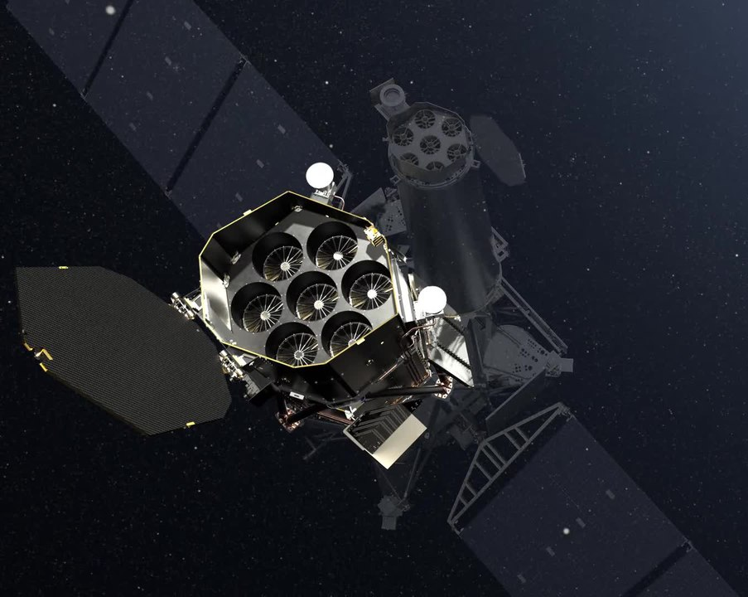
eROSITA
Launched: in 2019.
Band: 0.3 - 10 keV.
eROSITA is imaging the entire sky in the X-ray band over a 7-year period.
Science interests:
Active galaxies
Milky Way galaxy stars
...
Source: https://en.jinzhao.wiki/wiki/EROSITA

Slide 7
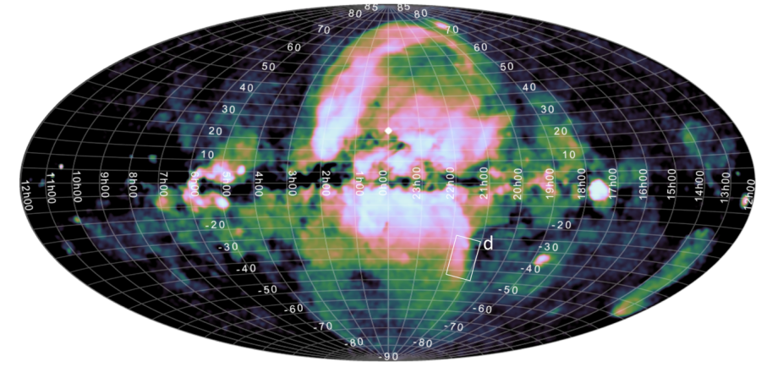
eROSITA Bubbles
Predehl et al. (2020)

Slide 8
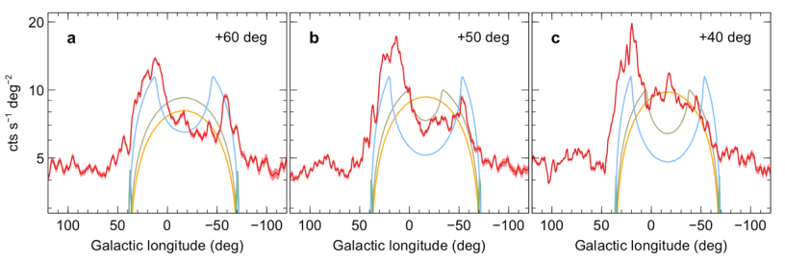
eROSITA Bubbles
Band: 0.6-1 keV.
Morphology: It is a shell-like structure.
The total energy to power the bubbles is 10^56 erg.
Predehl et al. (2021)

Slide 9
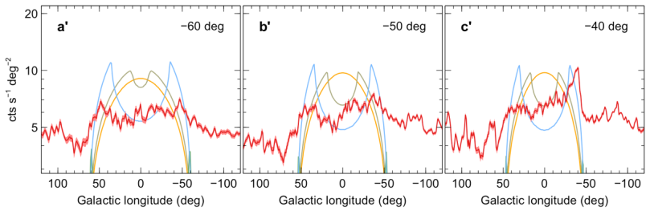
eROSITA Bubbles
Band: 0.6-1 keV.
Morphology: It is a shell-like structure.
The total energy to power the bubbles is 10^56 erg.
Predehl et al. (2021)

Slide 10
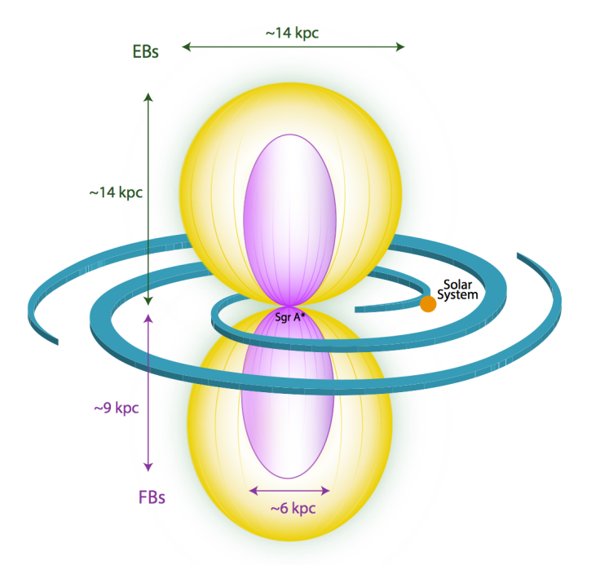
Link Between Feimi & eROSITA bubbles
The Fermi bubbles may have the same formation origin as the eROSITA bubbles.
They have similar shape, while eROSITA bubbles wrap the Fermi bubble well
The inner boundary of eROSITA bubbles clearly separate Fermi bubbles
Source: Predehl et al. (2021)
Notes:
Instead, we consider the simplest scenario in which the
eROSITA and Fermi bubbles are causally connected, with the Fermi bubbles driving the expansion of
the eROSITA bubbles and both structures being associated with the same (gradual or instantaneous)
energy release in the nuclear region of the Milky Way. In this scenario, the outer boundary of the
Fermi bubbles plausibly represents a contact discontinuity that separates the shock-heated interstellar
medium from the shocked outflow, and the boundary of the eROSITA bubbles is the shock that
propagates through the halo gas. The pressure is thus continuous across the interface between the
eROSITA and Fermi bubbles and the total thermal energies of the two features simply reflect their
volumes (ignoring the effects of stratification, which may be non-negligible).

Slide 11
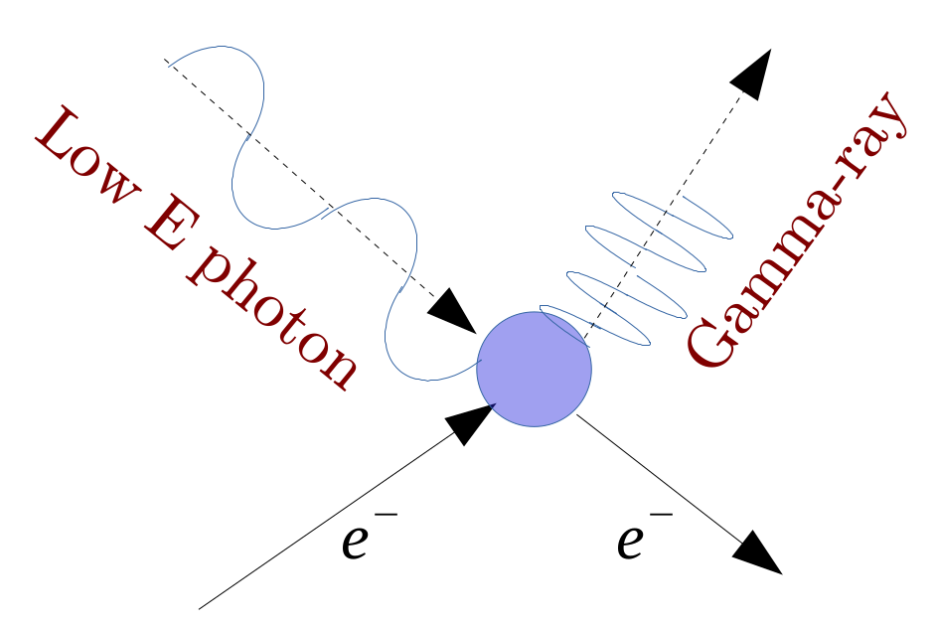
How to form the high energy bubbles?
First: What is the emission mechanism?
1
High speed electron
Mechanism: Inverse Compton scattering. CMB photons gain energy from high velocity cosmic ray electrons.

Slide 12


How to form the high energy bubbles?
First: What is the emission mechanism?
2
Colide
$$π$$
Decay
Mechanism: Collisions of non-thermal protons with thermal jet protons and stellar wind protons produce neutral pions. Neutral pion can immediately decays into two photons.
Crocker et al. (2014) demonstrate this can be applied to Fermi bubbles.

Slide 13
How to form the high energy bubbles (Fermi)?
Second: What activity at the Galatic center (GC) triggered the event ?
1
Starburst near the GC
Timescale estimation:
L ~ 10^41 erg/s (SFR~1 solar mass/year)
T ~ 10-100 Myr
Wind
Positives:
1. Cloud kinematics
Negatives:
1. Lack MHD and proper CR physics
2. Require SFR is 3-5 times higher
Crocker et al., 2015; Sarkar et al., 2015, 2017, 2019

Slide 14
How to form the high energy bubbles (Fermi)?
Second: What activity at the Galatic center (GC) triggered the event ?
2
Wind from AGN accretion disk
Timescale estimation:
L ~ 10^42 erg/s
T ~ 6-7 Myr
Wind
Positives:
1. Age is compatible with age of the central
stellar disc (less than 0.5 pc)
Negatives:
1. Winds have to be long lasting (7 Myr)
...
Mou et al, 2014, 2015

Slide 15
How to form the high energy bubbles (Fermi)?
Second: What activity at the Galatic center (GC) triggered the event ?
3
AGN jet
Timescale estimation:
L ~ 10^45 erg/s
T ~ 0.1 Myr
Jet
Positives:
1. Small time scale allows fast CR transport
Negatives:
1. Very high mechanical luminosity
2. The jet has to be perpendicular to the disc
Yang+2012; Also, Zubovas+2011

Slide 16
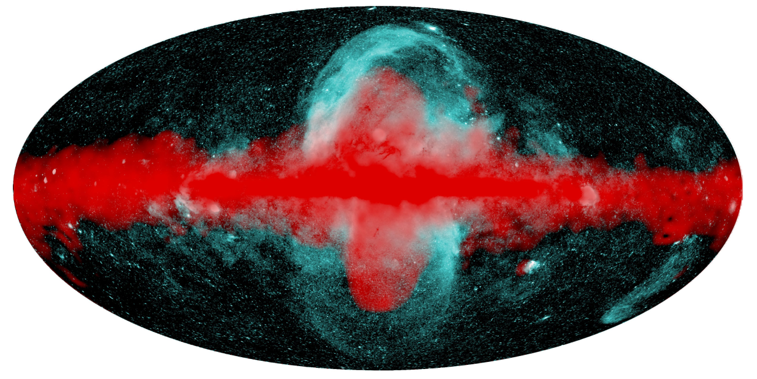
Take Home Messages
1. We have found Fermi bubbles (Gamma ray) and eROSITA bubbles (X ray) in the Galatic center. They may have similar origin.
2. Cosmic phroton collison and inverse compton scattering can produce Gamma ray and X ray.
3. These bubbles may leave some information from black hole activities or stars evolution at the GC.
4. The origin of the bubbles is still debatable.
Source: Predehl et al. (2021)

Slide 17
Possible Questions
1. Why the X-ray bubbles haven’t been observed in the past?
2. How well can we resolve the boundary?
3. What we need to do to constrain the origin of these bubbles?
4. 1 erg = 624.15 GeV
5. One neutral pion has mass ~ 135MeV/c^2
6. Why we are interesting at this topic?
7. How star formation generate wind?
8. How to constran the age of these bubbles?
9. How to estimate the energy of these bubbles?
10. What is the star formation rate at the GC currently?
11. Can we observe these bubbles in other galaxies?
12. Why star formation in other part of Milky way doesn’t have bubbles?
...

Slide 18
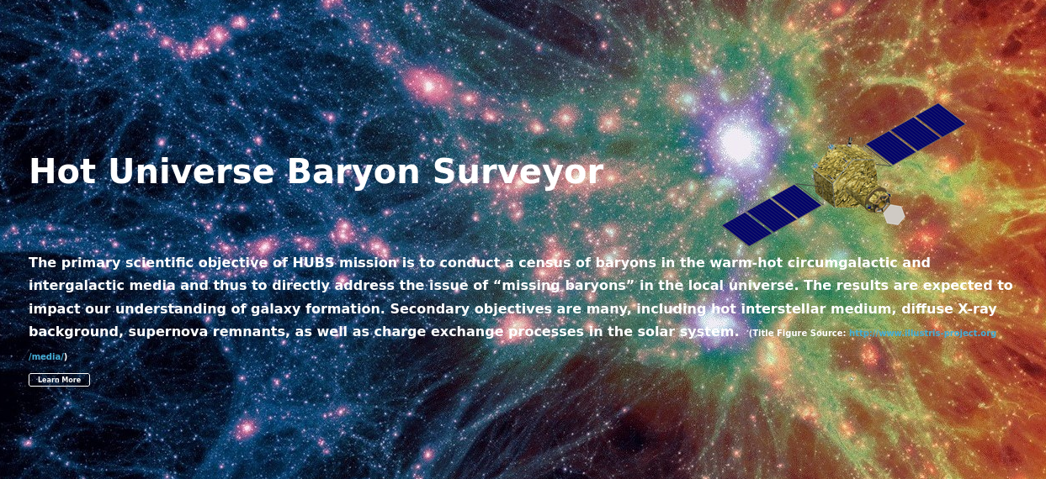
Possible Questions
How can we constrain the origin of these bubbles?

