Slide 1
Very regular high-frequency pulsation modes in young intermediate-mass stars
Timothy R. Bedding, Simon J. Murphy, Daniel R. Hey, et al.
https://doi.org/10.1038/s41586-020-2226-8
Presenter: Xiangyun Long

Slide 2
Take-home massage
Asteroseismology is a powerful tool in understanding the physics of intermediate-mass stars
This work reports identification of regular pulsation frequency patterns in intermediate-mass stars via TESS data
these will expand the reach of asteroseismology to new frontiers

Slide 3
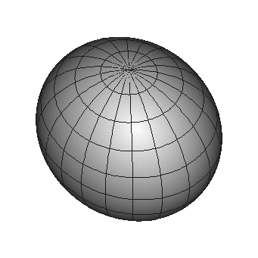
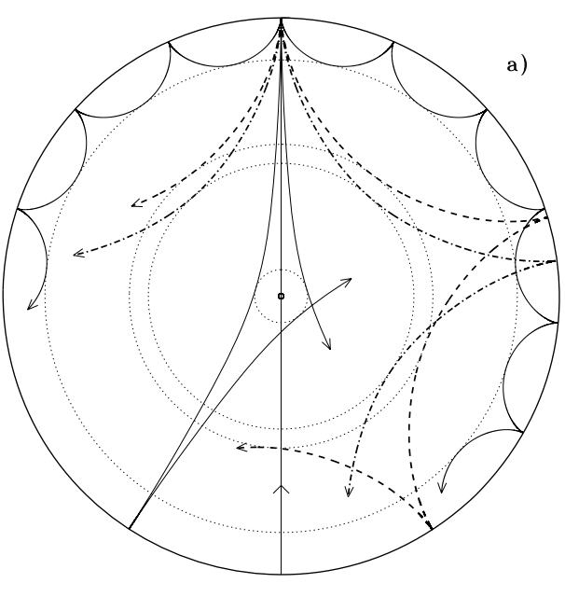
Asteroseismology
Asteroseismology probes the internal structures of stars by using their natural pulsation frequencies
It relies on identifying sequences of pulsation modes that can be compared with theoretical models
Aerts, C et.al Asteroseismology 2010

Slide 4
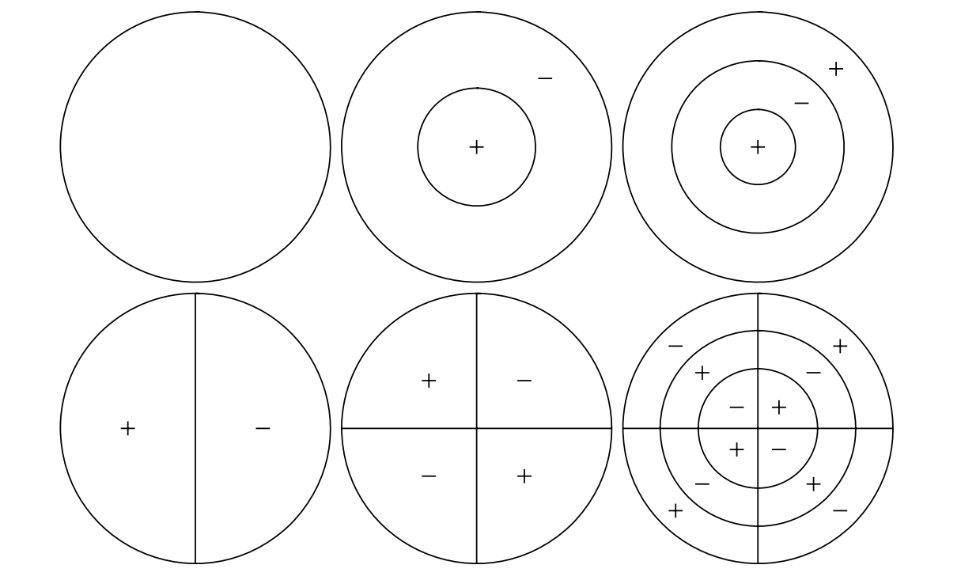
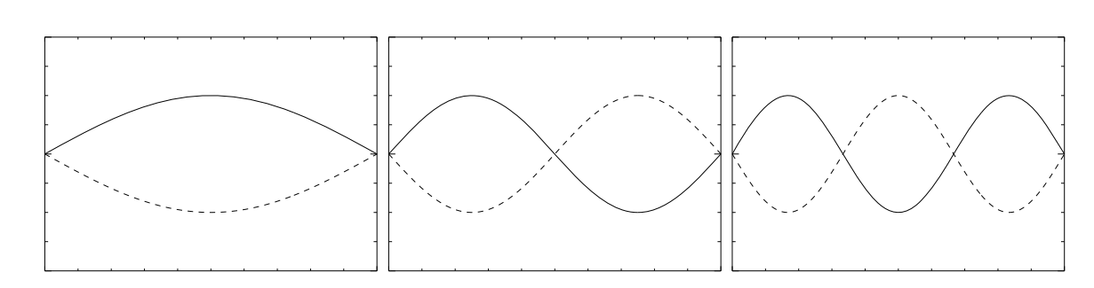
Patterns in a non-rotating star
Number of nodes in oscillations l
Unmoving nodes
Radial order n
indicates the number of nodes along the radius
Aerts, C et.al Asteroseismology 2010

Slide 5
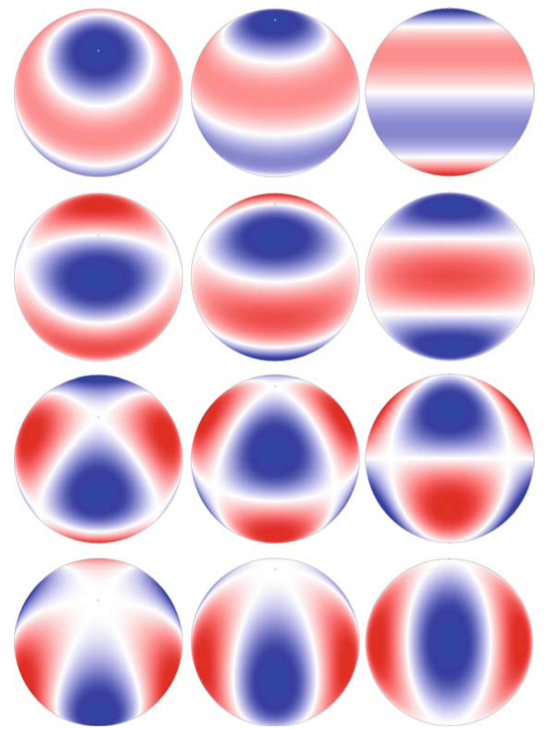
Patterns in a rotating star
More complicated
The azimuthal order m
specifies how many of the surface nodes are lines of longitude.
Aerts, C et.al Asteroseismology 2010

Slide 6
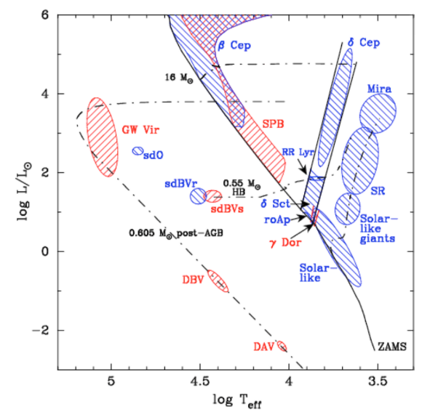
What are δ Scuti variables
intermediate mass
pulsate in low-order pressure modes
McNamara, D. H. Interesting properties of Delta Scuti stars. 2009
Notes:
Their oscillations are driven by the classical kappa mechanism in the Hell ionization zone

Slide 7
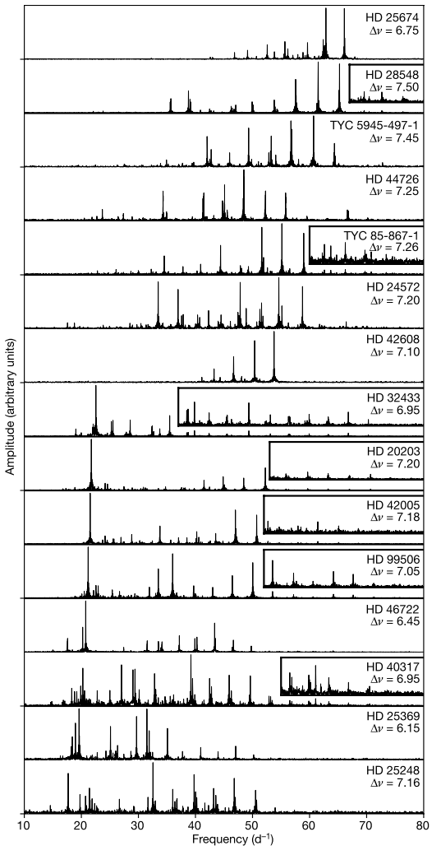
Data from TESS and Kepler
Data from TESS
provides light curves for many thousands of δ Scuti stars
first nine 27-day sectors of TESS data
Additional data from Keplar
Observed about 300 δ Scuti stars at short cadence (60-s sampling) during its four-year nominal mission

Slide 8
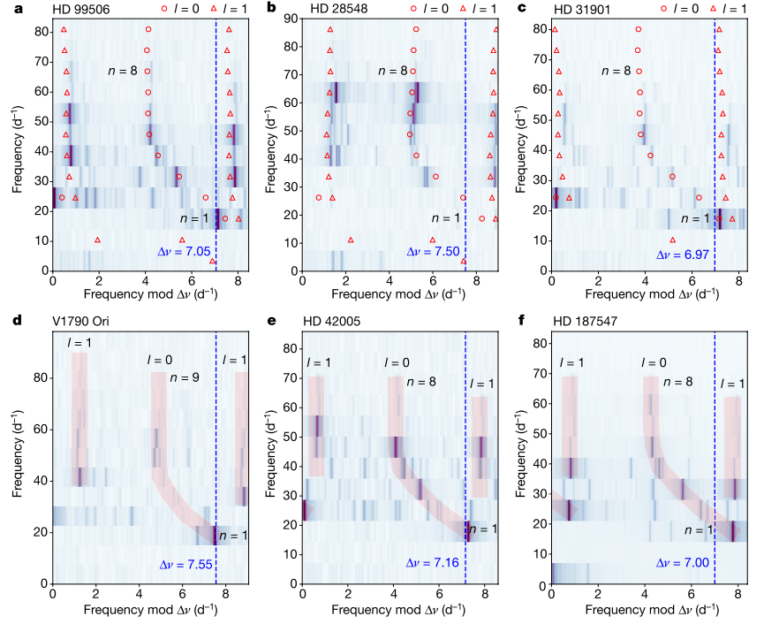
Mode identification with echelle diagrams
Red symbols: theoretical
match the observed modes reasonably well
allow mode identifications in other stars

Slide 9
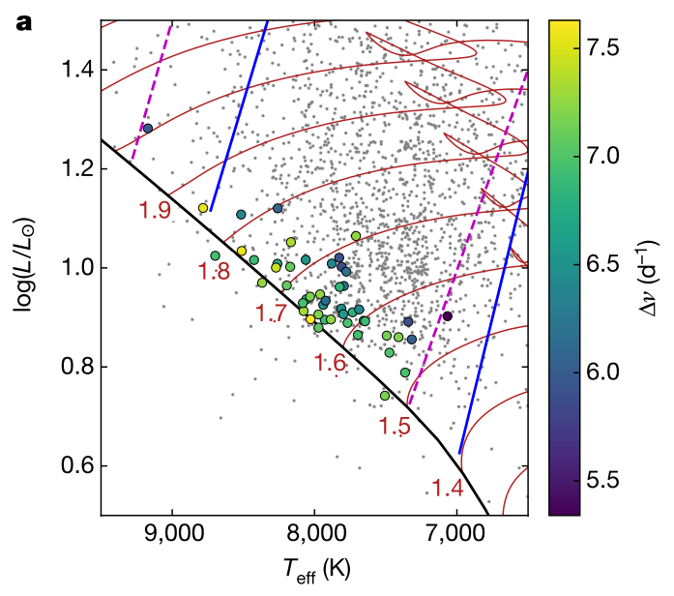
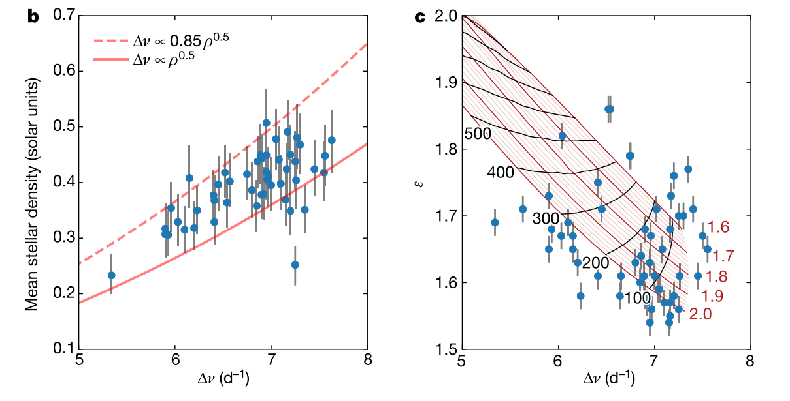
Hertzsprung-Russell diagram
located near the zero-age main sequence (ZAMS)
densities derived from fitting to evolutionary tracks in the H–R diagram
In solar-type stars, the value of ε does not change greatly during evolution. But in these intermediate-mass stars, this appears not to be the case
Notes:
and ε serves as a useful indicator for age

Slide 10
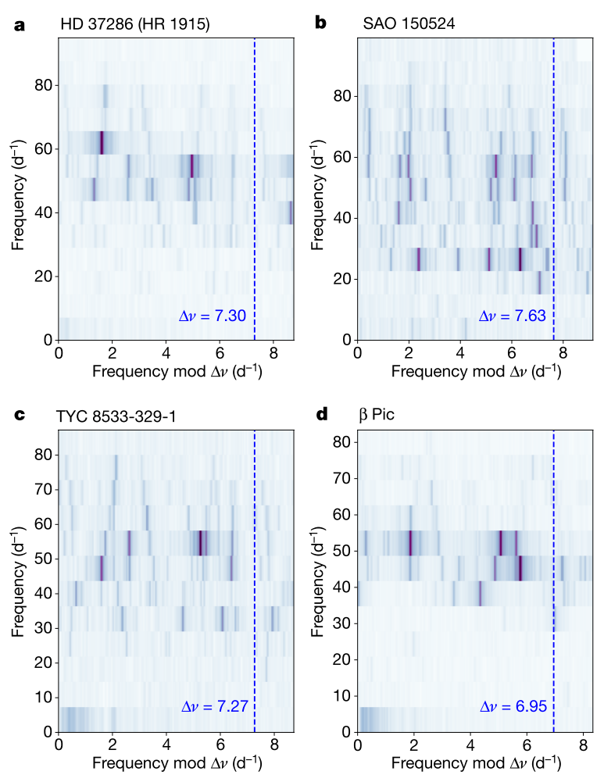
More complicated echelle diagrams
additional ridges at various angles that indicate sequences with slightly different spacings
The rotation axes of these stars are presumably at higher inclinations

Slide 11
What can we learn
determine the ages of young moving groups, clusters and stellar streams
Four stars in our sample exhibit excess emission in the WISE passbands, indicating a circumstellar dust disk
Six stars in our sample have been classified spectroscopically as λ Boötis stars, ), meaning that their surface chemical abundances show evidence for accretion from circumstellar material

Slide 12
Questions
Why is it a Nature paper
How do they determine the inclination of stars
There are several thousands of δ Scuti variables sources detected by TESS, only a few dozens are carefully studied in this work

Slide 13
Supplement page
Pressure mode V.S. Gravity mode

