Slide 1
A noninteracting low-mass black hole-giant star binary system
Speaker: Sen Wang
Student seminar, 2021.11.05

Slide 2
Content
Background
Method
Results
Comments

Slide 3
Background
Traditional method to detect compact object :
Emission from accreting binary systems or pulsars
Microlensing
Gravitational wave
Q: What if this two objects are noninteracting?
A: Radial Velocity method

Slide 4
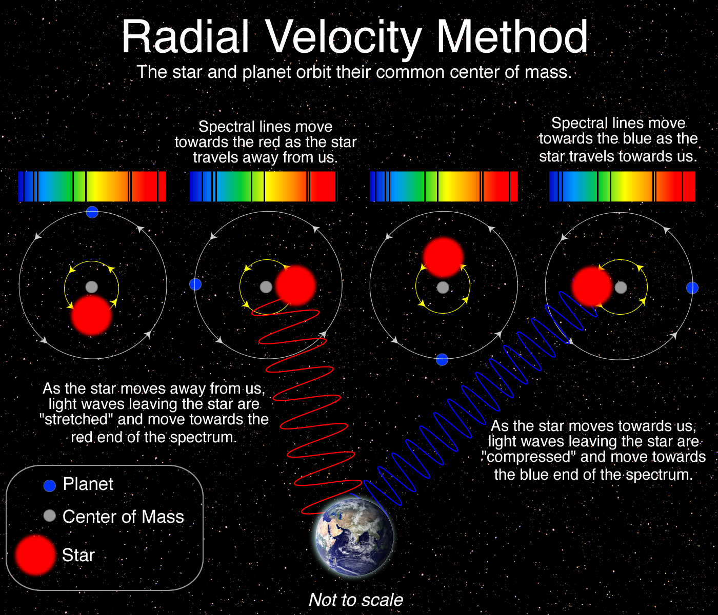
Method: radial velocity
Radial velocity of WHAT?
Why it shows radial velocity?
Credit: Las Cumbres Observatory

Slide 5
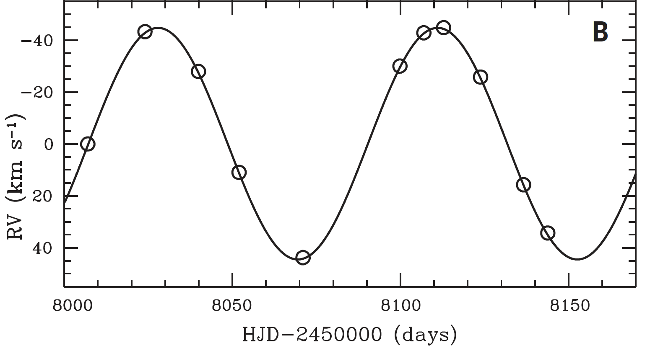
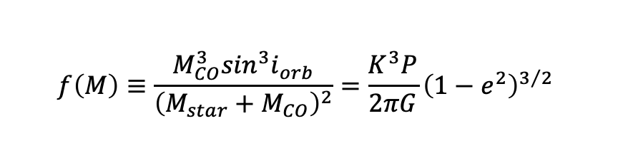
Information from RV measurement
Orbital period P
Radial velocity semi-amplitude K
Eccentricity e
$$f\left(M\right)≡\frac{M_{CO}^{3}\sin^{3}i_{orb}}{{\left(M_{star}+M_{CO}\right)}^{2}}=\frac{K^{3}P}{2πG}{\left(1−e^{2}\right)}^{3/2}$$

Slide 6

Information from RV measurement
Projected rotation(自转) velocity $v∙\sin{i_{rot}}$

Slide 7
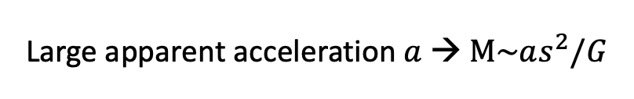
Source selection
Search for stellar binaries with massive unseen companions in data from Apache Point Observatory Galactic Evolution Experiment (APOGEE)
Photometric observations from All-sky Automated Survey for Supernovae (ASAS-SN)
Large apparent acceleration $a$ → $M\sim as^{2}/G$
Source in this paper:
2MASS J05215658+4359220
RA(J2000)=05 21 56.591
Dec(J2000)=+43 59 21.958

Slide 8

Results
Previous analysis from APOGEE
$T_{eff}≅4480±62 K$
$\log{g}≅2.59±0.06$
[C/N]$≅0$
Authors’ analysis from APOGEE
$v∙\sin{i_{rot}≅14.1±0.6} km s^{−1}$

Slide 9
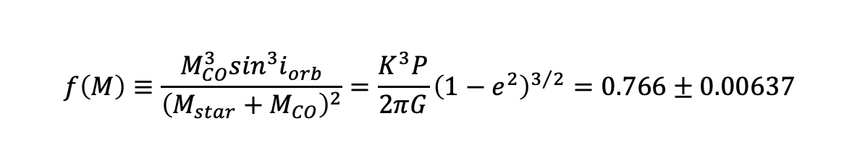

Results
Additional optical spectra and radial velocity from Tillinghast Reflector Echelle Spectrograph (TRES)
$\log{g}≅2.35±0.14$
$v∙\sin{i_{rot}≅16.8±0.6} km s^{−1}$
$P≅83.205±0.064$
$e≅0.00476±0.00255$
$K≅44.615±0.123 km s^{−1}$
$$f\left(M\right)≡\frac{M_{CO}^{3}\sin^{3}i_{orb}}{{\left(M_{star}+M_{CO}\right)}^{2}}=\frac{K^{3}P}{2πG}{\left(1−e^{2}\right)}^{3/2}=0.766±0.00637$$

Slide 10
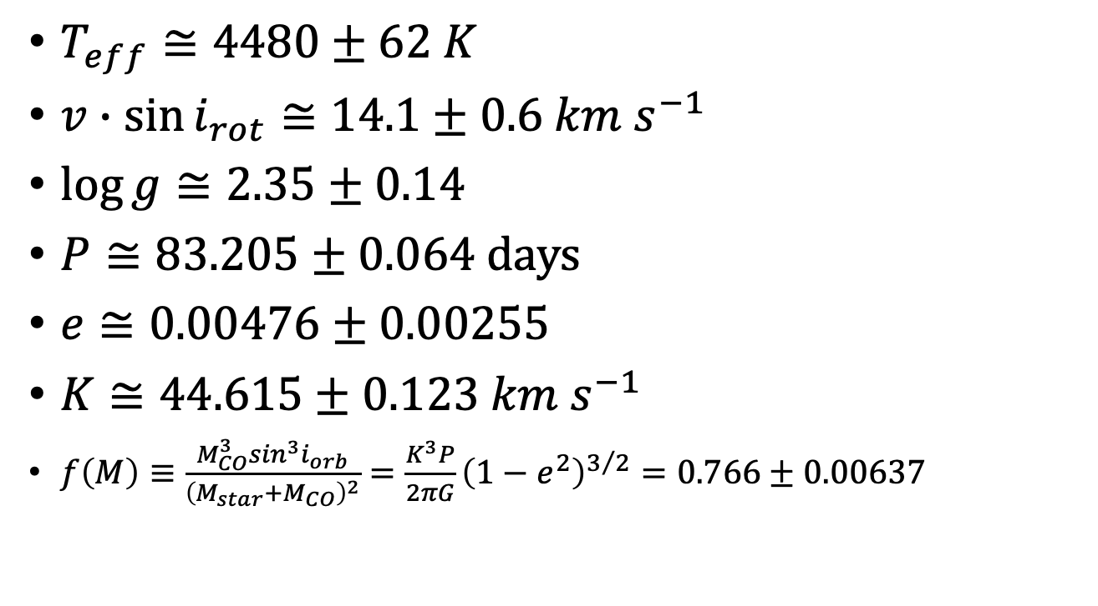
Summation of some results
$T_{eff}≅4480±62 K$
$v∙\sin{i_{rot}≅14.1±0.6 km s^{−1}}$
$\log{g}≅2.35±0.14$
$P≅83.205±0.064$ days
$e≅0.00476±0.00255$
$K≅44.615±0.123 km s^{−1}$
$f\left(M\right)≡\frac{M_{CO}^{3}\sin^{3}i_{orb}}{{\left(M_{star}+M_{CO}\right)}^{2}}=\frac{K^{3}P}{2πG}{\left(1−e^{2}\right)}^{3/2}=0.766±0.00637$

Slide 11
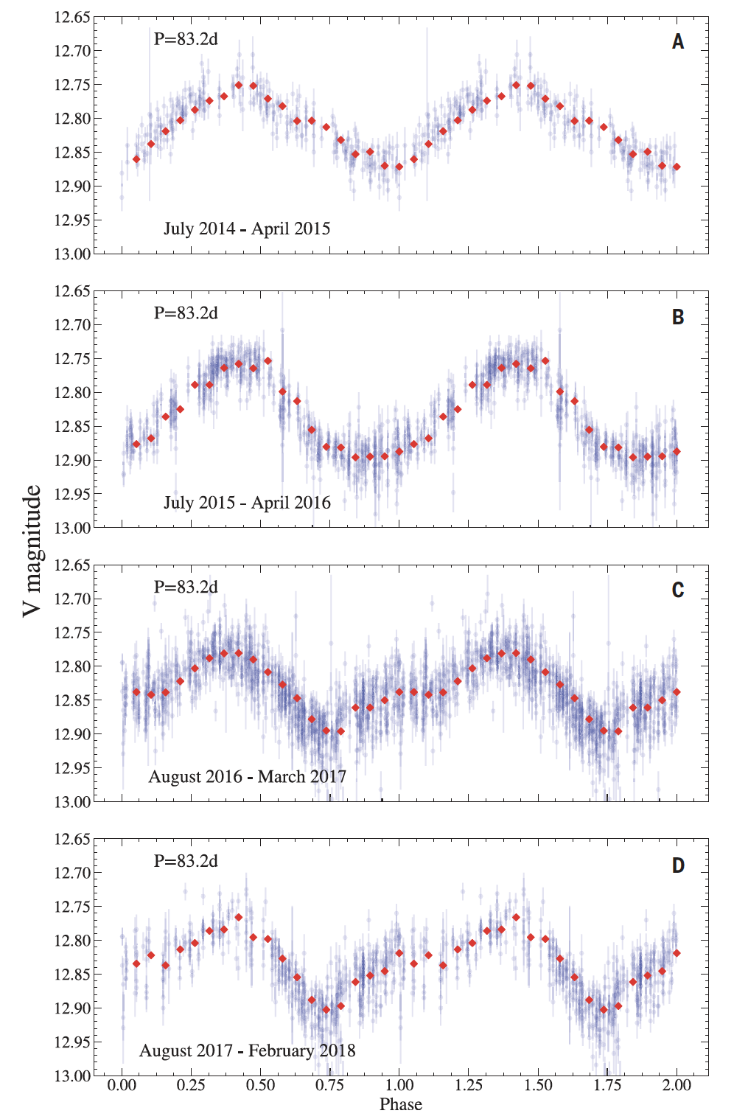
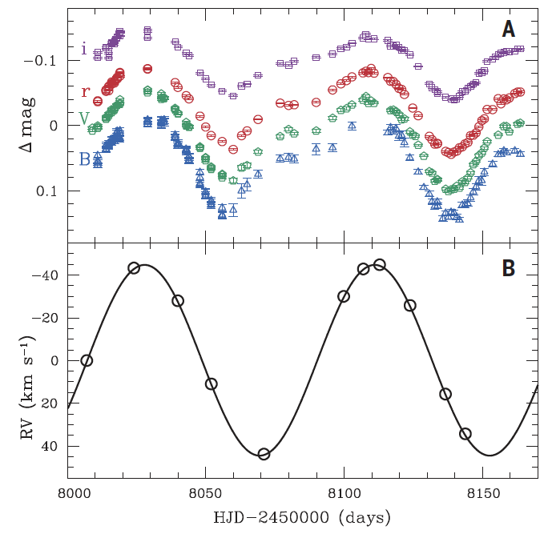


Photometric variation
hypothesis
$P_{Photo}≅82.2±2.5$ days
$$i_{orb}=i_{rot}$$

Slide 12
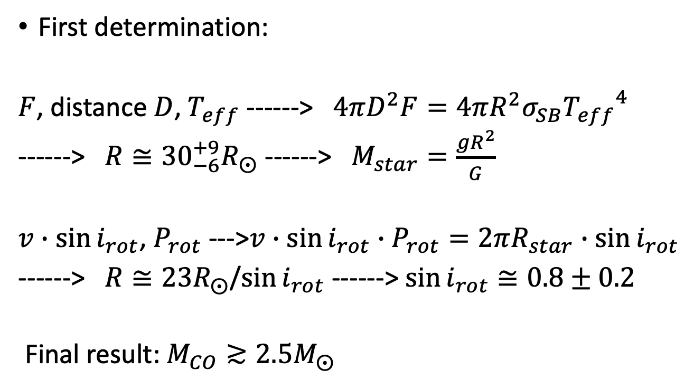
Derive the star mass and inclination
First determination:
$F$, distance $D$, $T_{eff}$ ------> $4πD^{2}F=4πR^{2}σ_{SB}{T_{eff}}^{4}$
------> $R≅{30}_{−6}^{+9}R_{⨀}$ ------> $M_{star}=\frac{gR^{2}}{G}$
$v∙\sin{i_{rot}}$, $P_{rot}$ --->$v∙\sin{i_{rot}}∙P_{rot}=2πR_{star}∙\sin{i_{rot}}$
------> $R≅23R_{⨀}$/$\sin{i_{rot}}$ ------> $\sin{i_{rot}}≅0.8±0.2$
Final result: $M_{CO}≳2.5M_{⨀}$

Slide 13
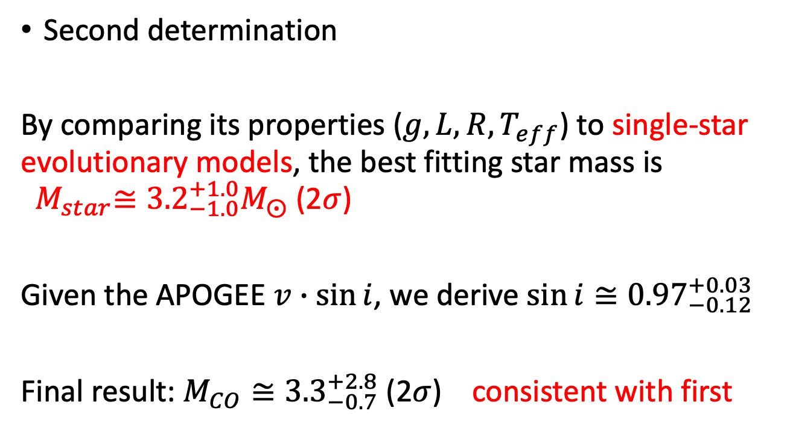
Derive the star mass and inclination
Second determination
By comparing its properties ($g, L, R, T_{eff}$) to single-star evolutionary models, the best fitting star mass is ${ M}_{star}≅{3.2}_{−1.0}^{+1.0}M_{⨀}$ (2$σ$)
Given the APOGEE $v∙\sin{i}$, we derive $\sin{i≅{0.97}_{−0.12}^{+0.03}}$
Final result: $M_{CO}≅{3.3}_{−0.7}^{+2.8}$ (2$σ$) consistent with first

Slide 14
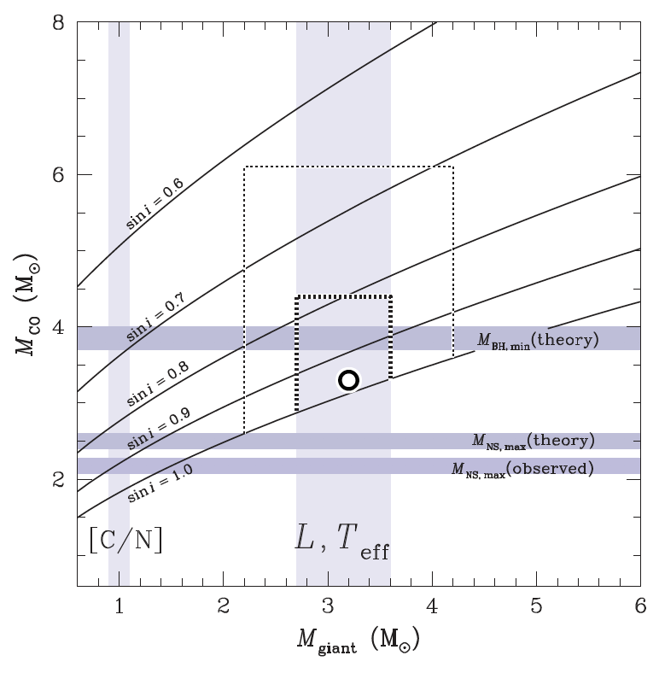

Slide 15
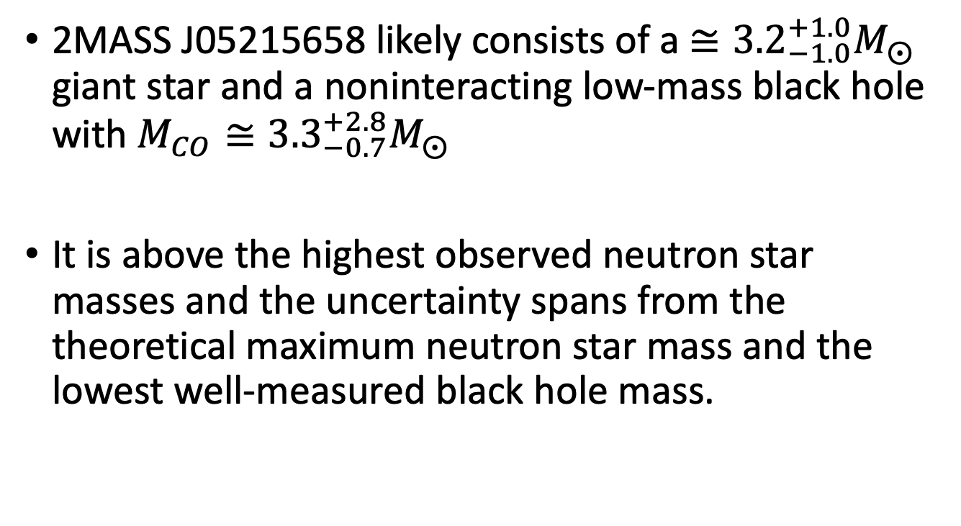
Conclusion
2MASS J05215658 likely consists of a $≅{3.2}_{−1.0}^{+1.0}M_{⨀}$ giant star and a noninteracting low-mass black hole with $M_{CO}≅{3.3}_{−0.7}^{+2.8}M_{⨀}$
It is above the highest observed neutron star masses and the uncertainty spans from the theoretical maximum neutron star mass and the lowest well-measured black hole mass.

Slide 16

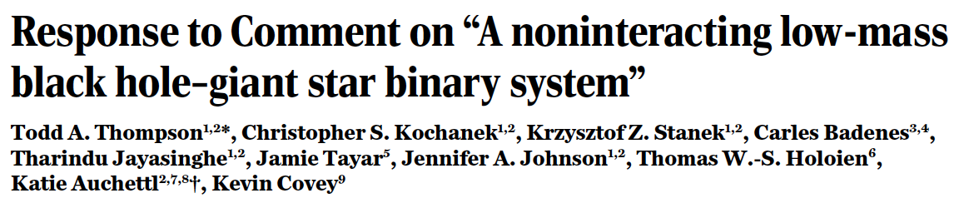
Comments
They think the giant mass could be over-estimated and that the compact companion may consist of a close binary system of two main-sequence stars.

Slide 17
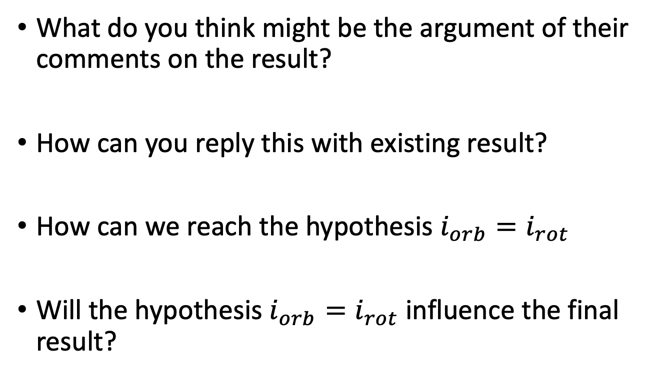
Questions
What do you think might be the argument of their comments on the result?
How can you reply this with existing result?
How can we reach the hypothesis $i_{orb}=i_{rot}$
Will the hypothesis $i_{orb}=i_{rot}$ influence the final result?

Slide 18
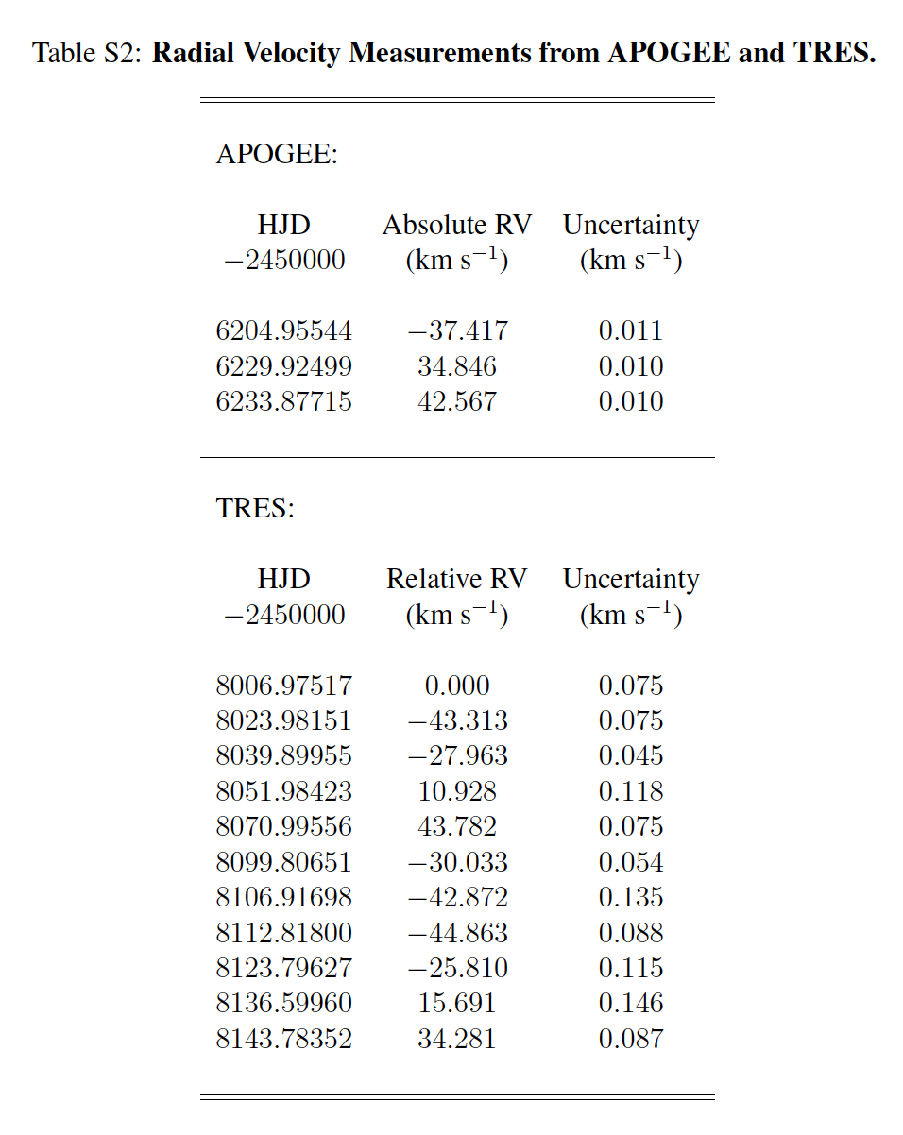
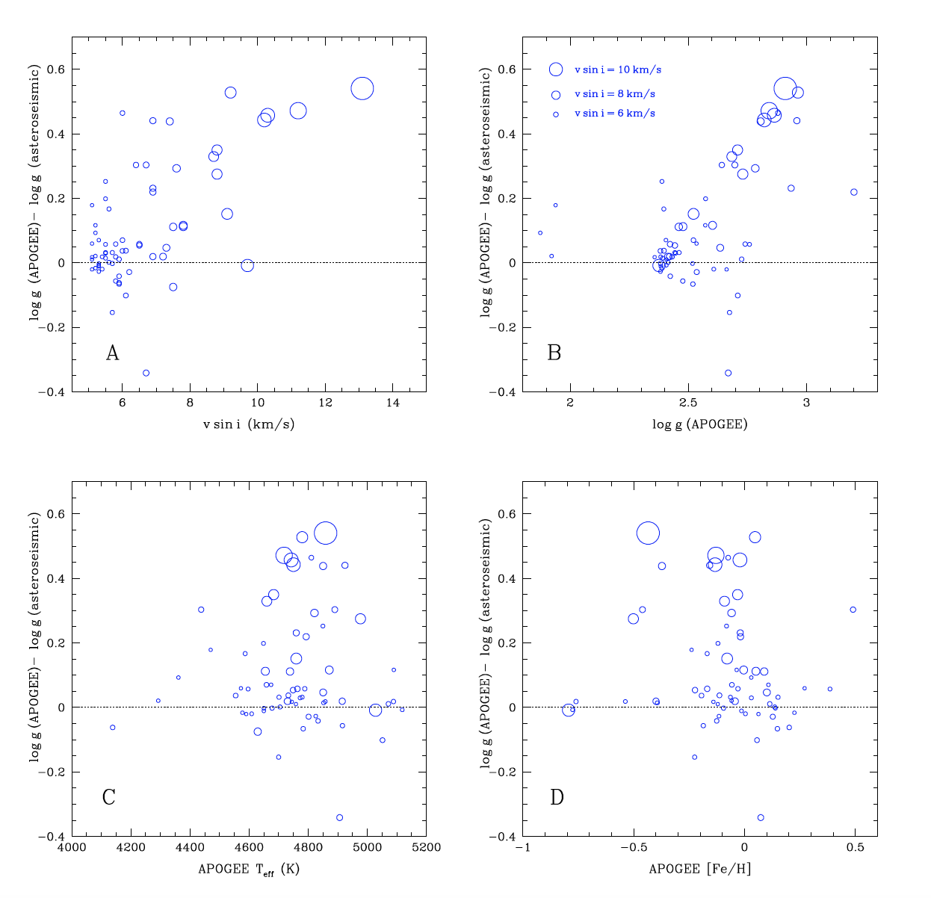
Backup

Slide 19
