Slide 1
Global maps of the magnetic field in the solar corona
Author: Zihao Yang , Christian Bethge , Hui Tian, Steven Tomczyk, et al
Speaker: 眭策

Slide 2
Contents
1. Background
2. Methods&Results
3. Summary&Questions

Slide 3
Background

Slide 4
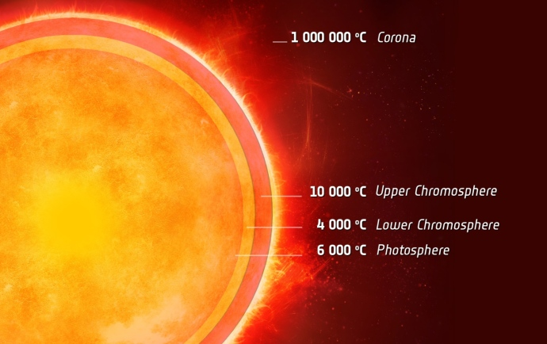
Coronal Magnetic Field
The Sun's corona is the outermost part of the Sun's atmosphere and is shaped by its magnetic field.
Layers of Sun’s Atmosphere

Slide 5
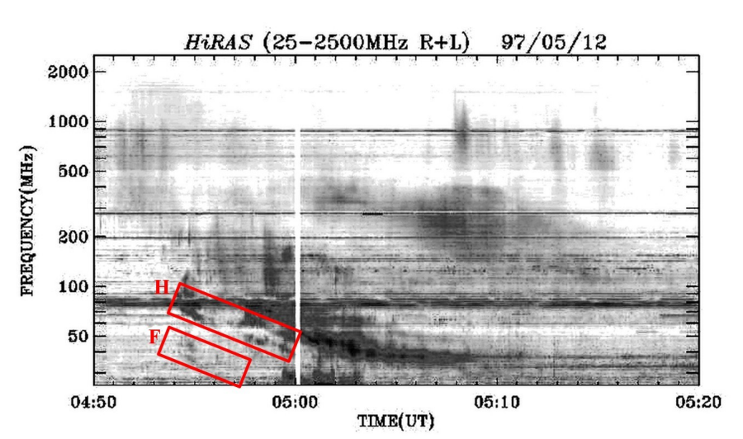
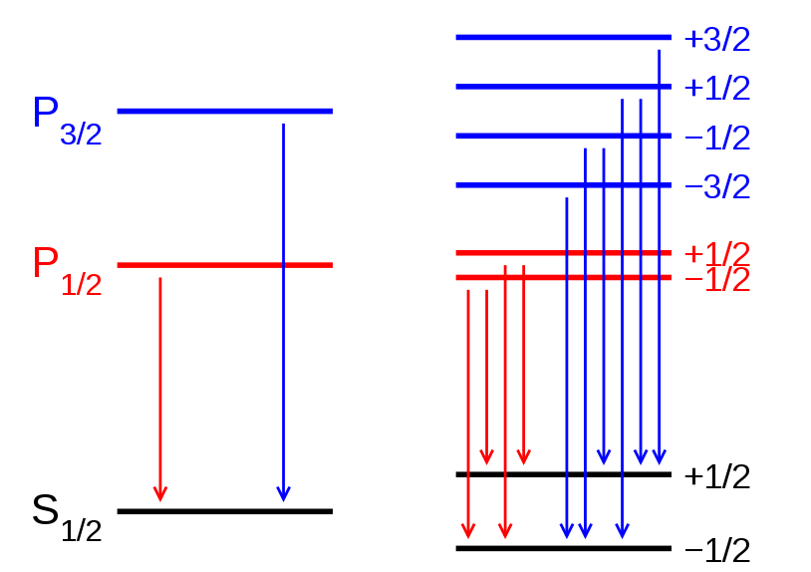
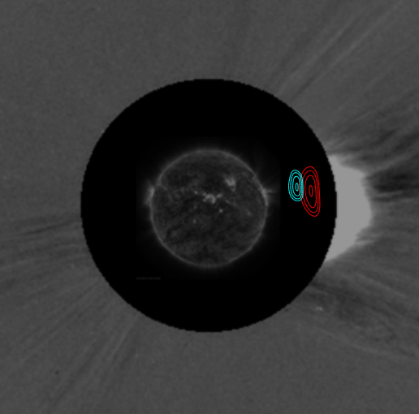
Probe Coronal Magnetic Field
Kumari et al (2019)
Mancuso et al (2018)
Zeeman Effect
Infer from Solar Eruptions
Infer from Radio Bursts

Slide 6
Coronal Seismology
Coronal seismology is a technique of studying the plasma of the Sun's corona with the use of magnetohydrodynamic (MHD) waves and oscillations.
Coronal Plasma
Fluid Mechanics
Electrically Conducting Fluids
Observable Waves
Electrodynamics

Slide 7
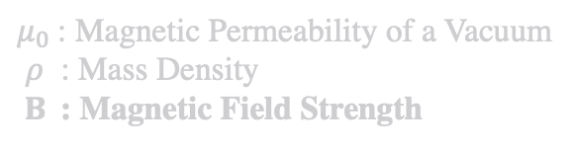
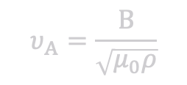
MHD waves In Uniform Plasma
Alfvén Wave
Fast Magnetoacoustic Wave
Slow Magnetoacoustic Wave
Linear Perturbation
Alfvén Wave
Incompressible, transverse oscillation that propagates along field.
$$υ_{A}=\frac{B}{\sqrt{μ_{0}ρ}}$$
Phase Speed:
$μ_{0}$: Magnetic Permeability of a Vacuum
$ρ$ : Mass Density
$B$: Magnetic Field Strength
The actual MHD wave modes in Corona are solved in plasma cylinders(Flux tubes)!

Slide 8
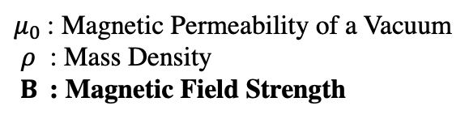
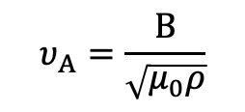
MHD waves In Uniform Plasma
Alfvén Wave
Fast Magnetoacoustic Wave
Slow Magnetoacoustic Wave
Linear Perturbation
Alfvén Wave
Incompressible, transverse oscillation that propagates along field.
$$υ_{A}=\frac{B}{\sqrt{μ_{0}ρ}}$$
Phase Speed:
$μ_{0}$: Magnetic Permeability of a Vacuum
$ρ$ : Mass Density
$B$: Magnetic Field Strength
The actual MHD wave modes in Corona are solved in plasma cylinders(Flux tubes)!

Slide 9
MHD waves In Uniform Plasma
Alfvén Wave
Fast Magnetoacoustic Wave
Slow Magnetoacoustic Wave
Linear Perturbation
Alfvén Wave
Incompressible, transverse oscillation that propagates along field.
$$υ_{A}=\frac{B}{\sqrt{μ_{0}ρ}}$$
Phase Speed:
$μ_{0}$: Magnetic Permeability of a Vacuum
$ρ$ : Mass Density
$B$: Magnetic Field Strength
The actual MHD wave modes in Corona are solved in plasma cylinders(Flux tubes)!

Slide 10
Methods&Results

Slide 11
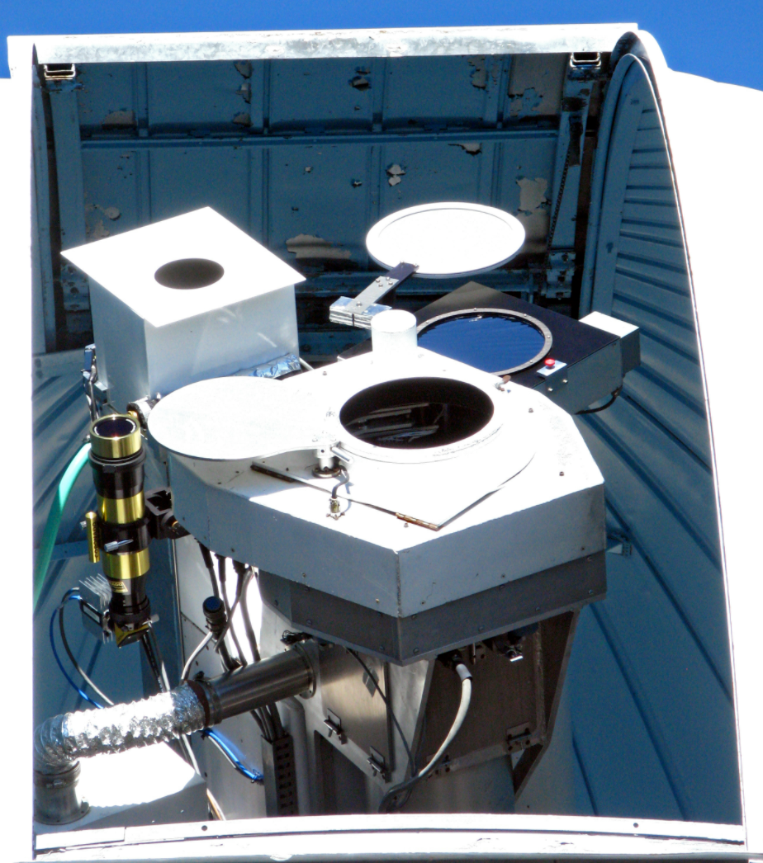
First Detection of Alfvén Wave (Steven Tomczyk et al 2007)
CoMP is designed to measure the complete polarization state at the 1074.7 and 1079.8 FeXIII coronal emission lines in order to constrain the strength and orientation of coronal magnetic fields.
Coronal Multi-Channel Polarimeter (CoMP)

Slide 12
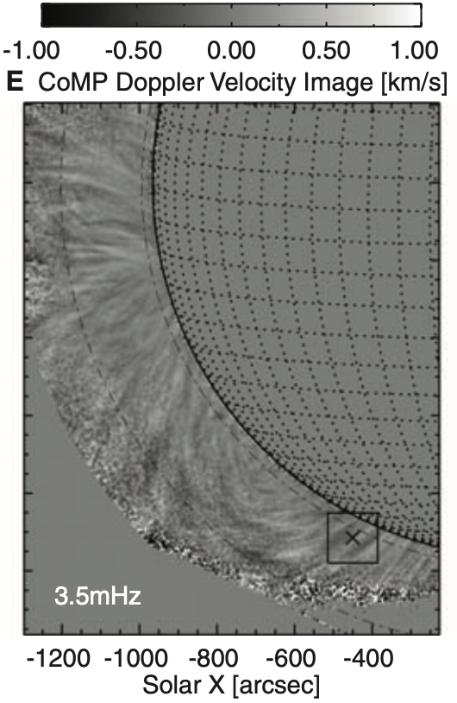
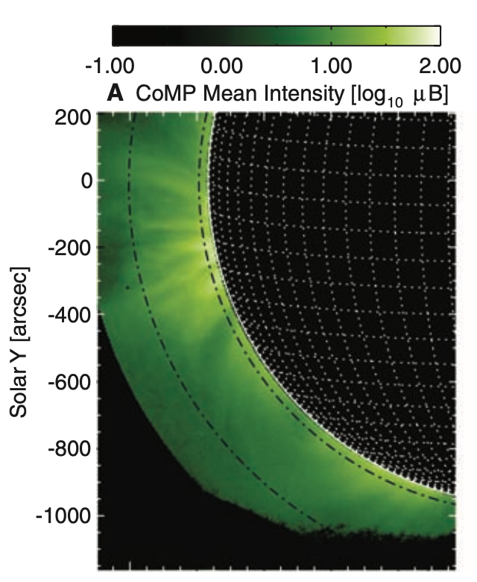
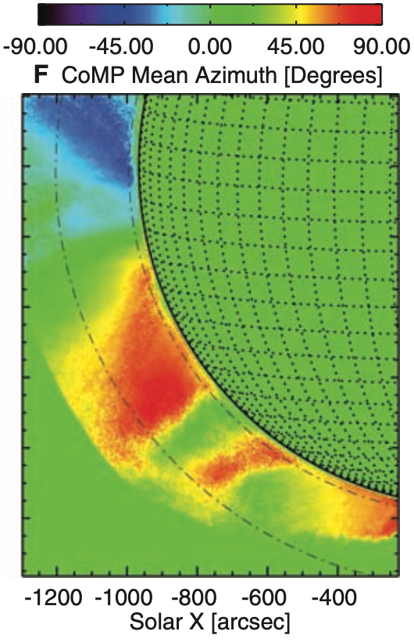

First Detection
Doppler Shift
Doppler Velocity Map
Probe the 1074.7nm FeXIII line’s intensity, doppler shift and polarization
Polarization
Magnetic Field Direction Map[Azimuth]

Slide 13
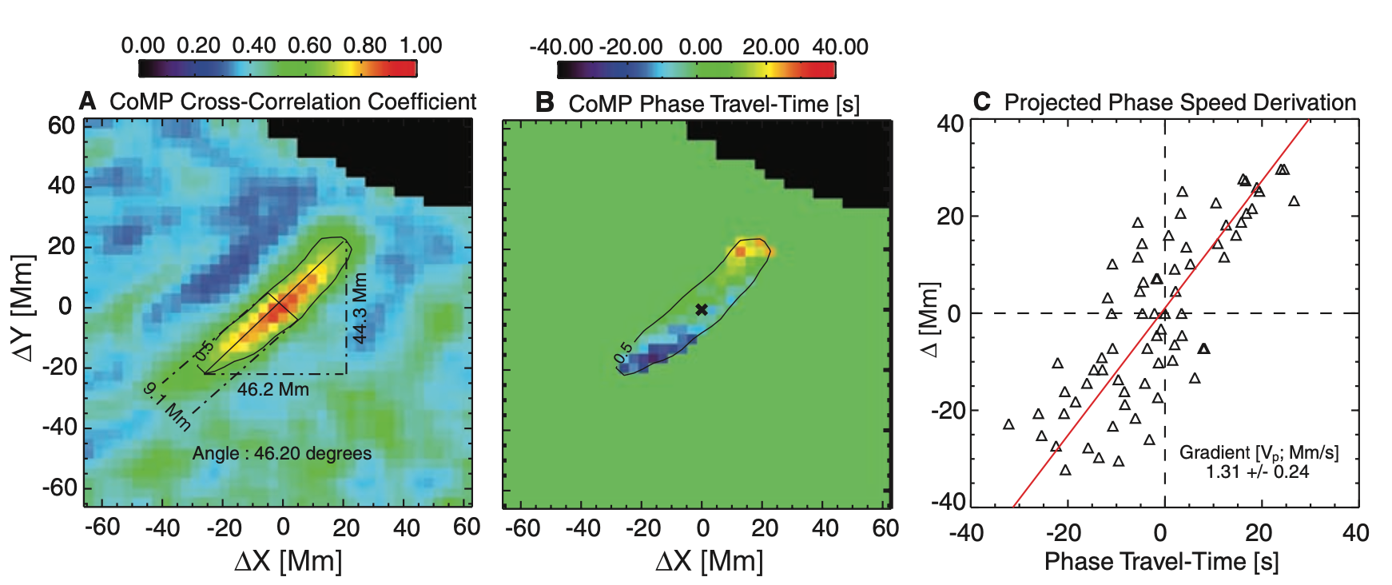
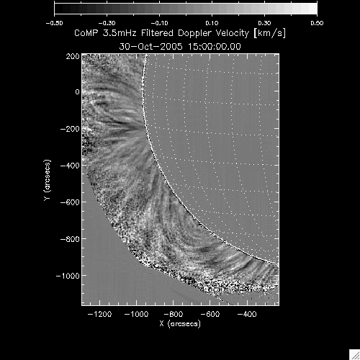
First Detection
Calculate Correlation

Slide 14
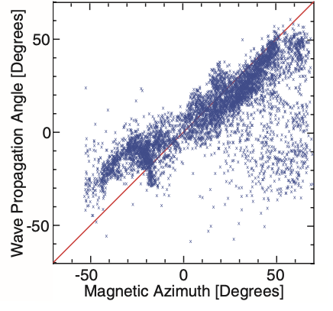
First Detection
Phase Speeds $\sim 2 Mm/s$
Alfvén Wave!
Waves Propagate Along Field Lines

Slide 15
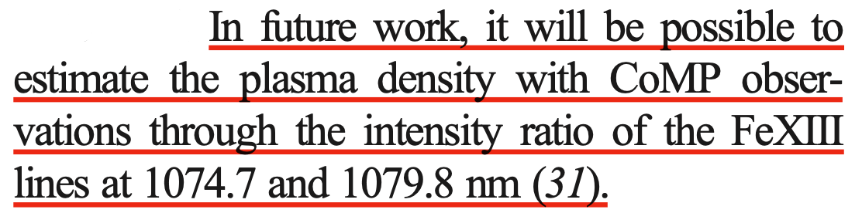
Summary of the 2007 Paper
Correlation
Fit
Dopler velocity
Phase travel time, distance
Wave propagation angle,
Phase speed
1074.7nm FeXIII Line
Polarization
Magnetic field direction
Alfvén Wave

Slide 16
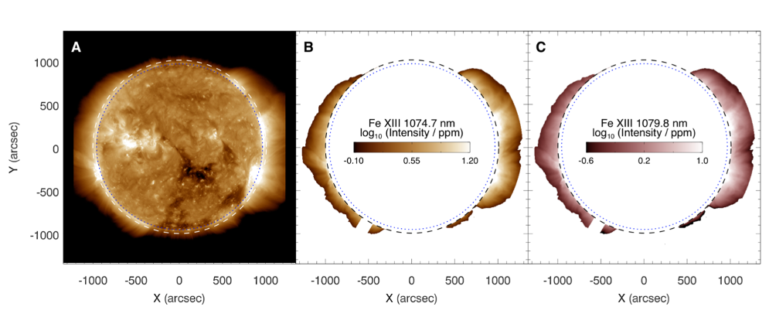
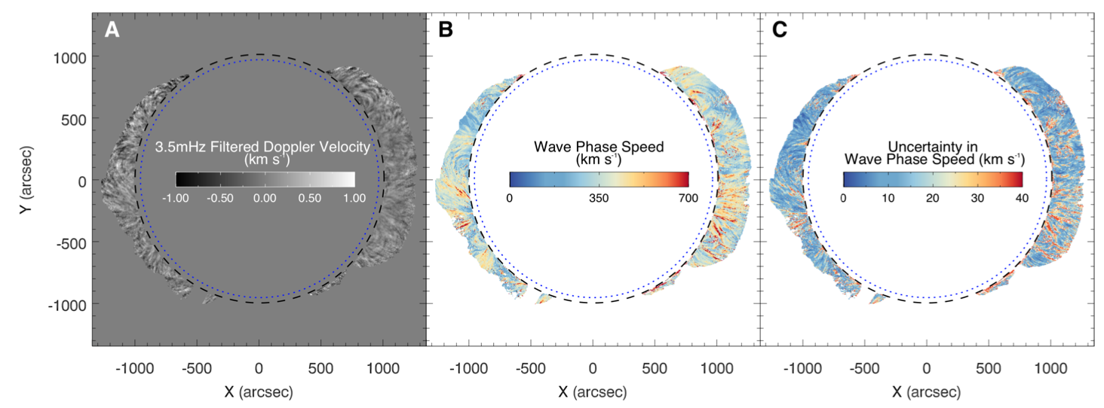
Probe the global magnetic field in Corona
(Yang et al 2020)
Similar Wave Tracking method is used in this work to obtain the Wave Phase Speed

Slide 17
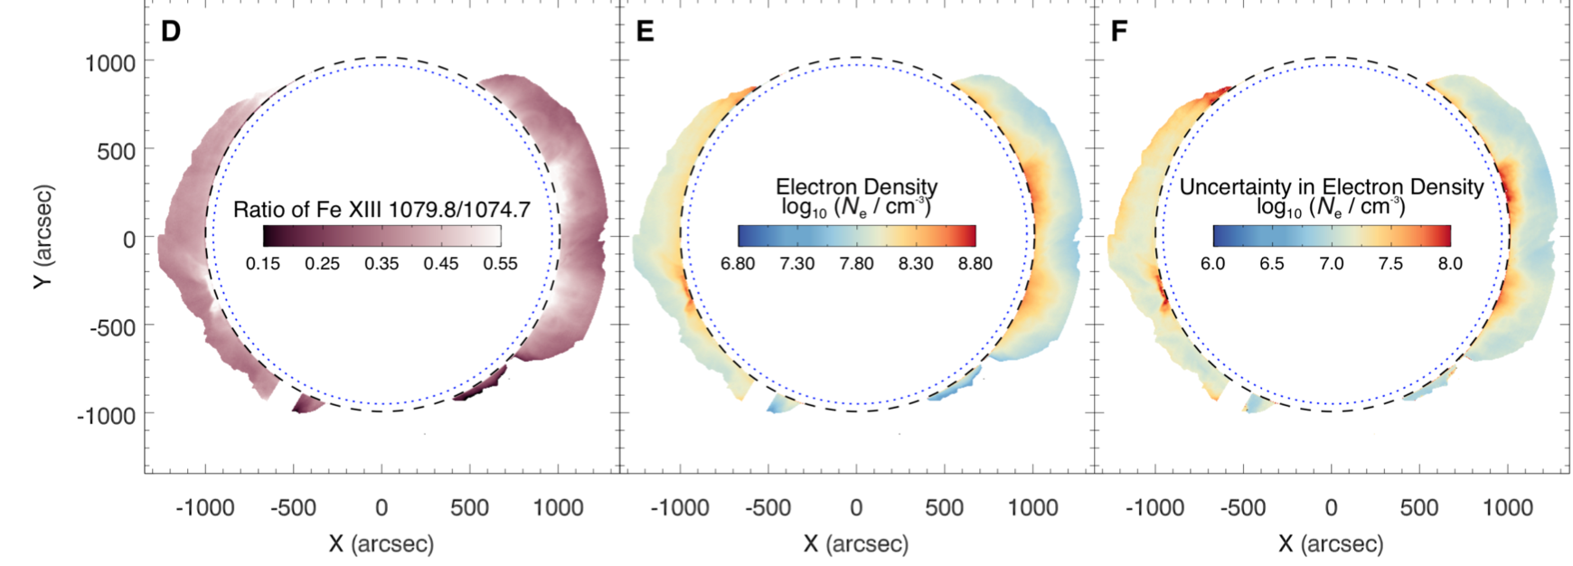

Probe the global magnetic field
The intensity ratio of the two Fe XIII lines is sensitive to the electron density, allowing us to derive the global coronal electron density map.
Considering the typical coronal composition:
$$\left\langle ρ\right\rangle =1.2N_{e}m_{p}$$

Slide 18
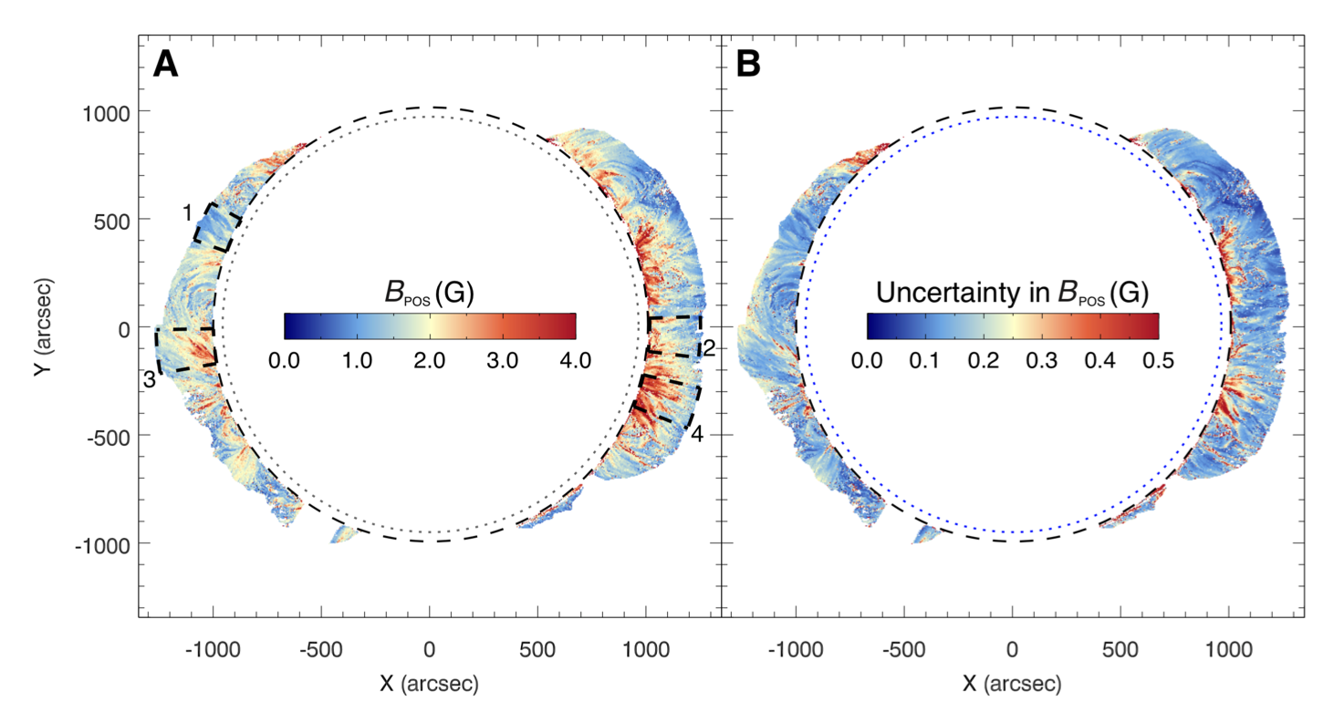
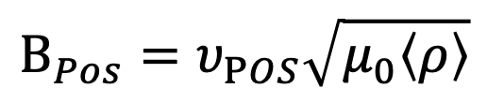
First global magnetic field in Corona
$${B_{Pos}=υ}_{POS}\sqrt{μ_{0}\left\langle ρ\right\rangle }$$

Slide 19
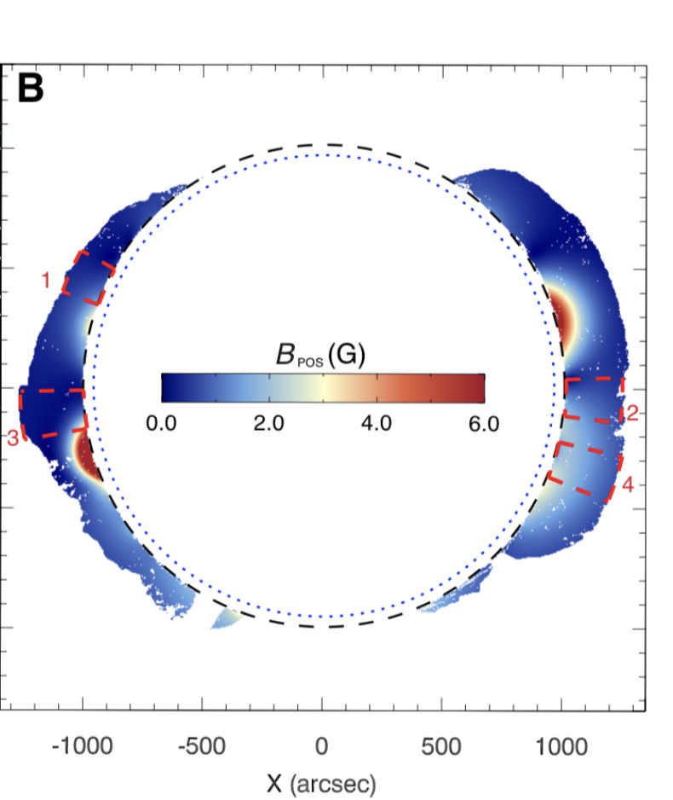
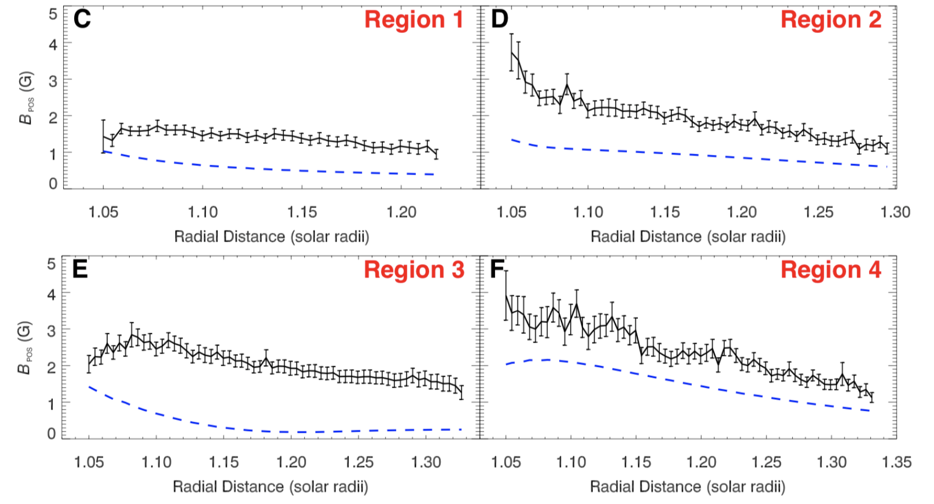
Comparison with Simulation
At many locations the radial variation of $B_{Pos}$ has a discrepancy between CoMP measurements and PFSS results.

Slide 20
Summary
1079.8nm FeXIII Line
Line Intensity
Mass density
Line Intensity
Magnetic field strength
Dopler velocity
Phase speed
1074.7nm FeXIII Line
Polarization
Magnetic field direction

Slide 21
Comments
1. “ A rare example (for astronomy) of a successful theoretical calculation driving observational effort ” (Steven R. Furlanetto’s comment on 21 cm transition)
2. A very successful first attempt to probe the global map in the solar corona.
3. Many assumptions are made in the calculation. The influence of these assumptions should be further explored.

Slide 22
Questions
Why there is no results for upper and bottom part of the corona?
Why did it take so long to estimate the mass density after successfully probing the phase speed?
Can we use other modes of MHD wave to probe the magnetic field?
Why use the 1079.8nm and 1079.8nm FeXIII Line?

Slide 23
Answers(some of them may be problematic)
1. Why there is no results for upper and bottom part of the corona?
They are relatively cold and less dense coronal holes. Current method likely cannot provide magnetograms in coronal holes due to the very low S/N of the two Fe xiii lines.
2. Why did it take so long to estimate the mass density after successfully probing the phase speed?
There were some problems in the calibration of the instrument until 2016. However this doesn’t influence the conclusion in the 2007 paper since phase speed is only determined by relative doppler velocity between different pixels.

Slide 24
Answers(some of them may be problematic)
3. Can we use other modes of MHD wave to probe the magnetic field?
Other modes usually are not pure transverse or related to the sound speed. The torsional mode may be a potential candidate with enough resolution.
4. Why use 1079.8nm and 1079.8nm FeXIII Line?

