Slide 1
Fast and inefficient star formation due to short-lived molecular clouds and rapid feedback
Kruijssen et al. 2019
Presenter: Xinyu Zheng
Advisor: Xuening Bai
2021.11.12 @ Astro Student Seminar 2021 Fall

Slide 2
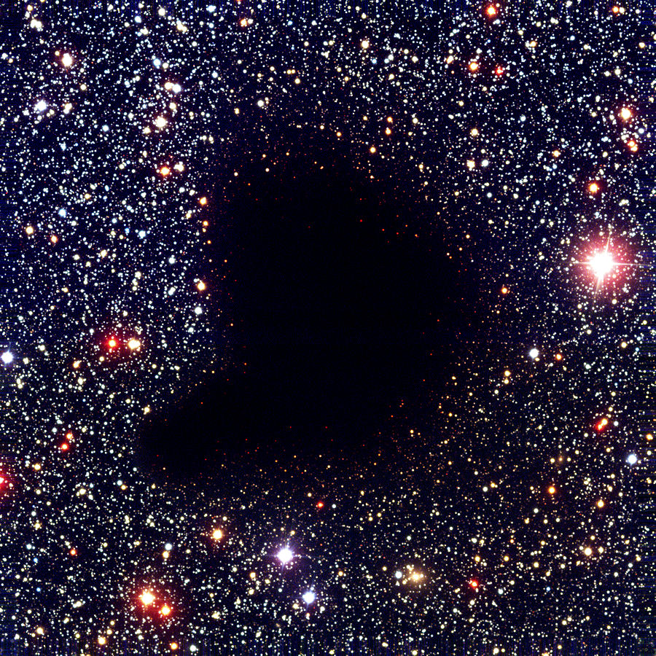
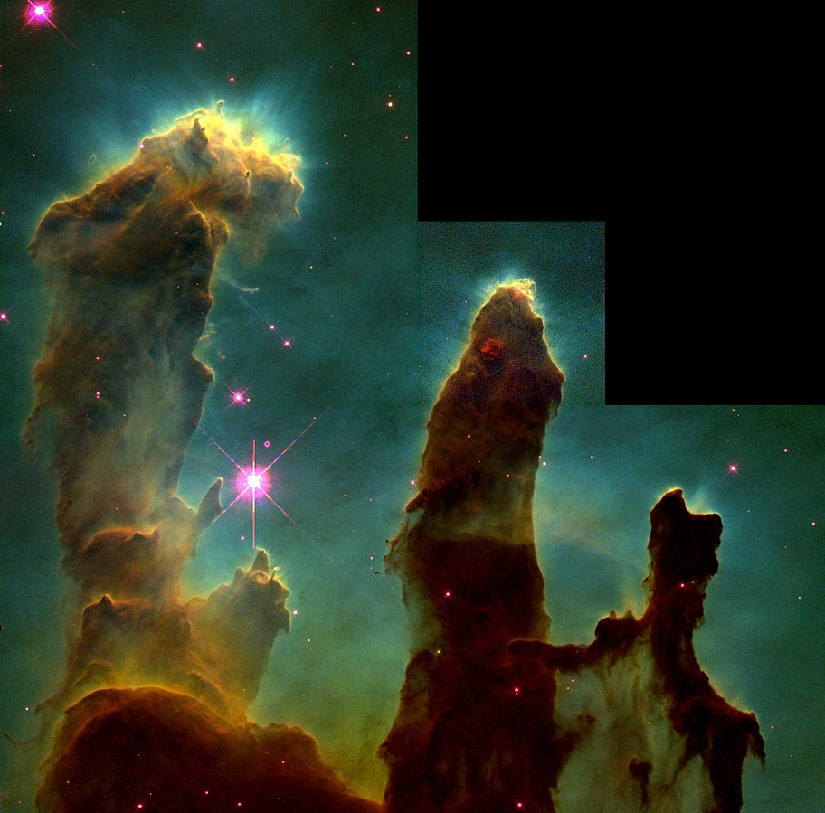
Molecule cloud and star formation
Molecule cloud
Star forming region

Slide 3
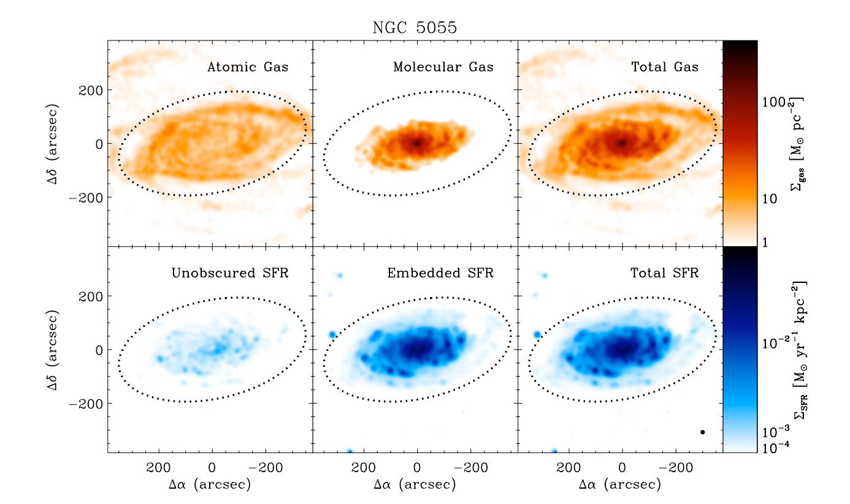
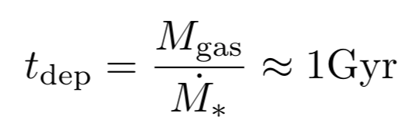

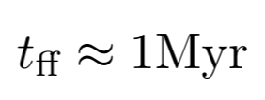
Mystery
(x 2014)

Slide 4
This study: new observation and new method
High resolution observation!
New method (correlation, statistics)
Fast and inefficient star formation
due to
short-lived molecular clouds and rapid feedback

Slide 5
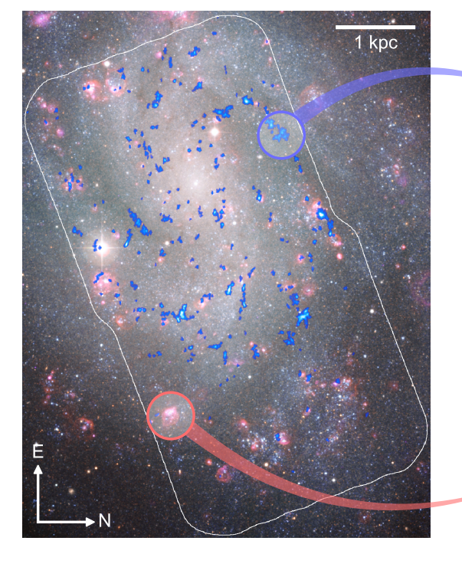
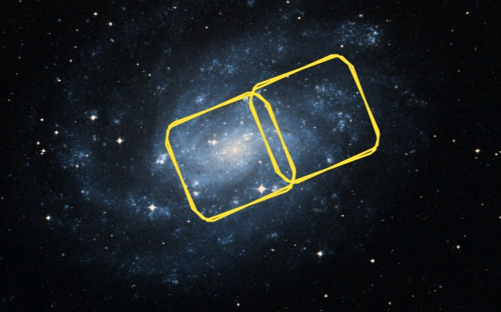


The observation
NGC 300
distance: 1.86Mpc
m(V): 9
size(V): ~15’ * 20’
mass: ${2.9 ×{10}^{10}M}_{⊙}$
CO(1-0) observation: ALMA
Blue: ALMA CO(1-0) 2’’~20pc
Red: MPG/ESO(2.2m) $Hα$

Slide 6
The method
Lifetime of a single MC
t_fb
t_CO
t_H_alp
CO
CO
+
H_alp
H_alp

Slide 7
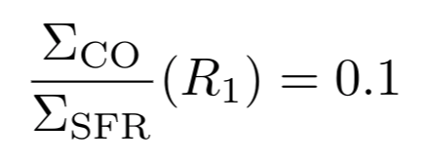
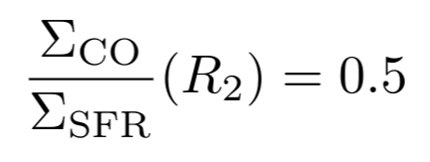
The method

Slide 8



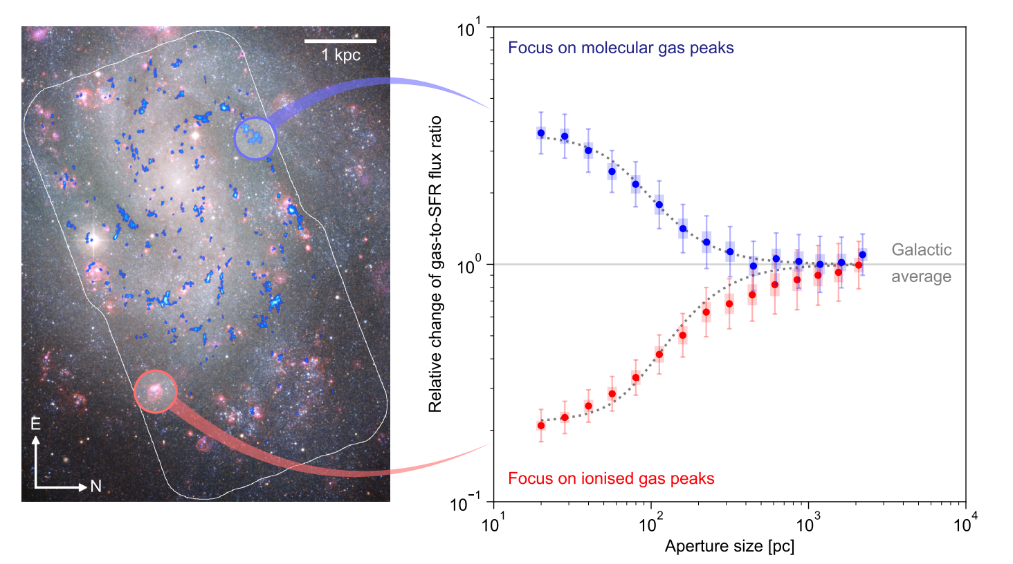
The method
fit

Slide 9
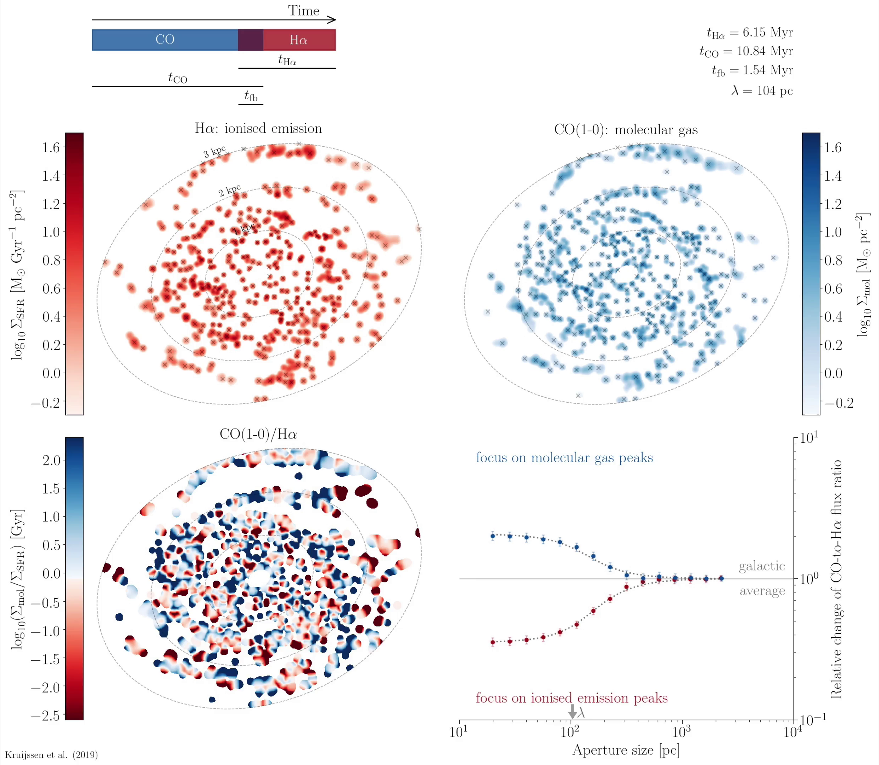
The method
fit

Slide 10
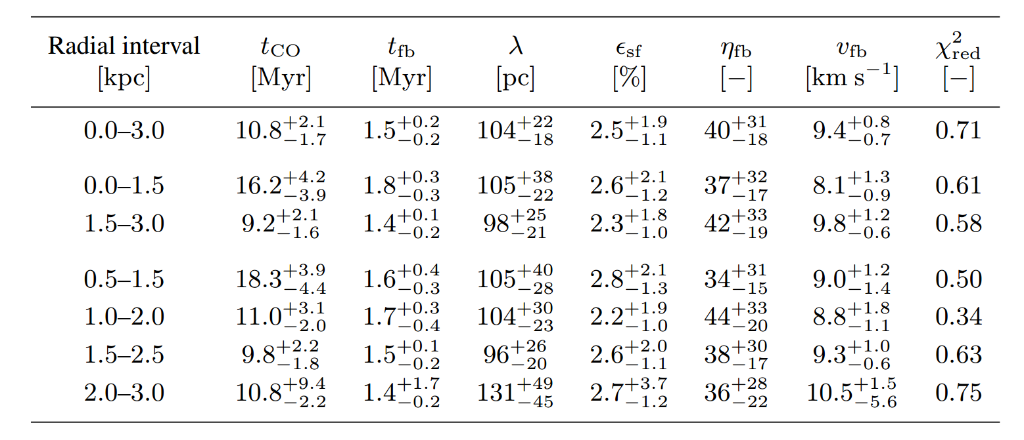
The results
fitted
derived

Slide 11
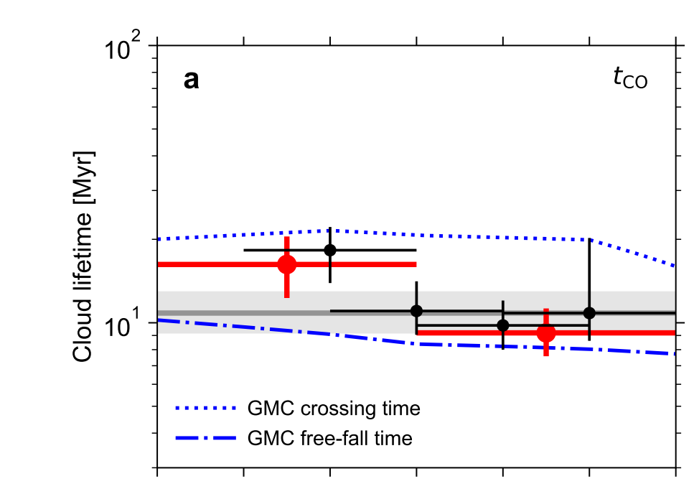
Discussion
Short-lived
rapid feed back:
Early feedback from forming stars
before supernovae (3Myr)
Future work:
1’’ resoltuion for 10Mpc galaxies
(ongoing, see Chevance et al. 2020)
0.1’’ resolution for high-z(z>1) galaxies
...

Slide 12
Relation to other works
4 decades of trying to figure out GMC lifetime:
1~100Myr: contrasting
different experiment designs
Subjective define of GMC and HII region
Advantages of this method:
Can be applied systematically to a large sample of galaxies
Clear physical expression, give constraints on theoretical works
Star forming theories (cloud scales)
From static picture to “mass flow”
Lifecycle of GMC
Dependence on galactic environment
Sub-grid physics for cosmological-scale simulation of galaxy evolution.

Slide 13
Take-home messages
This study uses new observation data and a promising new method to constrain several key parameters of GMC lifecycle.
This study shows a typical GMC lifetime of 10Myr, feedback time of 1.5Myr, and mean distance between independent GMC of 100pc.
These measurements tells that star formation is fast and inefficient, due to early feedback from the forming stars, before supernovae.
This method can be applied to future data. And the results will put strong constraints on cloud-scale star formation theory.

Slide 14
My comments
Solid and interesting work!
How about other tracers?
How about azimuthal bins?

Slide 15
Thank you for listenning!

Slide 16
Major references
A Nature paper
Fast and inefficient star formation due to short-lived molecular clouds and rapid feedback Kruijssen, J. M. Diederik et al. 2019
An MNRAS paper to introduce the method (~80P)
An uncertainty principle for star formation - II. A new method for characterizing the cloud-scale physics of star formation and feedback across cosmic history Kruijssen, J. M. Diederik et al. 2018
Several follow-up studies
e.g. The lifecycle of molecular clouds in nearby star-forming disc galaxies Chevance, Mélanie et al. 2020
PHANGS website (a lot of beautiful figures)
https://sites.google.com/view/phangs/home

Slide 17
Acknowledgements
Thanks for Xuening Bai, Xuanyi Wu, Tao Jing, Xihui Zhao, Shengtang Wang. Discussions with you have greatly enhanced my understanding of this topic and this paper.

Slide 18
My (aggresive) questions
Why the uncertainty of cosmological simulation of galaxy evolution exists until now?
Why not the Milky Way and local groups?
How about do statistics about CO map and forming stars(UV, IR)?
Why with such a novel method? Instead of some easier method?

Slide 19
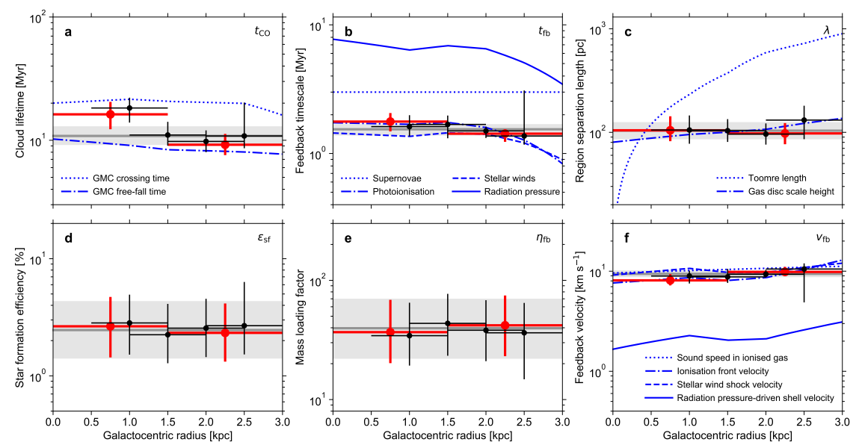
Dependence on radius

Slide 20
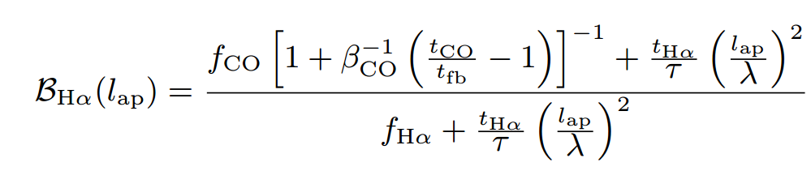
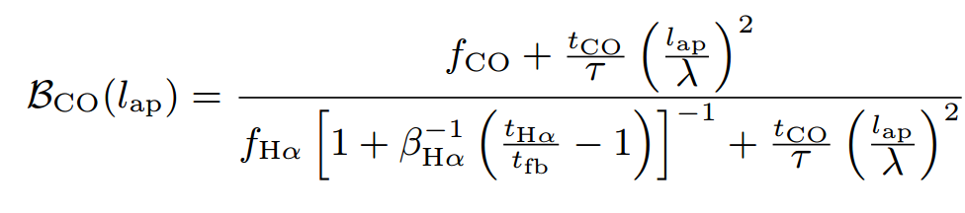
Fitting eqn.

Slide 21
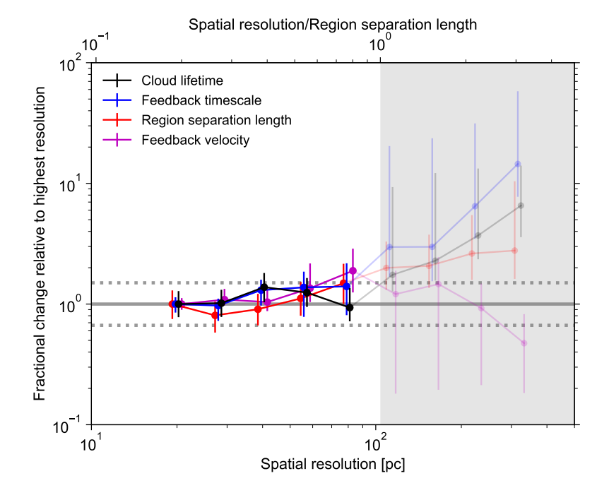
Demand for resolution

Slide 22
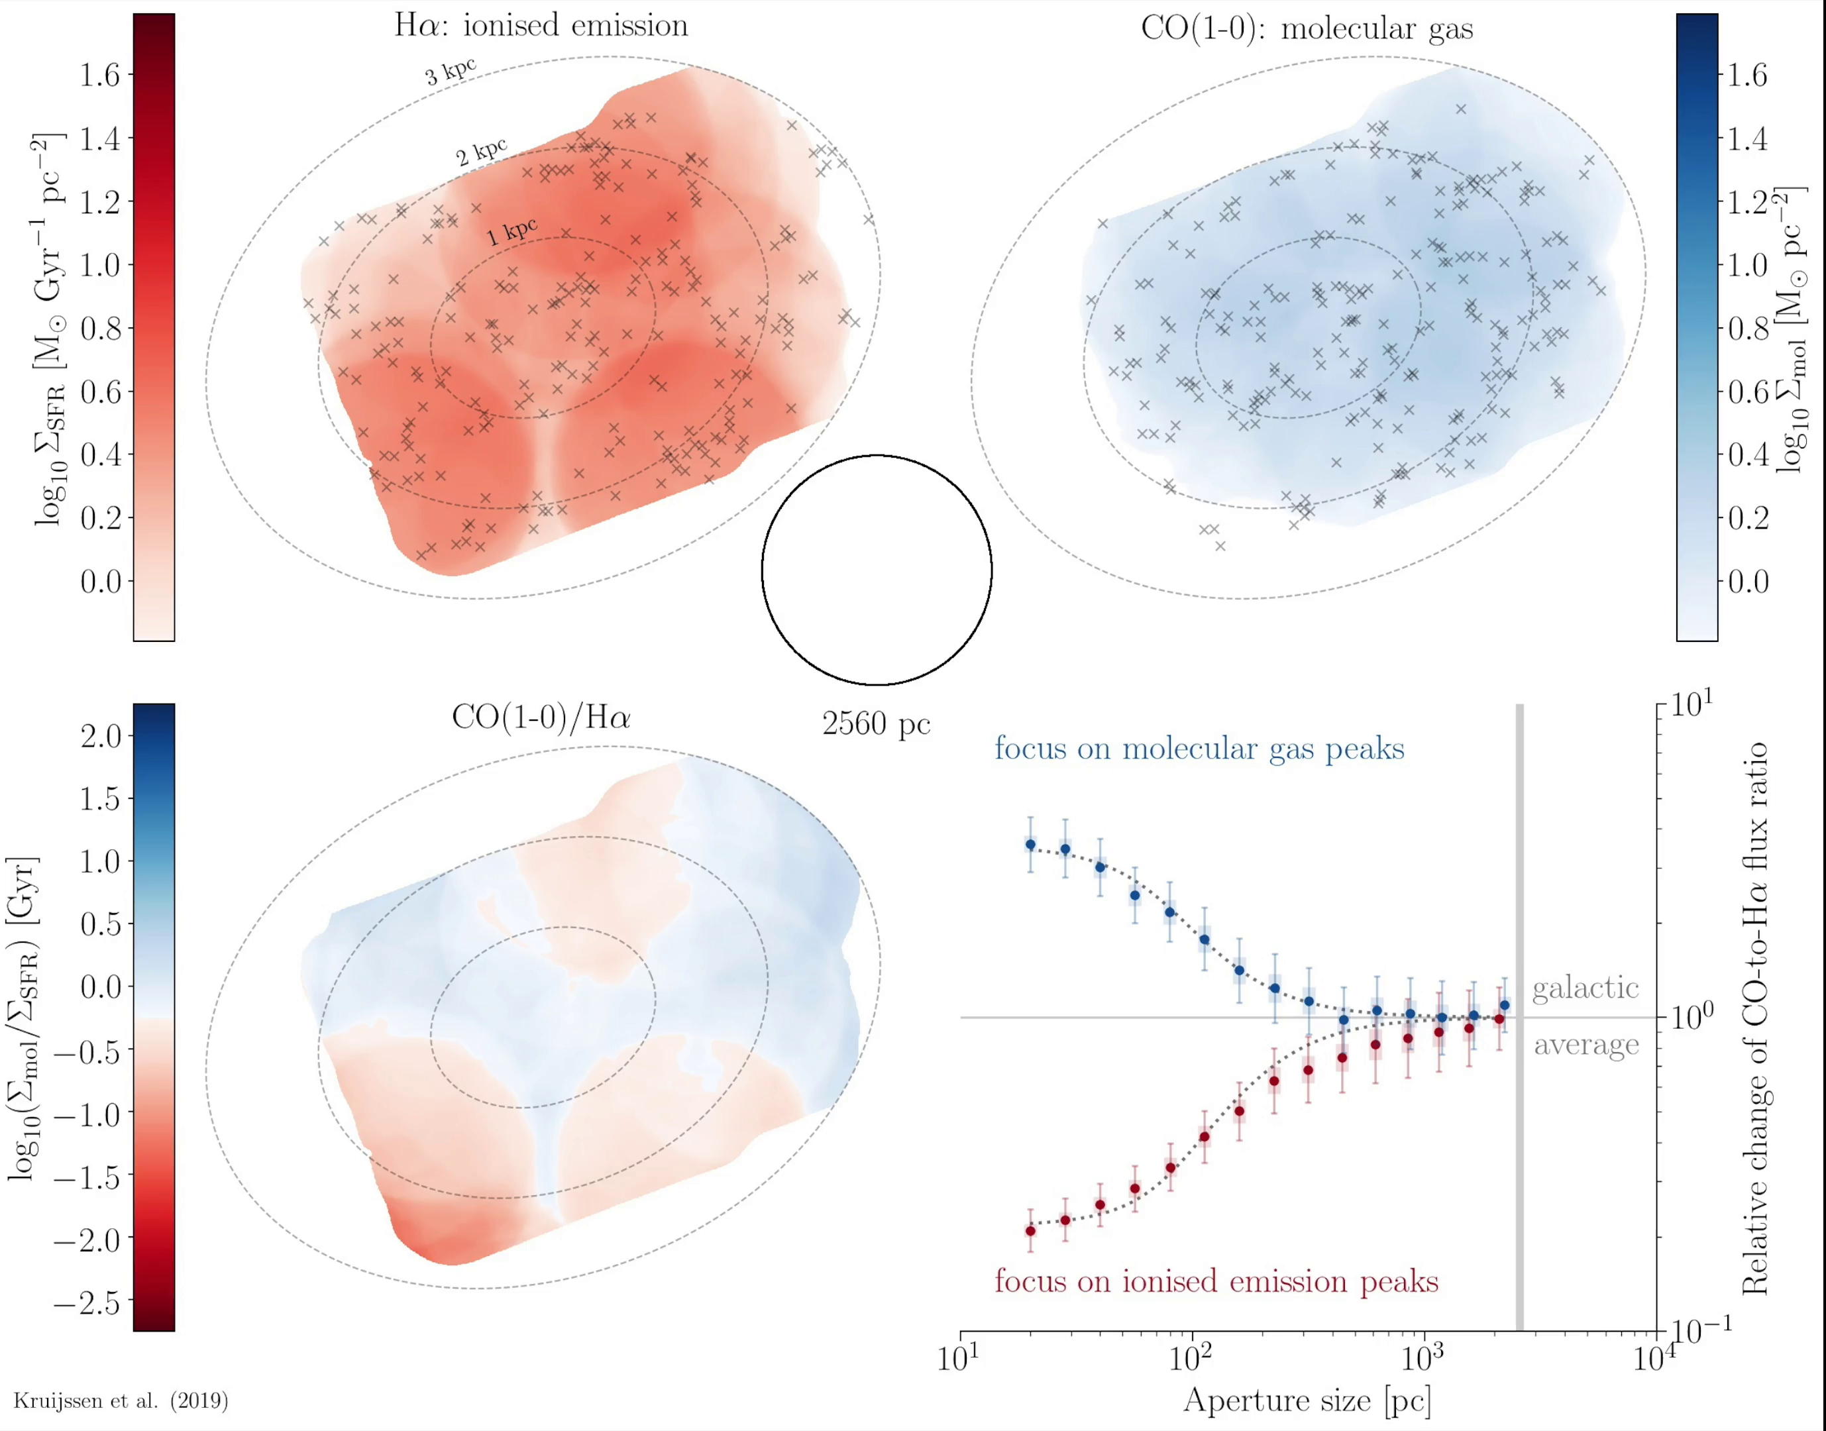
Demand for resolution

Slide 23
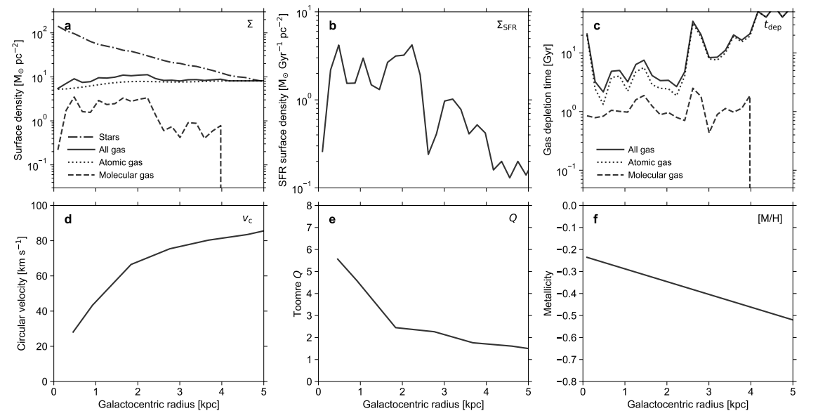
The NGC300 radial profile

Slide 24
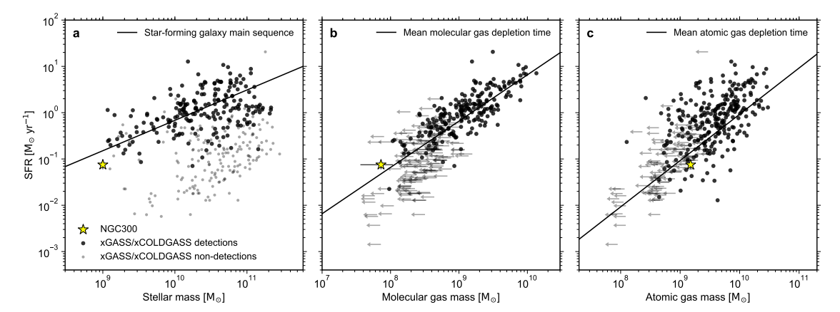
The NGC300 status in nearby SF galaxies

Slide 25
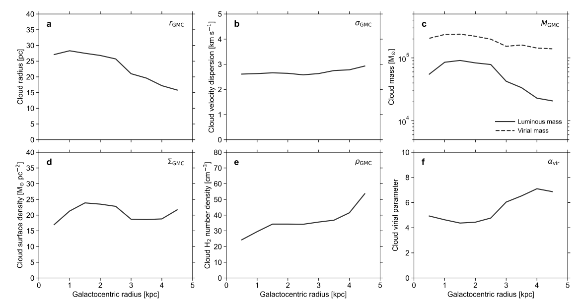
The GMC properties in NGC300

Slide 26
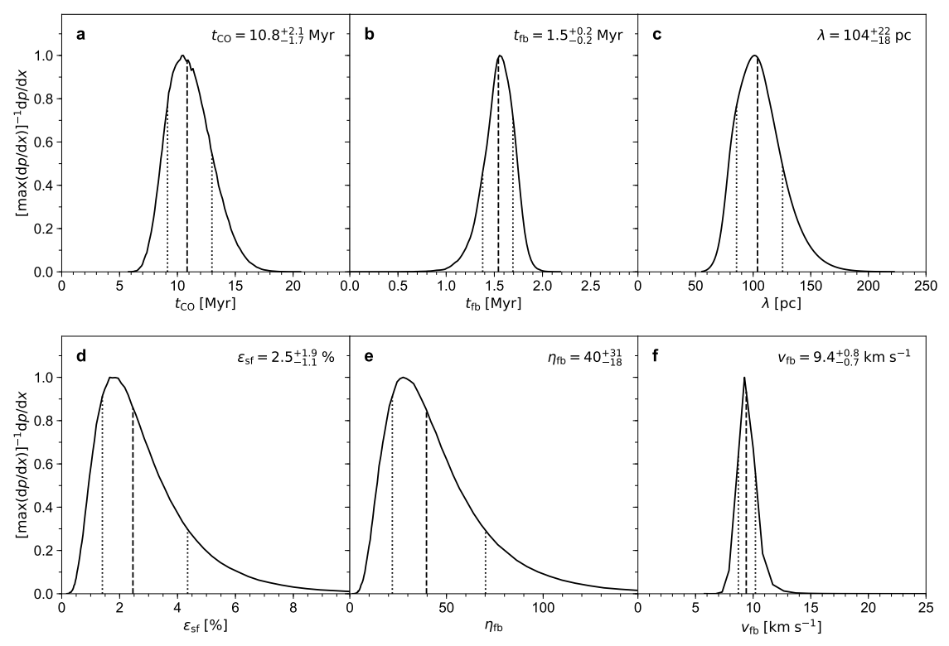
The fitted results

Slide 27
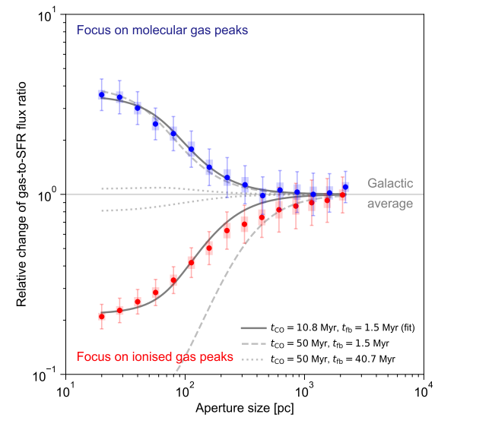
Dependence on the parameters

Slide 28
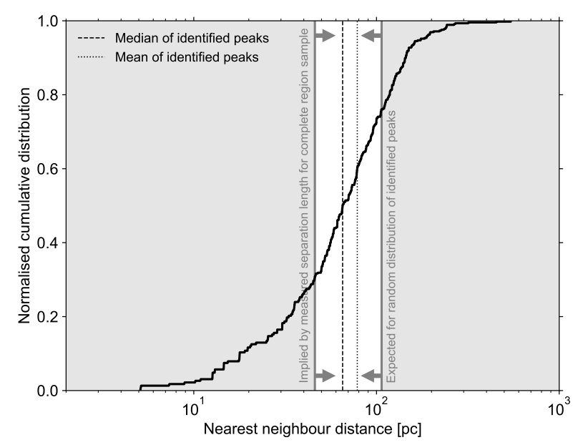
Nearest neighbour distances of emission peaks

Slide 29
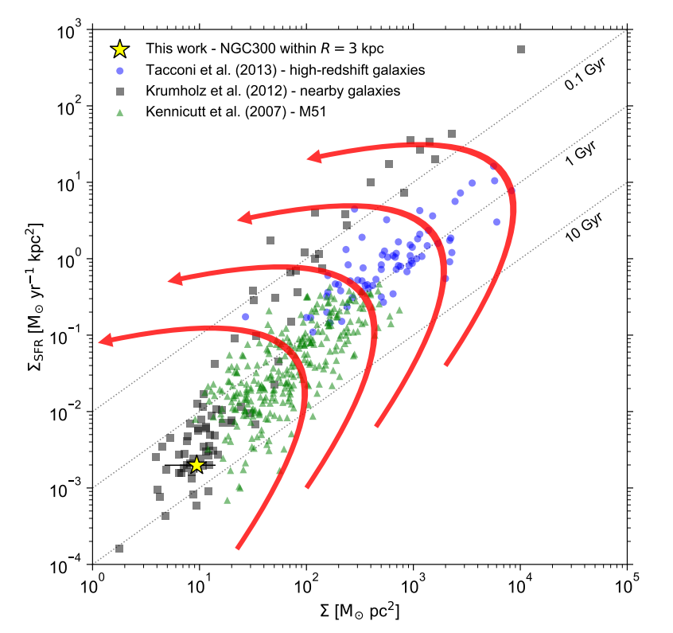
gas-SFR diagram

Slide 30
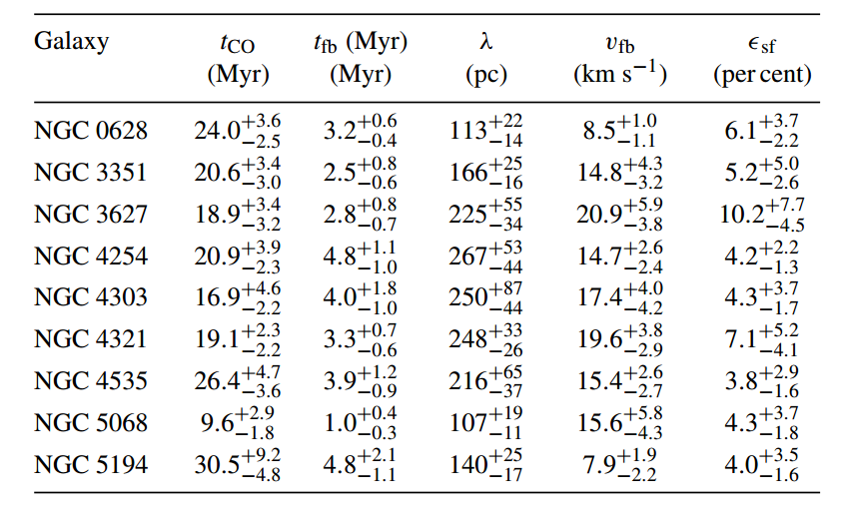
Chevance et al. 2020

Slide 31
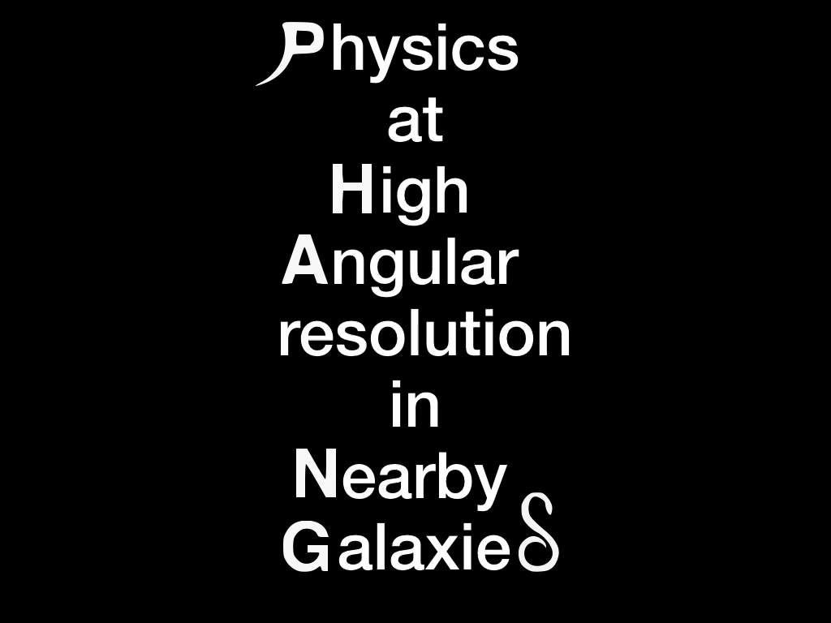
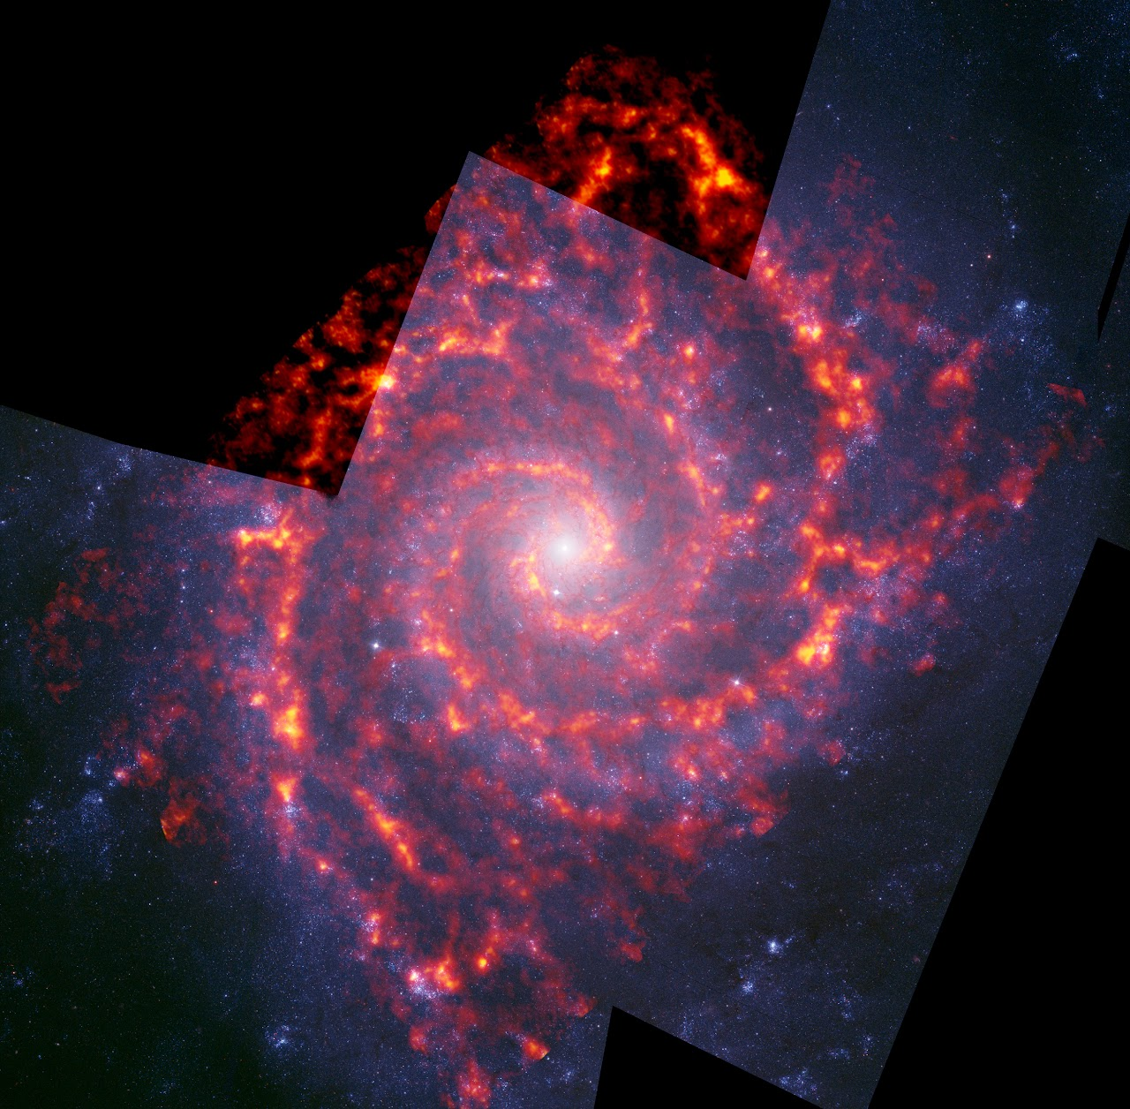

PHANGS-ALMA
see https://sites.google.com/view/phangs/home
The PHANGS (Physics at High Angular Resolution in Nearby GalaxieS) survey
Jiayi Sun (Team member)
B.S. from THU in 2015
Ph.D. from OSU in 2021
Now postdoc at McMaster Univ.

