Slide 1
SKA CD/EoR Science Team Meeting 2024
Summary Talk Yi Mao
July 19, 2024

Slide 2
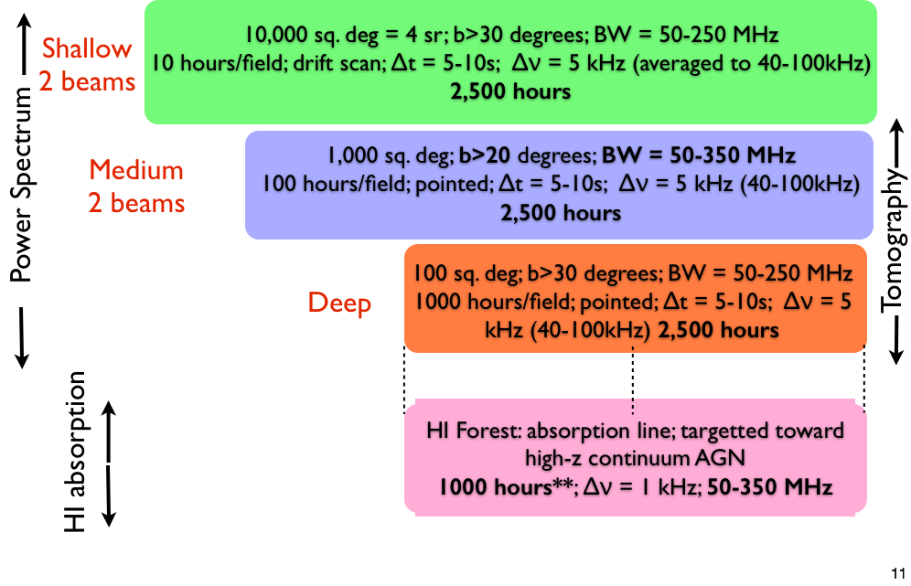
Cathryn Trott: SKA status update

Slide 3
Cathryn Trott: SKA status update

Slide 4
Andrei Mesinger: 21 cm cosmology
Where we are, where we go?

Slide 5
Summaries of my (incomplete and inaccurate) notes
Theories:
Kyungjin Ahn: 21 cm ISW
Bin Yue: velocity acoustic oscillations on the 21 cm CD signal
Yao Zhang: memory of reionization on the post-reionization Lya forest power spectrum and its imprint on the WDM
Di Wu: strong lensing of ionized structures
Impact of the EoR sources:
Qingbo Ma: effect of stellar population synthesis models on reionization
Leon Noble: impact on the 21-cm bispectrum
James Davies: Stochastic Halo Populations

Slide 6
Summaries of my (incomplete and inaccurate) notes
Observations:
Florent Mertens: LOFAR-EoR and NenuFAR Cosmic Dawn Projects
Rashmi Sagar: uGMRT Band-2
Samit Kumar Pal: calibration errors and instrumental noise
Foreground Models
Yanping Cong: Ultra-long wavelength sky model with absorption effect
Shijiao Yin: Ideal Sky Model
Foreground:
Le Zhang: SKA SDC 3a
Jiajun Zhang: ForkEoR (a ML-based cleaning and foreground removal method)

Slide 7
Summaries of my (incomplete and inaccurate) notes
Interference Techniques:
Caroline Heneka: optimal inference for 21cm cosmology
Daniela Breitman: an ML-based Bayesian inference with 21cm PS
Sabrina Berger: reconstruction of initial density field with HMC and zreion
Ian Hothi: 2D wavelet scattering transform (and 3D …)
Thomas Binnie: model selection with lightcone images
Cross-correlation of 21cm x other probes:
Samuel Gagnon Hartman: galaxy x 21cm signal
Ivelin Georgiev: kSZ x 21 cm signal

Slide 8
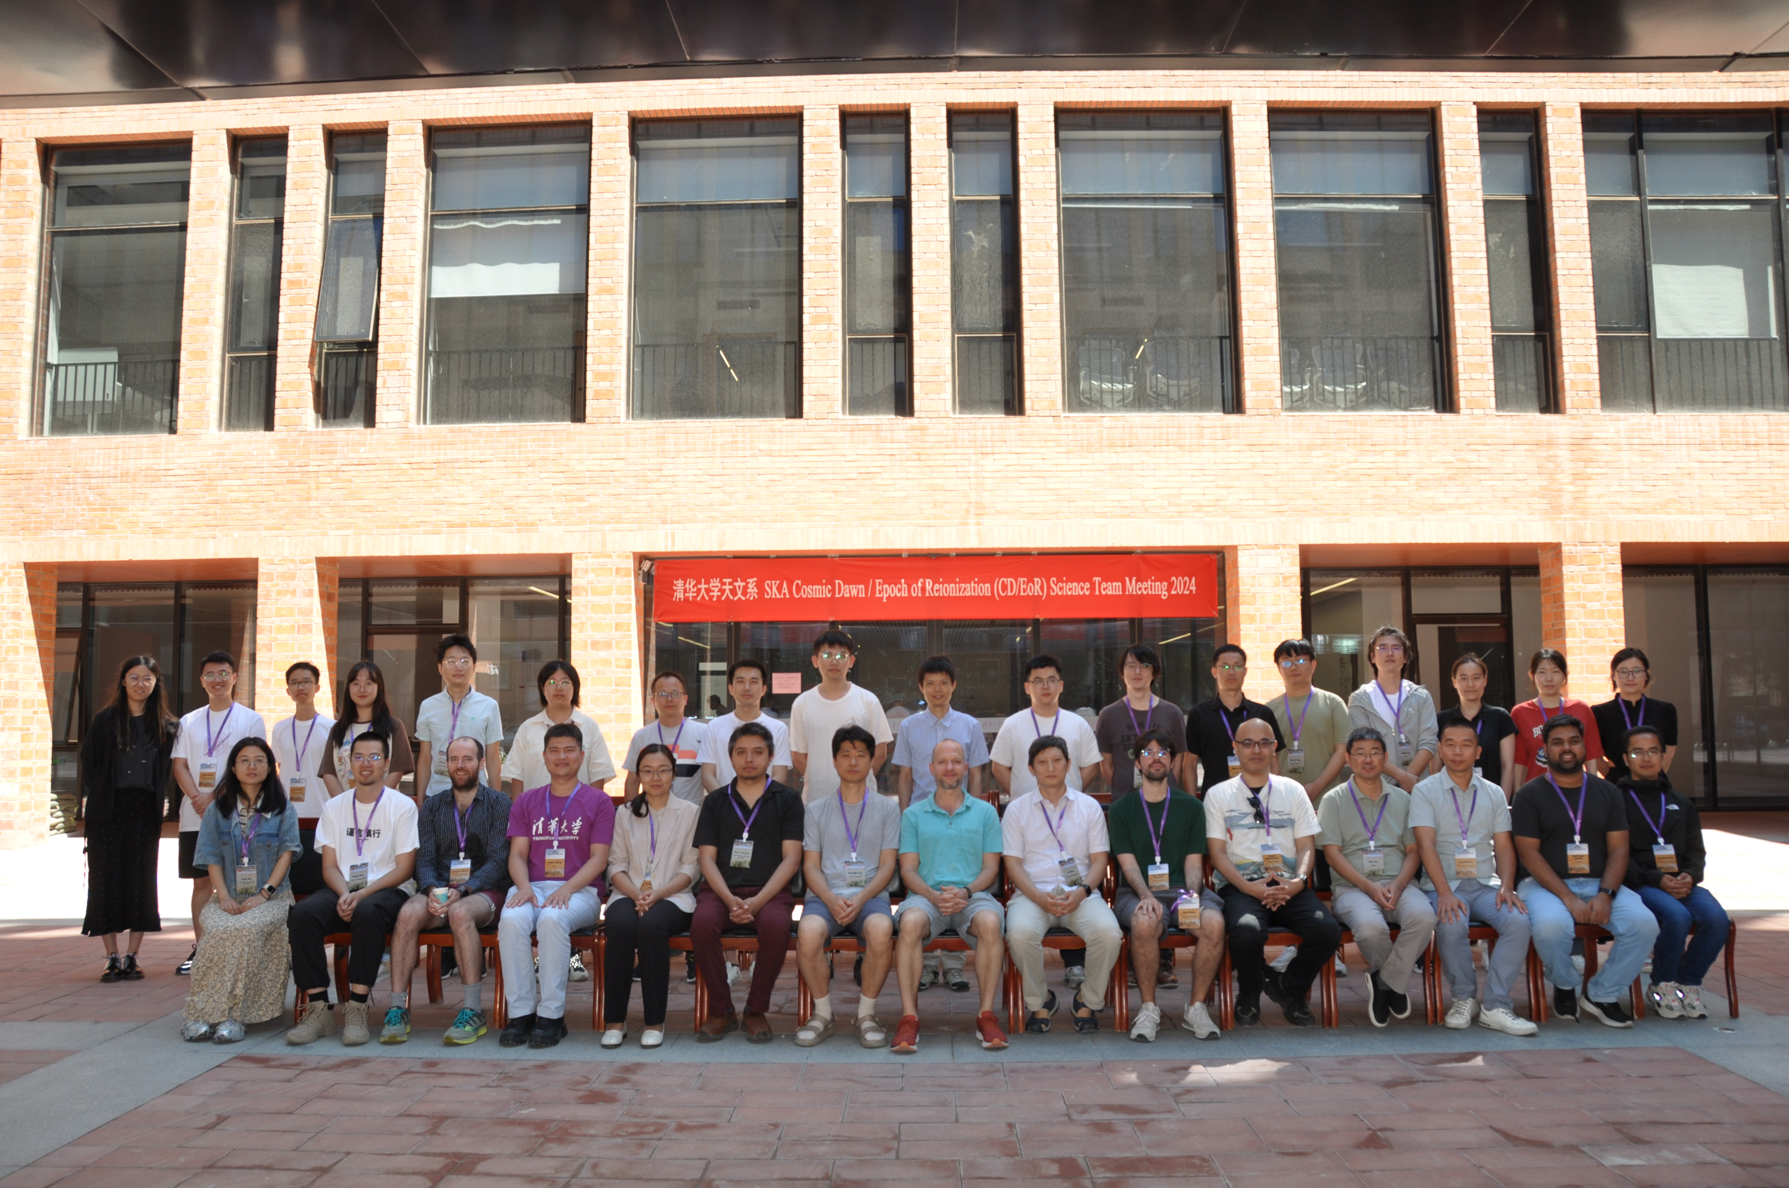
SKA CD/EoR ST Meeting 2024 (Beijing, China)
Which number is this meeting in the series of SKA CD/EoR ST Meeting?

Slide 9
SKA CD/EoR Science Team Meeting
Meeting I: June 2014, Giardini Naxos, Italy*
Meeting II: August 2015, Stockholm, Sweden*
Meeting III: October 2015, Groningen, Netherlands
Meeting IV: November 2016, Goa, India*
Meeting V: March 2017, Pisa, Italy
Meeting VI: September 2017, Zagreb, Croatia
Meeting VII: September 2018, London, UK
Meeting VIII: April 2019, Alderly Park, UK*
Meeting IX: March 2021, Virtual*
Meeting X: September 2022, Pisa, Italy
Meeting XI: September 2023, London, UK
Meeting XII: July 2024, Beijing, China
* Break Out during the general SKA meeting)

Slide 10
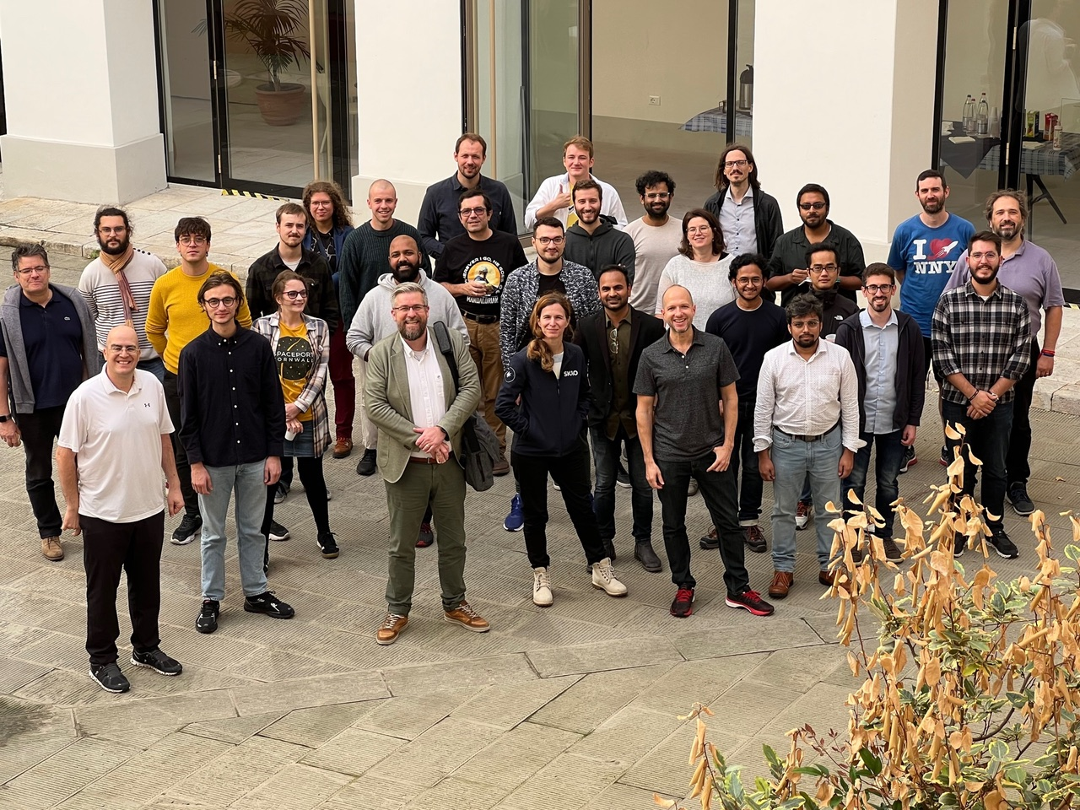
SKA CD/EoR ST Meeting X 2022 (Pisa, Italy)

Slide 11
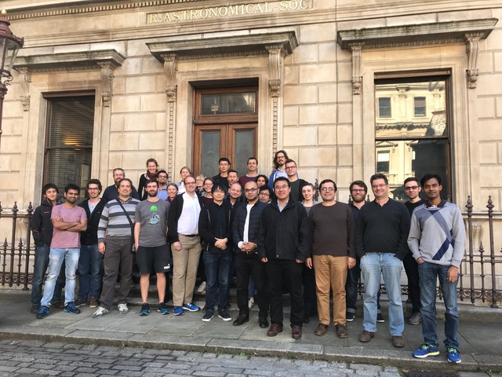
SKA CD/EoR ST Meeting XI 2023 (London, UK)

Slide 12
SKA CD/EoR ST Meeting XII 2024 (Beijing, China)

Slide 13
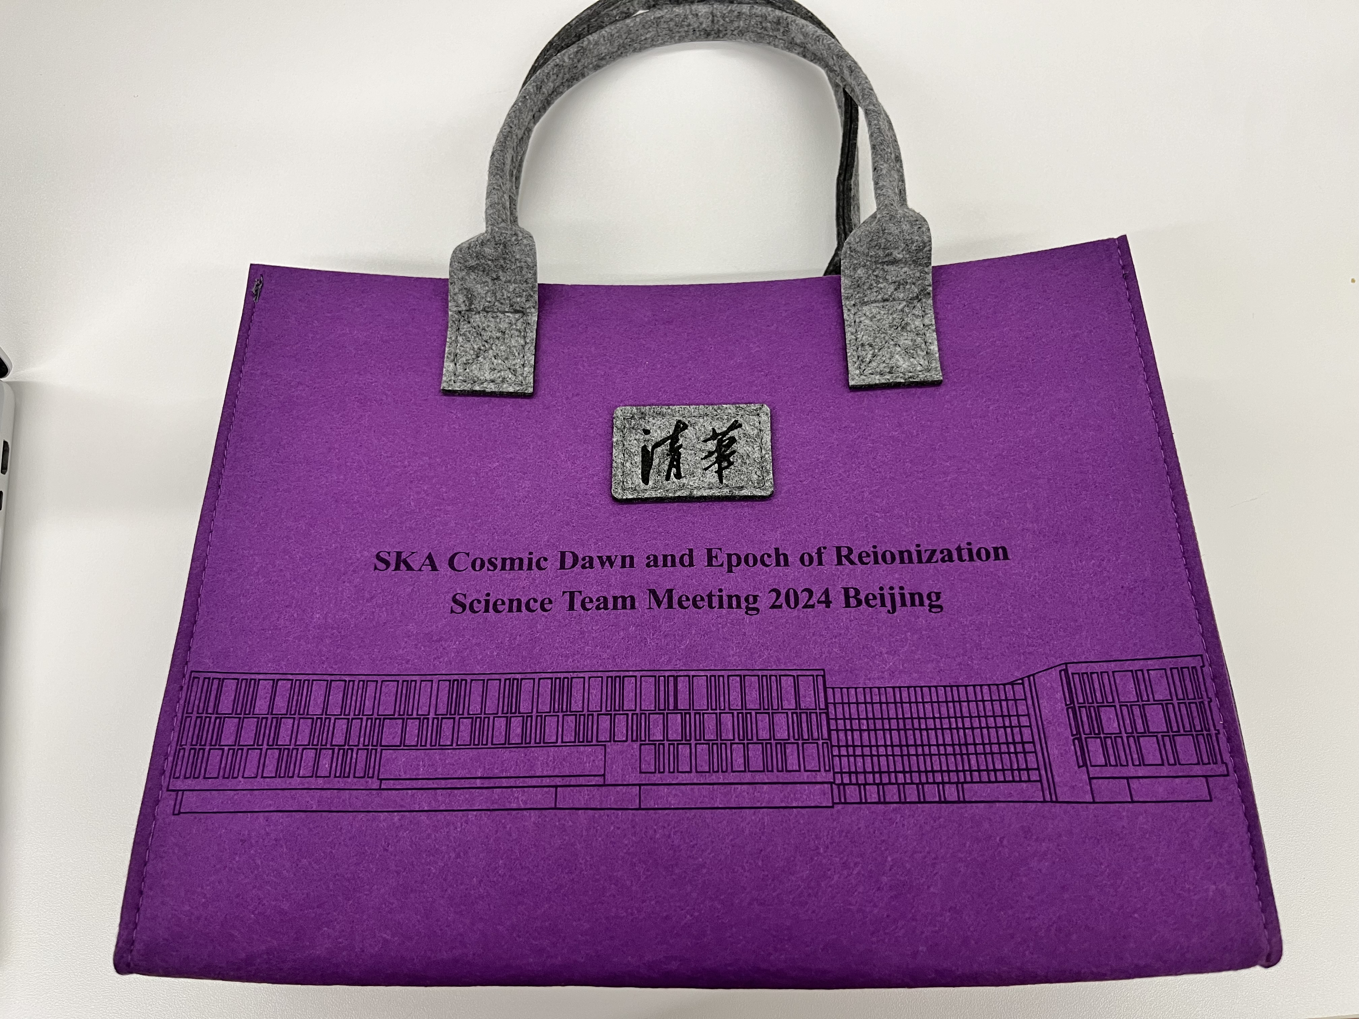
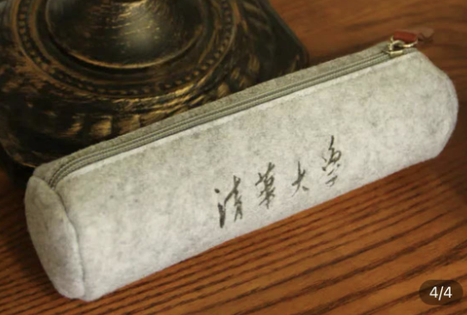
SKA CD/EoR ST Meeting XII 2024 (Beijing, China)

Slide 14
SKA CD/EoR Science Team Meeting
Meeting I: June 2014, Giardini Naxos, Italy*
Meeting II: August 2015, Stockholm, Sweden*
Meeting III: October 2015, Groningen, Netherlands
Meeting IV: November 2016, Goa, India*
Meeting V: March 2017, Pisa, Italy
Meeting VI: September 2017, Zagreb, Croatia
Meeting VII: September 2018, London, UK
Meeting VIII: April 2019, Alderly Park, UK*
Meeting IX: March 2021, Virtual*
Meeting X: September 2022, Pisa, Italy
Meeting XI: September 2023, London, UK
Meeting XII: July 2024, Beijing, China
Meeting XIII: tentatively in spring, Paris, France
* Break Out during the general SKA meeting)
Hope to See You All …

Slide 15
2025 SKAO Science Meeting and the new SKAO Science Book
Hope to See You All …

