Slide 1


zhangyao22@mails.tsinghua.edu.cn
Unveiling the dark matter nature with
reionization relics
Yao Zhang
Department of Astronomy, Tsinghua University
Supervisor: Yi Mao (Tsinghua University)
Collaborators:
Catalina Morales-Gutiérrez (University of Costa Rica),
Paulo Montero-Camacho (Peng Cheng Laboratory),
Heyang Long (The Ohio State University),
Christopher Hirata (The Ohio State University).
SKA Cosmic Dawn and Epoch of Reionization Science Team Meeting 2024 July 17 - July 19, 2024

Slide 2
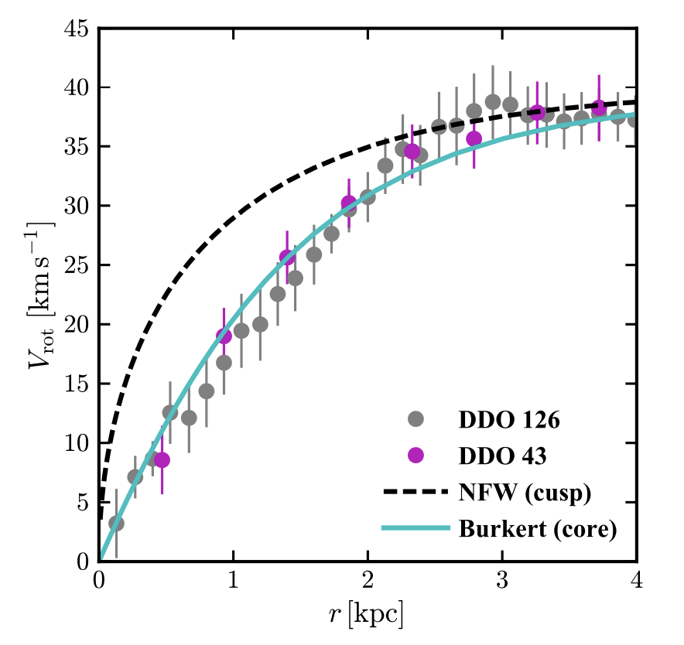
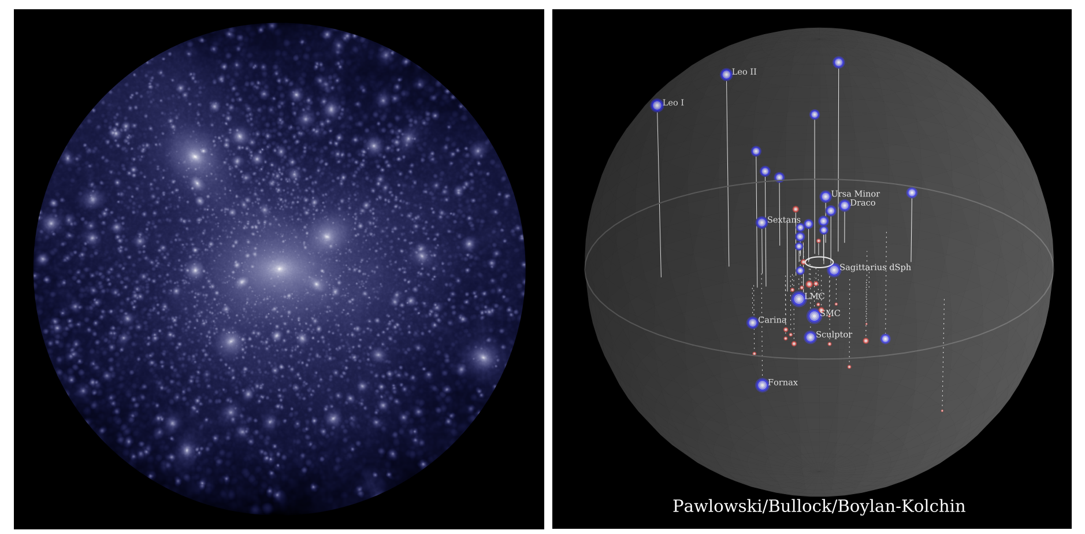


Small-scale challenges to the CDM model
Cusp-core problem
Missing satellites problem
$$ρ∝r^{−1}$$
500 kpc
$$ρ \sim const.$$
N-body simulation
observed satellite galaxies
(Bullock et al. 2017)
(Bullock et al. 2017)
Notes:
In the past three decades, people noticed that there might be some challenges to the CDM model.
For example, the missing satellites problem:
N-body simulations predict much more subhalos than observed satellite galaxies in our Milky Way.
And the cusp-core problem:
N-body simulations predict a cusp density profile at the center of a halo, as shown by the dashed line, but observations prefer a constant density core, shown by the data points.

Slide 3
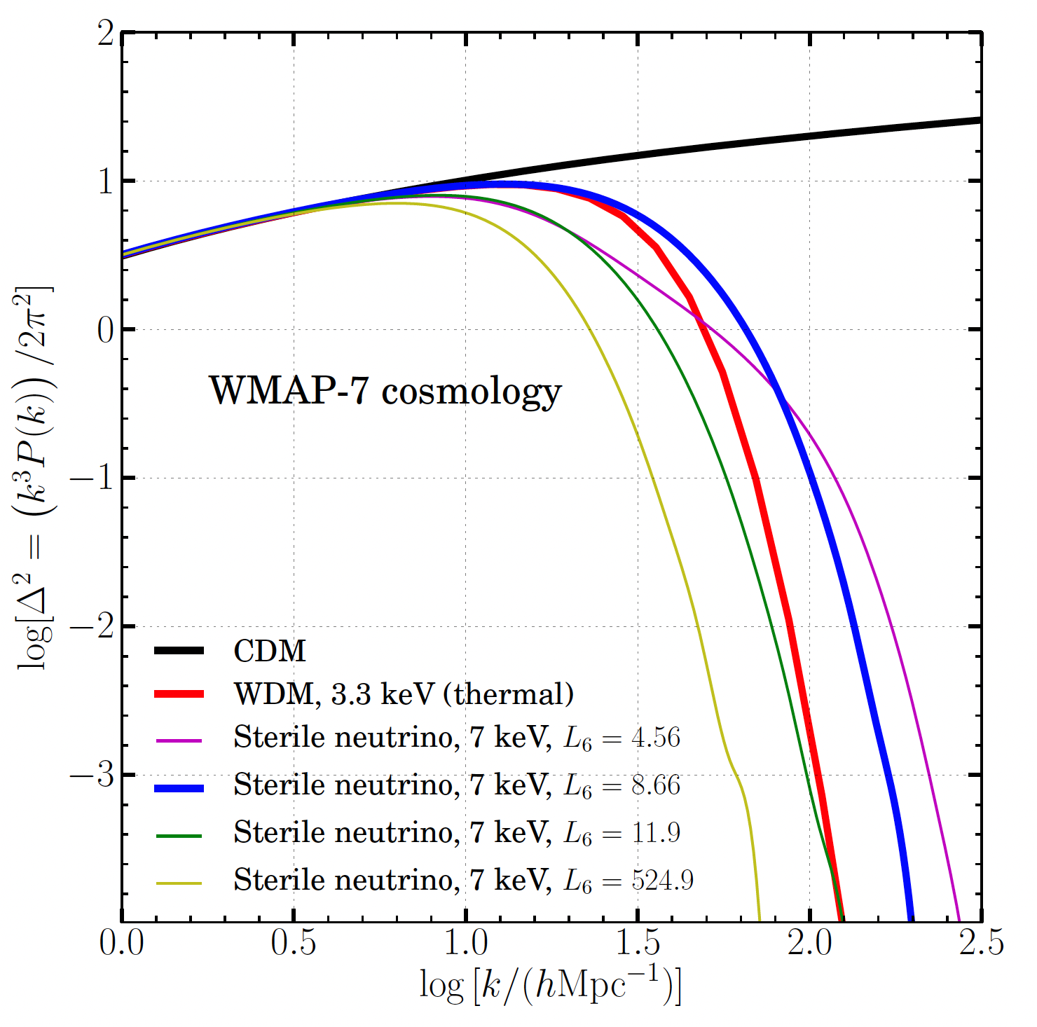
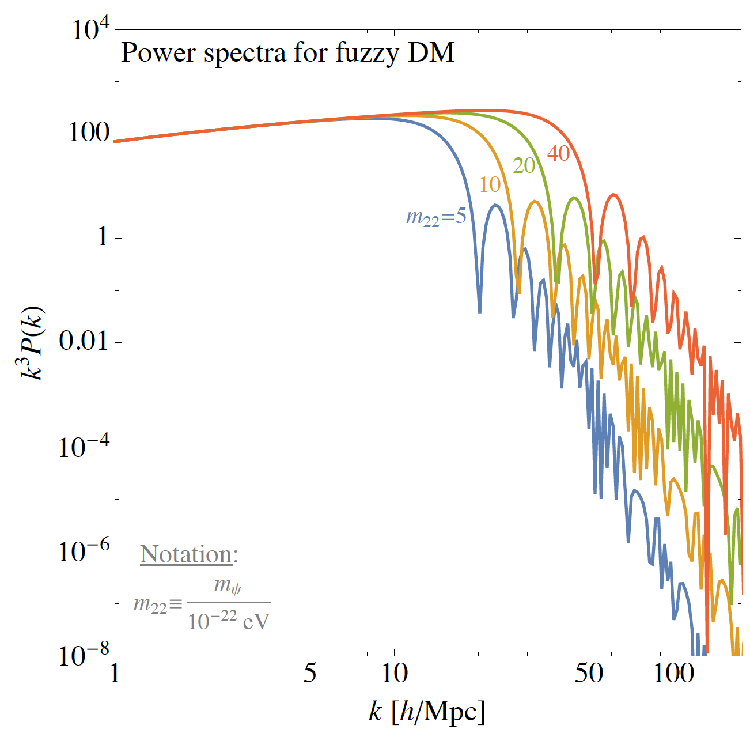
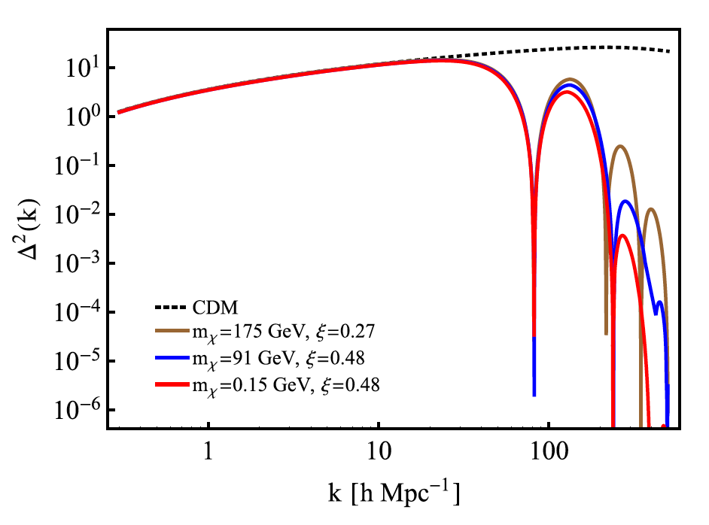
Other DM models: small-scale suppression
Warm Dark Matter
Fuzzy Dark Matter
Self-interacting Dark Matter
(Bose et al. 2016)
(Murgia et al. 2017)
(Hou et al. 2018)
Lyman alpha forest, satellite galaxy population, stellar streams…
Notes:
Therefore many other models have attracted attention, such as WDM, fuzzy dark matter and self-interacting dark matter.
We can see they all have small-scale suppresion on the matter power spectrum. So many observations have focused on small-scale structures, such as Lyman-alpha forest, satellite galaxy population and stellar streams.

Slide 4
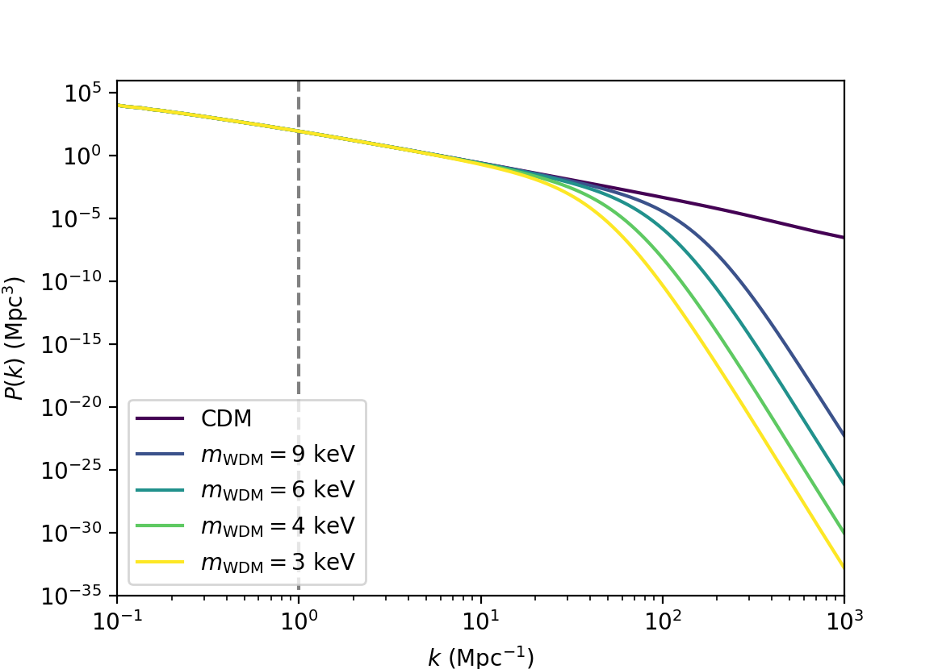
Constrain WDM by large-scale observations
Lyα forest power spectrum
21 cm IM power spectrum
WDM: suppress small-scale structures
k > 1 Mpc⁻¹
matter power spectrum
k ≲ 0.4 Mpc⁻¹
Notes:
In our work, we propose a new method to constrain WDM by large-scale observations. For the WDM models we considered, the suppression on matter power spectrum is significant at k larger than 1. But after considering reionization effects, we found that the lya forest and 21cm power spectrum can differentiate WDM models on large scales, as shown by the different colored lines. How to achieve this?

Slide 5
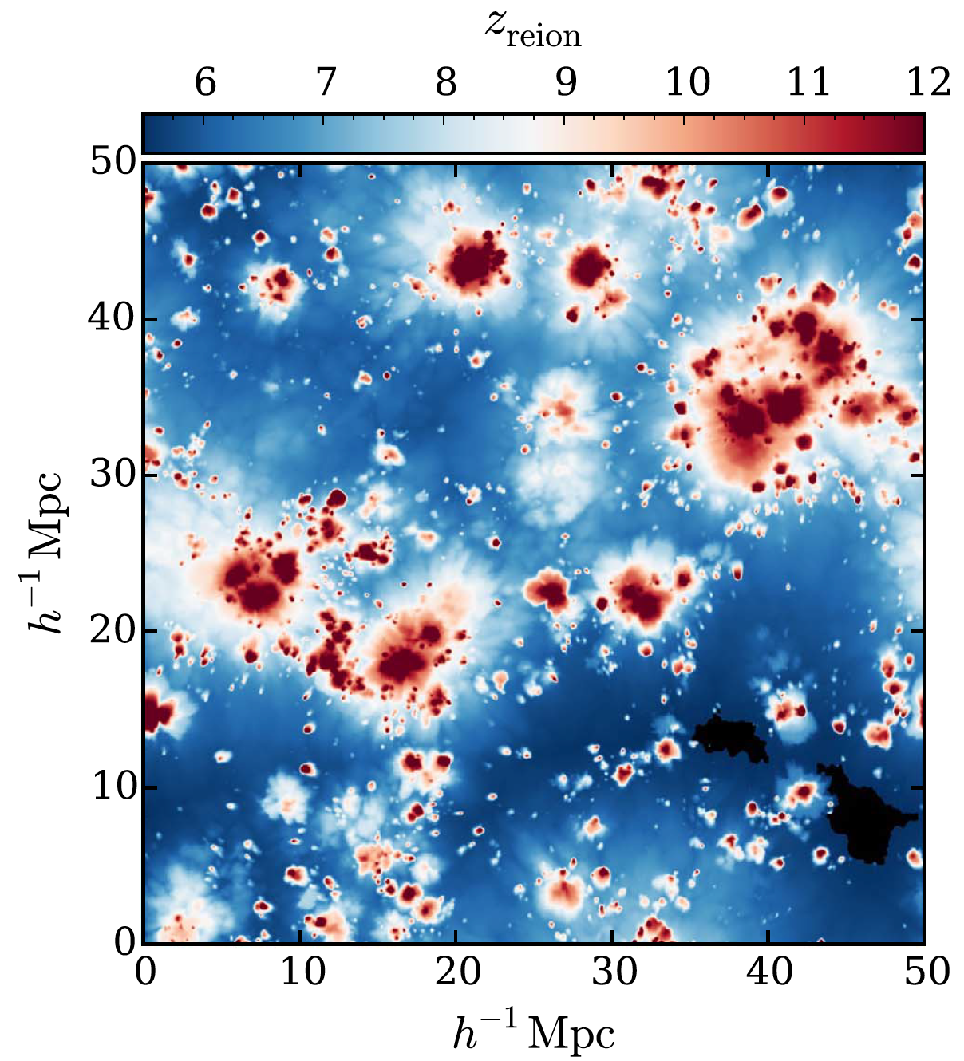
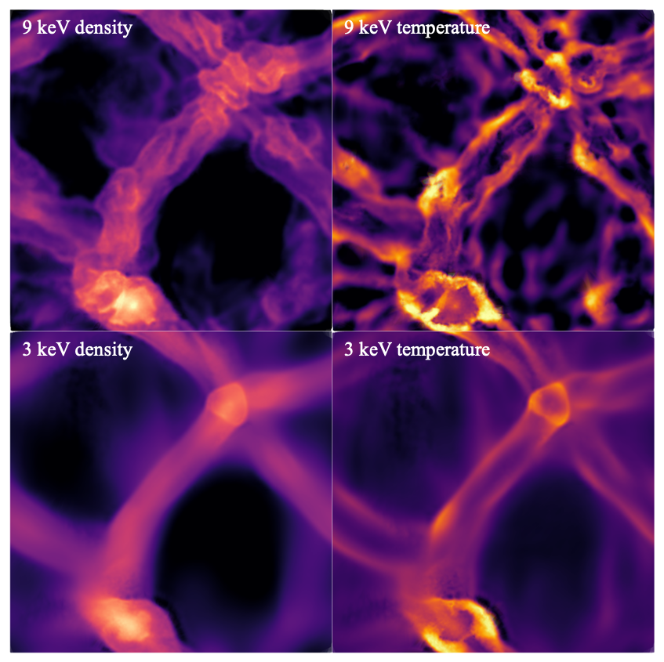
How does the small-scale suppression effect of WDM migrate to large scales?
Reionization relics!
Large scale: reionization is inhomogeneous.
Small scale: post-reionization evolution is sensitive to DM models.
(D’Aloisio et al. 2019)
Notes:
The key is the reionization relics. On large scale, reionization is inhomogeneous, On small scale, post-reionization evolution is sensitive to DM models. Combining these two effects can produce distinguishable large-scale signals.

Slide 6
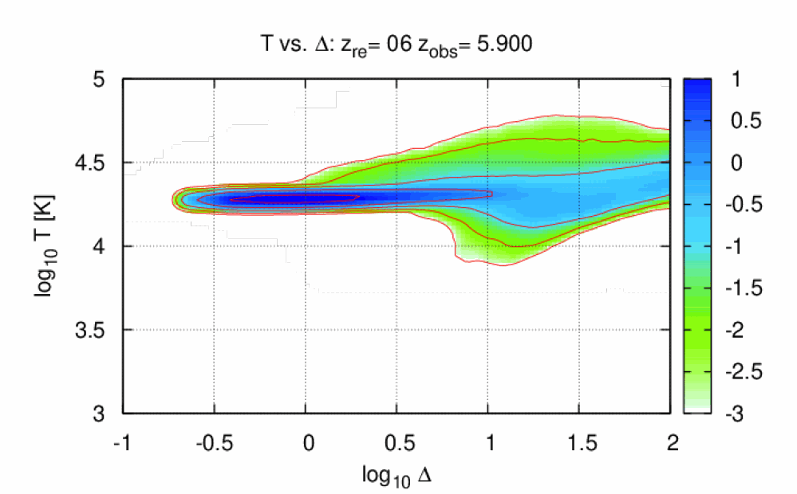
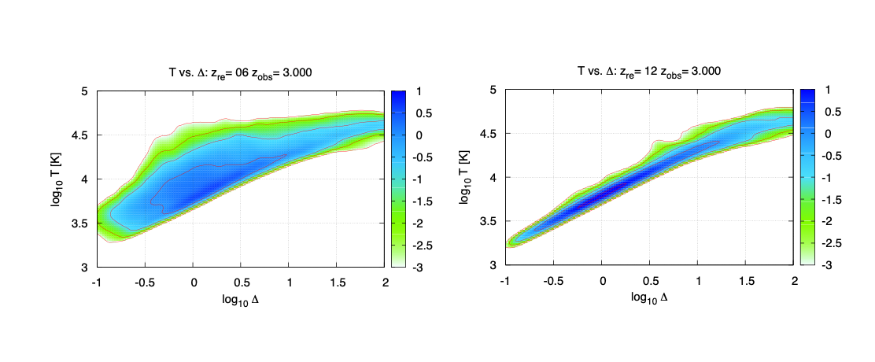
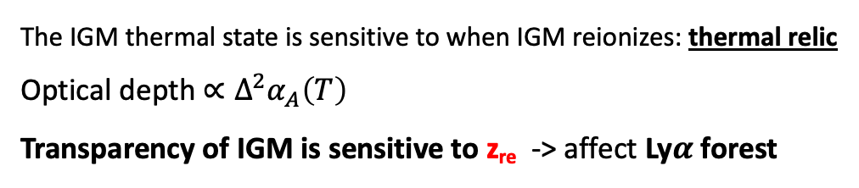
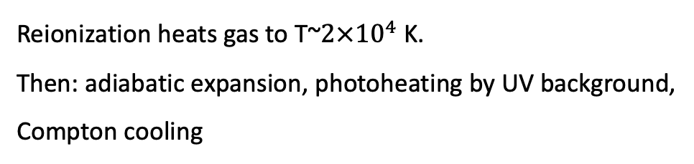
Reionization relic: IGM thermal state
“sensitive” to local z_{re}
Thermal history of IGM
reionize at z=6
reionize at z=12
The IGM thermal state is sensitive to when IGM reionizes: thermal relic
Optical depth $∝Δ^{2}α_{A}\left(T\right)$
Transparency of IGM is sensitive to z_{re} -> affect Ly$α$ forest
Reionization heats gas to T~$2×{10}^{4}$ K.
Then: adiabatic expansion, photoheating by UV background,
Compton cooling
Notes:
What is reionization relic, the first one the IGM thermal state

Slide 7
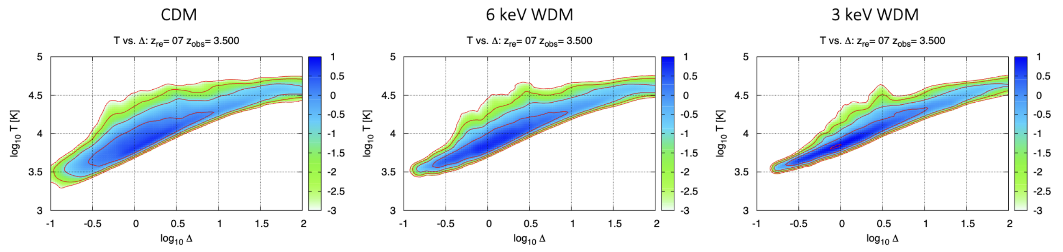
Effects of WDM
Free streaming velocity -> suppress small-scale structures
different thermal history
Different transparency - z_{re} relation:
distinguishable signal in Lyα forest power spectrum
For lighter WDM, density contrast is smaller, thus
dynamical response after reionization is less violent.
Notes:
What are the effects of WDM? Unlike CDM, WDM has non-negligible free streaming velocity, therefore suppress small-scale structures.
This figure shows the gas density and temperature after reionization in 9 keV and 3 keV models. We can see for… This can affect the post-reionization evolution, and thermal history in different DM models, as shown by the different temperature-density relation.
The bottom figure shows how the IGM transparency depends on the reionization redshift. The general trend is decrease, but the colored lines tell us the relations are different among WDM models, which produces distinguishable signal in Lya forest power spectrum.

Slide 8
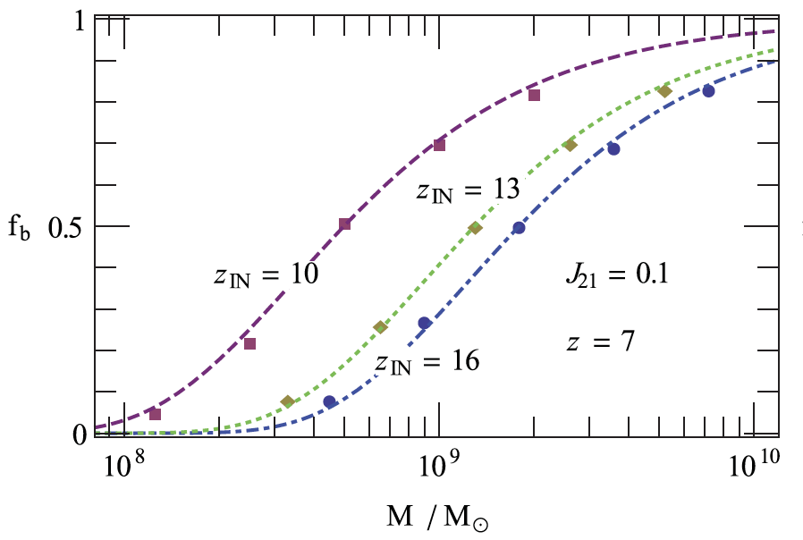
Reionization relic: suppress $f_{b}$ in low-mass halos
Increased pressure suppresses baryon infalling into low-mass halos.
In the post-reionization era, 21 cm signal mainly comes from
HI in halos and galaxies.
Baryon mass in low-mass halos is sensitive to z_{re} ->
affect HI density, and post-reionization 21 cm power spectrum
(Sobacchi & Mesinger, 2013)
Earlier reionization has stronger suppression effect.
In WDM models, there are fewer low-mass halos to be
affected by reionization.
Notes:
The second reionization relic is the suppression of baryon fraction in low-mass halos. After reionization, the increased pressure can suppress baryon infalling into low-mass halos.
In this figure, the different lines indicates different reionization redshifts. We can see that earlier reionization has stronger suppression effect.
In the post-reionization era, 21 cm signal mainly comes from HI in halos and galaxies. The left figure tell us that the Baryon mass in low-mass halos is sensitive to z_re, Therefore the HI density is sensitive, too, as shown in the right figure. This will affect 21 cm power spectrum. We can see that the HI density dependency on z_re is the strongest for CDM and the weakest for the lightest WDM, because in WDM models there are fewer low-mass halos to be affected by reionization.

Slide 9
Combine with inhomogeneity
Fluctuations of transparency and HI density on ionized bubble scales
large-scale signals in the power spectrum
(D’Aloisio et al. 2019)
Different positions reionize at different redshifts.
Notes:
Above discussion only focus on local reionization on small scales. On large scales, reionization is inhomogeneous. Different positions reionize at different redshifts. And combine with the reionization relics, we can infer that the regions that reionize earlier have lower transparency and HI density, and the inverse applies to late reionizaed regions. This leads to fluctuations of transparency and HI density on ionized bubble scales, therefore producing large-scale signals in the power spectrum.

Slide 10
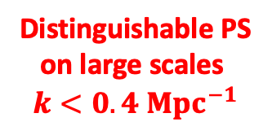
Power spectrum
Ly$α$ forest power spectrum
21 cm power spectrum
Distinguishable PS
on large scales
$$k<0.4 {Mpc}^{−1}$$
Notes:
This slide shows our main result. The left column is lya forest power spectrum, and the right column is the 21cm power spectrum. The colored lines are power spectrum after considering reionization relics in different DM models. The power spectrum can differentiate DM models on large scales, k<0.4. And the fractional difference between WDM and CDM PS can reach about 20%, for the lightest model we consider, 3keV.

Slide 11
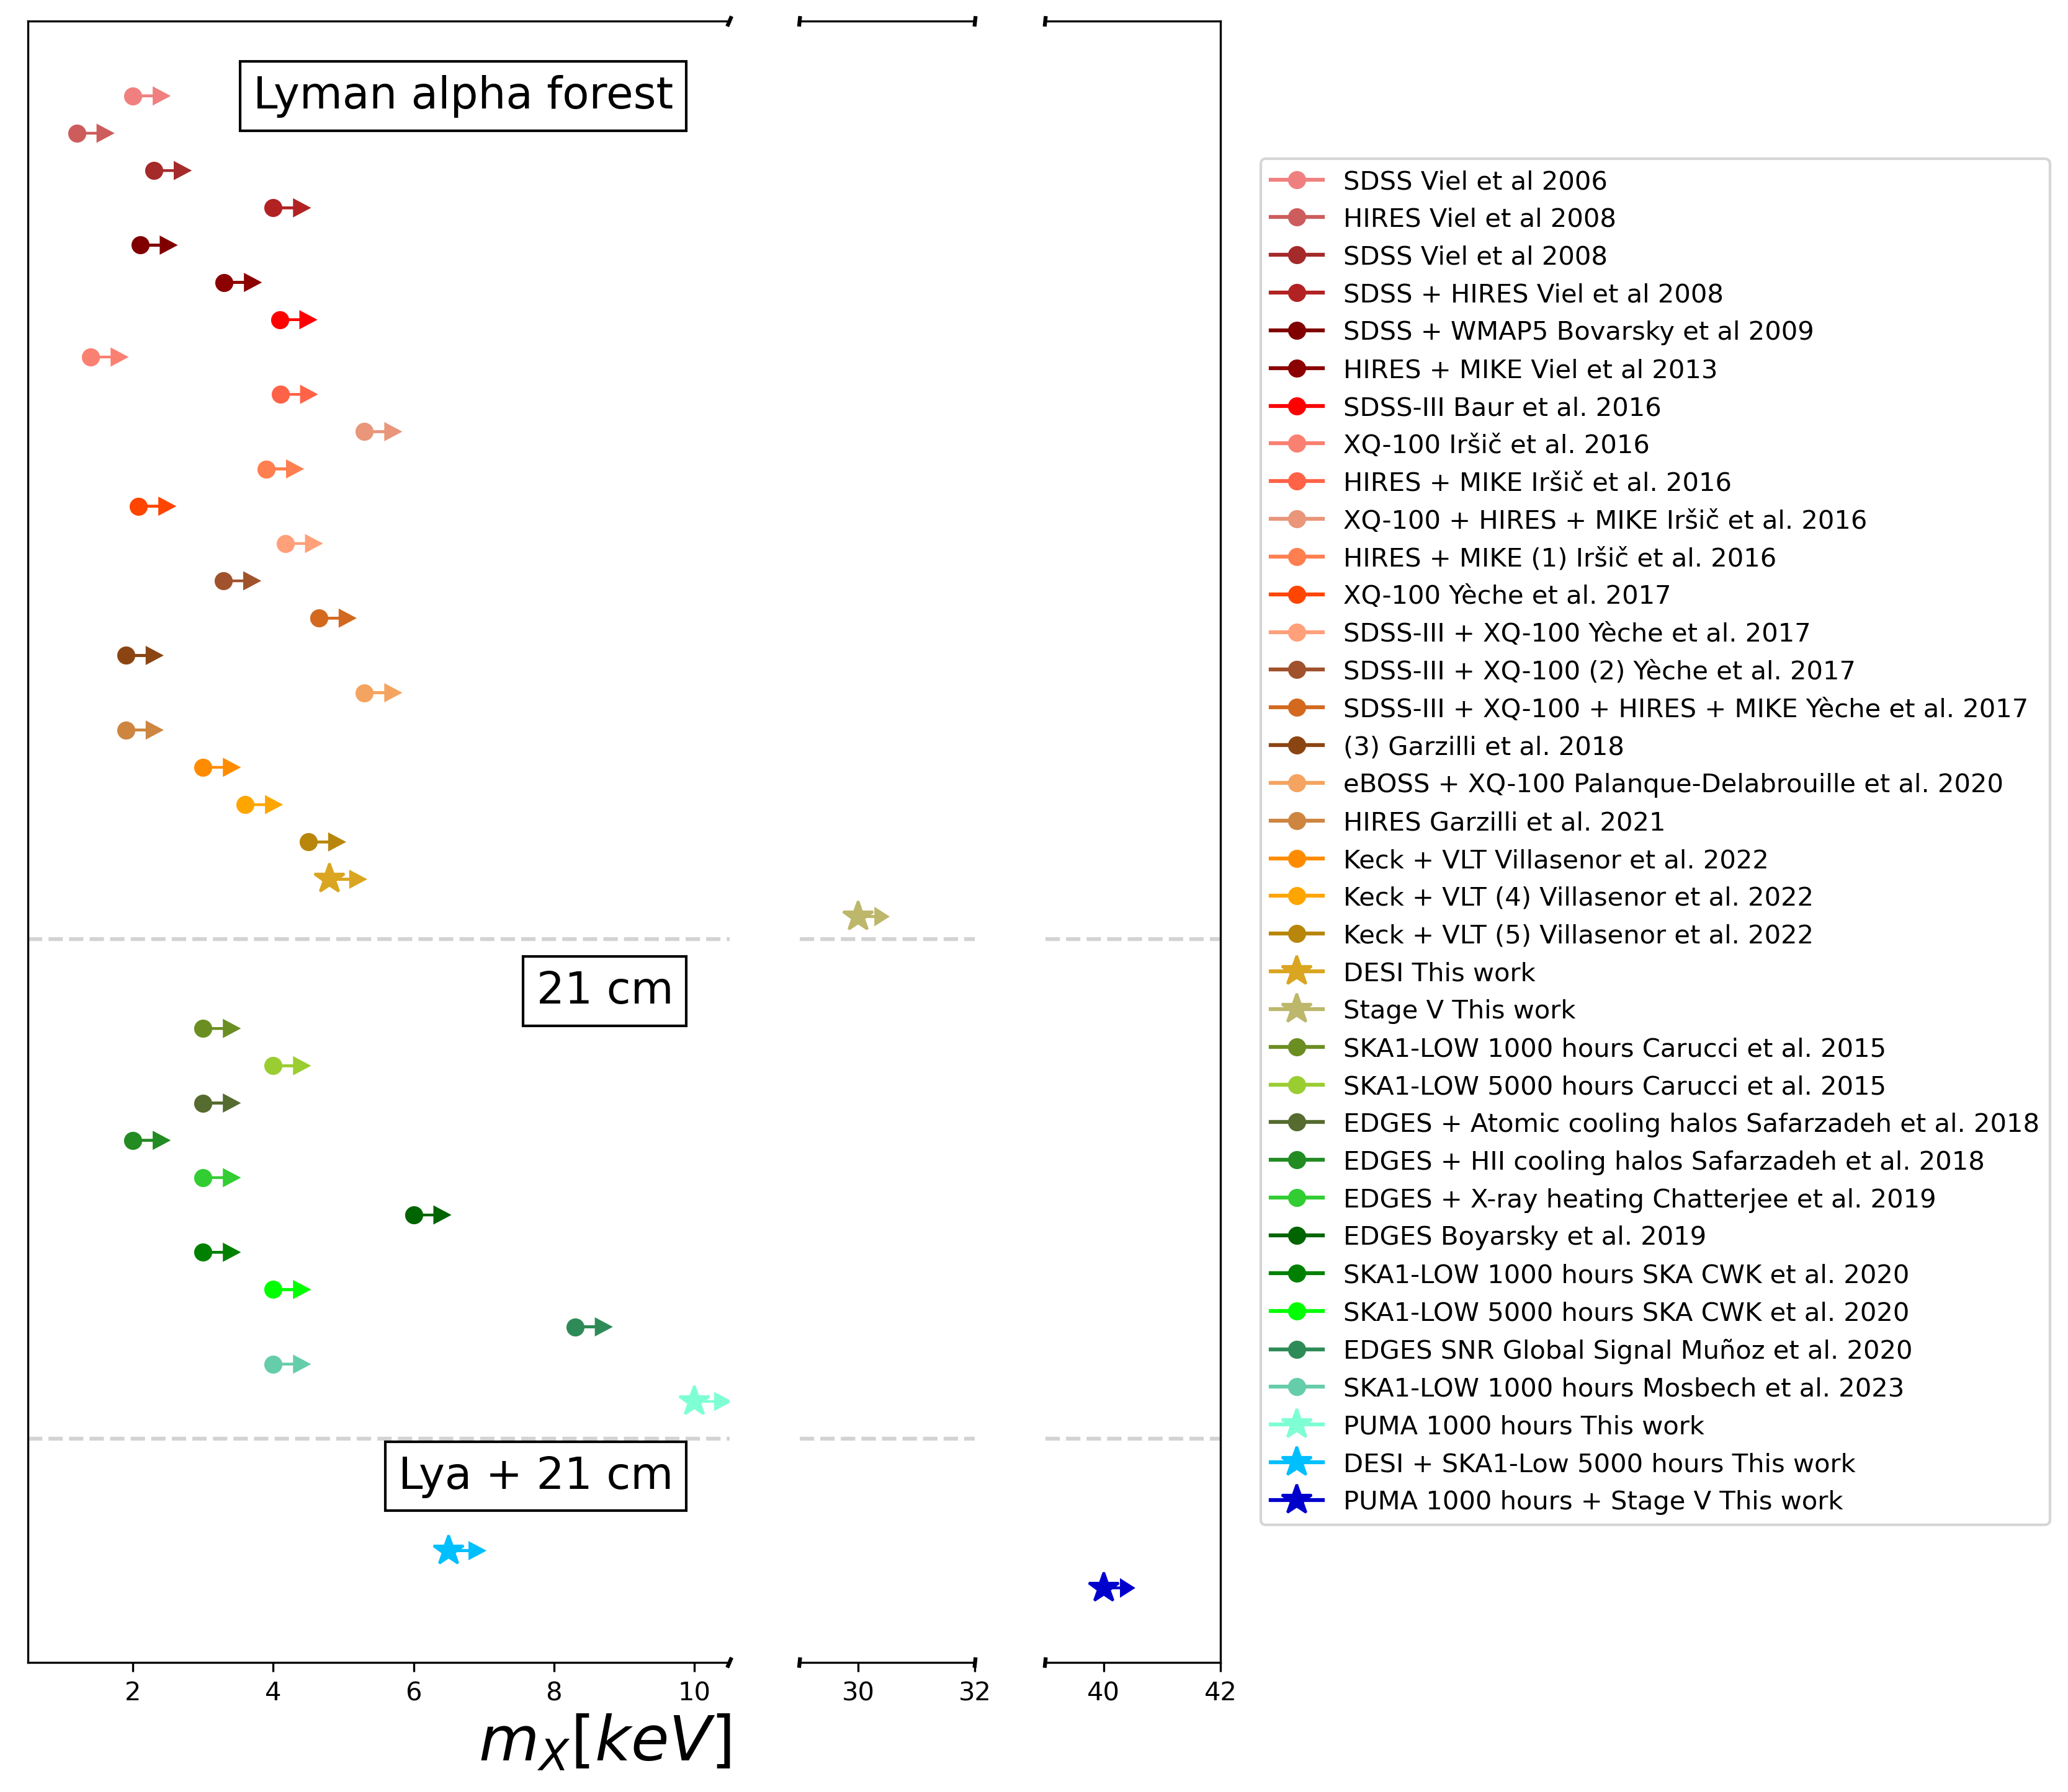
Forecast: constraint on m_{WDM}
DESI Lyα survey m_{WDM} > 4.8 keV
DESI Lyα survey + SKA1-LOW 21 cm IM m_{WDM} > 6.5 keV
PUMA 21 cm IM m_{WDM} > 10 keV
Stage V (e.g. MUST) Lyα surveys m_{WDM} > 30 keV
PUMA 21 cm IM + Stage V Lyα surveys m_{WDM} > 40 keV
(95% credible intervals)
Notes:
Then we try to forecast the ability of current and future surveys to constrain WDM mass by our method. Here are the mcmc results. The right figure summarize many previous constraints and forecasts. The purple contours show the constraint by DESI lya survey. We obtain a lower limit of 4.8 keV. The blue contours show how the ska1-low 21cm measurements can improve DESI’s constraint to 6.5 keV. The grey contours is the puma’s constraint, which gives 10 keV. PUMA is the next generation survey for 21 cm intensity mapping in the post-reionization era. We also consider Stage V spectroscopic survey, we assume the survey area is twice that of DESI and the noise is one-third that of DESI. This gives 30 keV, which is an extremly tight constraint. Combination of PUMA and Stage V can even improve the constraint to 40 keV.

Slide 12
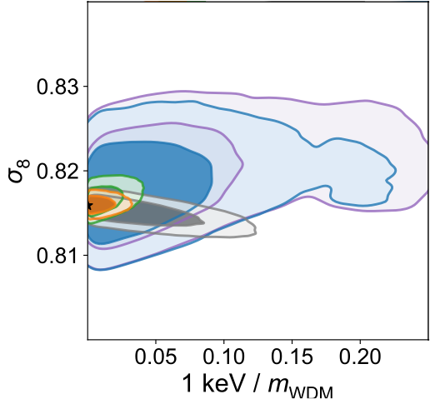
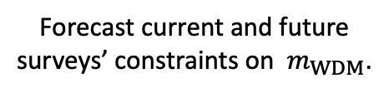
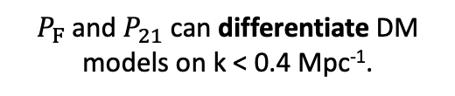
Summary
zhangyao22@mails.tsinghua.edu.cn
On small scales, IGM post-reionization evolution is sensitive to DM models.
$P_{F}$ and $P_{21}$ can differentiate DM models on k < 0.4 Mpc⁻¹.
Forecast current and future surveys’ constraints on ${ m}_{WDM}$.
Not limited to WDM, can be applied to other DM models with small-scale suppression.
Notes:
To summarize, we found…

Slide 13
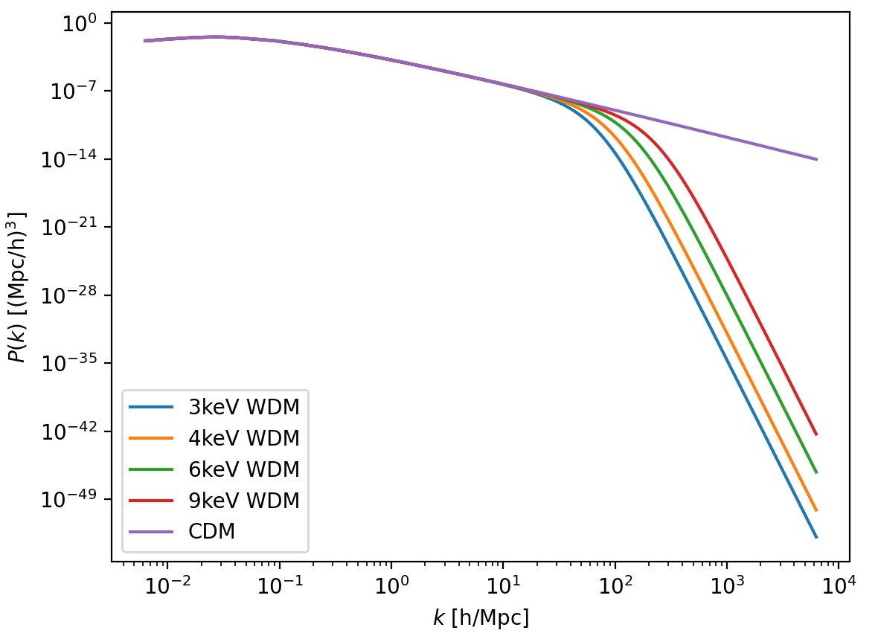
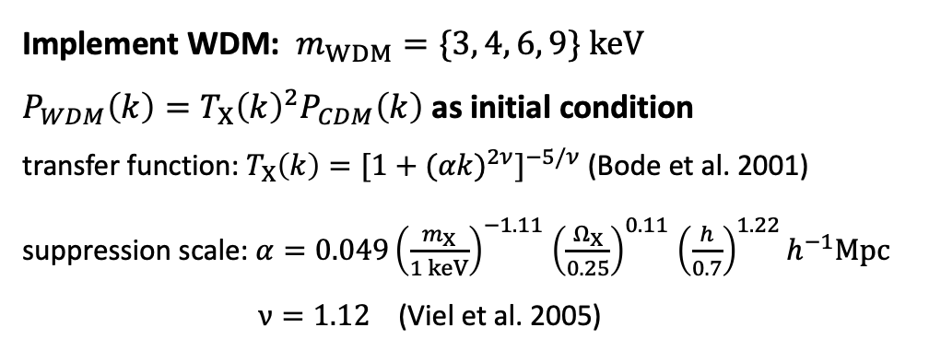
Small-scale simulations
$$P_{m,X}\left(k,z_{obs}\right)=−\int_{z_{min}}^{z_{max}}{\frac{∂X}{∂z}(z,}z_{obs})P_{m,x_{HI}}\left(k,z\right)\frac{D_{g}(z_{obs})}{D_{g}(z)}dz$$
matter power spectrum
Small scale: high-resolution hydrodynamical simulation
Modified Gadget-2 box size: 1275 kpc
Particle mass: 9.72$×$10³ $M_{⊙}$ (DM), 1.81$×$10³ $M_{⊙}$ (gas)
redshift of reionization: z_{re} = 6, 7, 8, 9, 10, 11, 12
calculate $ψ\left(z_{re}\right)$ and $Ξ\left(z_{re}\right)$
Implement WDM: $m_{WDM}=\{3, 4, 6, 9\} keV$
$P_{WDM}\left(k\right)={T_{X}\left(k\right)}^{2}P_{CDM}\left(k\right)$ as initial condition
transfer function: $T_{X}\left(k\right)=[{1+{(αk)}^{2ν}]}^{−5/ν}$ (Bode et al. 2001)
suppression scale: $α=0.049{\left(\frac{m_{X}}{1 keV}\right)}^{−1.11}$ ${\left(\frac{Ω_{X}}{0.25}\right)}^{0.11}$ ${\left(\frac{h}{0.7}\right)}^{1.22}h^{−1}Mpc$
$ν=1.12$ (Viel et al. 2005)
Warm dark matter
suppression of small-scale structure
$$k>1 {Mpc}^{−1}$$

Slide 14
Large-scale simulations
Implement WDM:
transfer function + effective Jeans mass
a new minimum mass that enters the
mean collapse fraction
$$M_{J}≈1.5×{10}^{10}{\left(\frac{Ω_{X}h^{2}}{0.15}\right)}^{\frac{1}{2}}{\left(\frac{m_{X}}{1 keV}\right)}^{−4}M_{⊙}$$
(Sitwell et al. 2014)
$$P_{m,X}\left(k,z_{obs}\right)=−\int_{z_{min}}^{z_{max}}{\frac{∂X}{∂z}(z,}z_{obs})P_{m,x_{HI}}\left(k,z\right)\frac{D_{g}(z_{obs})}{D_{g}(z)}dz$$
Large scale: semi-analytic simulation
21CMFAST box size: 400 Mpc
256³ HI cells and 768³ matter density cells
calculate $P_{m,x_{HI}}(z_{re},k)$
k = 0.12 Mpc⁻¹

Slide 15


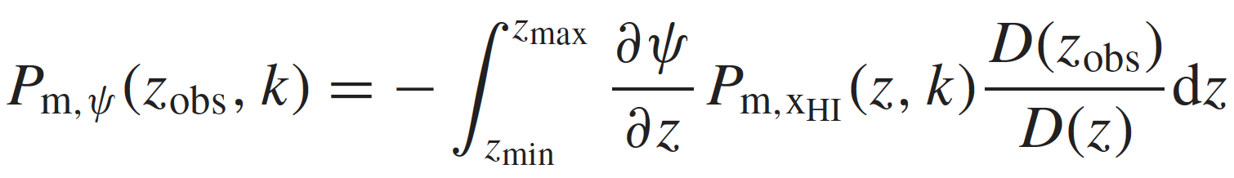
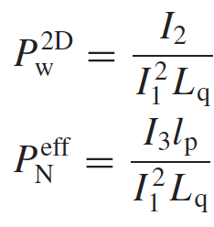
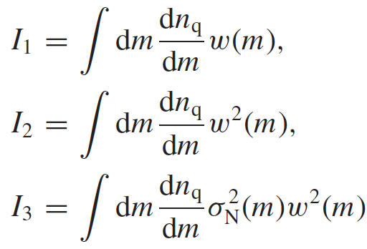
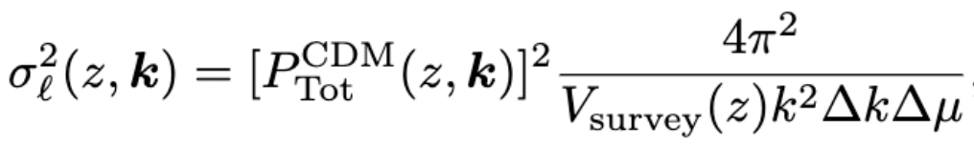
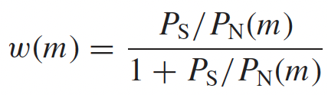
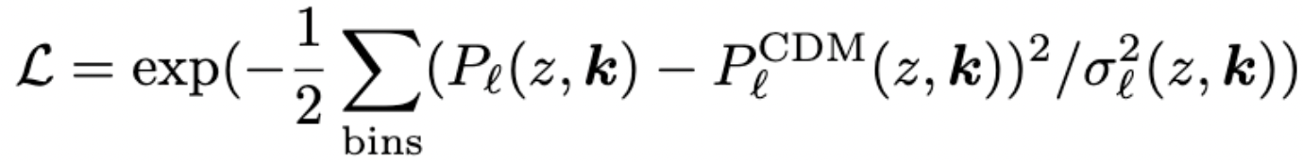
Ly$α$ forest power spectrum
Ly$α$ transmission:
optical depth: $τ=τ_{1} Δ^{2}α_{A}\left(T\right)$ $τ_{eff}=0.0023{(1+z)}^{3.65}$
$ψ\left(z_{re}\right)=ln[τ_{1}\left(z_{re}\right)]$- $ln[τ_{1}\left({\overline{z}}_{re}\right)$]

Slide 16

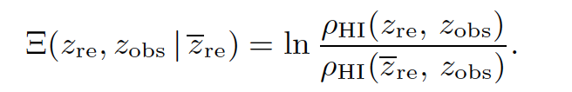

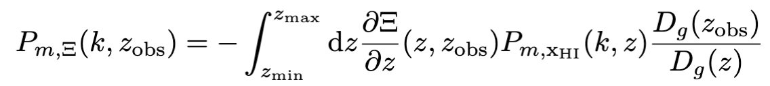
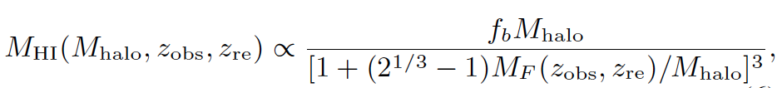
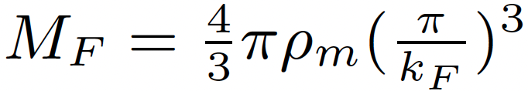
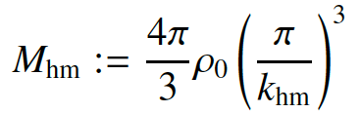
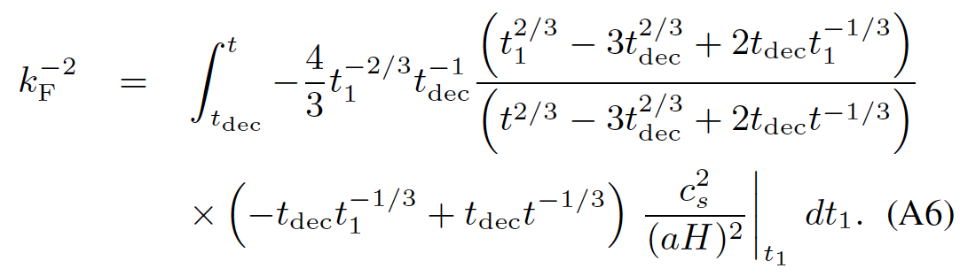
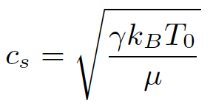
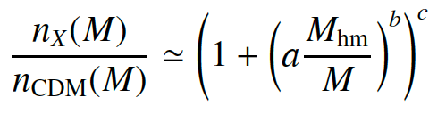
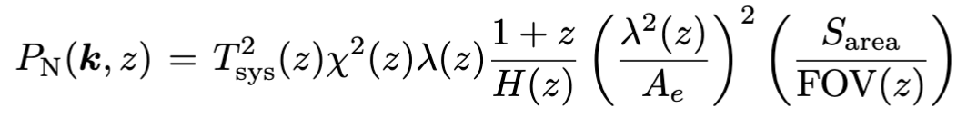
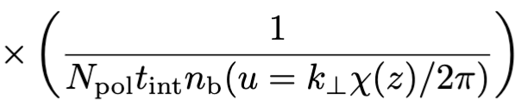
21 cm power spectrum
HI density fluctuation:

Slide 17
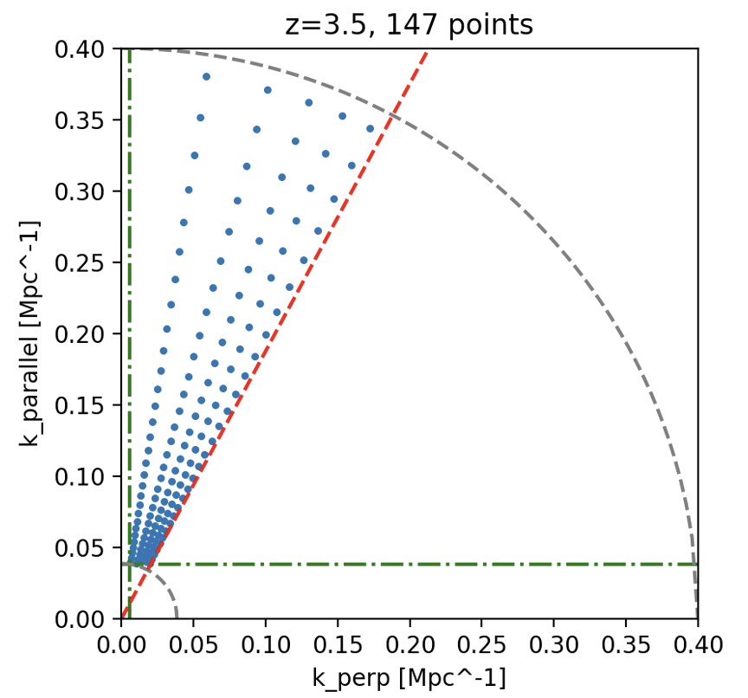



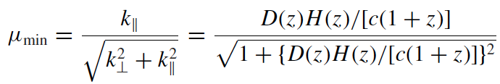
Telescope | SKA1-LOW | PUMA
Redshift range | 3.5<z<5.5
Observing time ($t_{int}$) | 5000 h | 1000 h
Sky coverage ($f_{sky}$) | One pointing (FOV) | 0.5
Dish/Station diameter ($D_{phys}$) | 40 m | 6 m
Maximum baseline ($b_{max}$) | ~ 1 km | ~ 1.5 km
Number of receivers ($N_{b}$) | 224 stations | ~ 32000
$$Δz$$ | 0.3 | 0.2
wedge | No | Yes
30 k bins in log space from $k_{min}$ to $k_{max}$=0.4 Mpc⁻¹
wedge:

