Slide 1
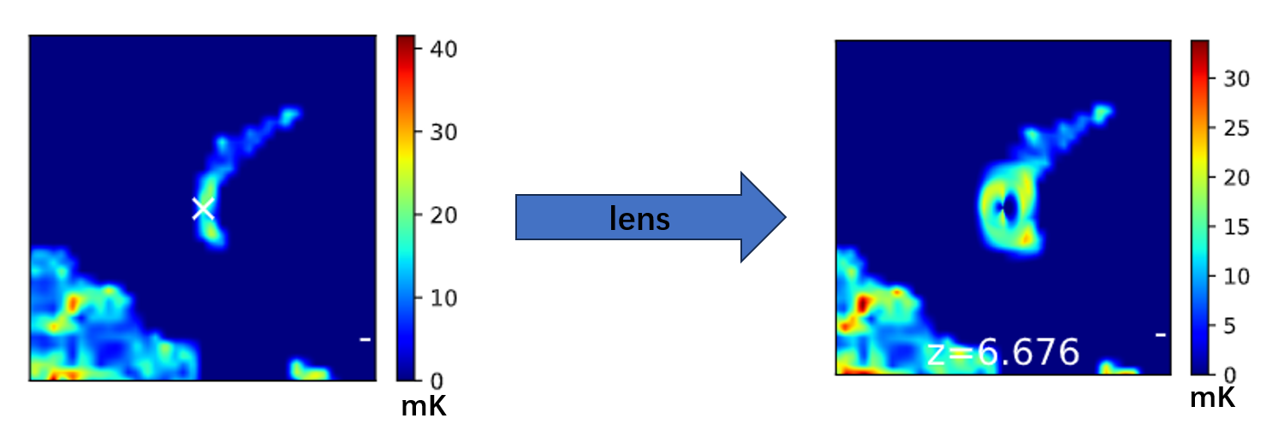
Strong Gravitational lensing effects on ionized structures
during the Epoch of Reionization
Di Wu
Ph.D student
wudi@bao.ac.cn
National Astronomical Observatories, CAS
Generated by 21cmFASTv3

Slide 2
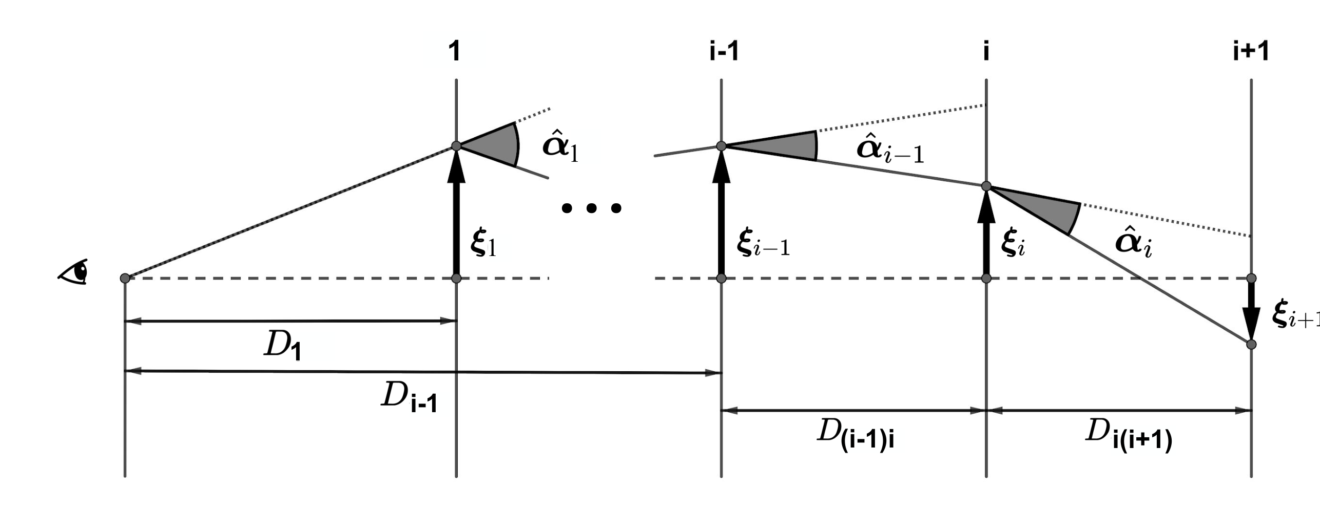
Massive objects curve the trajectory of light
The flux of background source could be magnified by gravitational lensing.
Schematic demonstration of gravitational lensing
(adopted from NASA, ESA & L. Calcada)

Slide 3
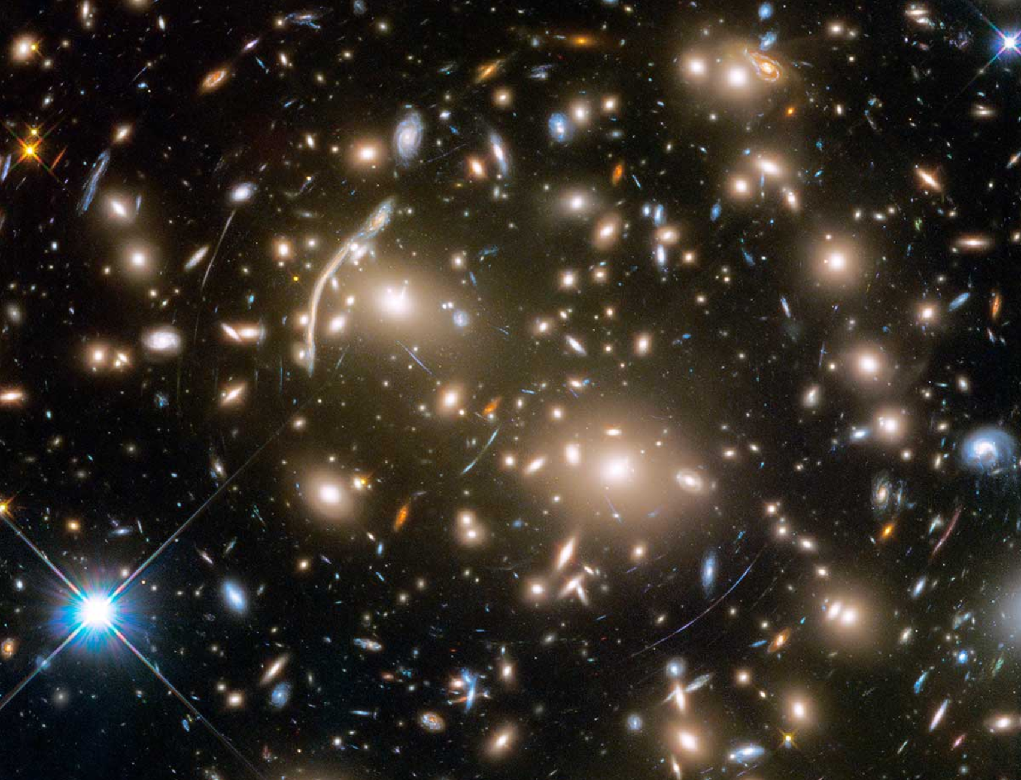
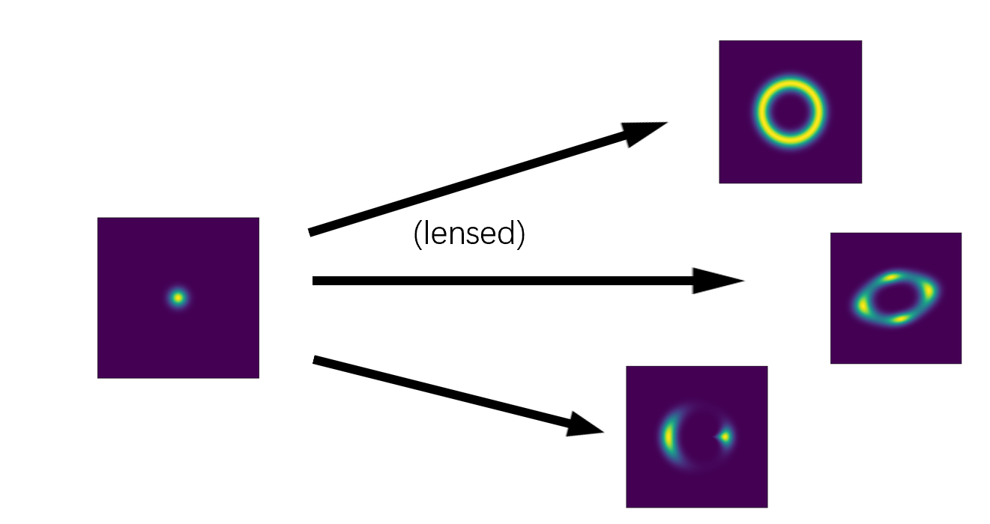
Strong gravitational lensing distorts the background image
Abell 370
(NASA, ESA, and J. Lotz and the HFF Team)

Slide 4
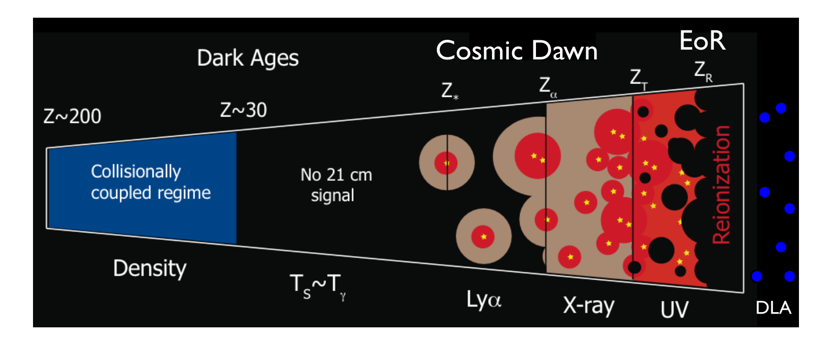
Lensing of structures in 21 cm cosmology during EoR?
lens
(Adopted from Jonathan R. Pritchard and Abraham Loeb 2012)
Future 21cm tomographic imaging is important
?
1. How does the strong lensing distort the image in future observations?
2. Lensing probability?
3. futher more, will lensing change the observed properties of EoR?

Slide 5
Tentative numerical experimentation trying to explore the lensing effect
Basic idea:
Simulate the foreground lens and background cosmic 21cm signal
Ray-tracing lensing simulation to explore the lensing effect

Slide 6
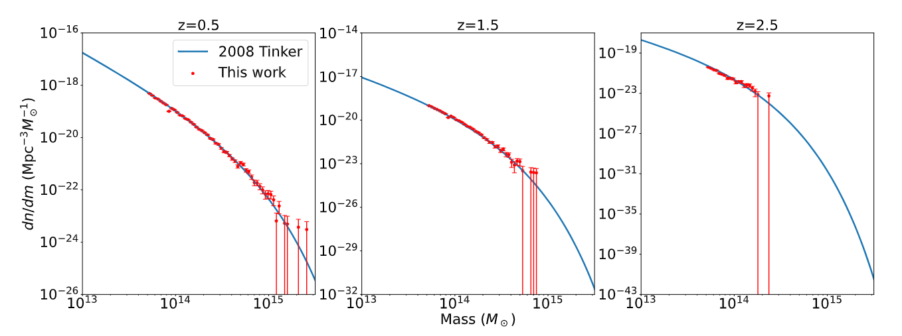
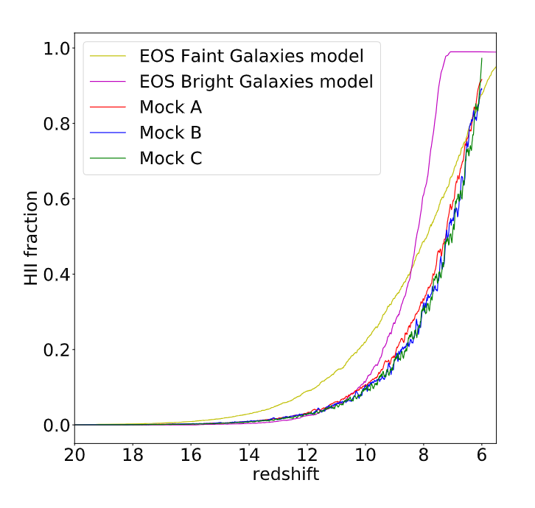
Foreground lens light cone and Background ionization simulation
Generating the Dark matter(DM) halo catalog based on N-body simulation (Tinker et al. 2008).
1. Six simulation parameters for each DM halo (mass, redshift, Ra, Dec, ellipticity, projected major axis orientation).
2. A mass profile fitted from N-body simulation is adopted (truncate NFW).
We adopted 5 ionization mocks as background signal
(1). 2 out of 5 are come from the EOS project.
(Andrei Mesinger et al. (2016))
(2). 3 out of 5 are generated by 21cmFAST.
(Andrei Mesinger et al. (2011), Murray et al., (2020))

Slide 7
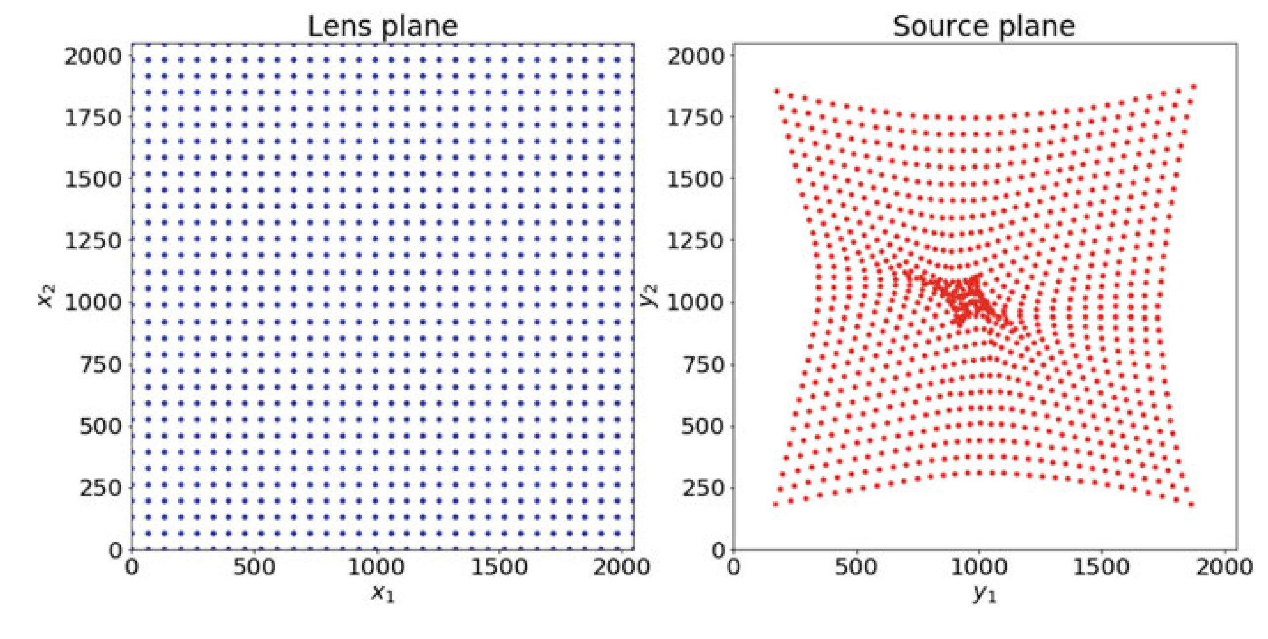
Ray-tracing lensing simulation
Background
signal
Foreground
lens
Lens simulation
Two series of ray-tracing lensing simulation
1. ray-tracing simulation inside the 21 cm temperature light cone
(one by one for each deflector, calculate the flux magnification)
2. ray-tracing simulation inside the ionization fraction light cone
(to obtain the lensing effect on the ionized bubble)
results
Adopted from Meneghetti et al. (2021)

Slide 8
Results- lensing probability
Black scatter dots with red error bar: lensing probability evolution
Blue line: HII fraction evolution
Lensing probability (flux magnification>2) and HII fraction as a function of redshift

Slide 9
Results- lensing probability
The bimodality of lensing probability in 3 out of 5 mocks
The first peak: Lensed ionizing sources
The second peak: Lensed HI island

Slide 10
Results- simulation resolution
Green line: high-resolution mock
blue line: medium-resolution mock
red line: low-resolution mock
1. The ionization simulation resolution is deficient to resolve all the ionizing sources in the simulation.
2. The amplitude of lensing probability increases as simulation resolution increases when the density of the ionizing source is larger than a certain extent.

Slide 11
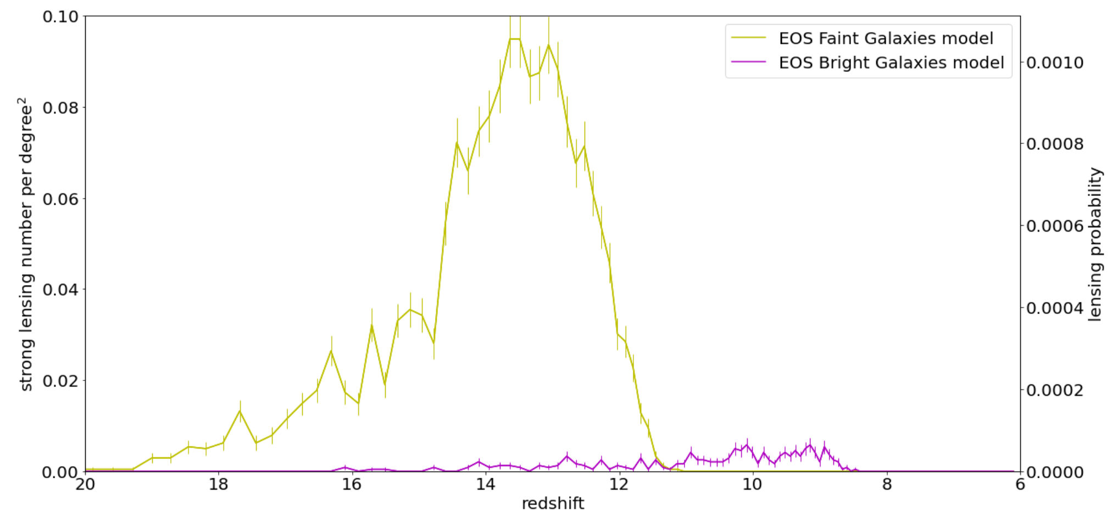
Results- ionization parameter settings
Compared to Bright galaxies dominated ionization model, Faint galaxies dominated model tends to have higher lensing probability and earlier lensing event.

Slide 12
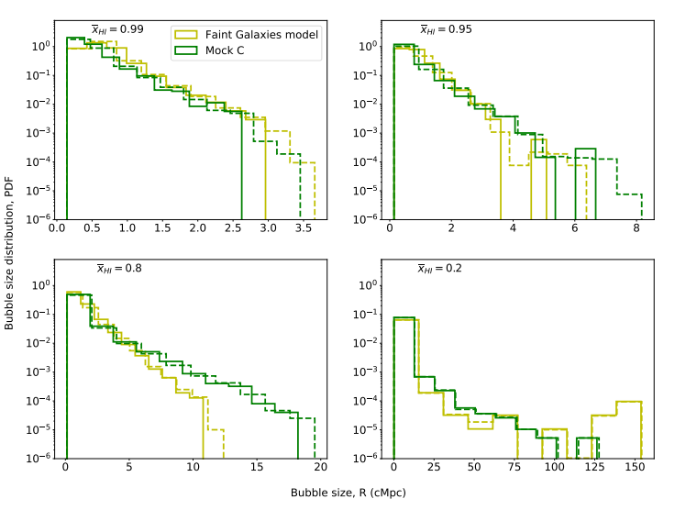
Results – distortion of ionized Bubble Size Distribution(BSD)
Bubble size distribution based on the Mean-Free-Path algorithm(left) and Friends-of-Friends algorithm(rigtht)
The large end of BSD in the early EoR has an increase of up to ~35% because of the presence of strong lensing. (Faint Galaxies model when average HI fraction= 0.99)

Slide 13
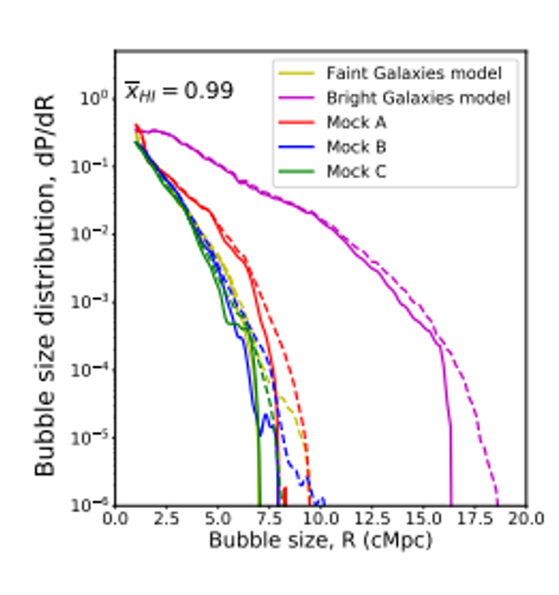
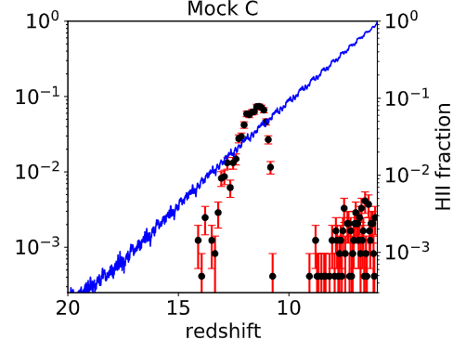
summary
We conduct a series of numerical simulations to explore the lensing effect on the structures during EoR in future 21 cm tomographic imaging observations. The simulation results indicate that:
1. Lensing probability possibly exhibits Bimodility during EoR.
2. Lensing causes significant distortion of BSD at its large end in the early stage of EoR.
Thanks for your attention!

Slide 14
Results – distortion of ionized Bubble Size Distribution
Bubble size distribution based on the Mean-Free-Path algorithm for all five mocks

Slide 15
Discussion-flux calculation range

Slide 16
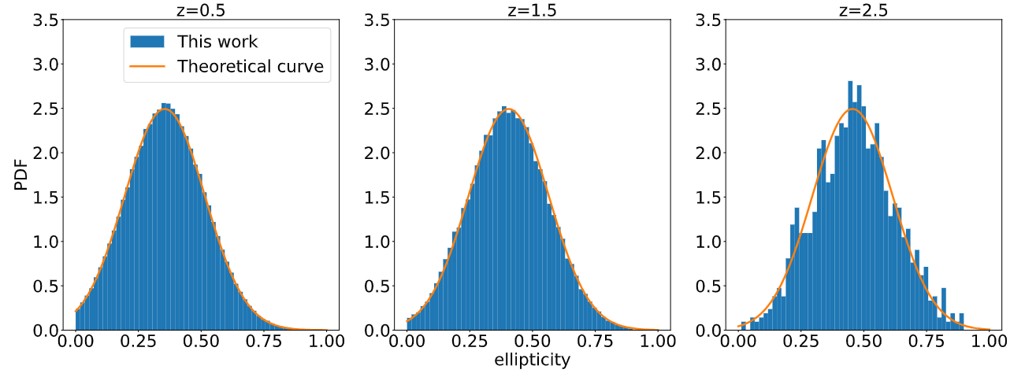
Foreground lens light cone
Generating the Dark matter(DM) halo catalog based on N-body simulation (Tinker et al. 2008).
1. Six simulation parameters for each DM halo (mass, redshift, Ra, Dec, ellipticity, projected major axis orientation).
2. A mass profile fitted from N-body simulation is adopted (truncate NFW).

Slide 17
Background ionization simulation
We adopted 5 ionization mocks as background signal
(2 types of light cone: 21 cm differential temperature, HII fraction)
(1). 2 out of 5 are come from the EOS project.
(Andrei Mesinger et al. (2016))
(2). 3 out of 5 are generated by 21cmFAST.
(Andrei Mesinger et al. (2011), Murray et al., (2020))

Slide 20
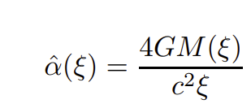
强透镜对宇宙黎明与再电离时期21cm信号的影响-背景
引力透镜
光线在引力作用下发生汇聚，原有的图像会被放大

