Slide 1
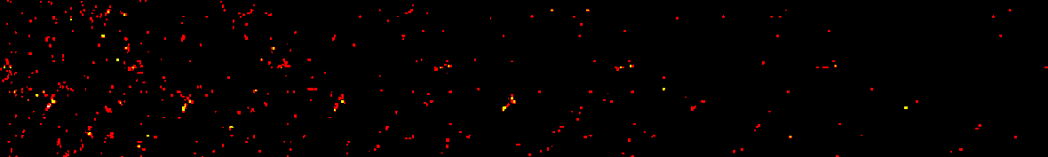
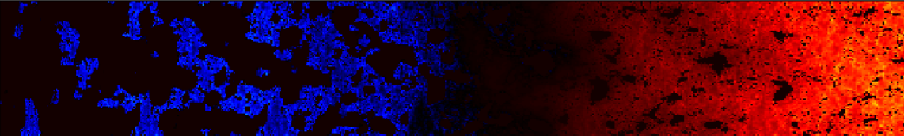

Cross-Correlating Galaxies with the Cosmic 21-cm Signal
Samuel Gagnon-Hartman
Supervisor: Andrei Mesinger

Slide 2
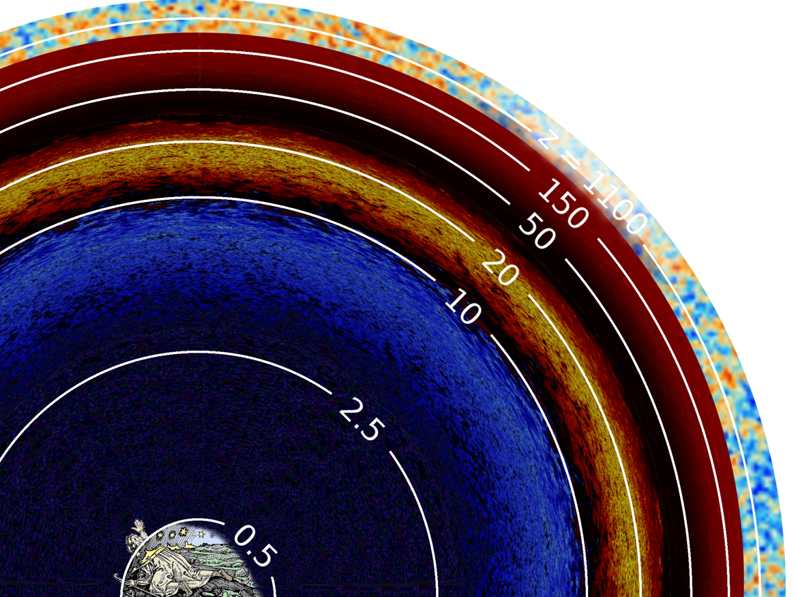
The Cosmic 21-cm Signal is Cool!
- The majority of our lightcone remains unprobed
- We can only access this information through LIM
- Allows us to answer questions about dark matter, inflation, the Hubble tension, etc…
Image Credit: Cynthia Chiang

Slide 3
The Cosmic 21-cm Signal is Hard to Detect ☹
The interferometer itself
- You’ve seen a couple of other talks by now
-It ain’t easy
RFI
Probably dragons????
Galactic Foregrounds
The ionosphere
Image Credit: Cynthia Chiang

Slide 4
A Way Forward: Cross Correlation
Spatially correlating two signals:
Uncorrelated systematics
Correlation can verify constituent signal
Spatial correlation yields additional information for inference
Galaxy Field
21-cm Brightness Temperature Field

Slide 5
A Way Forward: Cross Correlation
Spatially correlating two signals:
Uncorrelated systematics
Correlation can verify constituent signal
Spatial correlation yields additional information for inference
Galaxy Field
21-cm Brightness Temperature Field

Slide 6
This Work
We forward model mock observations of the 21-cm signal and its accompanying galaxy field and estimate the significance of a detection in cross-correlation
- Model for the 21-cm signal
- Model for galaxies
- Model for instruments (telescope + interferometer)
Galaxy Field
21-cm Brightness Temperature Field

Slide 7
This Work
We forward model mock observations of the 21-cm signal and its accompanying galaxy field and estimate the significance of a detection in cross-correlation
- Model for the 21-cm signal
- Model for galaxies
- Model for instruments (telescope + interferometer)
Final Producible:
Estimated S/N in the cross-power spectrum for a mock
galaxy survey
Galaxy Field
21-cm Brightness Temperature Field

Slide 8
Forward Modeling the Cross-Spectrum
Cosmology + Astrophysics
21-cm Field
Galaxy Field

Slide 9


Forward Modeling the Cross-Spectrum
Cosmology + Astrophysics
21-cm Field
Galaxy Field

Slide 10

Forward Modeling the Cross-Spectrum
Cosmology + Astrophysics
21-cm Field
Galaxy Field
Observed Galaxy Field
Telescope Observing Strategy + Sensitivity

Slide 11


Forward Modeling the Cross-Spectrum
Interferometric Noise + Other Systematics
Cosmology + Astrophysics
21-cm Field
Observed 21-cm Field
Galaxy Field
Observed Galaxy Field
Telescope Observing Strategy + Sensitivity

Slide 12
Forward Modeling the Cross-Spectrum
Interferometric Noise + Other Systematics
Cosmology + Astrophysics
21-cm Field
Observed 21-cm Field
Cross-Power Spectrum
Galaxy Field
Observed Galaxy Field
Telescope Observing Strategy + Sensitivity

Slide 13
Forward Modeling the Cross-Spectrum
Interferometric Noise + Other Systematics
Cosmology + Astrophysics
21-cm Field
Observed 21-cm Field
Cross-Power Spectrum
Cross Spectrum Uncertainty
Galaxy Field
Observed Galaxy Field
Telescope Observing Strategy + Sensitivity

Slide 14
Forward Modeling the Cross-Spectrum
Interferometric Noise + Other Systematics
Cosmology + Astrophysics
21-cm Field
Observed 21-cm Field
Cross-Power Spectrum
Cross Spectrum Uncertainty
Galaxy Field
Observed Galaxy Field
S/N of Cross-Spectrum
Telescope Observing Strategy + Sensitivity

Slide 15
Forward Modeling the Cross-Spectrum
Interferometric Noise + Other Systematics
Cosmology + Astrophysics
21-cm Field
Observed 21-cm Field
Cross-Power Spectrum
Cross Spectrum Uncertainty
Galaxy Field
Observed Galaxy Field
S/N of Cross-Spectrum
Telescope Observing Strategy + Sensitivity

Slide 16
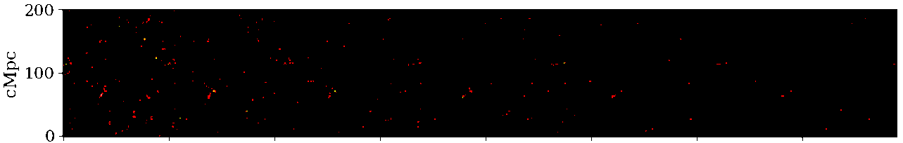
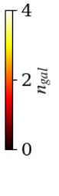
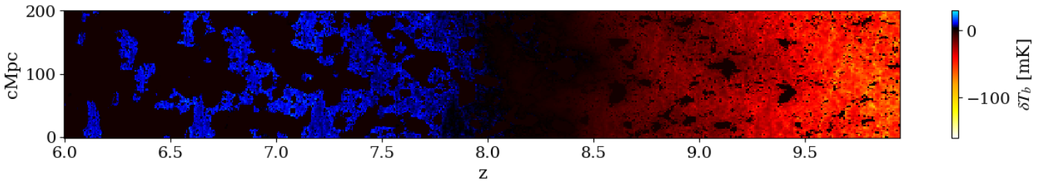
21cmFASTv4 – New Features
- Explicit galaxy populations — efficient halo finding
Galaxies used as sources for reionization: galaxy field consistent with IGM properties
Stochasticity implemented in star formation rate and halo mass function: greater realism

Slide 17


21cmFASTv4 – New Features
- Explicit galaxy populations — efficient halo finding
Galaxies used as sources for reionization: galaxy field consistent with IGM properties
Stochasticity implemented in star formation rate and halo mass function: greater realism
Check it out on GitHub:
Soon…
Greater details in an upcoming paper by James Davies

Slide 18
Biasing the Galaxy Field
Only the brightest galaxies are observable in practice
This depends on the magnitude limit of the galaxy mapping survey
We select galaxies based on their Lyman alpha emission since a line detection is required to achieve high redshift precision
UV luminosity from Mirocha and Furlanetto 2019 (https://arxiv.org/abs/1803.03272)
Lyman alpha flux from Mason et al. 2018 (https://arxiv.org/abs/1709.05356)

Slide 19
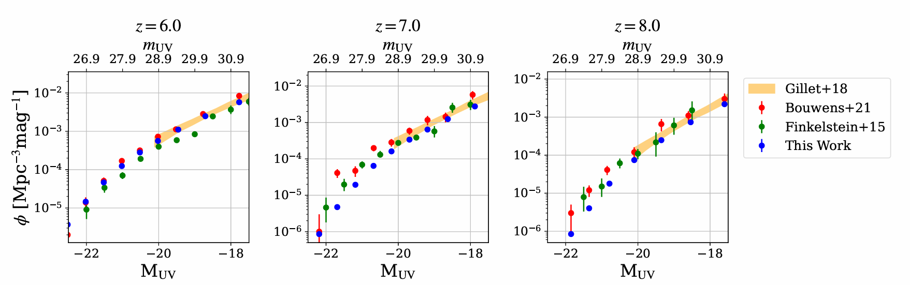
UV Luminosity Function

Slide 20
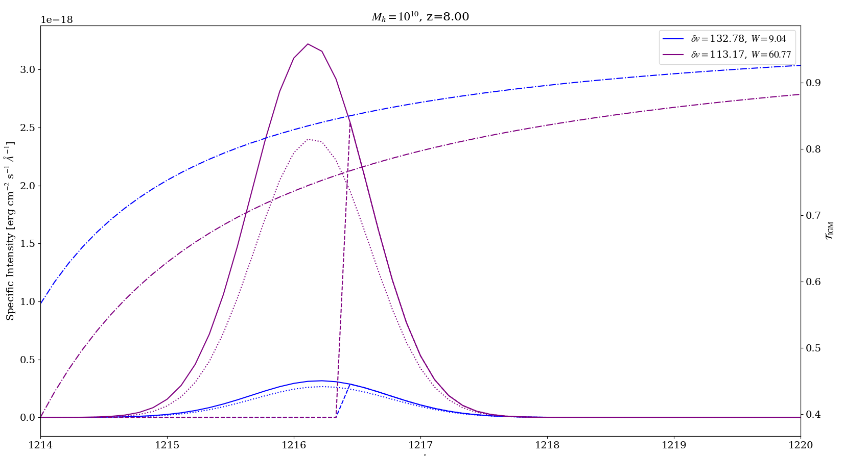
UV Luminosity Function

Slide 21
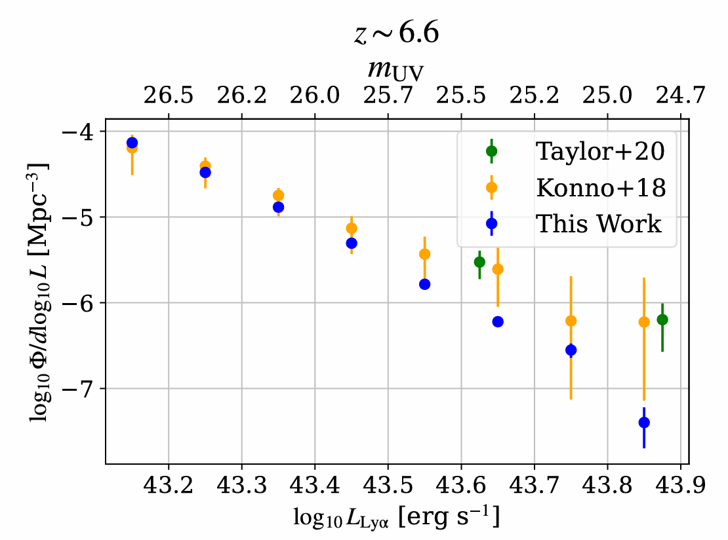
Lyman Alpha Luminosity Function

Slide 22
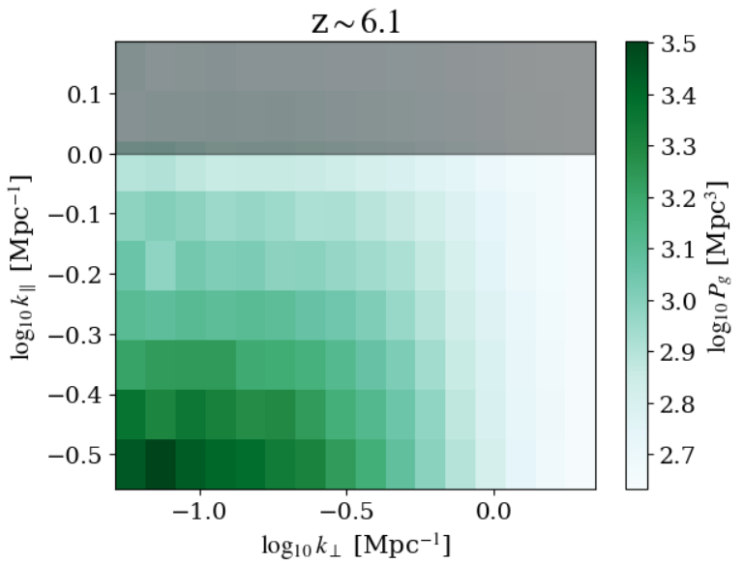
Redshift Precision and the Galaxy Power Spectrum
Redshift uncertainty sets an upper limit on Line-of-Sight k-modes
Excluded!

Slide 23
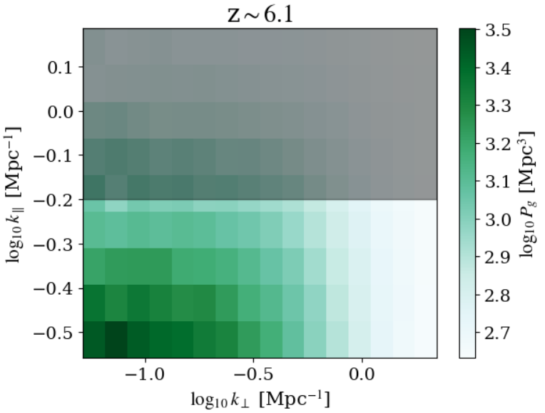
Redshift Precision and the Galaxy Power Spectrum
Redshift uncertainty sets an upper limit on Line-of-Sight k-modes
Excluded!

Slide 24
Redshift Precision and the Galaxy Power Spectrum
Redshift uncertainty sets an upper limit on Line-of-Sight k-modes
Different instrument types yield different redshift uncertainties
Narrow-band dropout: ~5 %
Grism: ~1%
Spectroscopy: ~0.1%

Slide 25
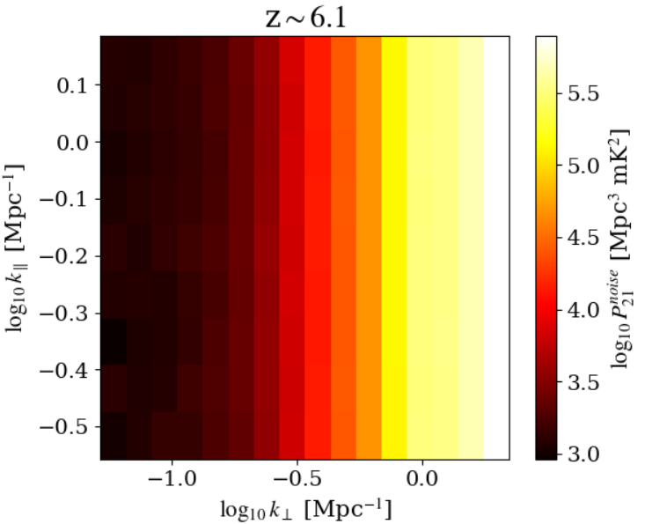
Thermal Noise in 21-cm Interferometers
The thermal noise in a k-mode is inversely proportional to the number of baselines probing that mode.
Noise level mostly varies in transverse modes since that’s where the baselines vary

Slide 26
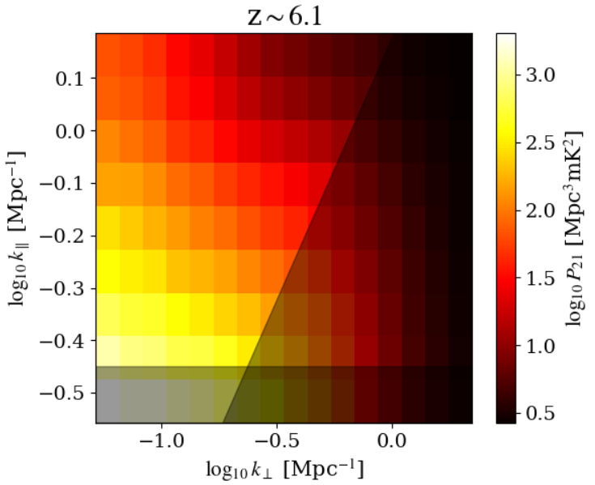
21-cm Foregrounds
Spectrally-smooth foregrounds occur at low LoS modes
However, mode-mixing propagates foregrounds into the “Wedge”
The Wedge
Intrinsic Foregrounds

Slide 27
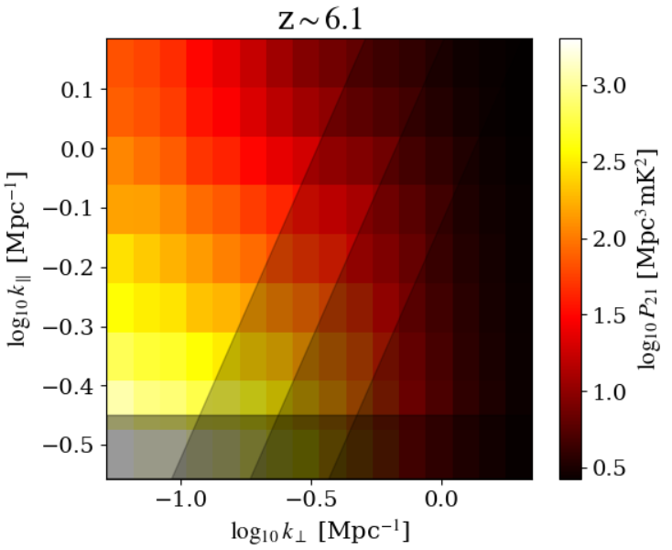
21-cm Foregrounds
The extent of the wedge is uncertain: in this study we vary the wedge as one of our free parameters
Pessimistic
Baseline
Optimistic (Recovery)
Intrinsic Foregrounds

Slide 28
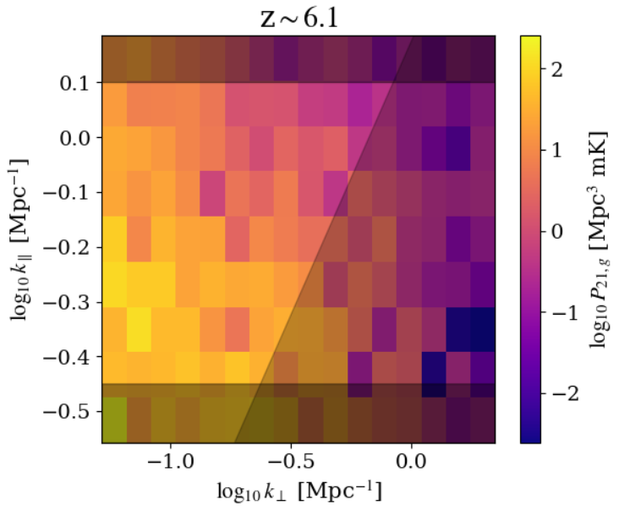
Cross-Spectrum Detection Scenarios
We vary the following telescopic survey parameters:
- Survey type
- Field of view
- Limiting magnitude
Redshift Uncertainty
The Wedge
We also vary the level of 21-cm foregrounds
Intrinsic Foregrounds

Slide 29
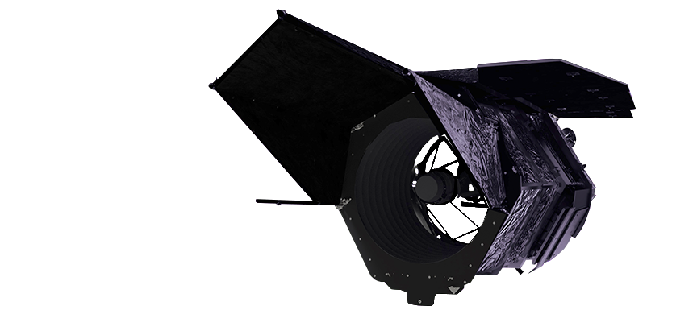
Benchmarks of Interest: Roman grism
HERA-Roman 21-cm-galaxy cross-correlations were investigated by La Plante et al. in 2023 (https://arxiv.org/abs/2205.09770)
We compare our results with theirs, albeit using SKA instead of HERA
Roman grism is insensitive to Lyman alpha at z<7.2

Slide 30
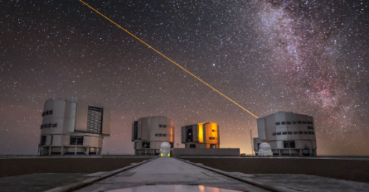
Benchmarks of Interest: MOONS
MOONS is a multi-object spectrograph planned for deployment at the Very Large Telescope
The MOONRISE high-redshift survey has already been granted guaranteed observing time to target ~1000 sources at
z>5.5 in a 1.2 sq.dg. FoV

Slide 31
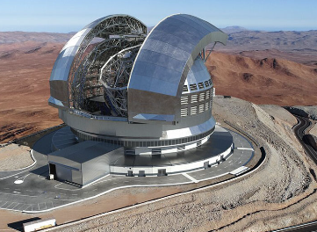
Benchmarks of Interest: MOSAIC
MOSAIC is a multi-object spectrograph planned for deployment at the Extremely Large Telescope
MOSAIC can achieve much deeper exposures in a shorter time than MOONS thanks to the massive observing area of ELT

Slide 32
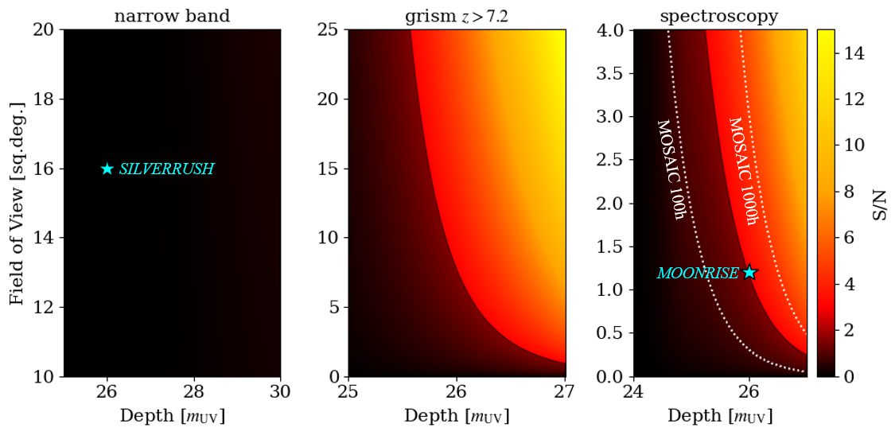
S/N Typical Foregrounds

Slide 33
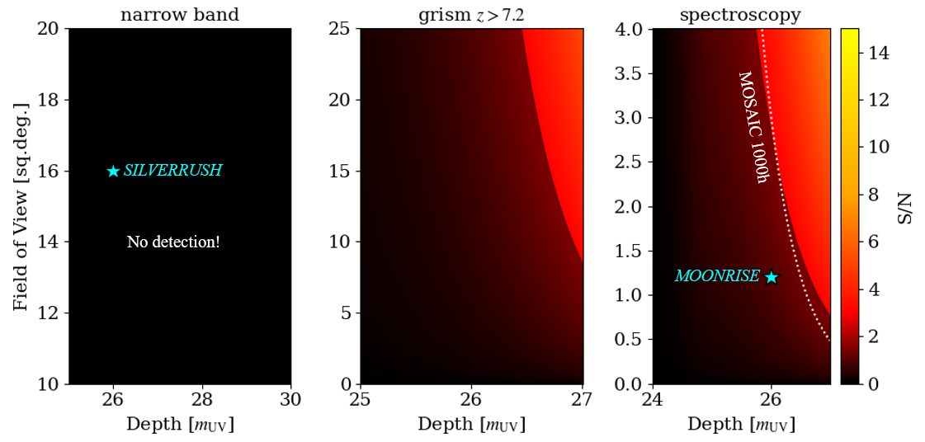
S/N Pessimistic Foregrounds

Slide 34
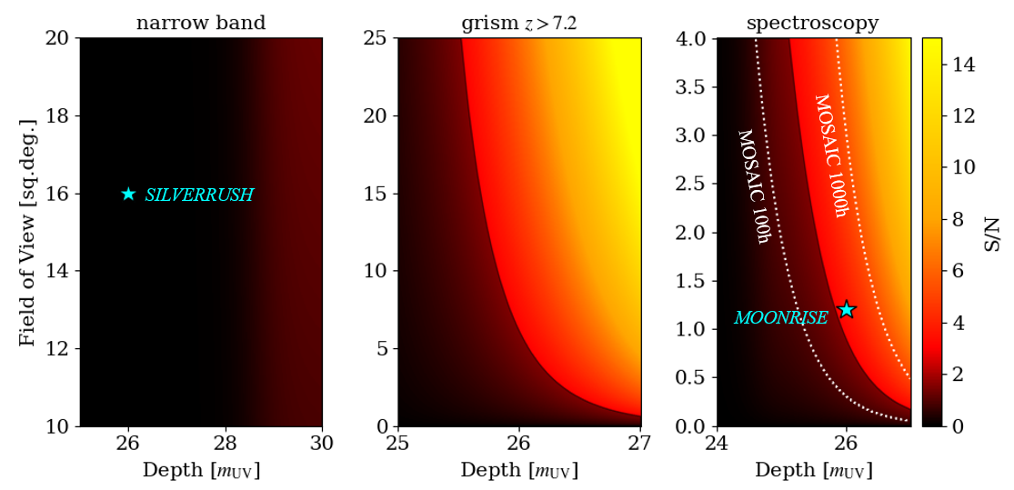
S/N Partial Foreground Recovery

Slide 35
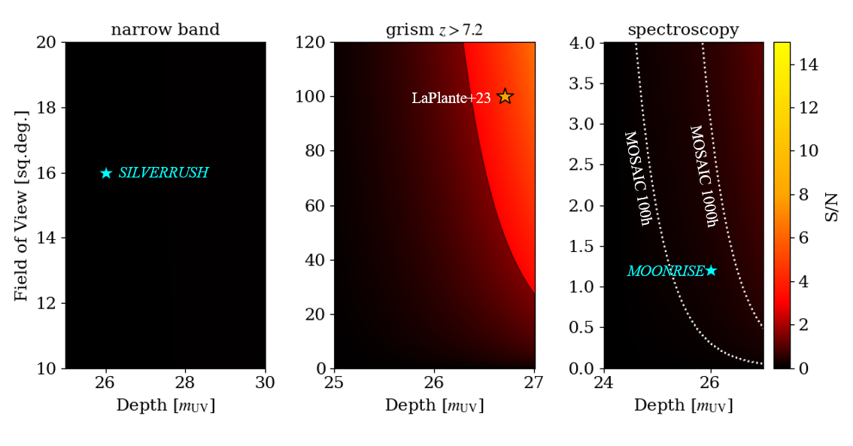
S/N HERA

Slide 36
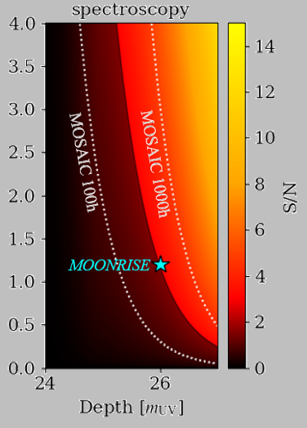
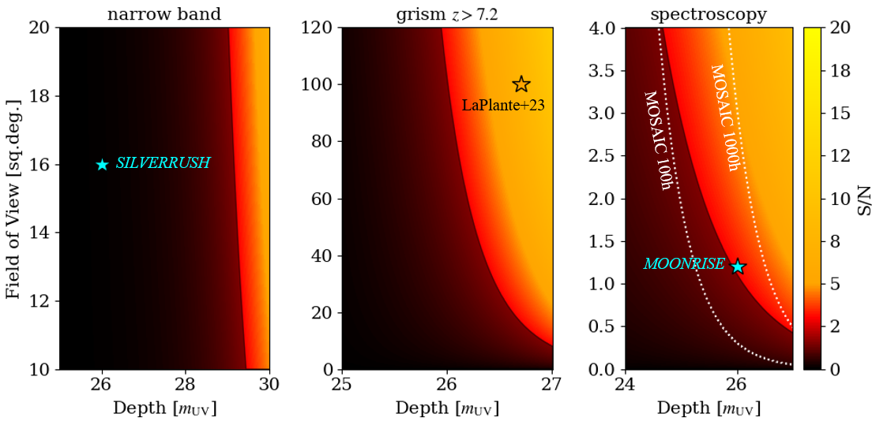
Conclusions
Cross-correlation with galaxies will allow us to confirm a detection of the cosmic 21-cm signal
The significance of a detection is sensitive to the level of 21-cm foregrounds
300 hours with MOSAIC can yield a detection with S/N~3
Don’t forget to check out
21cmFASTv4
and thanks for coming ☺

Slide 37
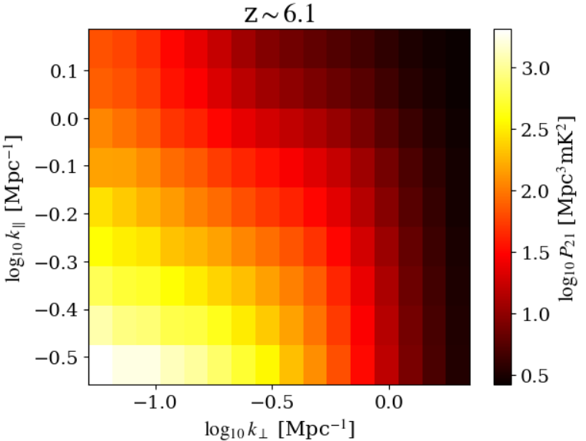
Extra Slides
Bin along transverse plan and line of sight independently
Fourier Transform

Slide 38
Cylindrical Power Spectra
Bin along transverse plan and line of sight independently
Fourier Transform

Slide 39
Cylindrical Power Spectra
Bin along transverse plan and line of sight independently
Fourier Transform

Slide 40
Cylindrical Power Spectra
Bin along transverse plan and line of sight independently
Fourier Transform

Slide 41
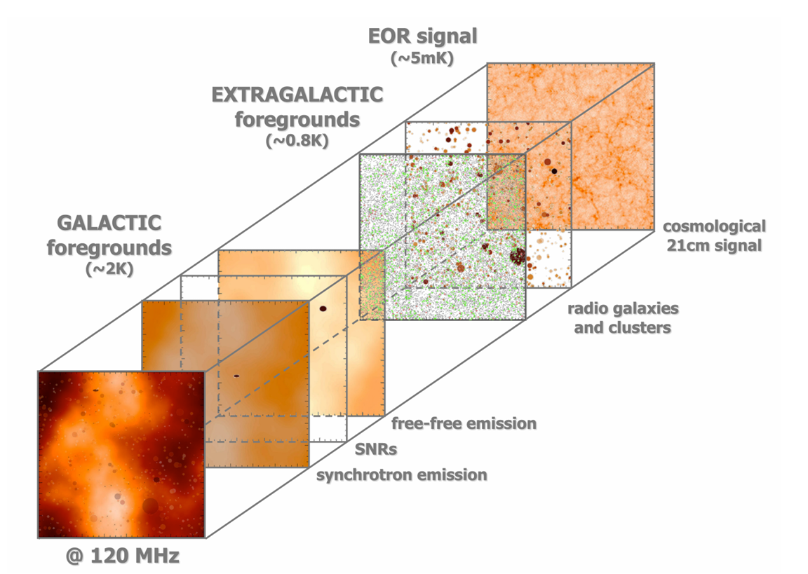
Image Credit: Vibor Jelic

Slide 42
Galaxies and the Intergalactic Medium
Galaxies are the principal drivers of evolution in the IGM
ionization
Matter
Galaxies
Intergalactic Medium
heating
Galaxy Field
21-cm Brightness Temperature Field

Slide 43
Cylindrical Power Spectra
Cylindrical power spectra separate information on the line of sight from information in the sky plane

Slide 44
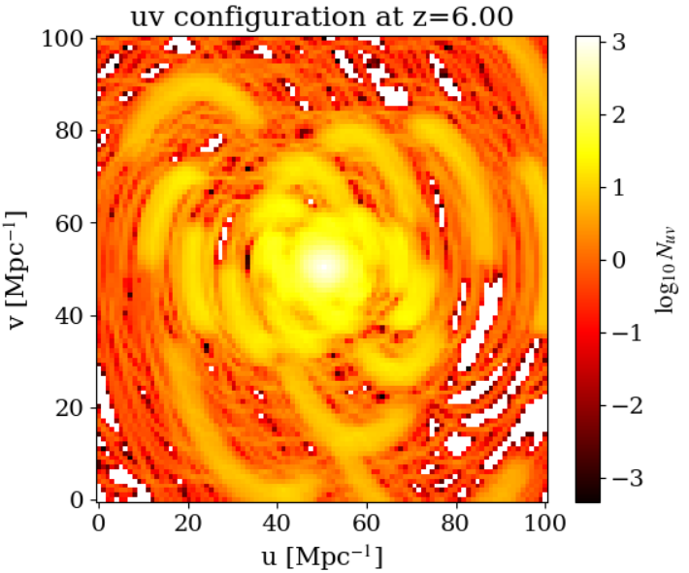
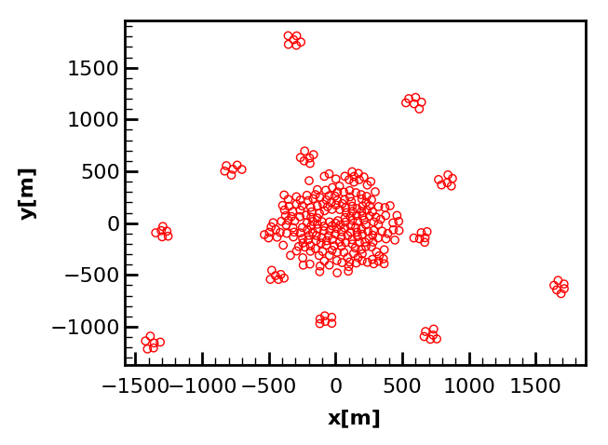
Thermal Noise in 21-cm Interferometers
The thermal noise in a k-mode is inversely proportional to the number of baselines probing that mode.

Slide 45
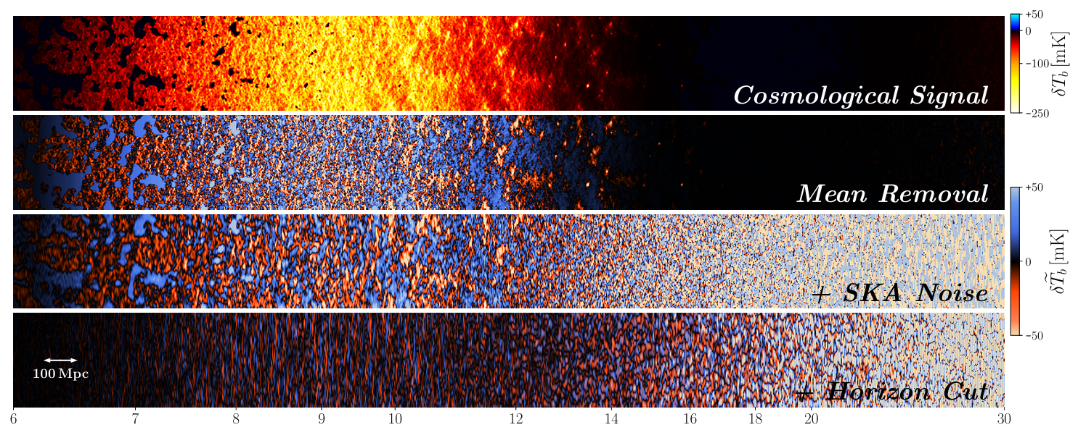
The Cosmic 21-cm Signal is Not Easy to Detect ☹
Modified from Prelogovic et al. (2021) [2107.00018]

Slide 46
The Cosmic 21-cm Signal is Not Easy to Detect ☹
Modified from Prelogovic et al. (2021) [2107.00018]

Slide 47
The Cosmic 21-cm Signal is Not Easy to Detect ☹
Modified from Prelogovic et al. (2021) [2107.00018]

Slide 48
The Cosmic 21-cm Signal is Not Easy to Detect ☹
Modified from Prelogovic et al. (2021) [2107.00018]

Slide 49
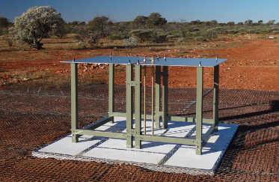
The Cosmic 21-cm Signal is Not Easy to Detect ☹
Modified from Prelogovic et al. (2021) [2107.00018]

Slide 50
The Cosmic 21-cm Signal is Not Easy to Detect ☹
Modified from Prelogovic et al. (2021) [2107.00018]

