Slide 1
Refining the Ideal Sky Model for CD/EoR Detection
Shijiao Yin
Supervisor:Huanyuan Shan
Shanghai Astronomical Observatory, CAS

Slide 2
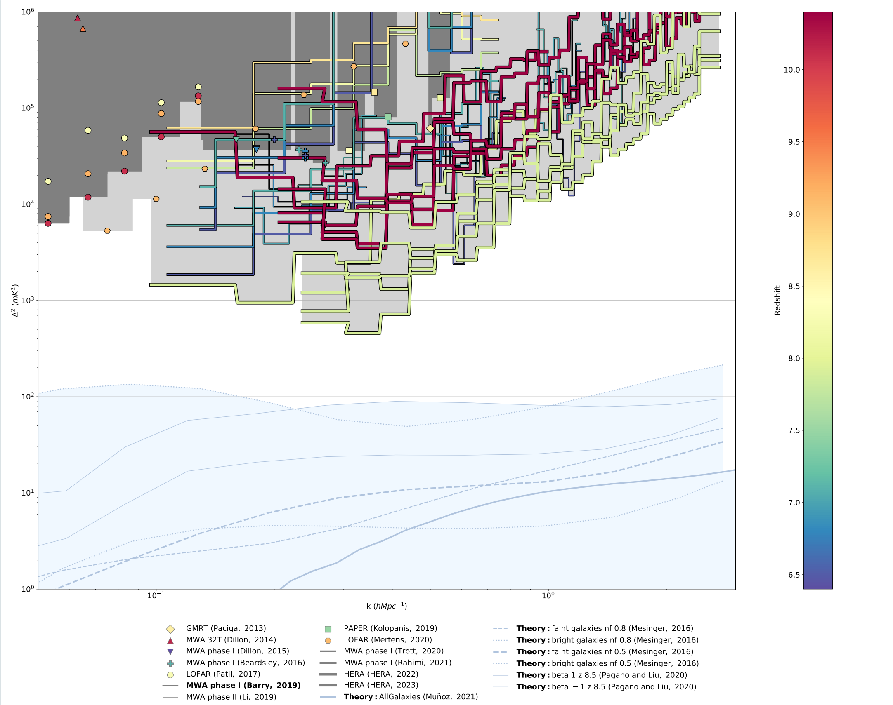
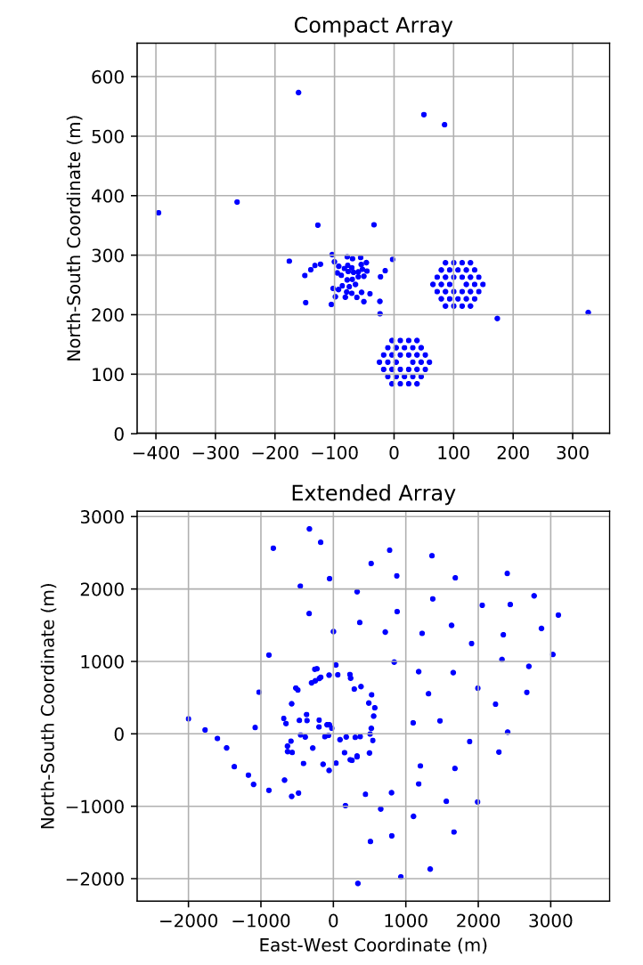
EoR Limit
MWA Phase II array layout.t
Notes:
Many current and upcoming radio interferometers are pursuing the EoR power spectrum (PS) observations, such as SKA, MWA; PAPER , LOFAR, HERA. MWA is SKA precursor telescopes, the right side picture shows MWA phase two layout. But as we can see in the left figure, lowest limit of these mechines haven’ t reach the theory prediction level yet.

Slide 3
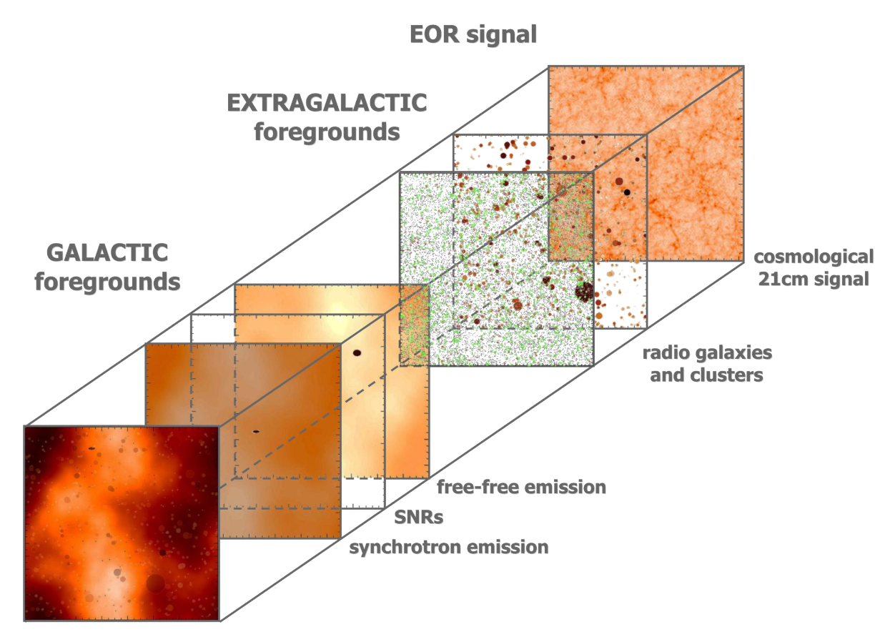
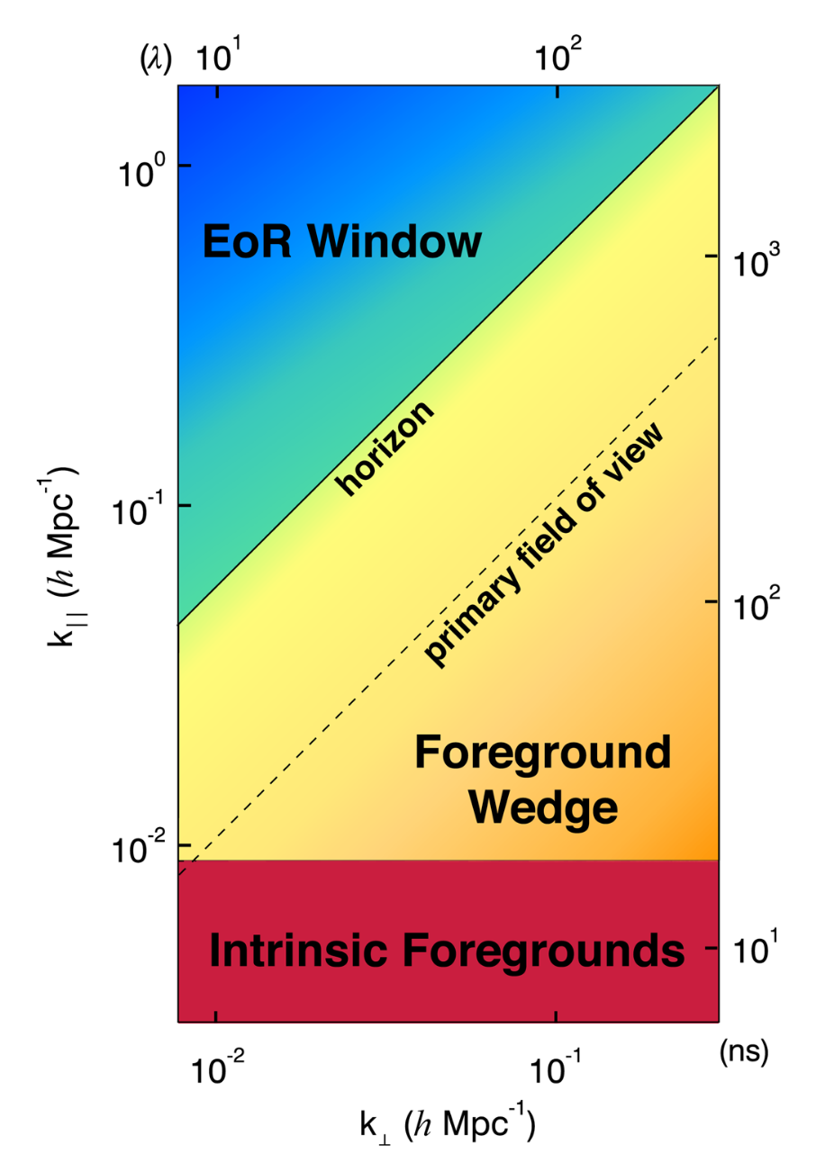
「
Foreground
」
A diagram showing the major foreground components contaminating the EoR signal. (ZAROUBI, 2013)
Astrophysical foregrounds are four to five orders of magnitude brighter than the expected cosmological signal (Furlanetto, 2016).
Suppressing this foreground contamination requires unprecedented precision in instrumental calibration.
A schematic representation of an expected 2D PS.
(Barry, 2016)
Notes:
A schematic representation of an expected 2D PS is shown here. Foregrounds dominate most part of the ps. The most sensitive, foreground-free measurement modes are expected to be in the lower-left corner of the ‘EoR window’, but the ‘EoR window’ also suffer from foreground contamination.

Slide 4
「
Calibration
」
The Measurement Equation
Sky-based Calibration
uses a sky model as a prior and is well suited to imaging arrays with good UV coverage
a maximum-likelihood estimate of the per-antenna gains maximizes：
Notes:
As the layout showed in slide 2 ,MWA use redundant calibration combine Sky-based sky-based and redundent Calibration. Sky-based calibration....it is obvious relies on sky-model

Slide 5
「
Calibration
」
Redundant Calibration
works for highly regular arrays and calibrates by matching visibilities from redundant baselines
minimizing yields degenerate solutions
four terms per frequency: overall amplitude A( f ), overall phase Δ( f ), and two phase gradient components Δ_{x}( f ) and Δ_{y}( f )
Redundant calibration must be separated into two distinct parts because of the degeneracies.
“Relative calibration” solves for the antenna gains up to the degenerate parameters A( f ), Δ( f ), Δx( f ), and Δy( f )
“Absolute calibration” constrains those degeneracies.
Notes:
It has to be separated into two distinct parts because of the degeneracies.

Slide 6
「
Calibration
」
h_{j} (f) : the gains constrained to have an average amplitude of 1, average phase of 0, and phase gradient of 0
A nondegenerate formulation
Absolute calibration solves for A(f), Δ(f), Δ_{x} (f), and Δ_{y} (f).
These parameters cannot be constrained from baseline redundancy and are generally calculated from a sky model.
maximum-likelihood estimated sky-based gains
Notes:
overall amplitude A( f ), overall phase Δ( f ), and two phase gradient components Δ_{x}( f ) and Δ_{y}( cannot be constrained from baseline redundancy and are generally calculated from a sky model. We need maximum-likelihood estimated sky-based gains.

Slide 7
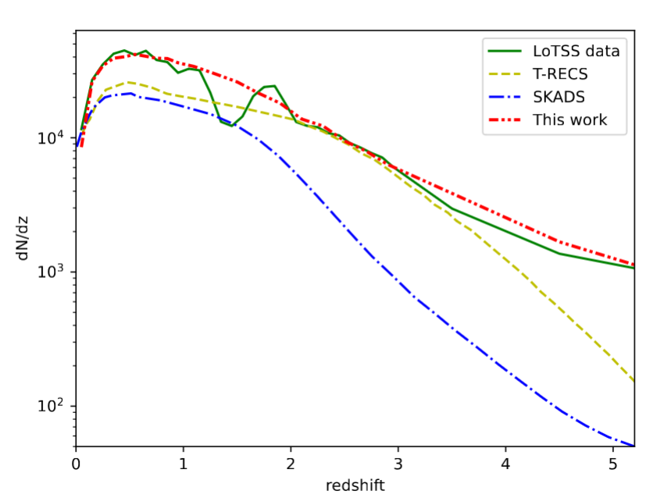
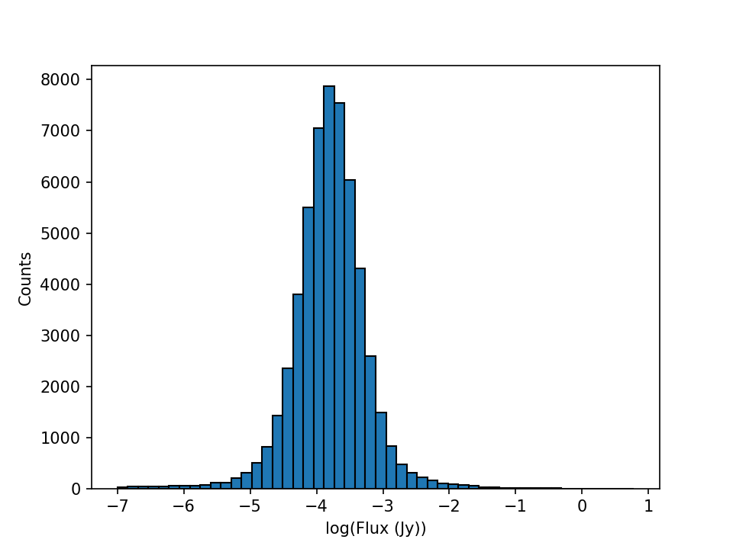
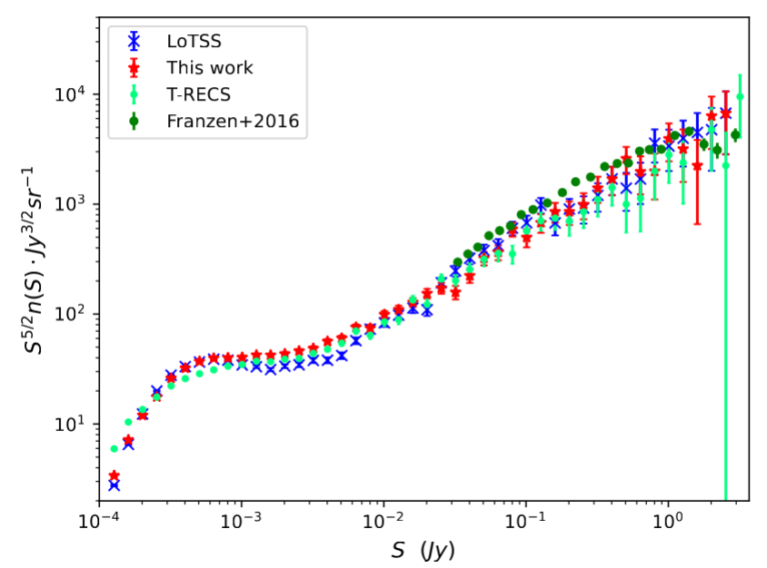
「
Sky Model
」
Any calibration steps that rely on a sky model are susceptible to errors from an inaccurate or incomplete sky model.
Model for the Extragalactic Radio Sky
Utilizing data from the LOFAR Two-meter Sky Survey (LoTSS) at 150 MHz
Recalibrated the luminosity function for various types of radio sources
Updated the Tiered Radio Extragalactic Continuum Simulation (T-RECS) code to generate refined mock radio source catalogues.
more closely with observed data at redshifts 𝑧 > 4.
Redshift distribution of radio sources
Flux distribution
The comparison of differential source counts in total intensity at 150 MHz.
Notes:
both skybased and redundent calibratiobion relies on sky model. However, there will always be unmodelled faint sources in the sky model. It is impossible to abtain an perfect sky model. We have to chose the precision we need. In order to establish the most suitable sky model for instrumental calibration, my work explore how the incompleteness of the sky model affect calibration results. MHz: mehahertz

Slide 8
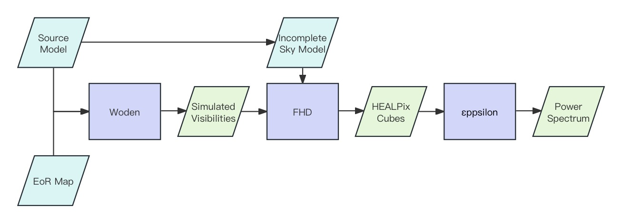
「
Simulation
」
Explore how the incompleteness of the sky model affect calibration results
FHD/εppsilon: A power spectrum (PS) pipeline which can calibrate and image data primarily developed for MWA ,and can also use as an in-situ simulation.
Notes:
to exlore how the incompleteness of the sky model affect calibration results, I performed end-to-end simulations of a full EoR PS analysis utilizing the FHD/εppsilon pipeline. this pipeline...I simulate an obsvertion with only eor signal. and an observation with both eor signal and point source model. And than do calibration and substrraction utilizing FHD. I provide the same point source model for simulation and calibration, but with flux-threshold in calibration, which means remove point sources with flux under certain value.

Slide 9
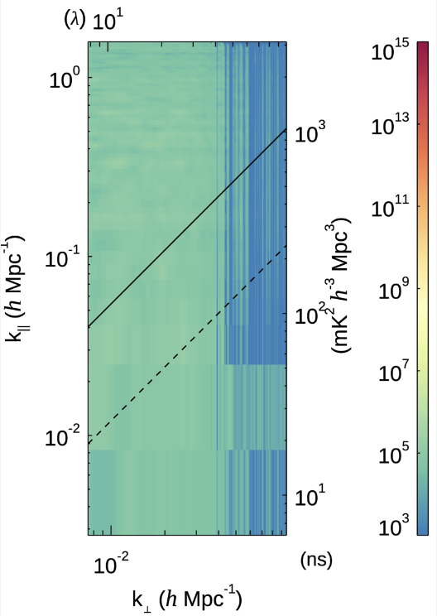
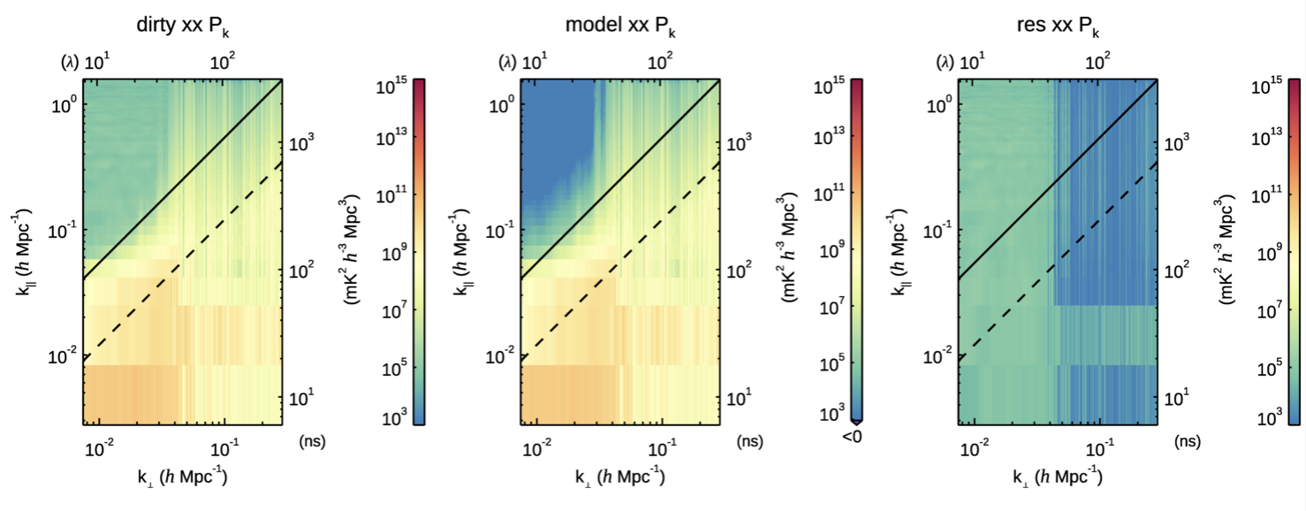
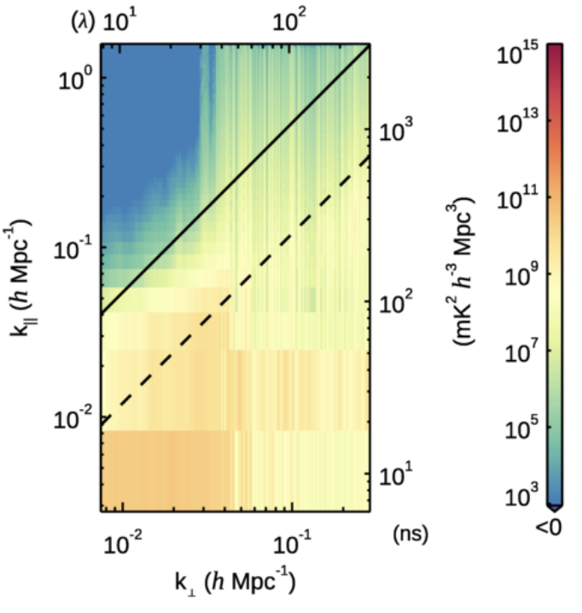
「
Results
」
Calibration:
low-order polynomials fit
two amplitude parameters
one phase parameter
Input eor power
Input point source model
Notes:
on left top is the power spectrum of an observation with only an flat noise like eor signal. on left lower is the power spectrum of an observation with only the sky model I mentioned before. On the right side is the output 2d ps of the pipeline. Note that here I use different model visibilities to calibration, but same model visibilities to substraction to avoid results affected by substraction.
Here I construct an rather ideal condition, using the metadata which observation coordinate is same as the zenith coordinate, result in a rather clean EoR Window.

Slide 10
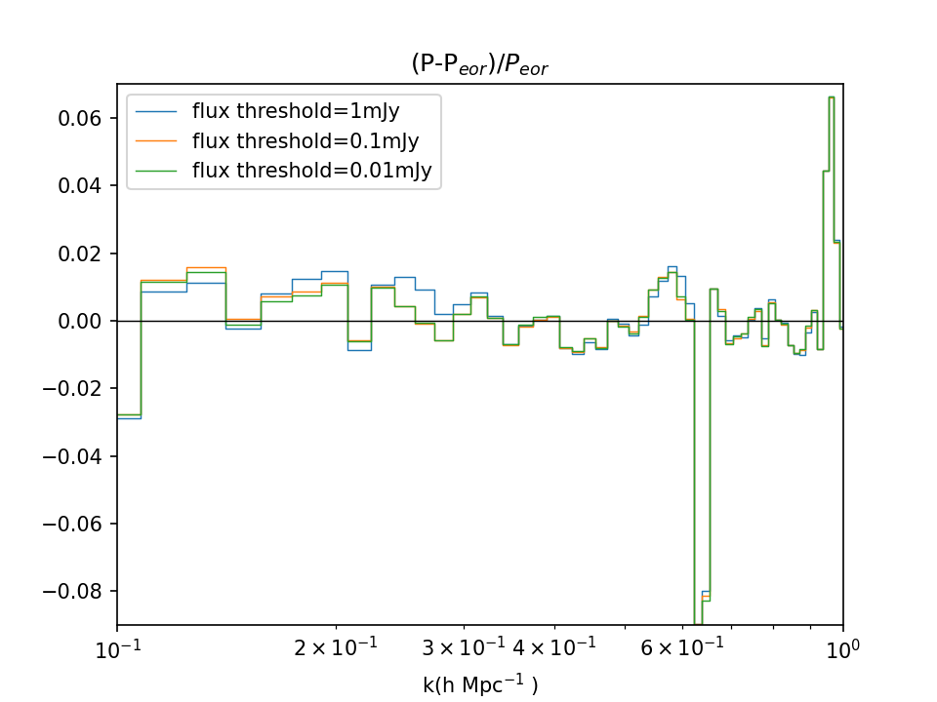
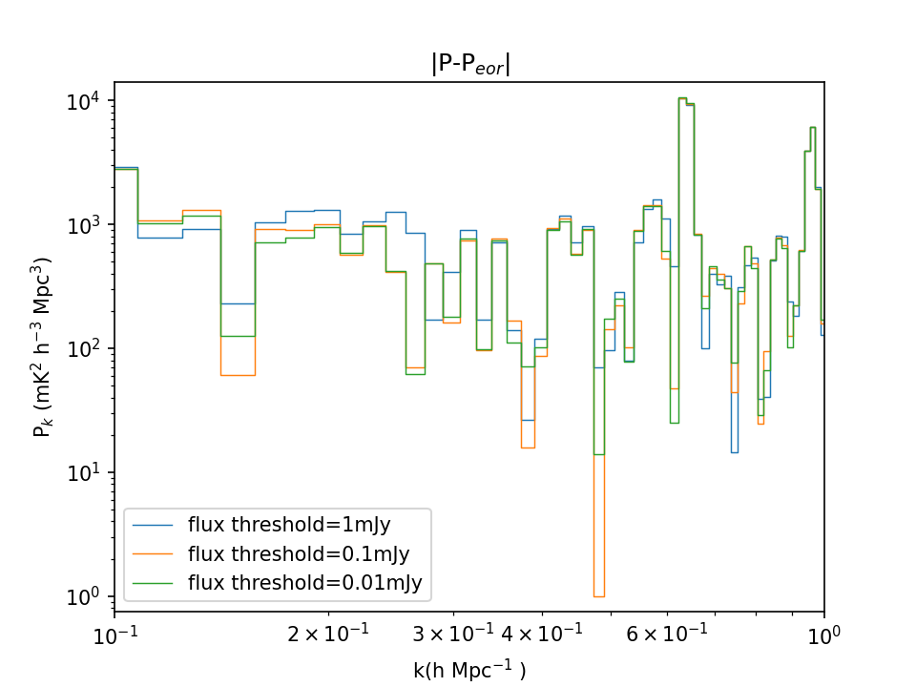
「
Results
」
Calibration:
low-order polynomials fit
two amplitude parameters
one phase parameter
Input eor power
0.1mJy Flux threshold performs best
Input point source model
Notes:
I tested calibration sky model with higher and higher flux-threshold. And the point source model flux distribution is on the lower middle. I contrast eor window of their residual ps, calculate their bias from the 1 d ps of input eor signal. It shows that ps with 0.1mJy Flux threshold performs best, even better than 0.01mJy threshold. I cann’t explain exactly yet. Maybe more caculations introduce higher error. this result reccommand sky models with flux threshold equal or lower than 0.1mJy when processing MWA observed data.

Slide 11
「
Future Work
」
More results with different thresholds
Test on different calibration methods
Improve the eor model
Consider the effect of observation error

Slide 12
2024.07
THANKS
Shijiao Yin

