Slide 1

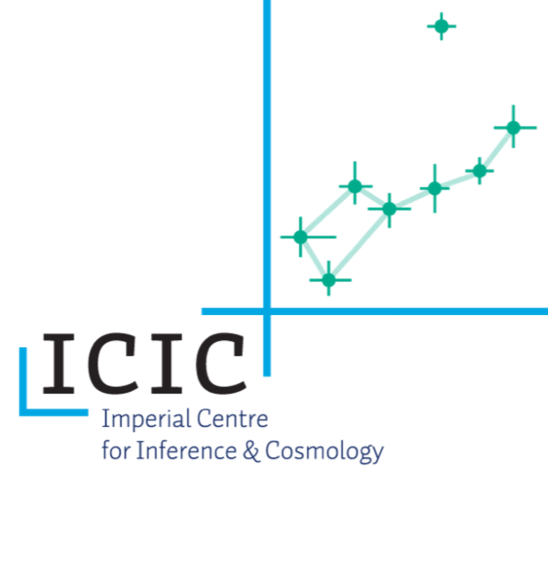
Statistical summaries for
Bayesian analyses in eor science
Tom Binnie – Beijing 2024
Imperial College London
Tsinghua university

Slide 2
What we’ll cover:
Methods
Bayesian parameter estimation, Bayesian Model Selection, ABC
3 types of Summary statistic
- (Fourier) Power Spectrum likelihood + 3DCNN + Morlet PS likelihood
(in Progress..)
Application
- FPS likelihood can be used reliably in a wide range of situations
- 3D-CNN likelihood-free inference can do model selection but with some flexibility caveats.
- MPS is still in development but looks very promising
Line of sight density structure modes contribute to cosmic variance

Slide 3
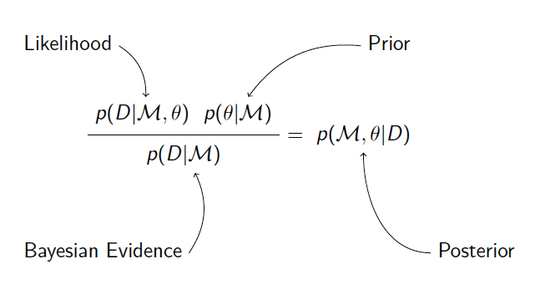
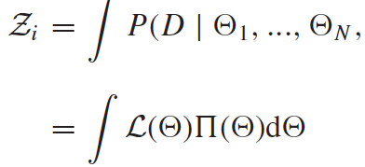

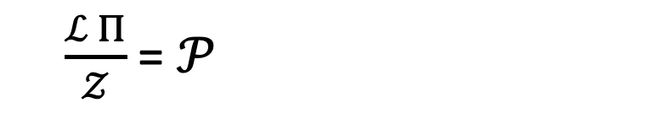

Intro to Bayesian Statistics
For Parameter Estimation
we want $ℒ_{max}$
$$p( θ|D, ℳ)$$
(with uniform priors) → $𝒫 ∝ ℒ$
$\frac{ℒ Π}{𝒵}$ = $𝒫$
For Model Selection
we want $𝒵_{i}=p(D|M_{i})$ – the Bayesian Evidence
- Conventionally t$ricky to calculate$

Slide 4
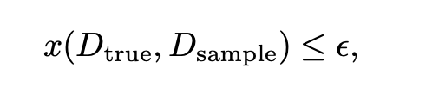

Bayesian likelihoods vs Approximate Bayesian Computation
Both require simulating a forward model
(AKA likelihood free inference or simulation based inference)
Likelihood describes the distance to a data set
a likelihood is not tractable
Within a threshold, a distance metric selects the parameters that are close to the data.
General likelihood:
(Typically assumes a Gaussian form around a data set)
Parameters within criteria estimate the posterior.
Allows MCMC sampling
e.g. Nested Sampling (model selection)
Emcee (parameter estimation)
Learning Posteriors with pyDelfi
(Alsing et al. 2018, 2019)
Both estimate the parameter posterior

Slide 5
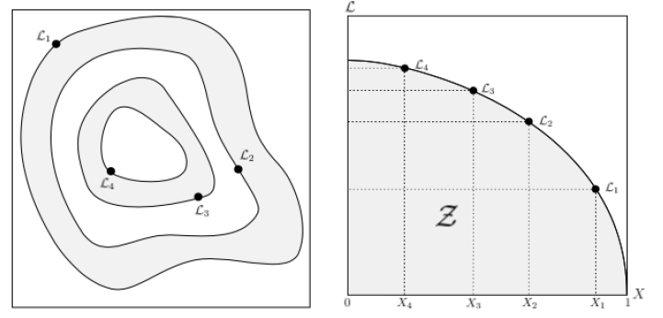
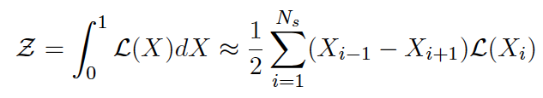
Nested Sampling - We use Multinest
(Feroz, Hobson et al. 2006)
Iso-likelihood contours
→ Ellipsoidal rejection sampling
Nd integral for Z becomes 1d
X = fraction of prior volume
(Feroz, Hobson et al. 2006)
(Feroz, Hobson et al. 2006)

Slide 6


Bayesian Model Selection
Now we have $𝒵=p(D|M)$ – the Bayesian Evidence
In general:
- a mock data set from each model
- can we rule out the wrong models?
The Jeffreys’ Scale
Strong – $ℬ_{12}$ > 150
Moderate – 10 < $ℬ_{12}$ < 150
Weak – $ℬ_{12}$ < 10
Odds are the results!
Different shades of grey on plots

Slide 7

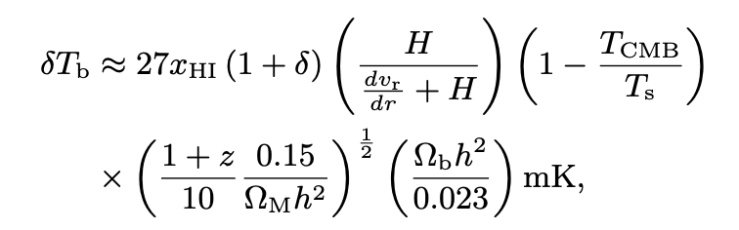


Standard 21cm likelihood
Fourier Power Spectrum
Throughout, FPS refers to spherically averaged 21cm brightness temperature (Fourier) power spectrum
Power Spectrum - the Fourier transform of the 2 point correlation function
Correlation function - the excess probability relative to a Poission distribution
(Cross correlation terms ignored)
FPS likelihood

Slide 8


Simulation - 21CMMC (Greig & Mesinger 2015)
& 21cmFAST (Mesinger et al 2013 Murray et al. 2023)
Semi-numerical simulation used for parameter estimation
1) Simple Model (FZH)
  Each has a linear density field realization
  Ionization defined by comparing photons to
  the number of baryons in a given region.
$T_{vir}$ - the minimum virial temperature for galaxies.
$ζ$ - UV ionising efficiency of galaxies.
2) Testing Morphologies
+ Ionization correlates with the density field directly - MHR
+ Mathematical Inverses
(FZHinv, MHRinv)
3) Testing Astrophysics
+ Including Spin temperature,
+ Including a power law in halo mass for $ζ$ (with and without UV LF synergy.

Slide 9
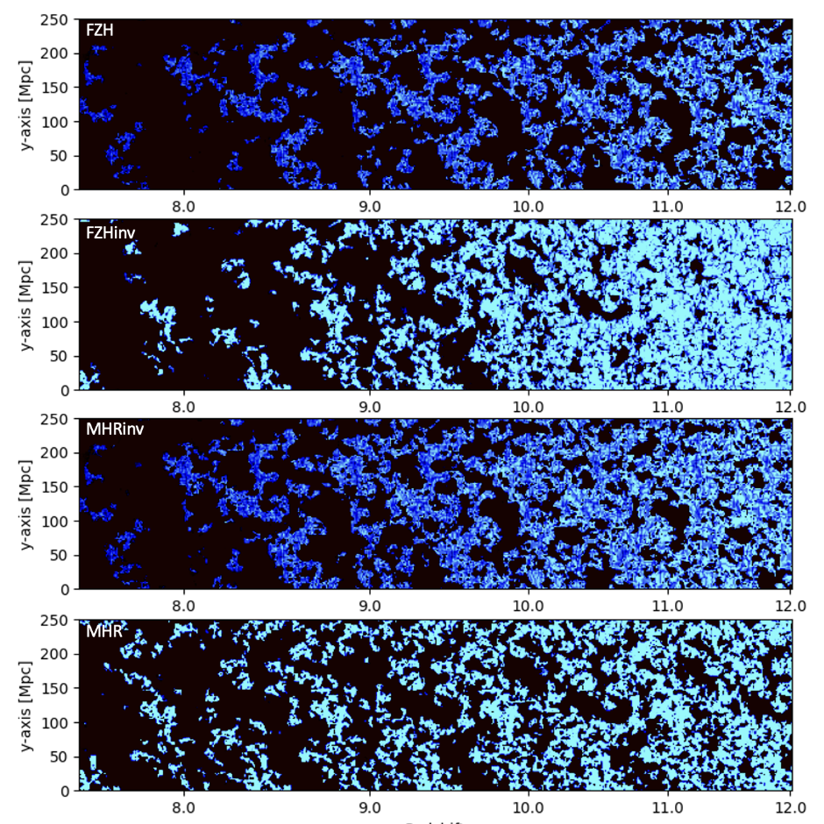
Morphological
light-cones
(21cmFast)
Inside-Out
Outside-In
Inside-Out
Outside-In
(Watkinson & Pritchard 2014)
(Binnie & Pritchard 2019)
(Furlanetto, Zaldarriaga & Hernquist 2004)
(Miralda-Escudé, Haenelt, Rees 2000)
(Binnie et al in prep.)

Slide 10
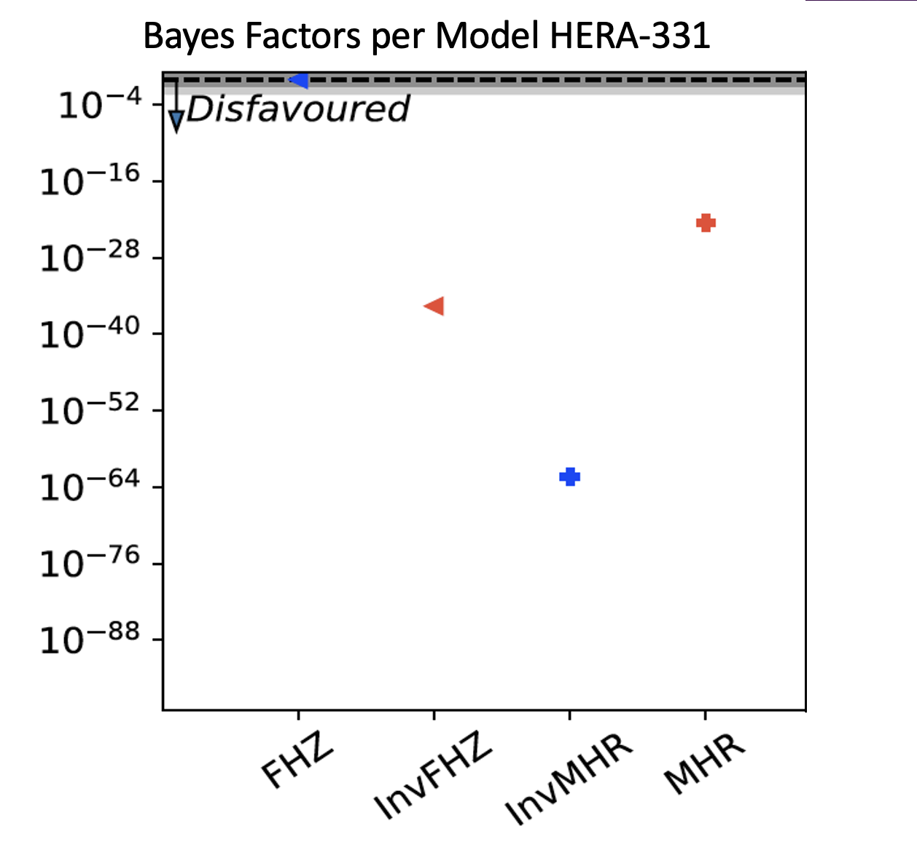
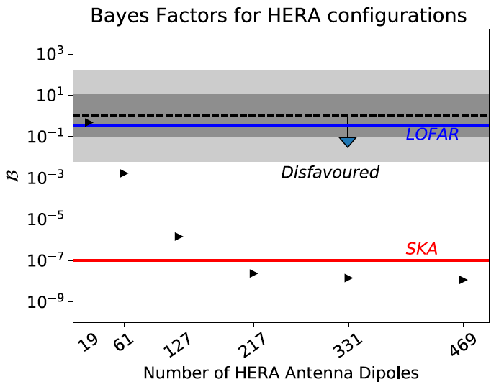
FPS results example
BMS can answer interesting questions:
(Most competitive model)
< = Global red = outside-in
+ = Local blue = inside-out
Telescope Simulations with 21cmSense Pober (2016)
1080hr
For full results see https://arxiv.org/pdf/1903.09064

Slide 11
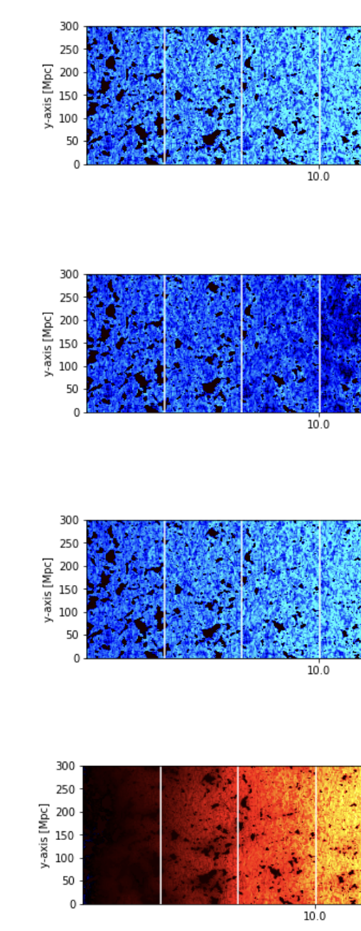
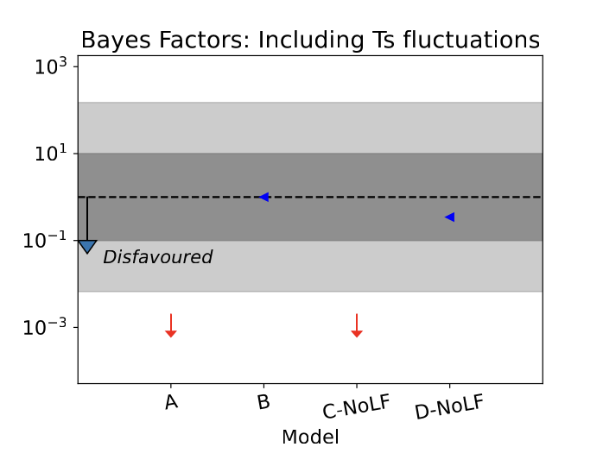
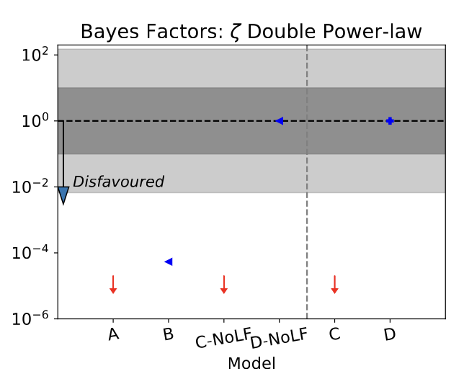

FPS results with Astrophysical models
A
No LF LF
Simple
B
Has Ts
C
Single PL (no TS)
(Blue includes Ts)
(D includes DPL)
D
Double PL + Ts
We can decisively distinguish between Astrophysical models.
– If the heating realization is significant.

Slide 12
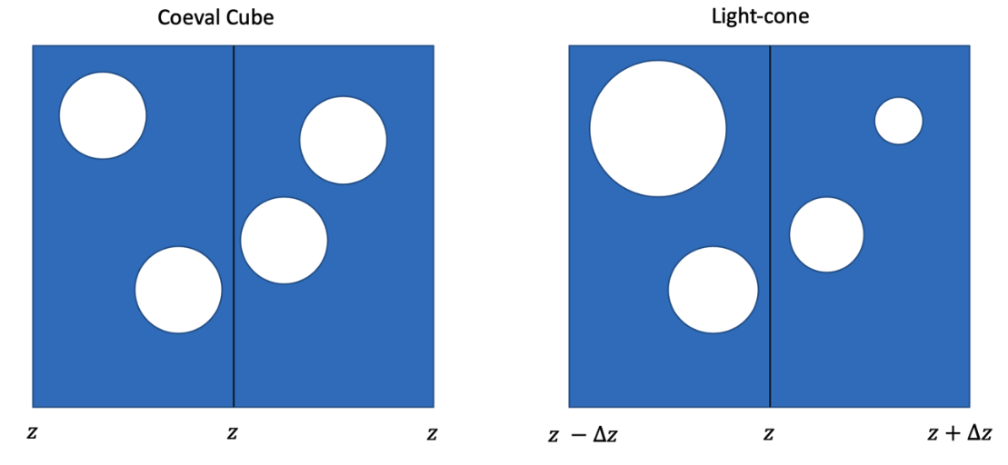
BUT…
Light-cone signal evolves along line of sight
FPS is not ergodic of light-cone
The Light-Cone Effect
With the FPS must take chunks to approximate ergodicity
(Datta et al 2012, 2014)
The 3D-CNN and Morlet Power Spectrum both try to interpret the entire light-cone

Slide 13
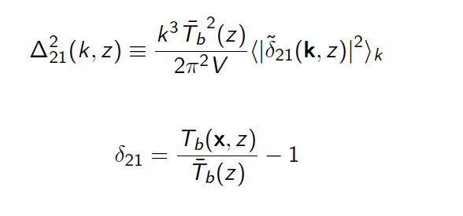
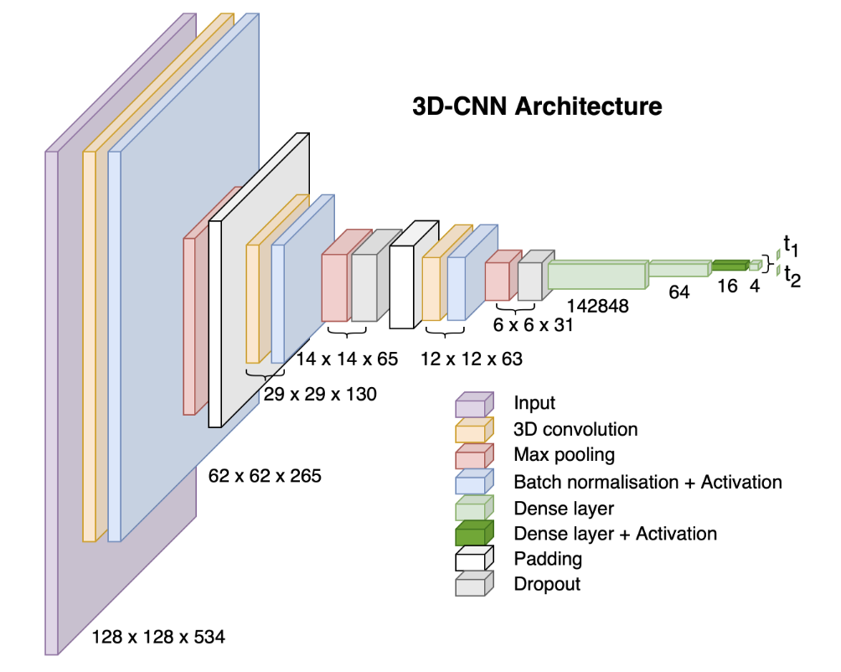
What is the 3D-CNN?
Before, we summarised the 21cm light-cone with the power spectrum
Now, Summaries (t) of the brightness temperature
field are created by compressing 21cm light-cones
with the 3D-CNN
3D-CNN uses parameters to obtain summary values instead of simulating
A different 3D-CNN is trained on each of the 4 EoR models with 10000 light-cones.
Mock data summaries are produced by summarizing a fiducial parameter simulation with the trained network.

Slide 14
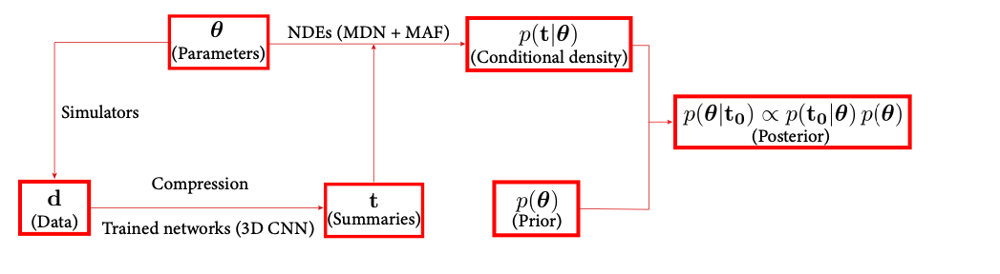


What is Pydelfi?
Pydelfi uses these summaries to asymptotically estimate the true posterior
Neural Density Estimators (NDE) - a combination of Mixture Density Networds and Masked Auto-regressive Flows
Delfi uses 5 MDN & 1 MAF
(Bishop 1994)
(Papamakarious et al. 2017)
- Training is achieved by minimizing the cross-entropy
(information content is related to
the log probability Q $∝$ lnP )

Slide 15
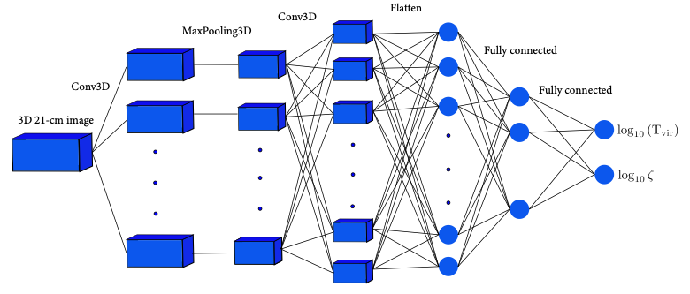
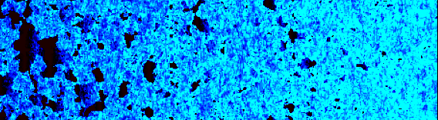
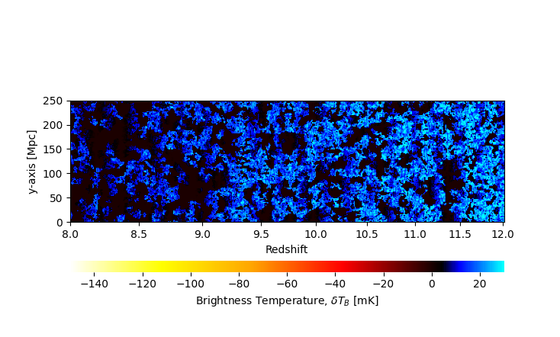






Pydelfi + 3DCNN
Process iterates
We can then learn $𝒫$ and find the
MAP $θ$.
Sampler suggests
parameters
($ζ, log⁡(T_{vir})$)
(t1, t2)
Pydelfi compares the entropy of sampled data summary to the mock data summary.
($ζ_{mock}, log⁡({T_{vir}}_{ Mock})$)
(t1_{Mock}, t2_{Mock})
Can we recover the mock data’s model?
$∫𝒫 dθ= 𝒵$ ,
$→$ $ℬ$ = $\frac{𝒵_{test}}{𝒵_{mock}} ≤ 1$
Can we recover the parameters that model used to produce the mock data?
Is $𝒫_{max}$= $𝒫$( $θ_{mock}$ ) ?
$$P\left(D | M\right)∝^{?}\int{dΘ \sum_{i}^{NDE}{W_{i}}P_{i}(t|Θ,ω)}$$
- Can the learnt-Posterior be used for Bayesian inference?

Slide 16
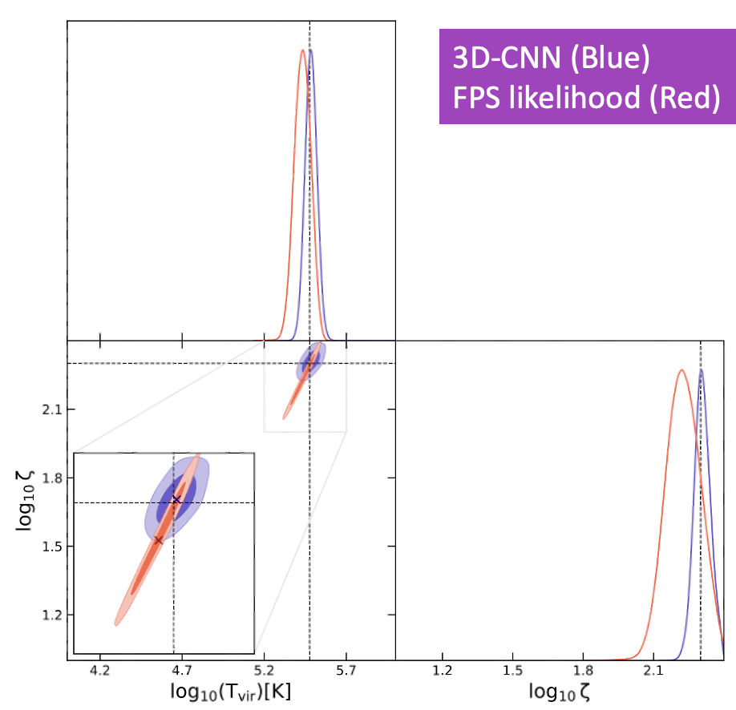
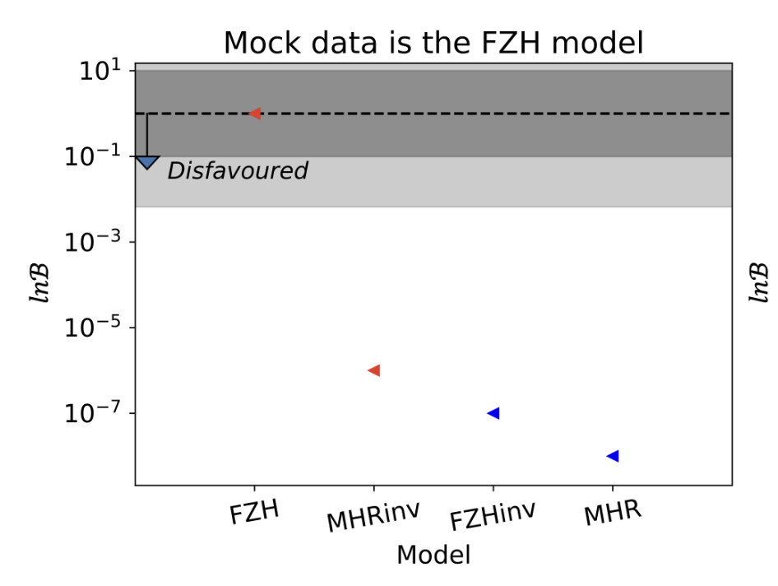
3D-CNN Results
Posterior Precision and accuracy improves with the Delfi-3DCNN compared to the FPS for the
FZH (inside-out) model
Credit: Zhao et al. 2022
Models can also be decisively distinguished by the 3D-CNN + pyDelfi for all 4 of our morphological models

Slide 17
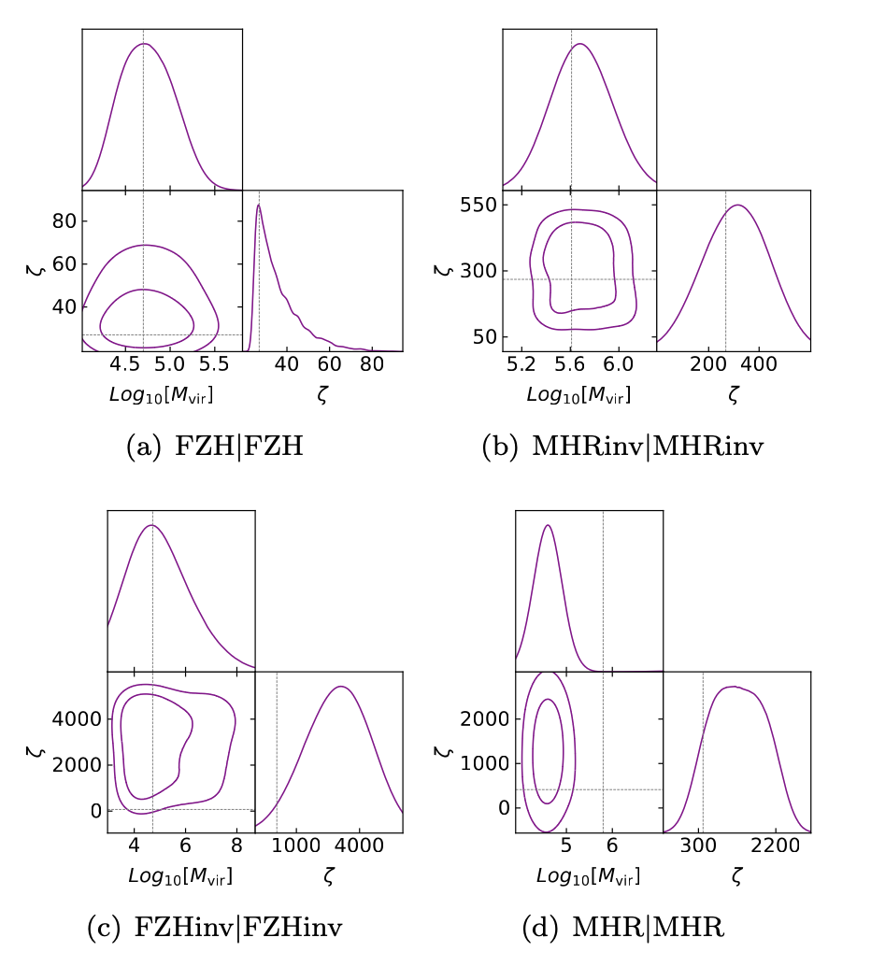
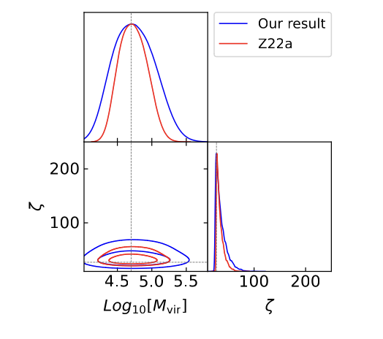
3D-CNN Results
BUT…
3D-CNN does not predicts accurate posteriors for outside-in morphology !
Inside-out models work well
Increasing the simulation resolution worsened parameter precision!

Slide 18





The Morlet Power Spectrum
Each Morlet Bases $Υ$, wrapped with Gaussian Envelopes
$k_{∥} \sim η(z)$
$ν_{c}$ = Line of sight position [Hz]
Envelopes adapts to evolution of the light-cone (based on Nyquist frequency)
Ergodic statistics
See Trott (2016) for more info
→ Simulated and Analytical covariances agree

Slide 19
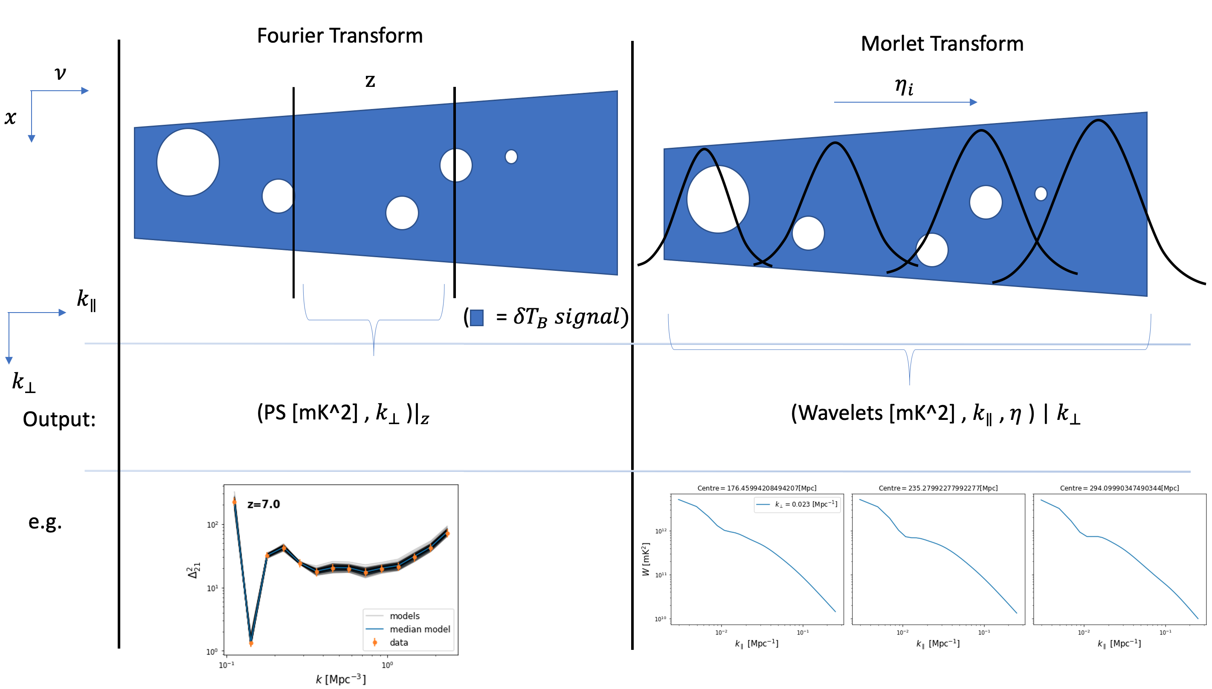
The Morlet Power Spectrum
Interpretation is analogous to the FPS

Slide 20
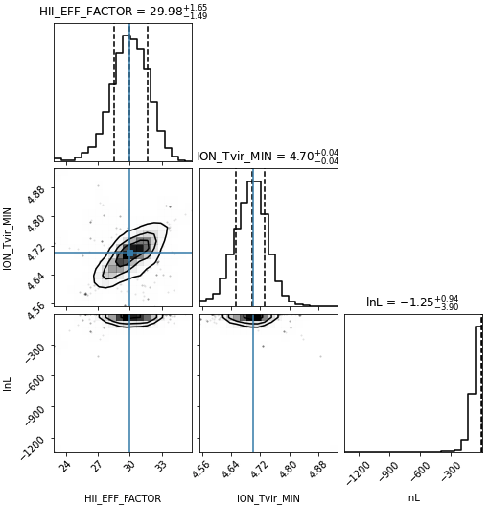
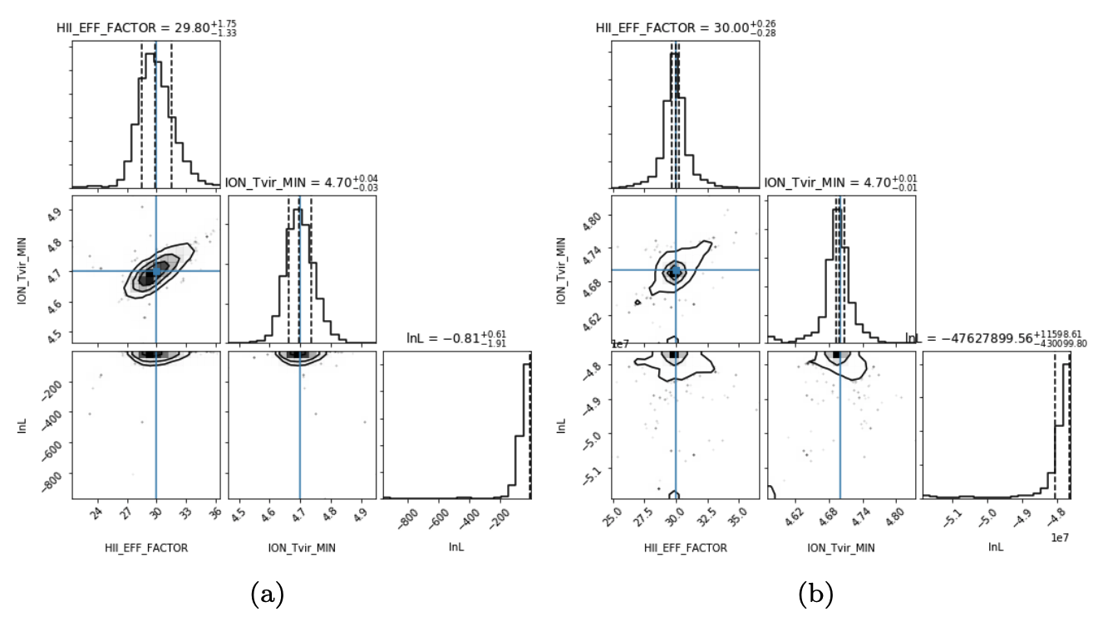
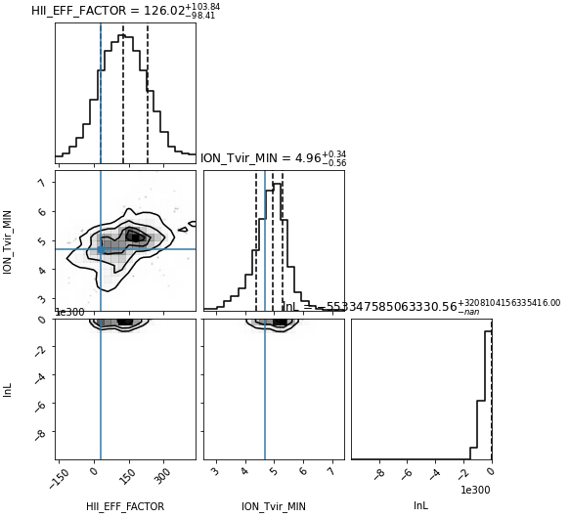

MPS Comparison with FPS
FPS
MPS
MCMC ${\sim 10}^{4}$points, 2 parameter FZH,
250Mpc box light-cone (redshifts 8-10) sliced into:
1 chunk
3 chunks
FPS
MPS
- 3 chunk MPS receives no largescale modes
(the wavelet just filters the data for no reason)
- 1 chunk FPS suffers badly from the LC effect
No telescope noise yet.

Slide 21
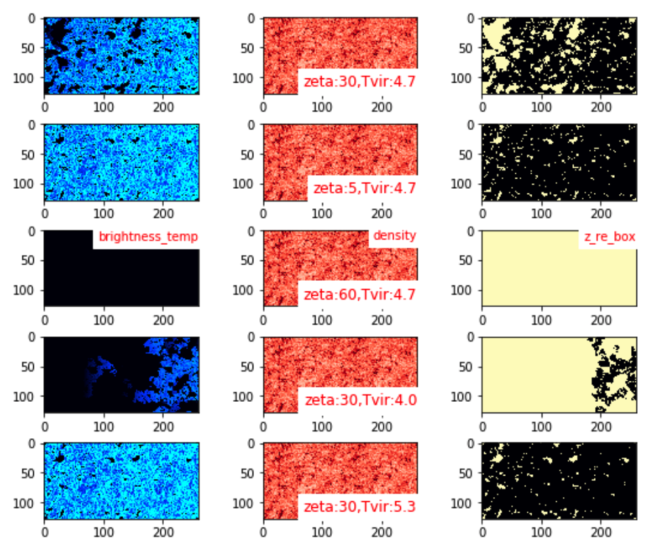
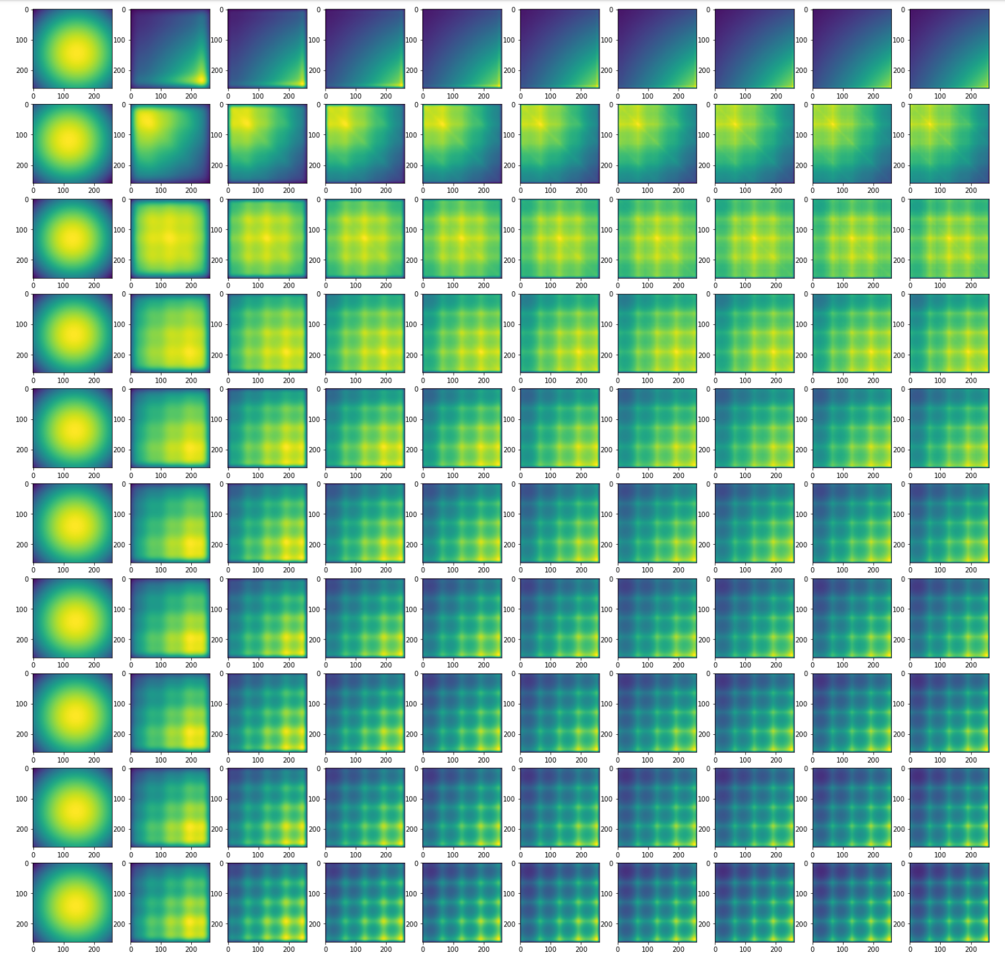

MPS Covariance interpretation is hard
Implementing the Morlet Transform
Box coordinates² plot per $k_{∥}$ ( given ${|k}_{⊥}| )$
BUT... Cross hairs line up with Simulation artifacts.

Slide 22
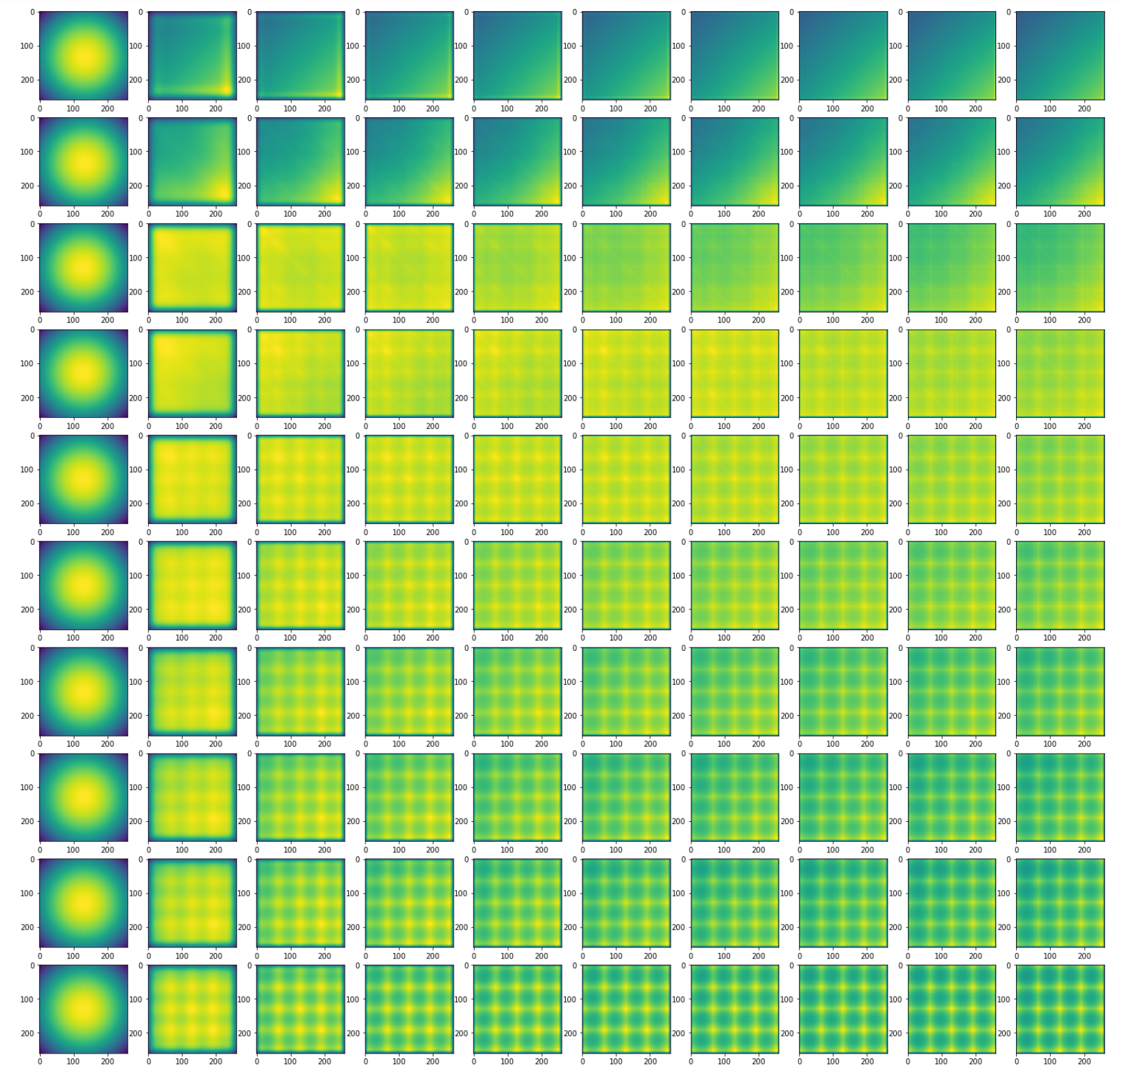
MPS Covariance interpretation is hard
Implementing the Morlet Transform
Box coordinates² plot per $k_{∥}$ ( given ${|k}_{⊥}| )$
BUT... Cross hairs line up with Simulation artifacts.

Slide 23
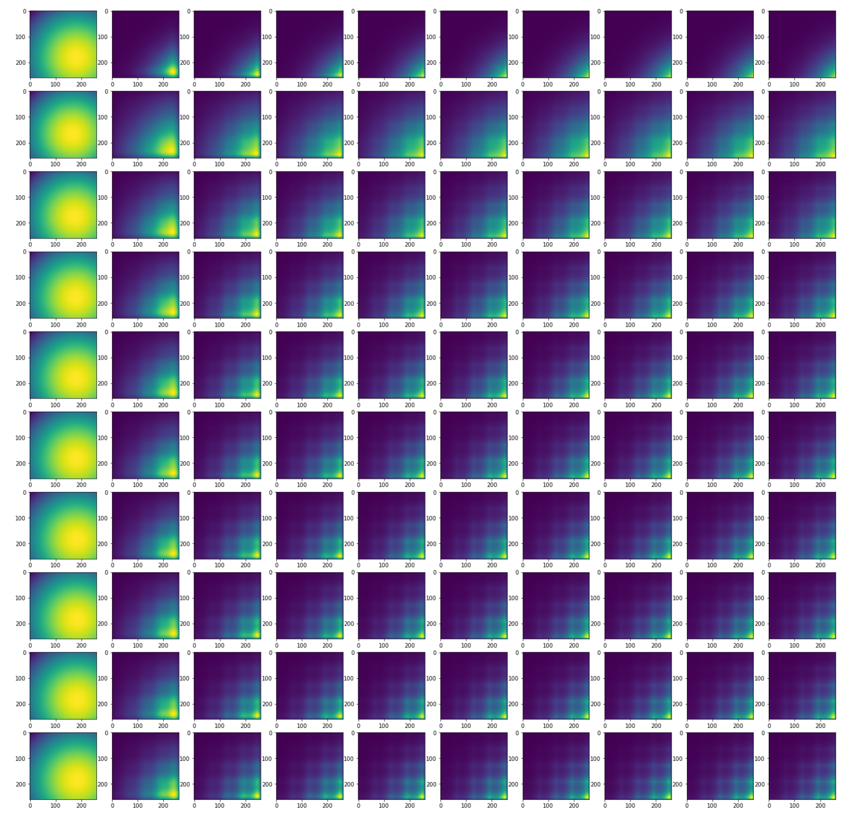
MPS Covariance interpretation is hard
Implementing the Morlet Transform
Box coordinates² plot per $k_{∥}$ ( given ${|k}_{⊥}| )$
BUT... Cross hairs line up with Simulation artifacts.

Slide 24
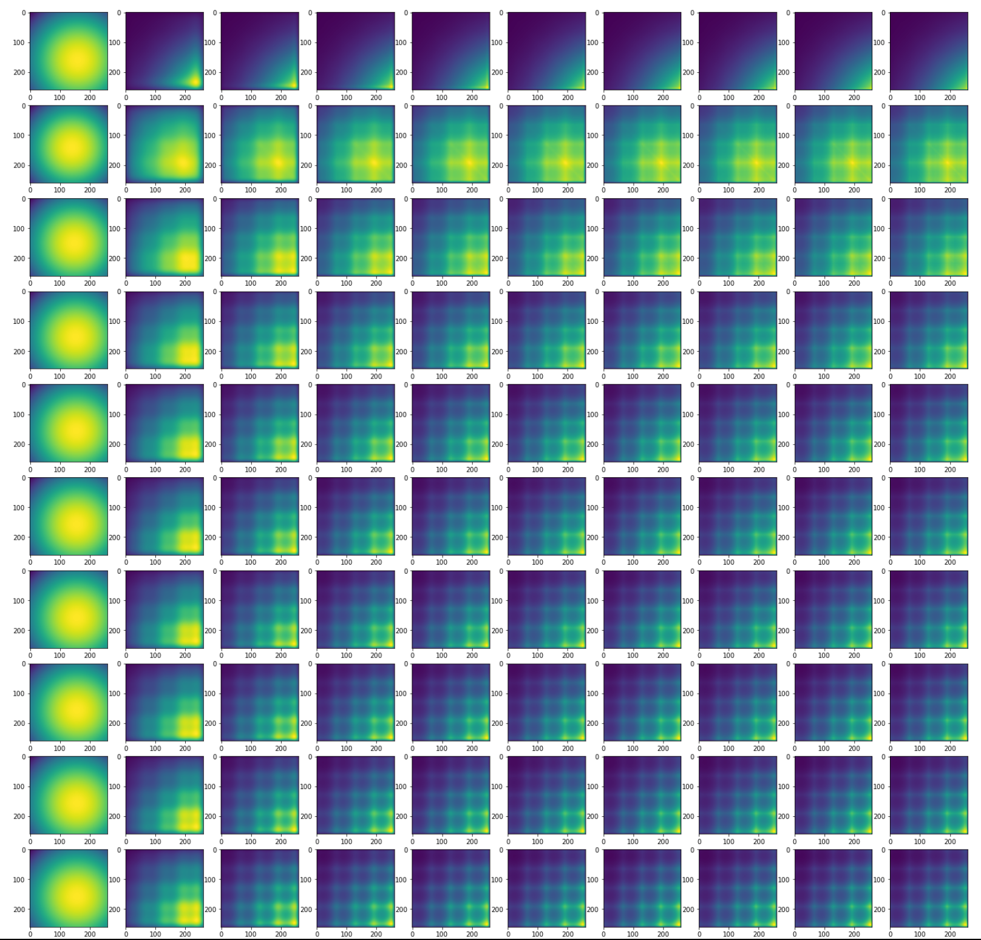
MPS Covariance interpretation is hard
Implementing the Morlet Transform
Box coordinates² plot per $k_{∥}$ ( given ${|k}_{⊥}| )$
BUT... Cross hairs line up with Simulation artifacts.

Slide 25
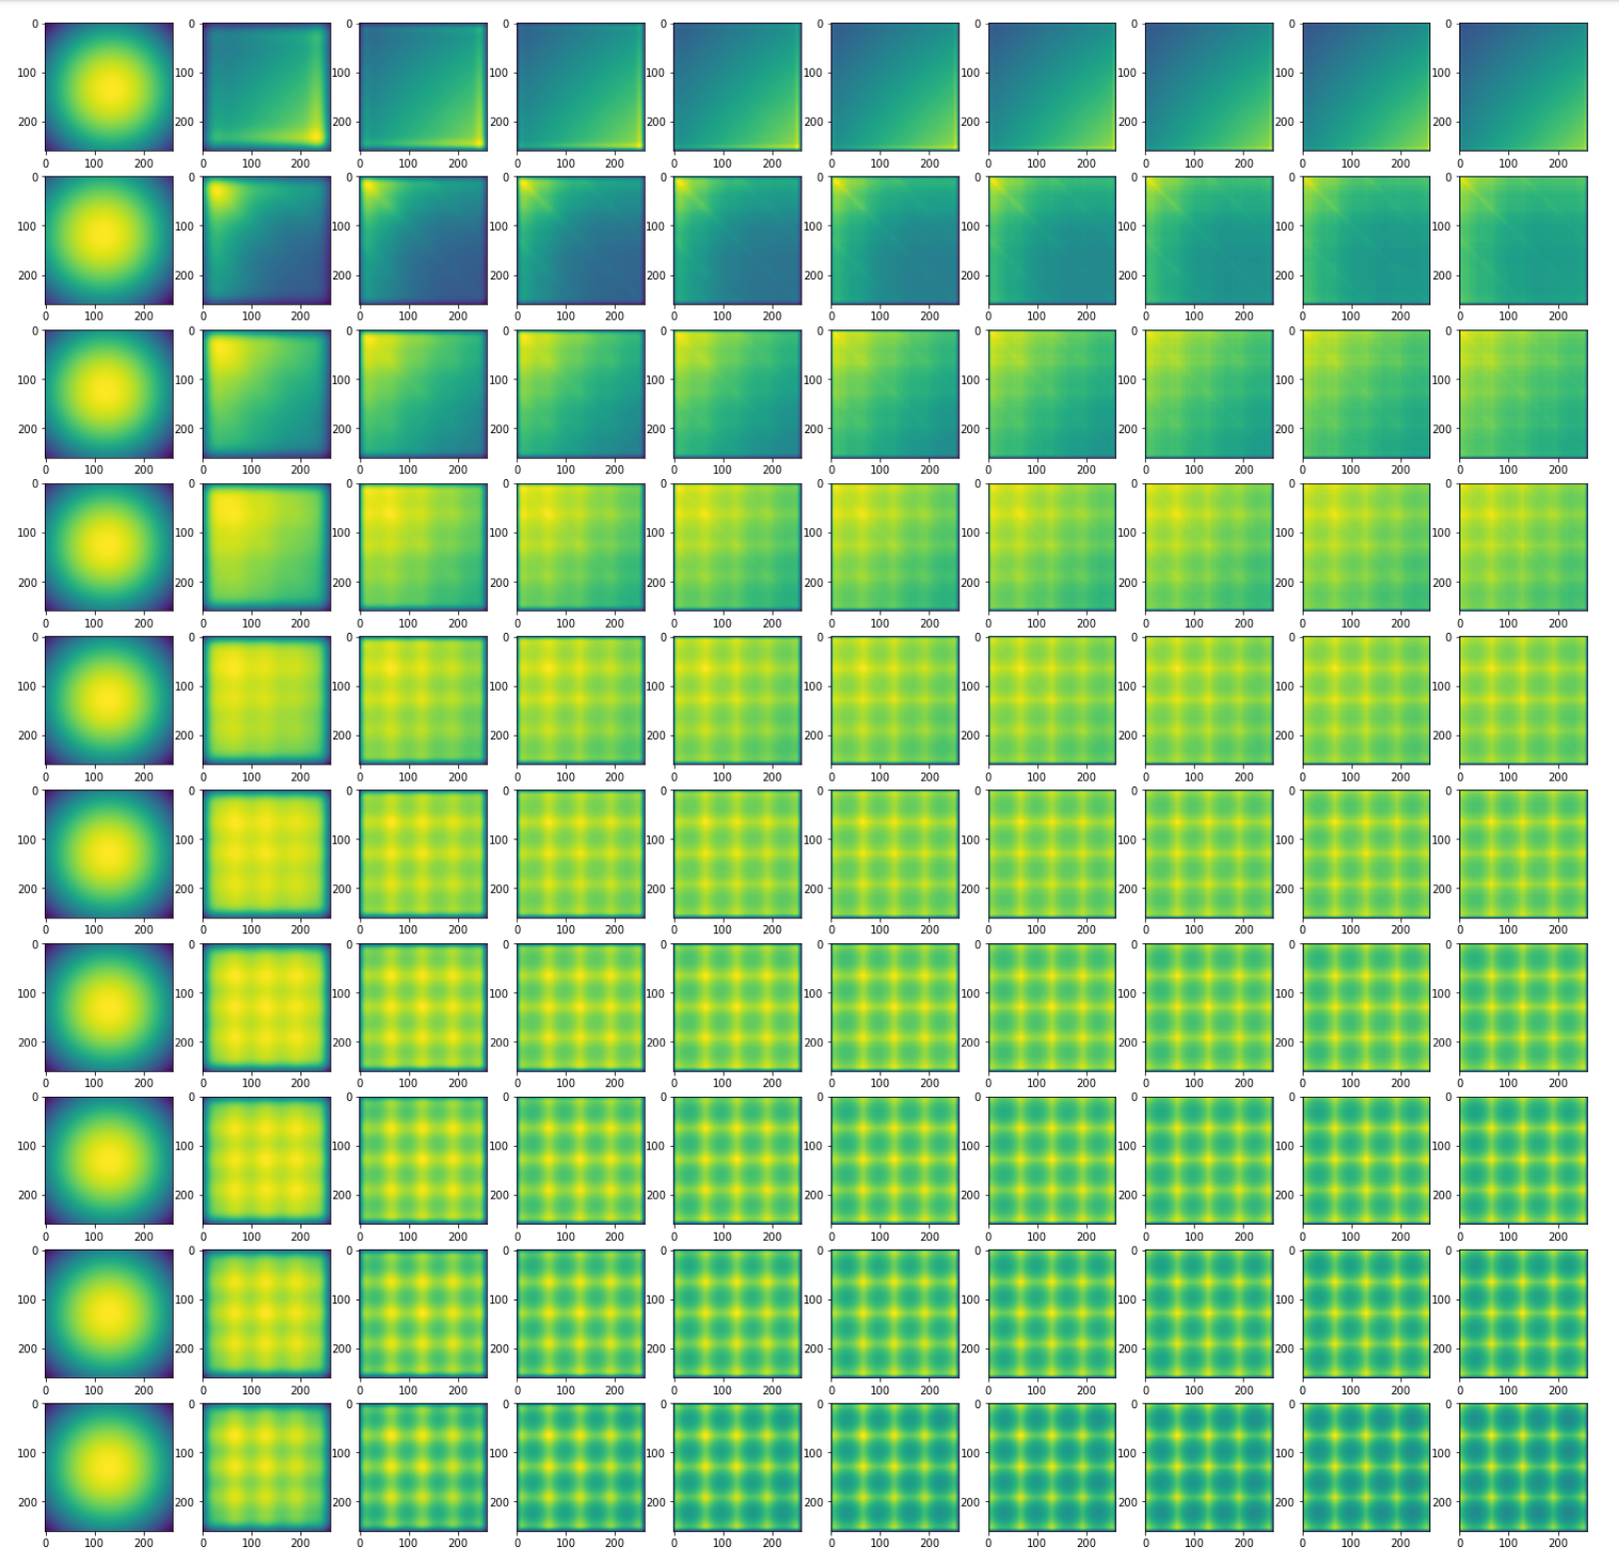
MPS Covariance interpretation is hard
Implementing the Morlet Transform
Box coordinates² plot per $k_{∥}$ ( given ${|k}_{⊥}| )$
BUT... Cross hairs line up with Simulation artifacts.

Slide 26
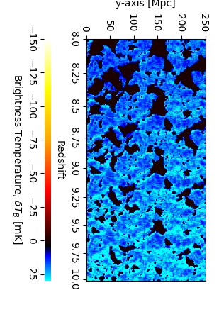
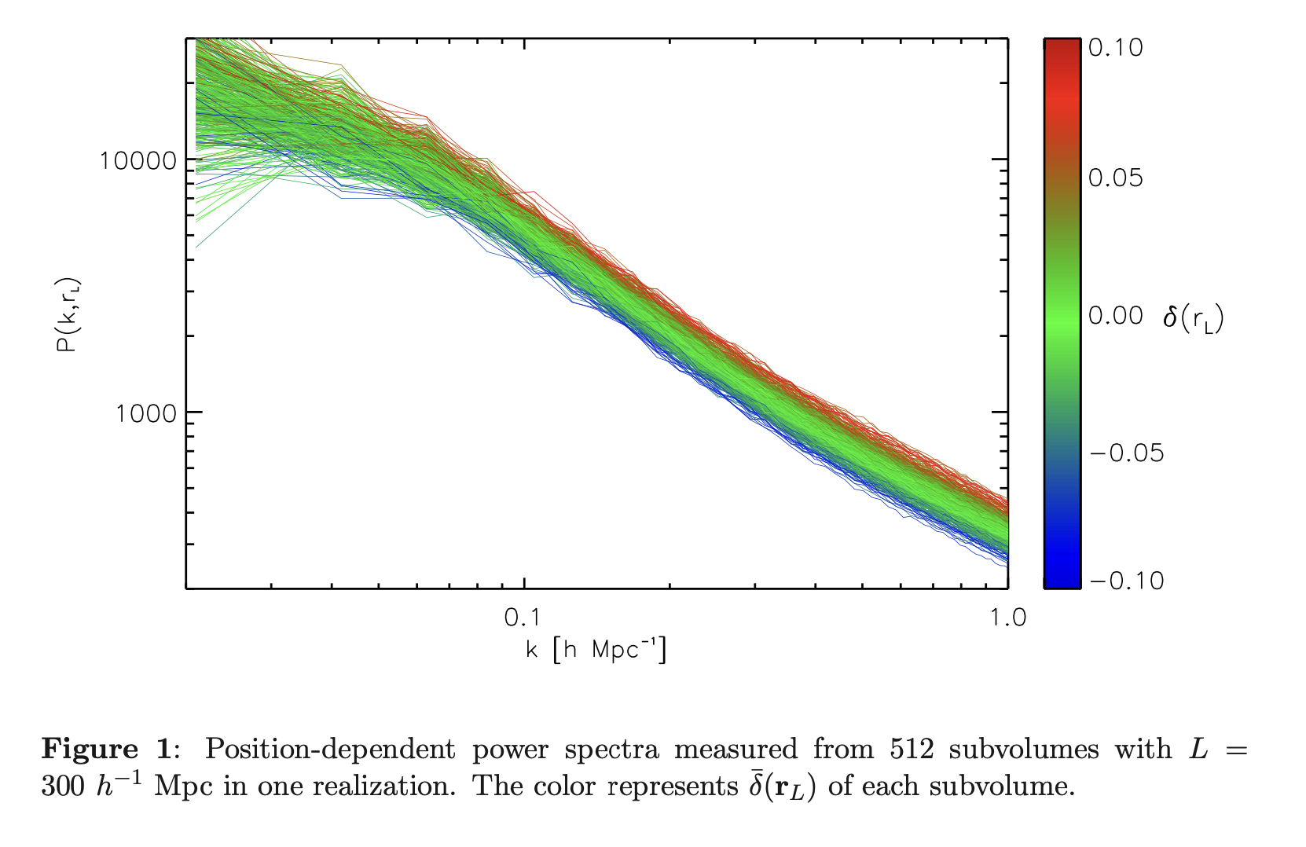
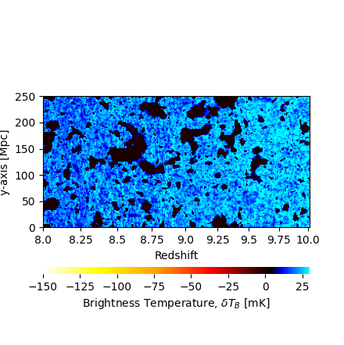
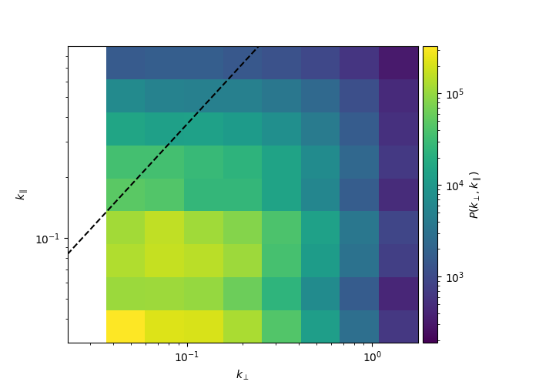
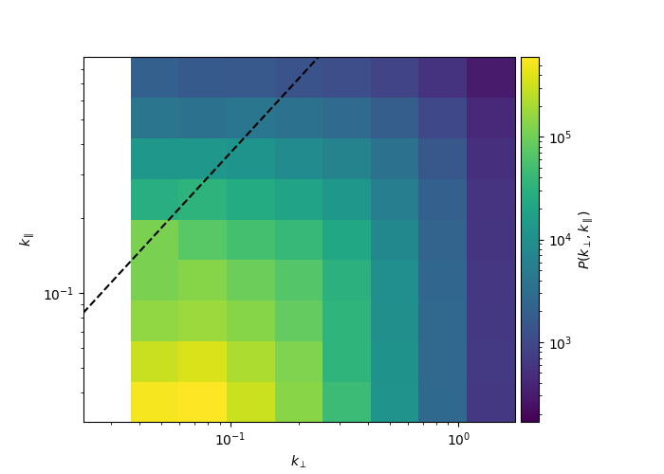
Long-mode lightcones
Original 21cmFast
(init box wraps)
Credit: Steven Murray
& Brad Greig
BUT…
Longer line of sight density modes produce cosmic variance
Chiang et al. 2014
– the ‘position dependent power spectrum’ is used to measure
the Bispectrum (Giri et al. 2020)
(1000 MWTs for a covariance in progress…)

Slide 27
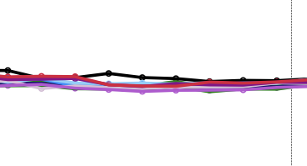
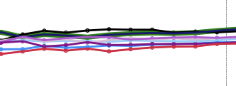
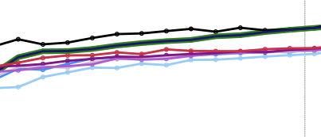
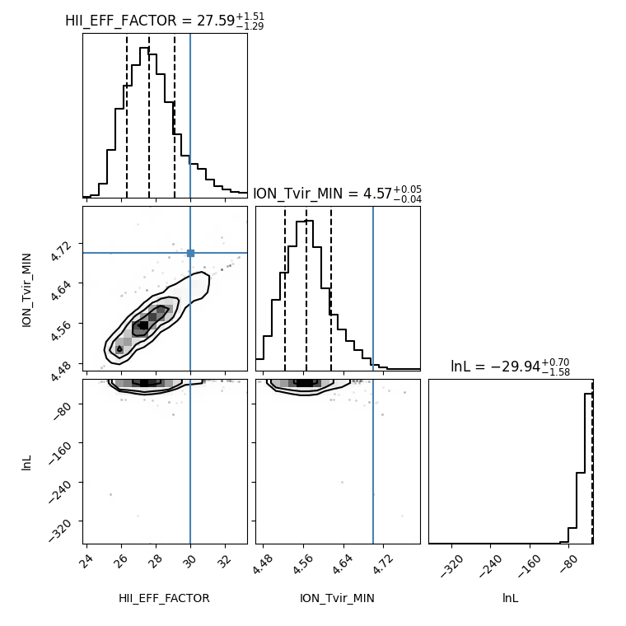

LoS Cosmic Variance with the FPS
- I’ve checked for aliasing (with resolution changes)
- Different random seeds cause different changes
if long modes are in the Data set
FPS posteriors can be biased >2$σ$

Slide 28
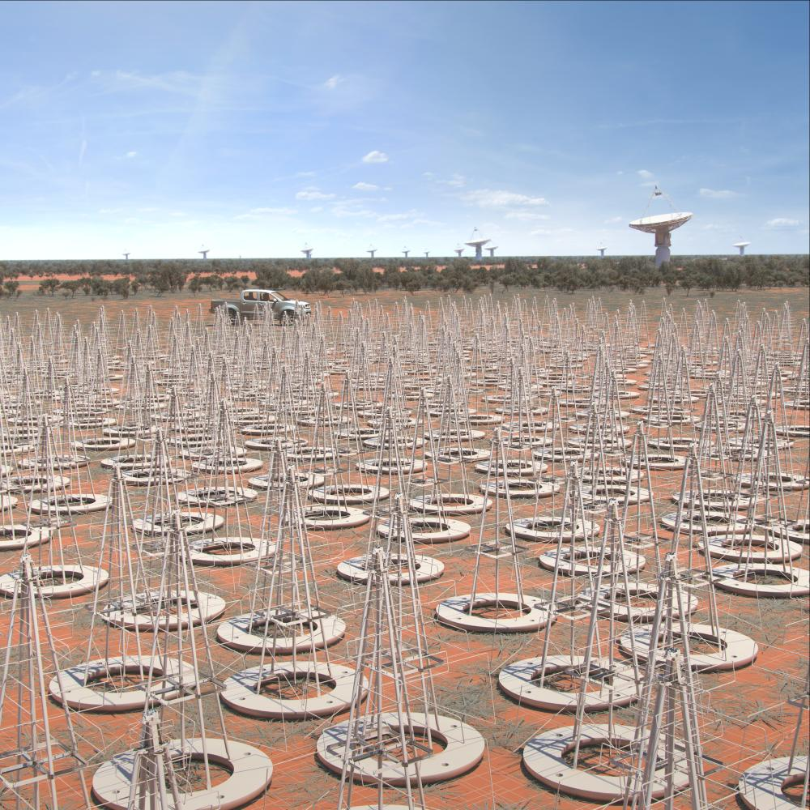

Bayesian model selection works in a wide variety of situations
Decisive disfavouring of EoR morphologies & astrophysics with with HERA and The SKA soon!
Statistical inference with CNNs is not flexible enough for use in EoR science.
(But L-free remains promising! Literature contains lots of alternatives… IMNN, Recurrent Neural Networks, Jenson-Shannon Divergence Razor etc.)
The Morlet Power Spectrum is very promising but needs work.
The Future
In progress…
- Adding Telescope noise
- Addressing LoS cosmic variance.
FZH Posterior variance [$ζ$, Log[$T_{vir}$]]
FPS – [± 2.0, ± 0.09 ],
3D-CNN - [± 1.6, ± 0.04],
MPS – [±0.03, ±0.01],

Slide 29
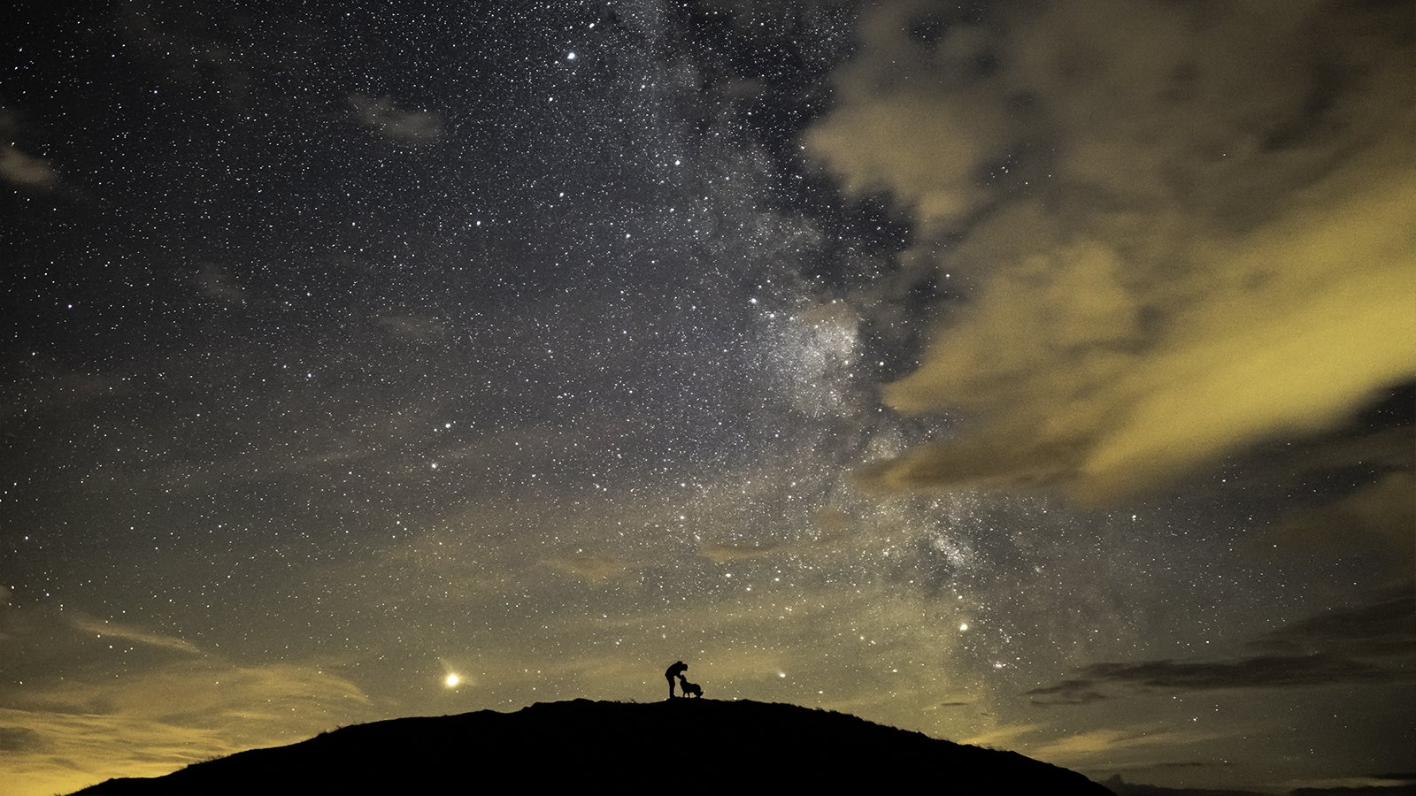
Thanks for Listening!
Pritchard J. R., Loeb A., 2012, Rep. Prog. Phys., 75, 086901
Loeb A., Furlanetto S. R., 2013, The First Galaxies in the Universe.
- Princeton Univ. Press, Princeton, NJ
Binnie T., Pritchard J. R., 2019, MNRAS, 487, 1160
Feroz F., Hobson M. P., Bridges M., 2009, MNRAS, 398, 1601
Greig B., Mesinger A., 2015, MNRAS, 449, 4246
Greig B., Mesinger A., 2017a, MNRAS, 472, 2651
Greig B., Mesinger A., 2017b, MNRAS, 465, 4838
Greig B., Mesinger A., Haiman Z., Simcoe R. A., 2017, MNRAS, 466,4239
Furlanetto S. R., Zaldarriaga M., Hernquist L., 2004, ApJ, 613, 1
Miralda-Escud´e J., Haehnelt M., Rees M. J., 2000, ApJ, 530, 1
Mesinger A., Furlanetto S., 2007, ApJ, 669, 663
Mesinger A., Furlanetto S., Cen R., 2011, MNRAS, 411, 955
McGreer I. D., Mesinger A., D’Odorico V., 2015, MNRAS, 447, 499
Greig B., Trott C., Barry N., mutch S., Pindor B., webster R., wyithe s., 2020, MNRAS, doi/10.1093
Zhao X., MAO Y., CHENG C., WANDELT, B. 2021 arXiv:2105.03344
Alsing j,.. CHARNOCK T., FEENEY S., WANDELT B., 2019, MNRAS, 488, 4440
Karamanis M., Beutler F., Peacock J., Nabergoj D., Seljak U. 2022 ARXIV: 2207.05652
Corander J., Remes U., Koski T., 2022 ARXIV 2206.04110
trott C., 2016, MNRAS, 461, 1, 126-135
Trott C., et al. doi/10.1093/mnras/staa414
Goupillaud P., Grossman A., Morlet J., 1984, Geoexploration, 23, 1,
Datta k., Mellema G., Ilian I., Shapiro P., Ahn K., 2012, MNRAS, 424, 3
Datta K., et al, 2014, MNRAS 442, 2
Zhao, X., Mao, Y., Wandelt, B. D., 2022, ApJ 932, 2, 236
Zhao, X., Mao, Y., Cheng, C., Wandelt, B. D., 2022, ApJ 926, 2, 151
Giri, S., D'Aloisio A., Mellema, g., komatsu ,e., ghara,r., Majumdar, s., 2019 jcap 02..058G
Chaing, C., wagner, C., Schmidt, c., komatsu, e., 2014 jcap 05..048C
https://www.rmg.co.uk/whats-on/astronomy-photographer-year
Questions?
Collaborators:
Yi Mao,
Xioasheng Zhao,
Meng Zhou,
Jonathan Pritchard,
Cath Trott,
Steven Murray,
David Prelogović,
Brad Greig.
Photo Credit: Ben Bush, Greenwich Planetarium

