Slide 1
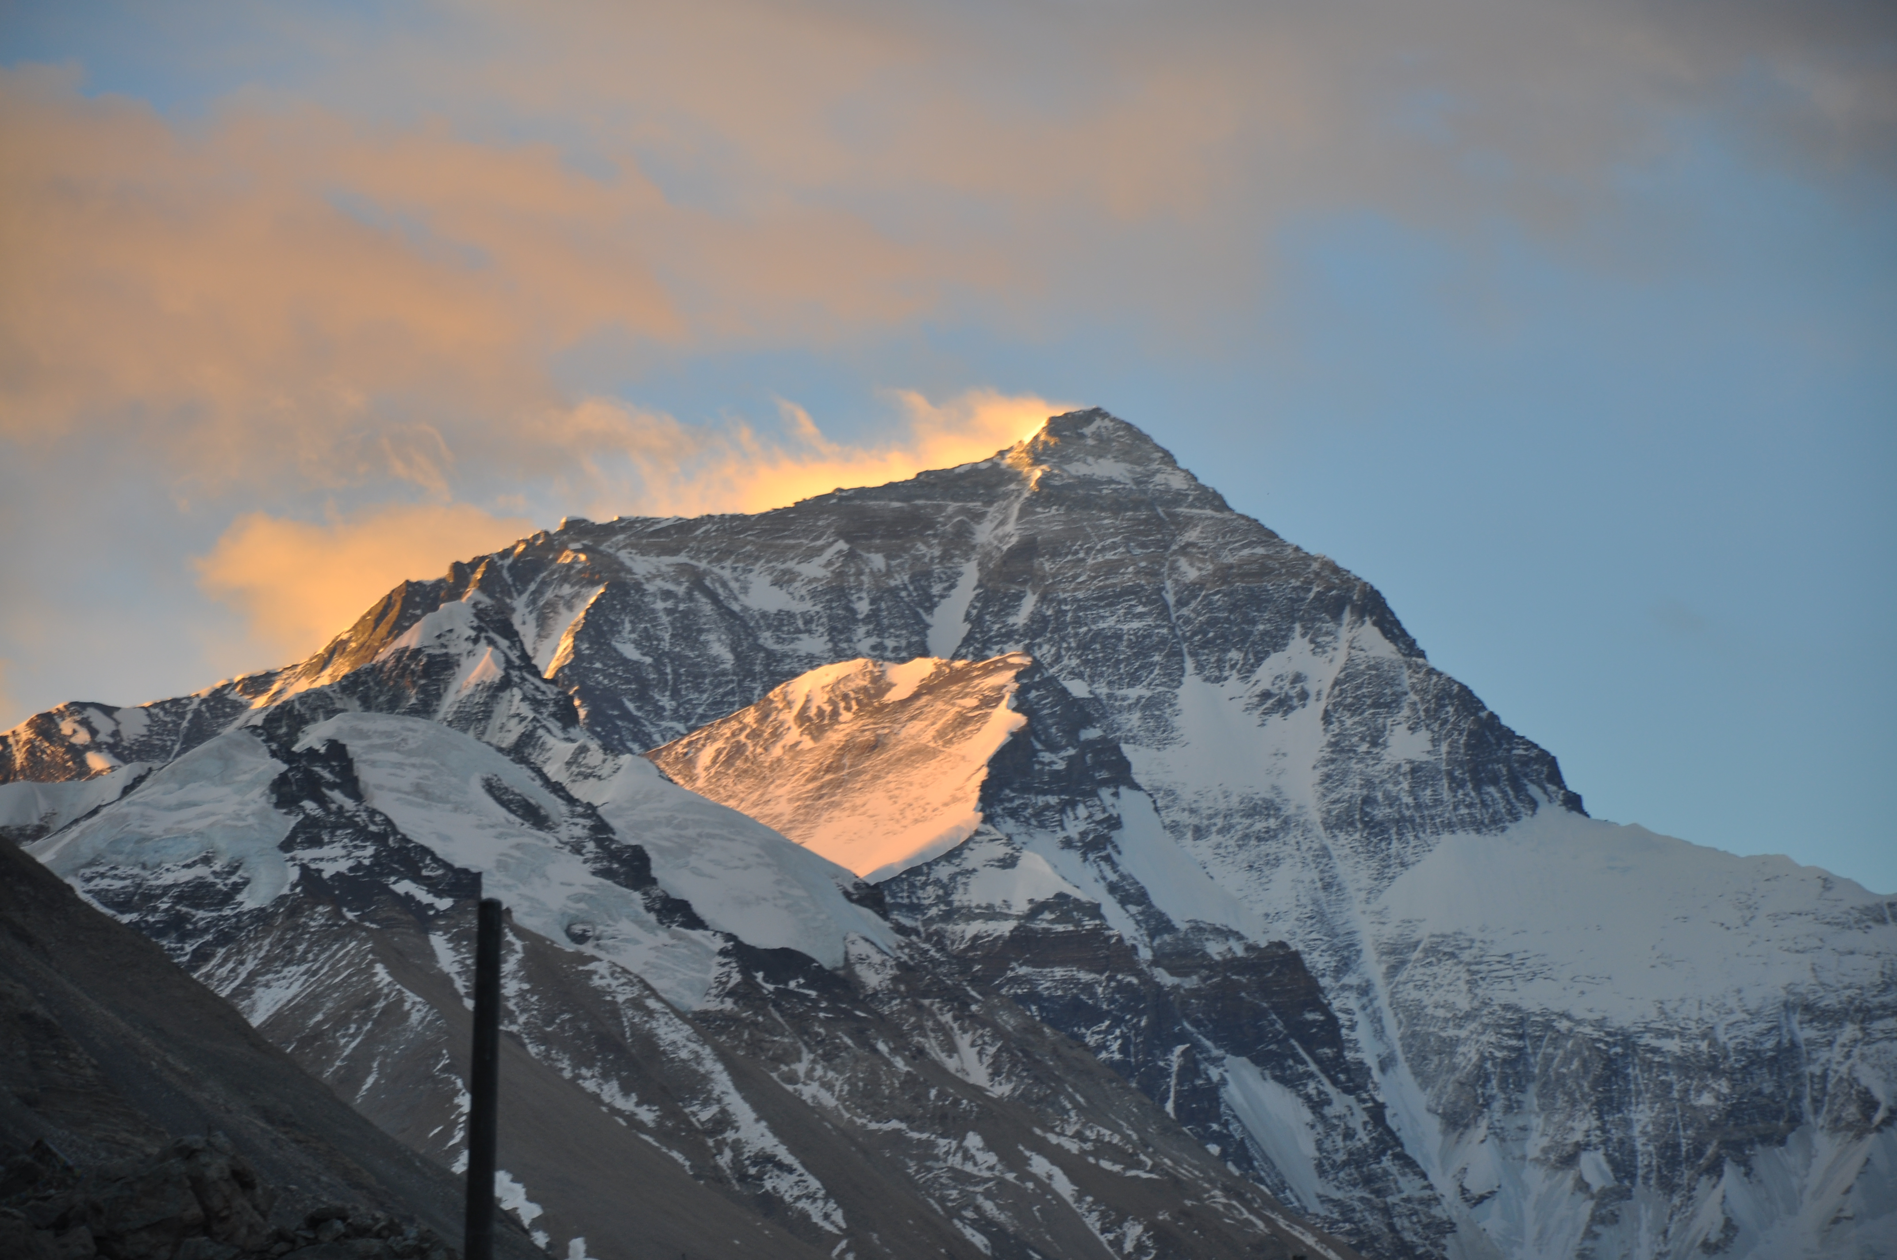
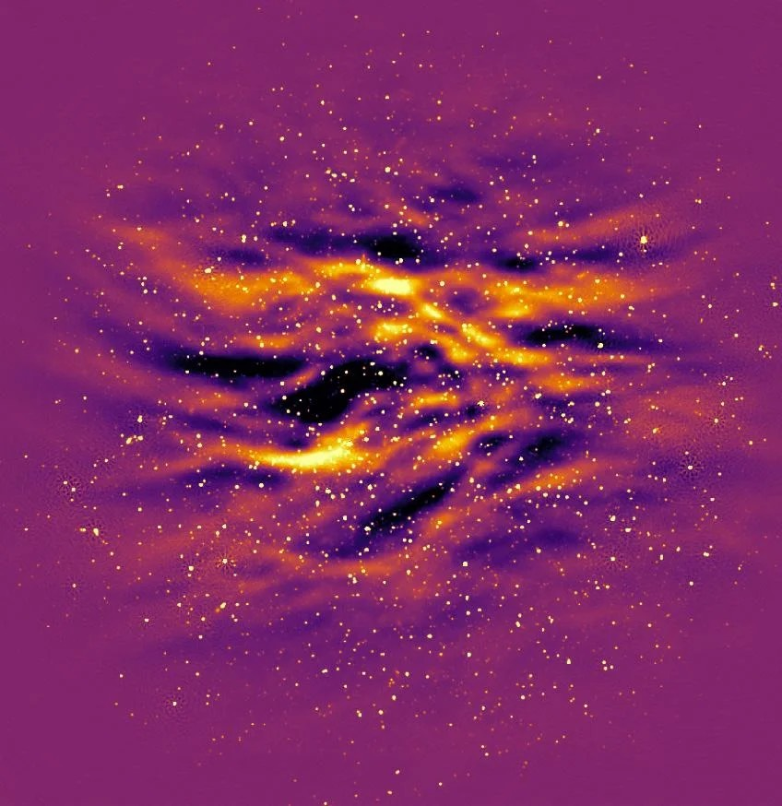
21 cm signal recovery in SKA Data Challenge 3
Le Zhang
Sun Yat-Sen University
SKA CD-EoR Science Team Meeting 2024
@Beijing 2024.07.19

Slide 2
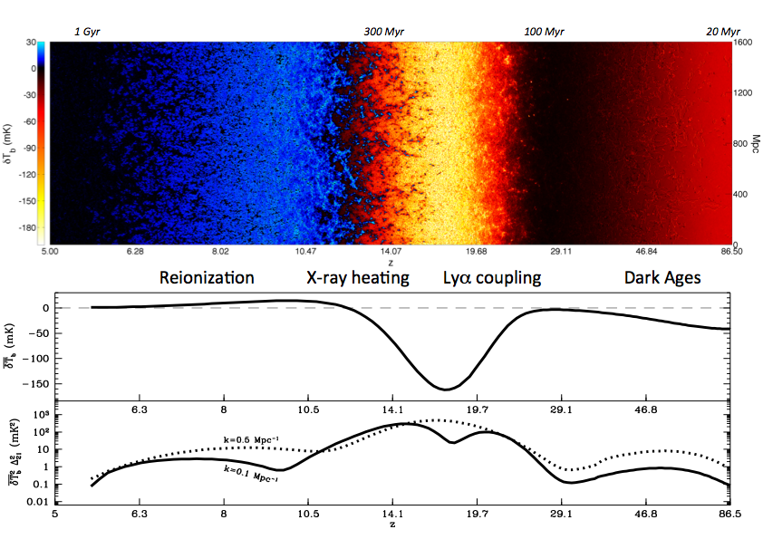
Foreground contamination
Strong foreground:
$$T_{foreground}≫10K$$
Faint signal:
$$T_{21cm}∼10mK$$
Mesinger et al. (2016)

Slide 3
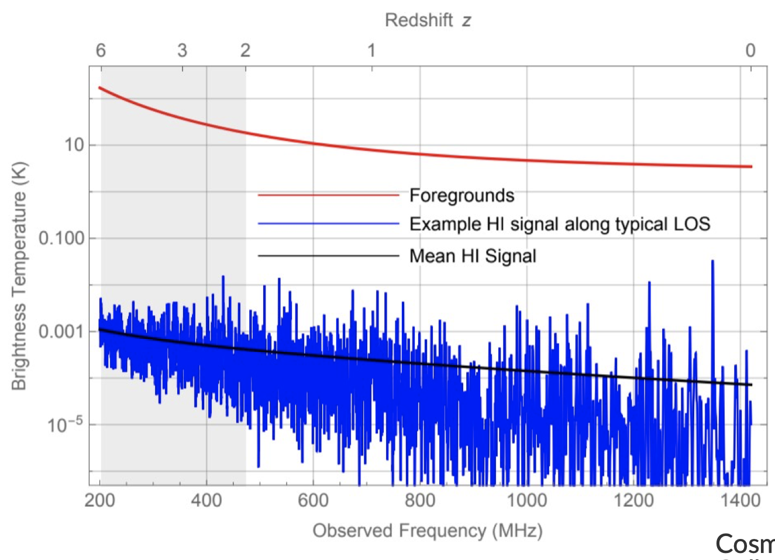
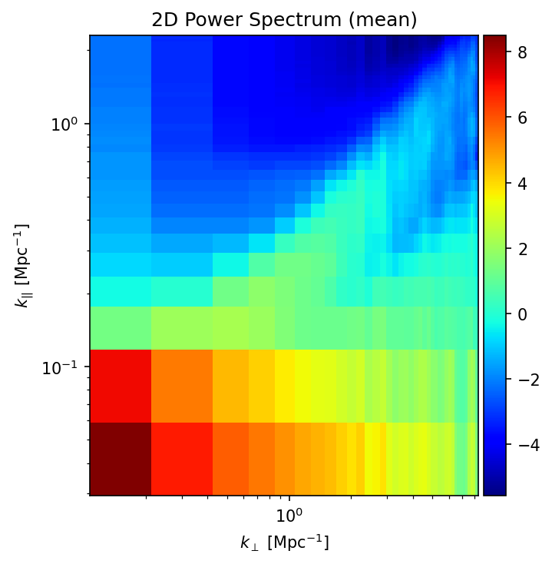
The key to separating out foregrounds: their spectral smoothness
21cm
foreground

Slide 4
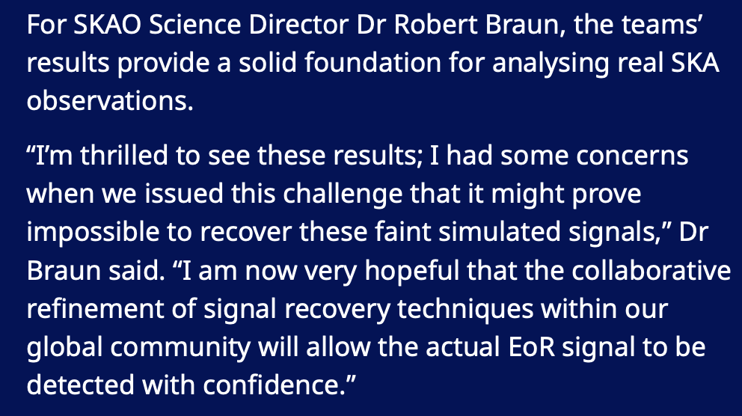

Slide 5
Science Data Challenge 3a – Datasets
General
Four-hour duration tracking observation
Thermal Noise Equivalent: 1000 hours
Field of View: One SKA1-Low pointing at RA, Dec = 0h, -30 deg
Visibilities/images
Size: 7.5 TB (Visibilities)
Integration Time: 10 seconds
Channel Width: 100 kHz
Frequency Coverage: 106-196 MHz (6 cubes $×$ 151 channels)
Image Cube (60 GB): 2048$×$2048, 16 arcsec pixels, natural/uniform weighting
The Challenge
Determine EoR power spectrum as function of scale and frequency
Cleaning foreground (10⁵ times brighter)
Presence of various residual calibration errors: DI, DD & bandpass

Slide 6
33 teams

Slide 7
SDC3a teams and FG-cleaning approaches
10 top teams:
HIMALAYA (SYSU): reconvolution + transfer function
DOTSS-21 (ML-GPR; Advanced_ML-GPR; Avoidance): Machine-learning+Gaussian Process Regression (GPR) to model the foregrounds to separate them from the 21-cm signal
ERWA: neural network applied in image; China SRC supported
Shuimu-Tianlai (Tsinghua-NAOC): oriented singular value decomposition (O-SVD)
Wizards of Oz 3D: improving the sky model to improve the quality of the sky-model-subtracted visibilities; 4th-order polynomial fitting; Pawsey Supercomputer supported
Akashganga: 2nd-order polynomial fitting+GPR
REACTOR: PI-AstroDeconv +PCA
SKACH: U-shaped 3D convolutional neural network to remove residual foreground; polynomial fitting in uv space
KUSANAGI: PCA+neural network; Cantabrigians: Bayesian GPR model; Hausos: CNN-based approach; Nottingham-Imperial: point-source model+ FastICA; Pisano Galaxy Moppers: foreground avoidance; Foregrounds-FRIENDS: PCA+neural network; HAMSTER: delay spectrum approach; KORSDC: PSF deconvolution+ICA SROT: GPR …

Slide 8
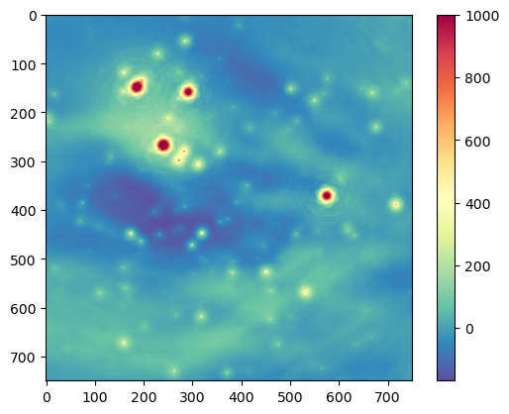
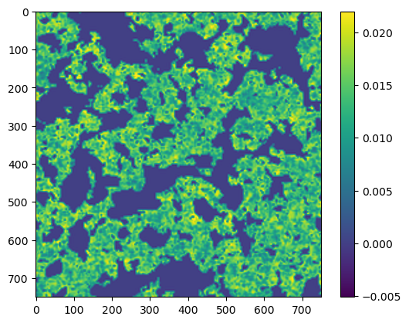
Challenge: FG contamination
five orders of magnitude brighter; FG removal accuracy of at least 1 in 10,000 required !!!
Raw SDC3a image
(natural weighting)
Ture EOR

Slide 9
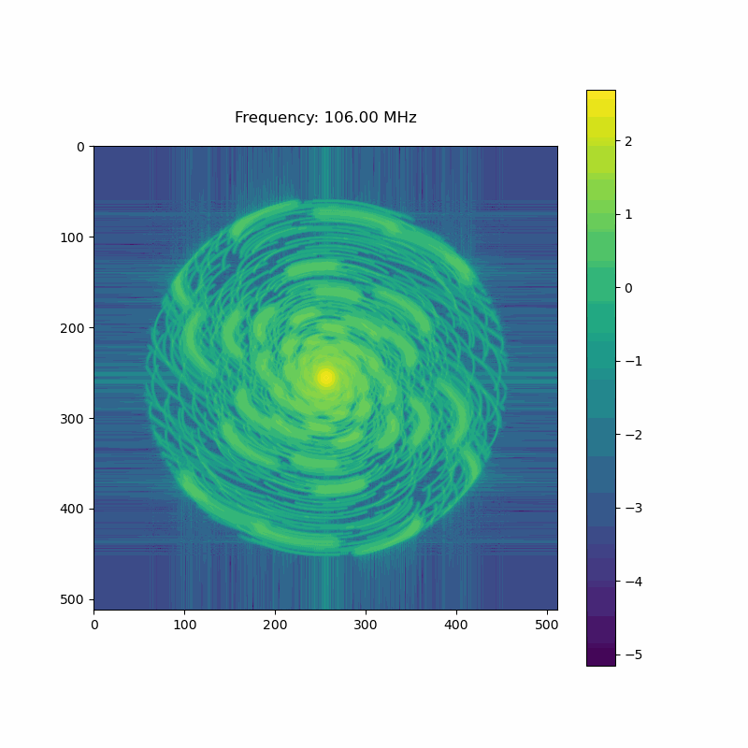
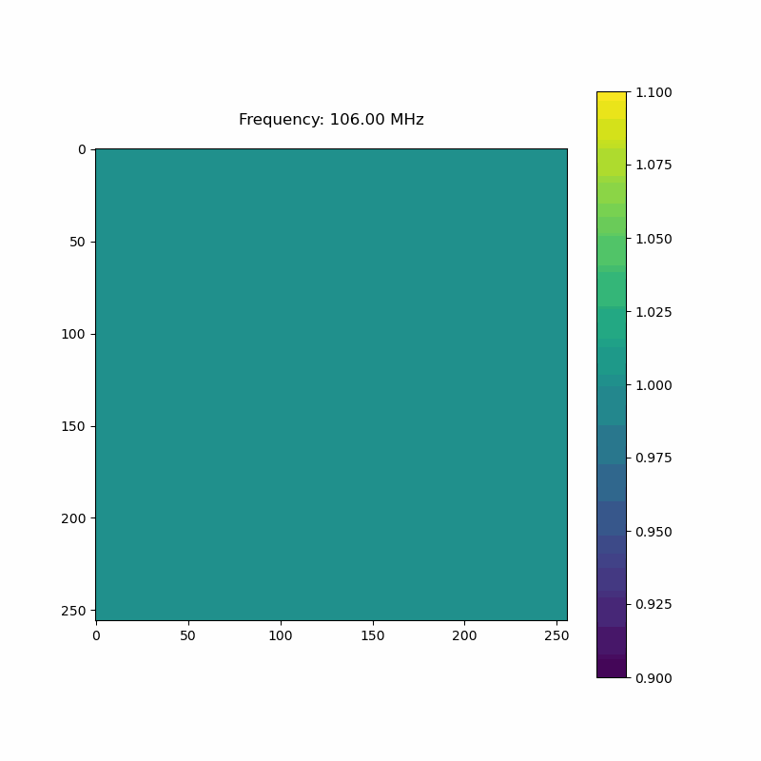
Key Challenge: frequency-dependent PSF
$→$ uv coverage changed with frequency
$→$ notable change for PSF (esp. its sidelobe) with frequency
uv coverage
PSF(v)/PSF(106 MHz)

Slide 10
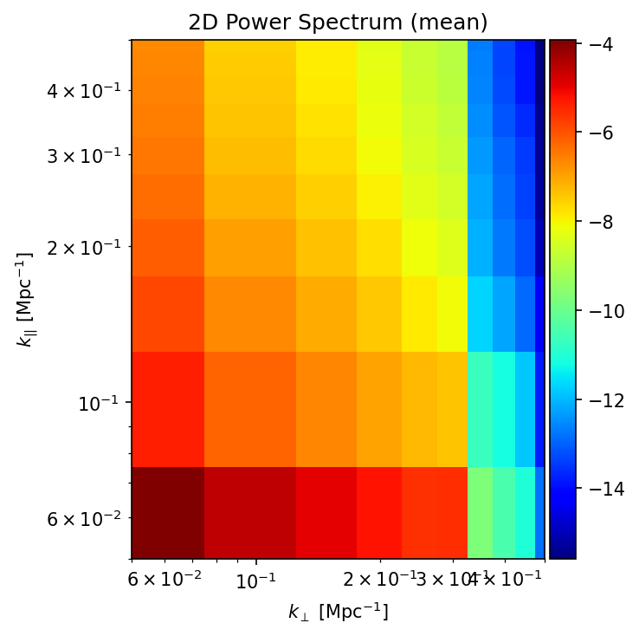
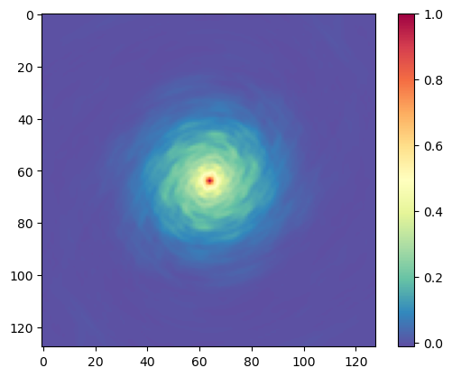
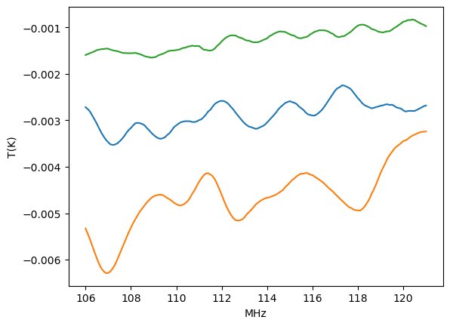
Key Challenge: frequency-dependent PSF
$→$ mode-mixing $→$ producing non-smooth FG spectrum
set up a point source on the sky without frequency dependence
following interferometric observation, the spectrum undergoes an oscillation
mode mixing: spatial modes mixed up with frequency modes
random positions on sky

Slide 11
Mode-mixing:
PSF varied with frequency, breaking down the smoothness
uv_PSF
frequency (LoS)
Look along frequency direction…
dirty map

Slide 12
Challenges:
“mode-mixing” breaks the smoothing and prevents foreground removal
PSF deconvolution — an ill-posed inverse problem; achieving the desired precision of 1 in 10,000 is not feasible
Solution: other way around?
Counterintuitive approach:
reconvolution rather than deconvolution
Reduction of mode mixing:
suppressing high-$k_{⊥}$ modes that vary significantly with frequency, which dominate the effect of mode mixing.

Slide 13
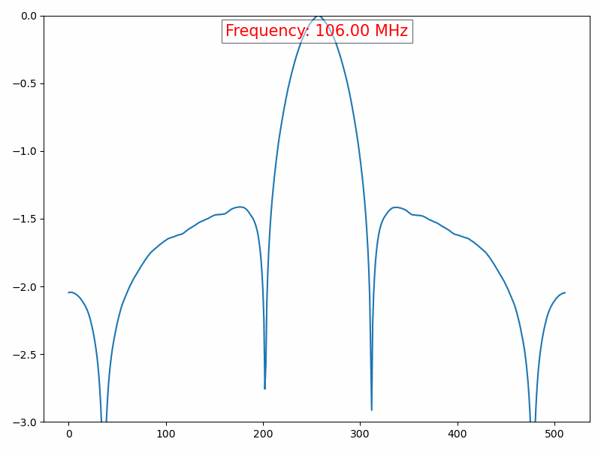
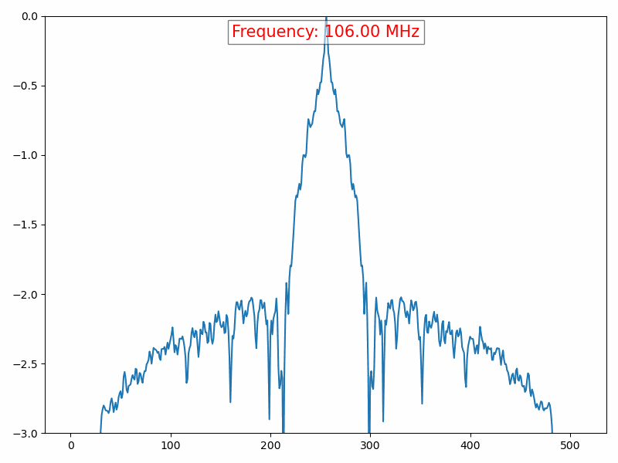
PSF$⊗$PSF
PSF

Slide 14
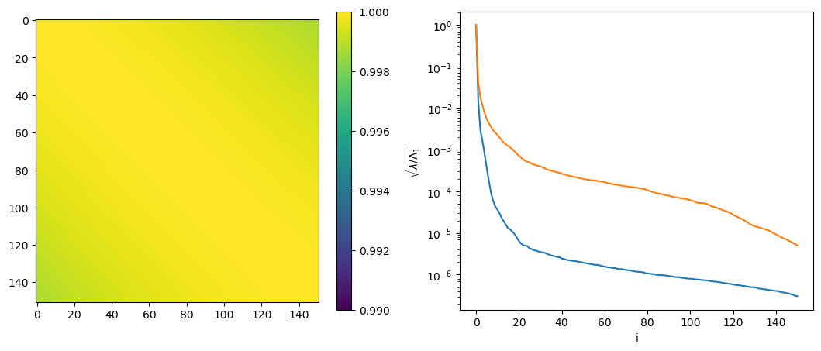
Smoothness recovered by “reconvolution”
$${Cov}_{νν^{′}}$$
eigenvalues
dirty map
HI level
reconvolution
project out the first ~20 modes - remove foreground perfectly!

Slide 15
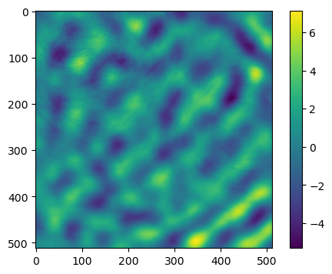
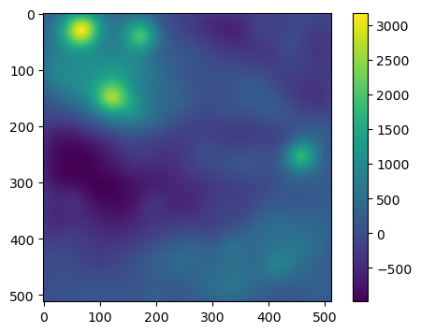
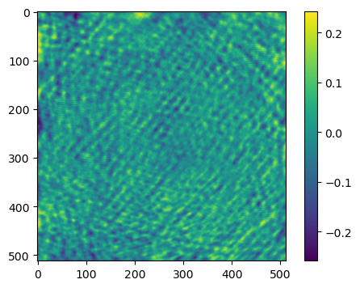
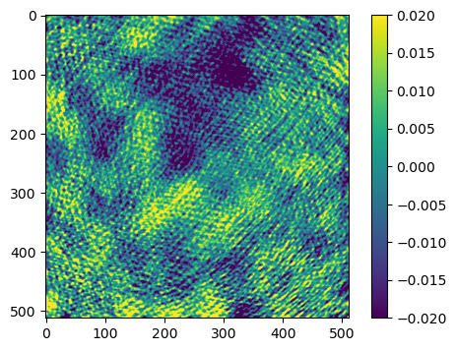
Residuals after PCA projection
$$N_{c}=3$$
$$N_{c}=0$$
$$N_{c}=10$$
$$N_{c}=20$$

Slide 16
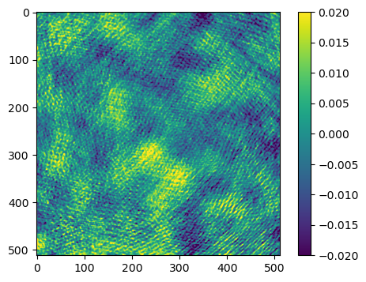
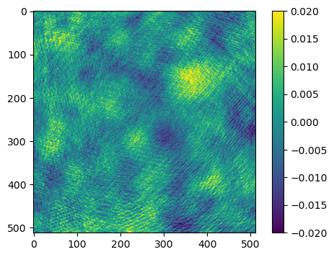
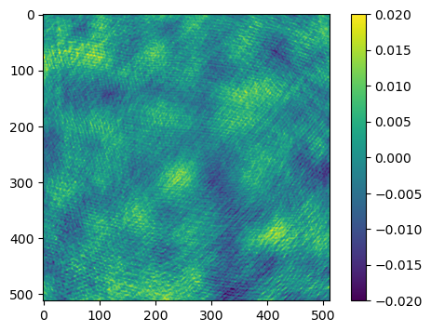
Convergence test:
further modes projected out
yet the residual patterns remained largely unaltered
$$N_{c}=25$$
$$N_{c}=30$$
$$N_{c}=40$$

Slide 17
Compared with 21cm image@ 121 MHz
Recon
True
Correlation coefficient of image ~ 0.5–0.6
Direct imaging of EoR at large scales is promising!

Slide 18
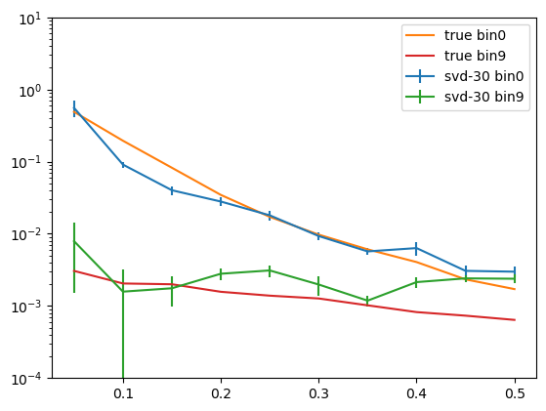
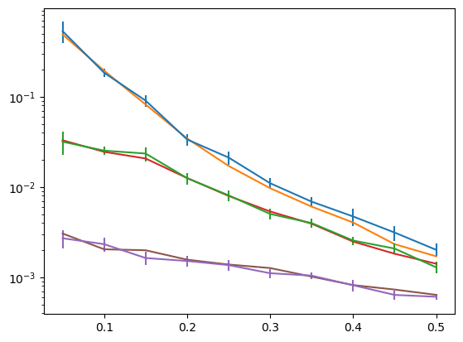
Transfer function: corrected for amplitude
correction for the amplitude of missing modes generated by PCA and various instrumental effects
transfer function — $T(k_{∥},k_{⊥})≡P_{21}^{true}(k_{∥},k_{⊥})/P_{21}^{rec}(k_{∥},k_{⊥})$
use mock realizations to estimate its mean and std
EoR reconstruction: $P^{reonc}=T(k_{∥},k_{⊥})×P^{svd}$

Slide 19
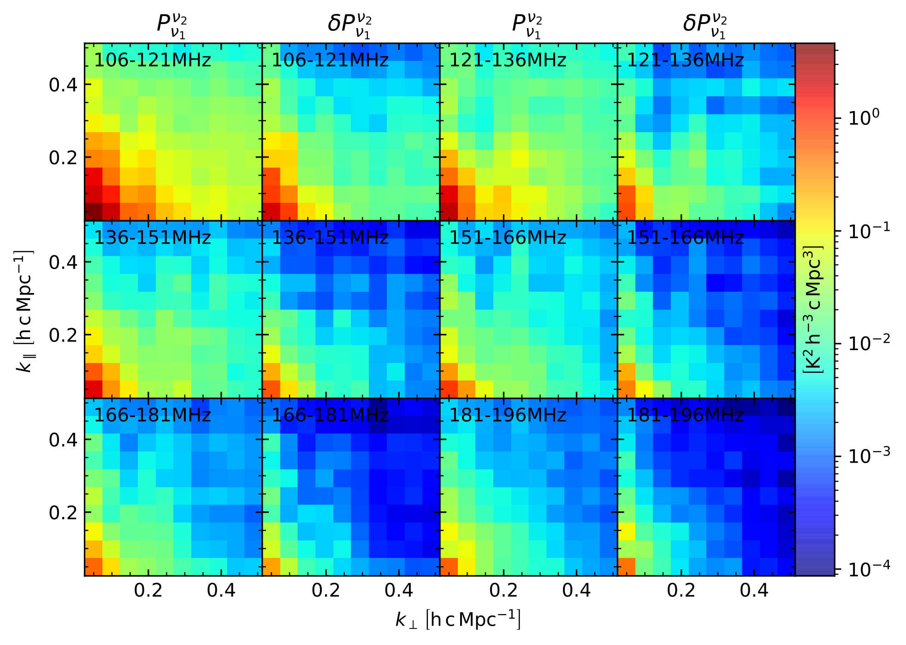
Submitted results—HIMALAYA

Slide 20
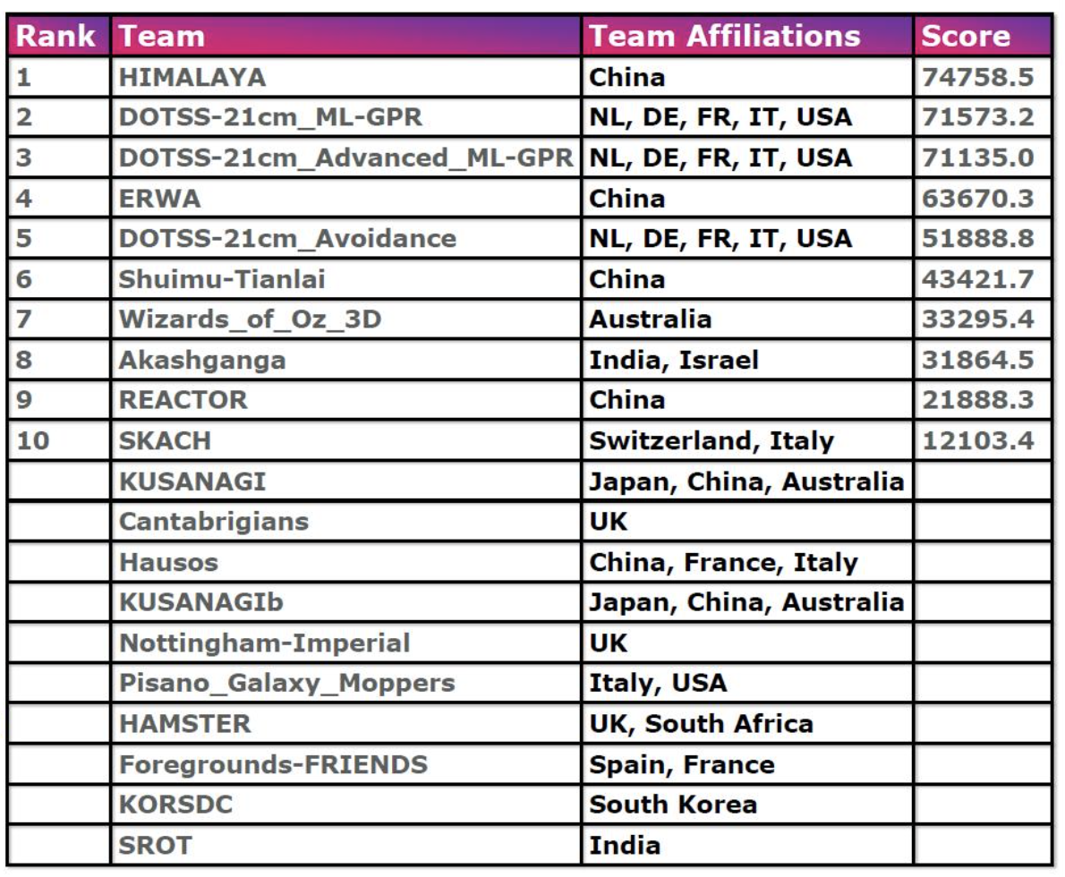

Slide 21
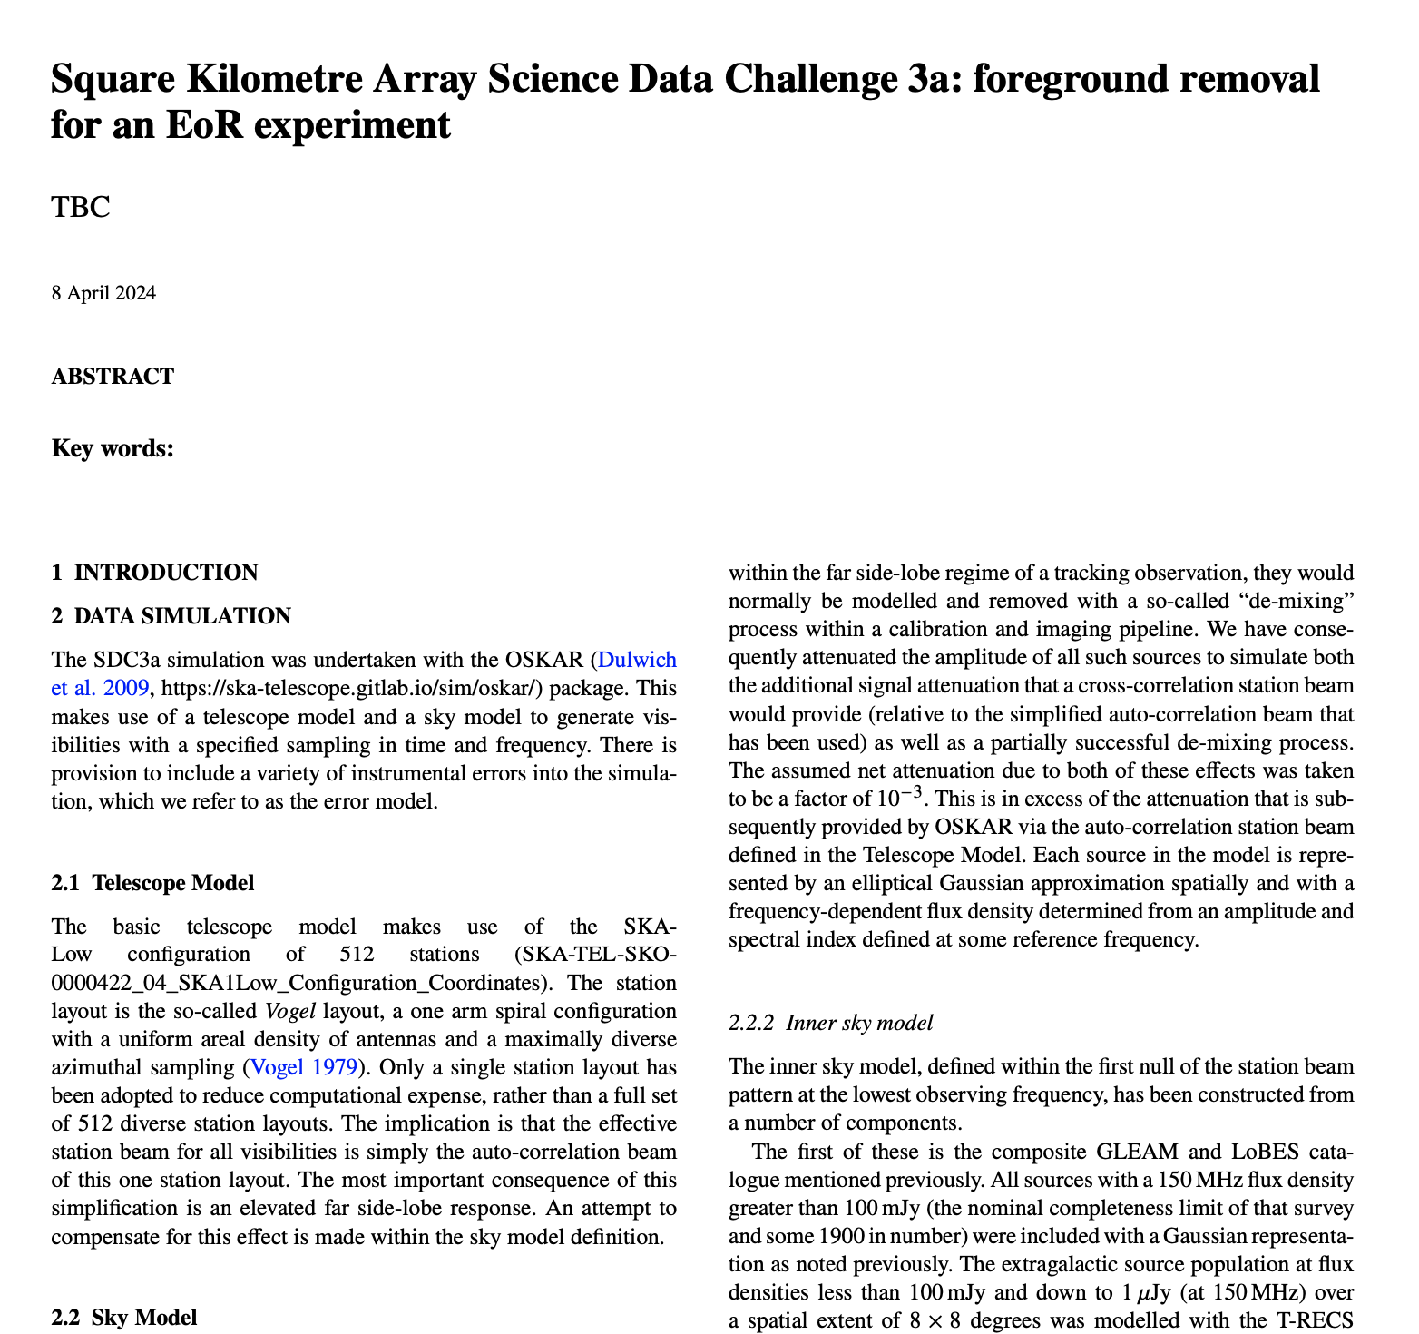
Collaborative paper in preparation …

Slide 22
Thanks！

