Slide 1
SKA Science Data Challenge 3b
EoR Inference

Slide 2
Schematic of a general inference pipeline

Slide 3
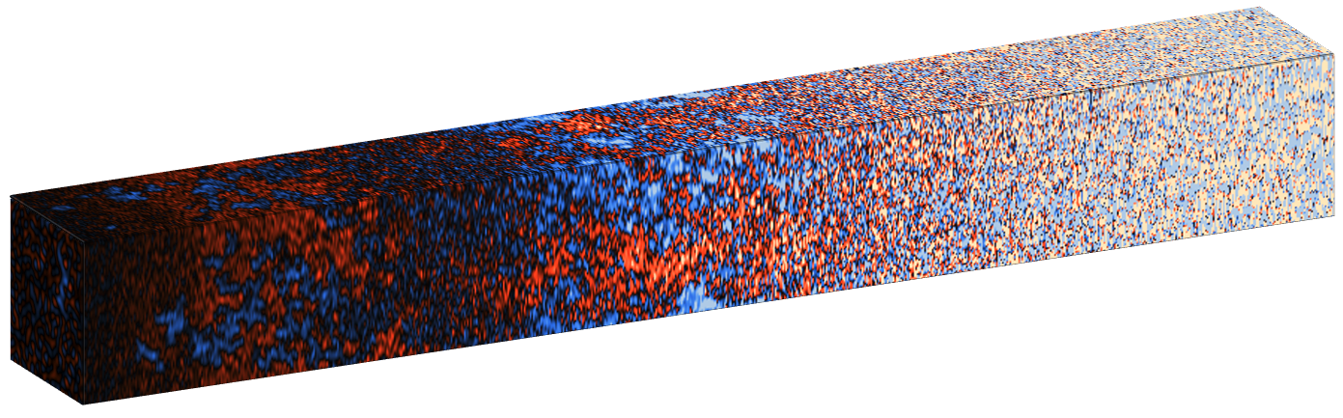
Observation
Cleaning
(backward modeing)

Slide 4
Observation
Cleaning
(backward modeing)
Compression

Slide 5
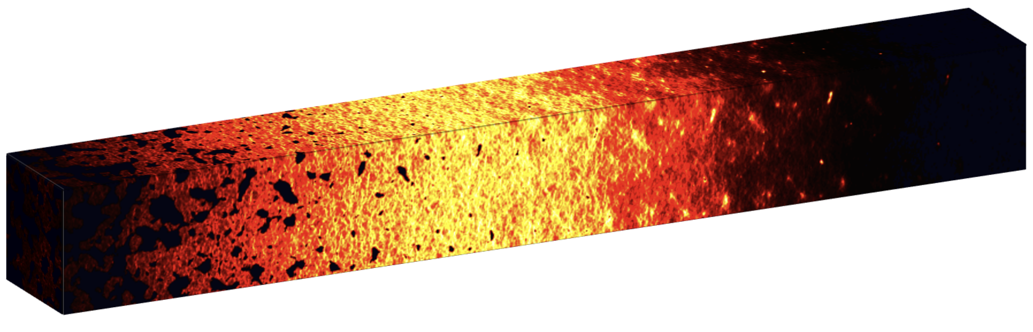
Simulation
Astrophysics
Observation
Cosmology
Cleaning
(backward modeing)
Compression

Slide 6
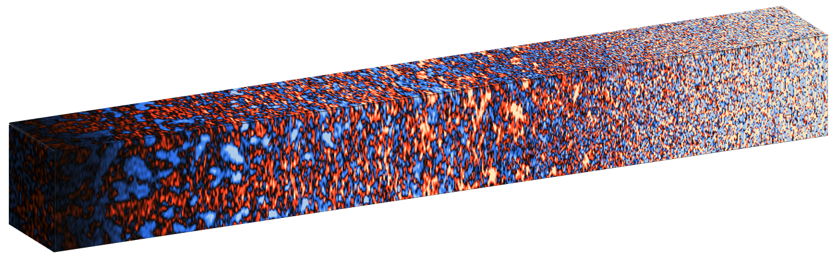
Simulation
Astrophysics
Observation
Cosmology
Cleaning
(backward modeing)
Telescope
simulator
Foreground /
Systematics
residual
simulator
Compression

Slide 7
Simulation
Astrophysics
Observation
Cosmology
Cleaning
(backward modeing)
Telescope
simulator
Foreground /
Systematics
residual
simulator
Compression
Compression

Slide 8
Simulation
Astrophysics
Observation
Cosmology
Cleaning
(backward modeing)
Telescope
simulator
Foreground /
Systematics
residual
simulator
Compression
Compression
Likelihood (analytic / LFI)

Slide 9
Simulation
Astrophysics
Observation
Cosmology
Cleaning
(backward modeing)
Telescope
simulator
Foreground /
Systematics
residual
simulator
Compression
Compression
Likelihood (analytic / LFI)
x N samples

Slide 10
SDC3b
the first step in bringing together the global 21cm interpretation community

Slide 11
Observation
Simple cleaning: wedge removal (guided by SDC3a)
~30h integration (tbc)
Cleaning
(backward modeing)

Slide 12
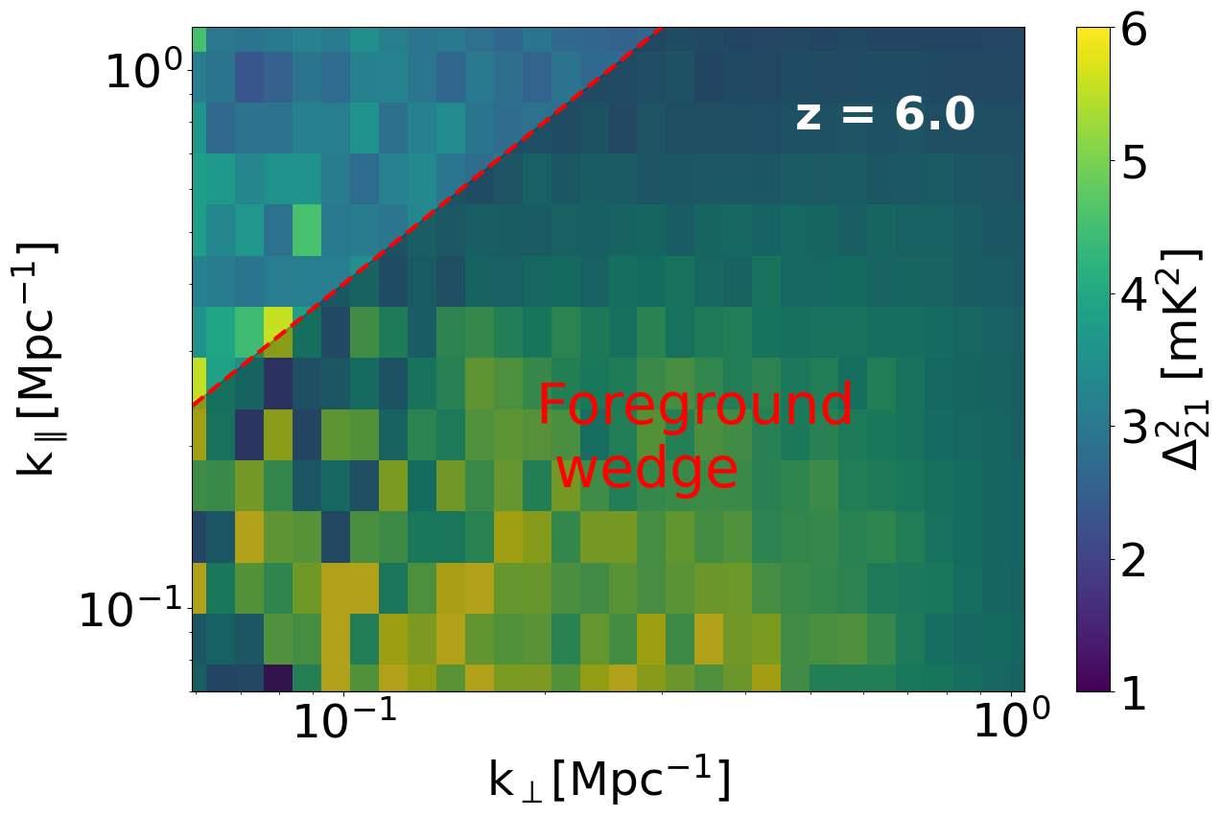
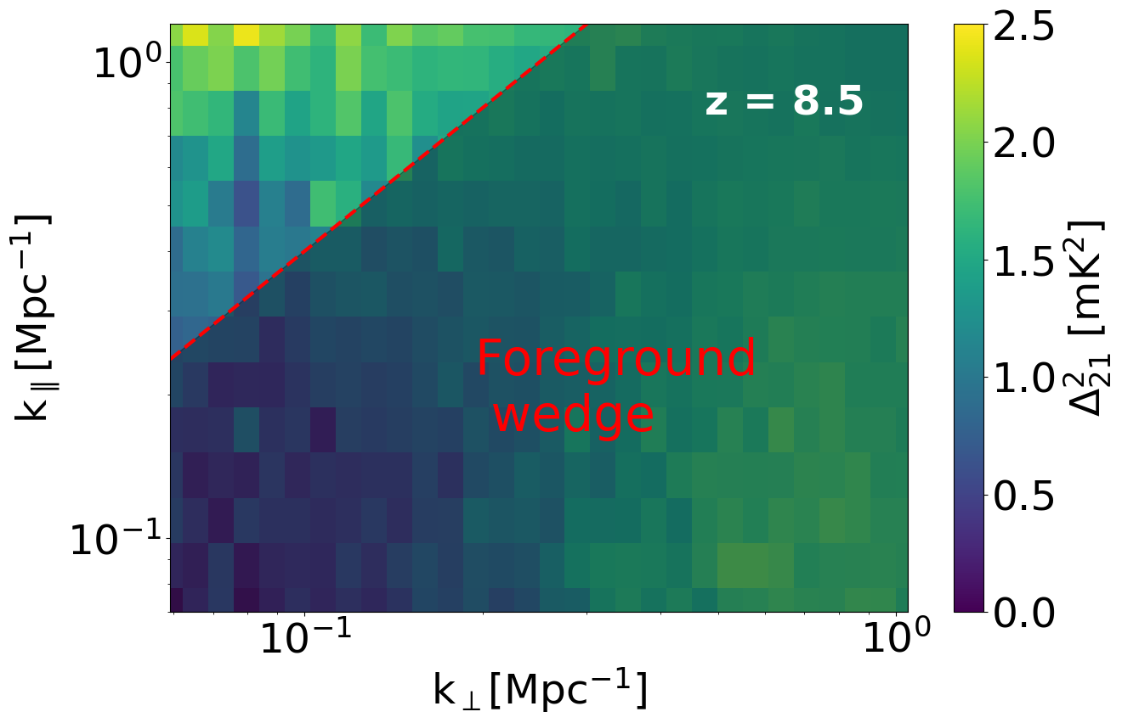
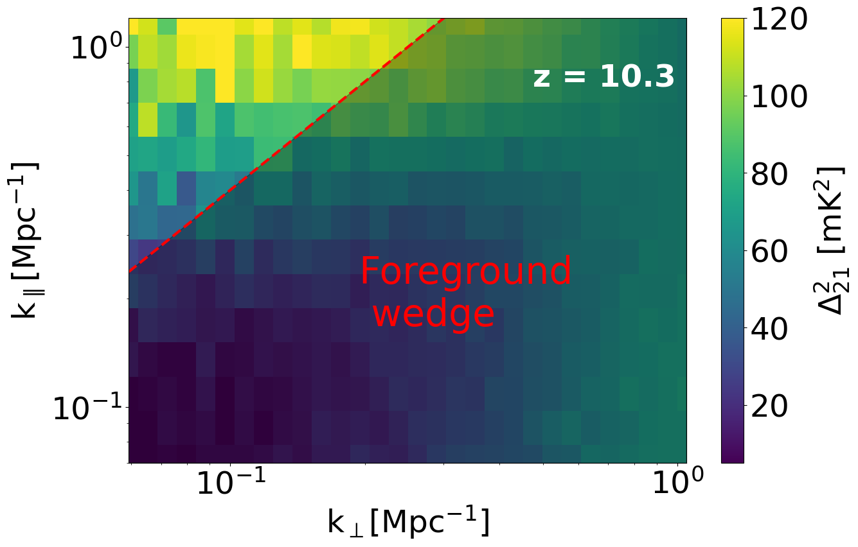
Observation
Simple cleaning: wedge removal (guided by SDC3a)
~30h integration (tbc)
Cleaning
(backward modeing)
2D power

Slide 13
Simulation
Astrophysics
Observation
GIVEN
Cosmology
Park+2019
Ts>>Tcmb
Cleaning
(backward modeing)
Compression
data 2D PS

Slide 14
Simulation
Astrophysics
Observation
GIVEN
Cosmology
Park+2019
Ts>>Tcmb
Cleaning
(backward modeing)
Telescope
simulator
given noise PS (tbc)
Compression
data 2D PS

Slide 15
Simulation
Astrophysics
Observation
GIVEN
Cosmology
Park+2019
Ts>>Tcmb
Cleaning
(backward modeing)
Telescope
simulator
given noise PS (tbc)
Compression
Compression
sim 2D PS
Likelihood (analytic / LFI)
data 2D PS

Slide 16
Simulation
Astrophysics
Observation
GIVEN
Cosmology
Park+2019
Ts>>Tcmb
Cleaning
(backward modeing)
Telescope
simulator
given noise PS (tbc)
Compression
Compression
sim 2D PS
Likelihood (analytic / LFI)
data 2D PS
P( x_{HI}(z) | data 2D PS)

Slide 17
SDC3b
Summary slides from A. Bonaldi

Slide 18
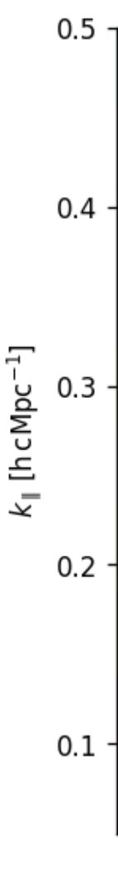
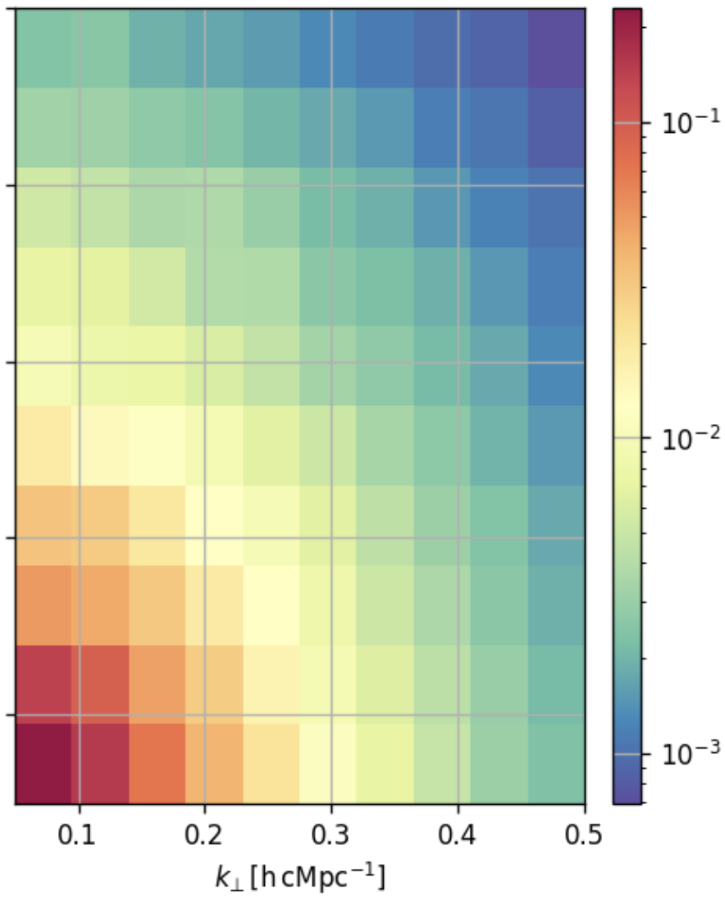


Science Data Challenge 3b: EoR Inference
Example 2D power spectrum
  Inference of reionization fraction for EoR
    2D power spectra
    Imaging cubes (TBC)
  Two simulators used: 21cmfast_v4 (default FFRT) and pyC2ray
21cmFast v4
(Davies, AM et al. in prep)
pyC2Ray
(Hirling, Bianco et al. 2024)
Park+2019 astrophysical parametrization w. scatter
Only ionizing radiation: Ts>>Tcmb
Vary BOTH astrophysical parameters AND simulators
slide courtesy of A. Bonaldi

Slide 19
Science Data Challenge 3b: EoR Inference
Example 2D power spectrum
  Inference of reionization fraction for EoR
    2D power spectra
    Imaging cubes (TBC)
  Two simulators used: 21cmfast_v4 and pyC2ray
  Power spectra sets:
    PS1, PS2: EoR + noise, different simulator and different astrophysical parameters
      Investigation of effect of different astro and RT simulators
    PS3: EoR + noise + residual foreg contamination
      Investigation of effect of residual foreg contamination
  Imaging set (TBC)
    IM1: EoR + noise + residual fore contamination
      Investigation of effect of residual foreg contamination on image-based inference techniques
slide courtesy of A. Bonaldi

Slide 20
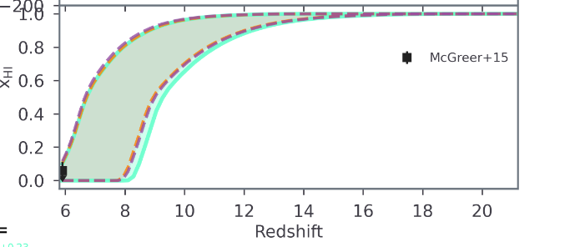
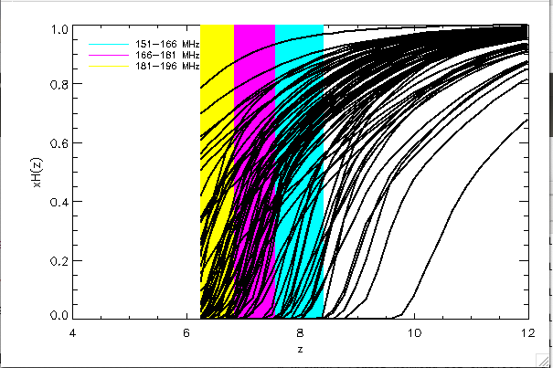
Science Data Challenge 3b: EoR Inference
    Frequency range 151-196 MHz, (z=6.25-8.4) where models display large variance
    Three 15 MHz frequency ranges:
      151-166 MHz (z=8.41.-7.56)
      166-181 MHz (z=7.56-6.85)
      181-196 MHz (z=6.85-6.25)
    Evolution is present within the 15 MHz frequency range
    30 h (TBC) integration for PS sets PS1, PS2, PS3
    1000 h (TBC) for imaging set IM1
  Ancillary: a set of at least 10 noise realizations to characterize noise bias and noise variance
Breitman et al. 2023
slide courtesy of A. Bonaldi

Slide 21
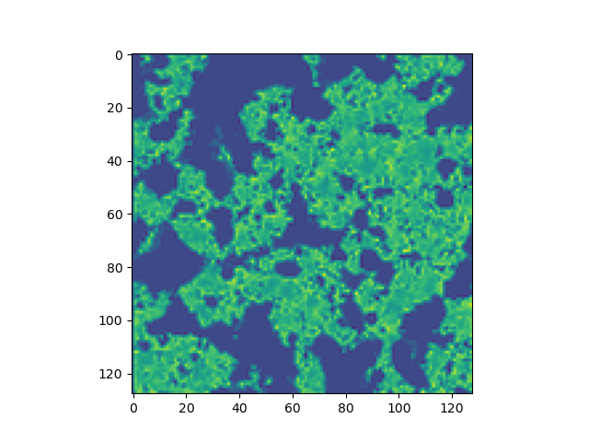
Science Data Challenge 3b: EoR Inference
  21cm simulation specs:
    700 x 700 cMpc on 350 X 350 box
    Planck18 cosmology
    Produce lightcones of 8X8 deg
    SKA-Low simulation
    2D power spectrum estimation on the inner 4 X 4 deg
    Source fields with 21cmfast
    Radiative transfer with either:
      Fast Fourier Transform Radiative Transfer (21cmFAST)
      Conservative Causal Ray Tracing (C2Ray)
In collaboration with M. Bianco, James Davies, A. Mesinger, Sambit Giri, and the rest of theory_challenge_skao slack channel!
    The 21-cm signal is assumed to be in the saturated spin temperature regime, with Ts >> Tcmb, for the redshifts of interest.
slide courtesy of A. Bonaldi

Slide 22
Science Data Challenge 3b: EoR Inference
Status:
  > 40 teams have registered and have accessed/are accessing their allocated computational resources
  Final SDC3b datasets in production
  A first test dataset to be distributed in a matter of days!!
    1 EoR power spectra set + ancillary
    Data description document v0
  SDC3b participants to start analysis on this dataset to prepare their set-up
  SDC team and EoR experts to review together all aspects of this dataset creation
  When validated, final PS datasets PS1, PS2, PS3 to be produced and shared
slide courtesy of A. Bonaldi

Slide 23
Scoring
Submit posteriors, p(x_{HI}(z₁), x_{HI}(z₂), x_{HI}(z₃) | d): a 3D array with pre-specified bins (tbc)
Score will be the value of the truth in the posterior:
p(x^{true}(z₁), x^{true}(z₂), x^{true}(z₃) | d)

Slide 24
Scoring
Submit posteriors, p(x_{HI}(z₁), x_{HI}(z₂), x_{HI}(z₃) | d): a 3D array with pre-specified bins (tbc)
Score will be the value of the truth in the posterior:
p(x^{true}(z₁), x^{true}(z₂), x^{true}(z₃) | d)
Score is not important! Goal is international participation, and testing pipelines on “out-of-distribution” data.

Slide 25
Questions/Comments/Discussion

